Slide 1

SDM Institute of Technology ,Ujire Department of Computer Science and Engineering
“MULTIPLE DISEASE PREDICTION SYSTEM”
Presented by:
Poornima
4SU20CS065
Notes:
1

Slide 2
Contents
1. Introduction
2. About company
3. Weekly report
4. Workflow
5. Snapshots
6. Conclusion
7. Scope for future work
Notes:
2
2

Slide 3
1.INTRODUCTION
The internship training was under the domain of Machine Learning. The project was to develop a Multiple Disease Prediction System.
Machine learning (ML) is defined as a discipline of artificial intelligence (AI) that provides machines the ability to automatically learn from data and past experiences to identify patterns and make predictions with minimal human intervention.
1

Slide 4
1.INTRODUCTION
A Multiple Disease Prediction System (MDPS) is an advanced healthcare solution designed to predict the likelihood of various diseases in individuals by analyzing a wide array of health data.
Leveraging machine learning algorithms and big data analytics, these systems aim to enhance early detection, improve diagnostic accuracy, and personalize treatment plans, ultimately contributing to better health outcomes and efficient healthcare management.

Slide 5
2.ABOUT COMPANY
TechCiti is a software company. Since established in 2013, TechCiti has become a pioneer in providing distinguished end-to-end IT infrastructure solutions to its customers through their business functions maximizing customer engagement with personalized services. They have successfully established in their business functions across 12 + major cities across PAN India with over 56 + satisfied corporate customers.
2

Slide 6
3.WEEKLY REPORT
The internship was carried out for 4 weeks starting from 14th August to 9th September,2023.
Weeks | Task/Work Completed | Remark and signature of manager
Week 1 | Introduction to company culture, Training on Frontend design, Introduction to HTML, CSS and Bootstrap. | Frontend Development
Week 2 | Introduction to Python basics and python libraries required for machine learning | Python Programming
Week 3 | Introduction to Flask and Streamlit framework and completion of website for proposed project. | Streamlit Development
Week 4 | Introduction and training on Machine Learning algorithms, Successful implementation of multiple disease prediction system | Machine Learning
Table 3.1:Weekly Work Done Table
4

Slide 7
4.WORKFLOW
4.1 Methodology Used
Step 1: The user should register with valid credentials to login to the website.
Step 2: The user should login to a website .
Step 3: After login user can enter details about their health.
Step 4: User can see the results that weather the he/she is prone to any of the disease
8

Slide 8
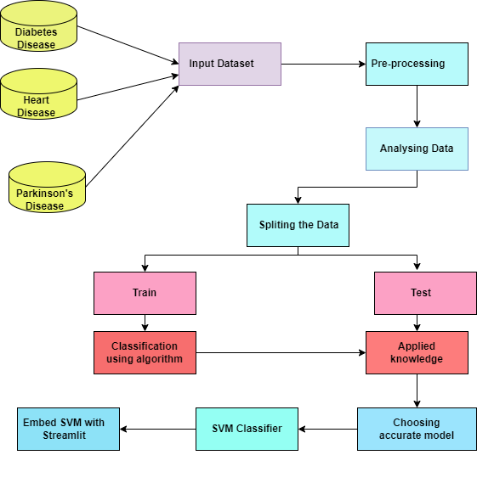
4.2 System Architecture
Fig.4.2 System Architecture
9

Slide 9
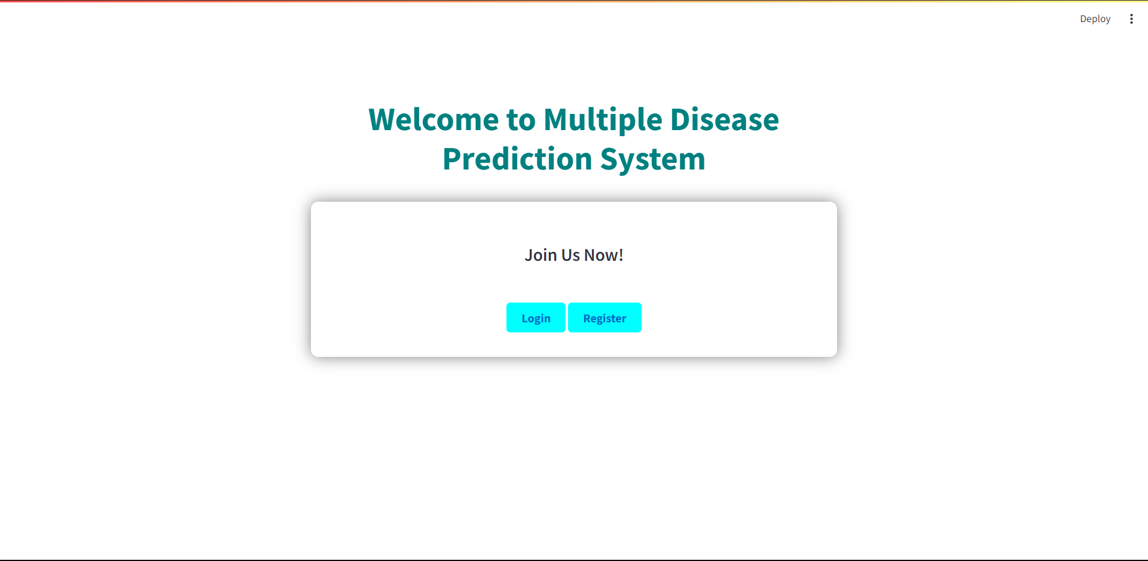
5.SNAPSHOTS
Home Page
Figure 5.1 Home Page
10

Slide 10
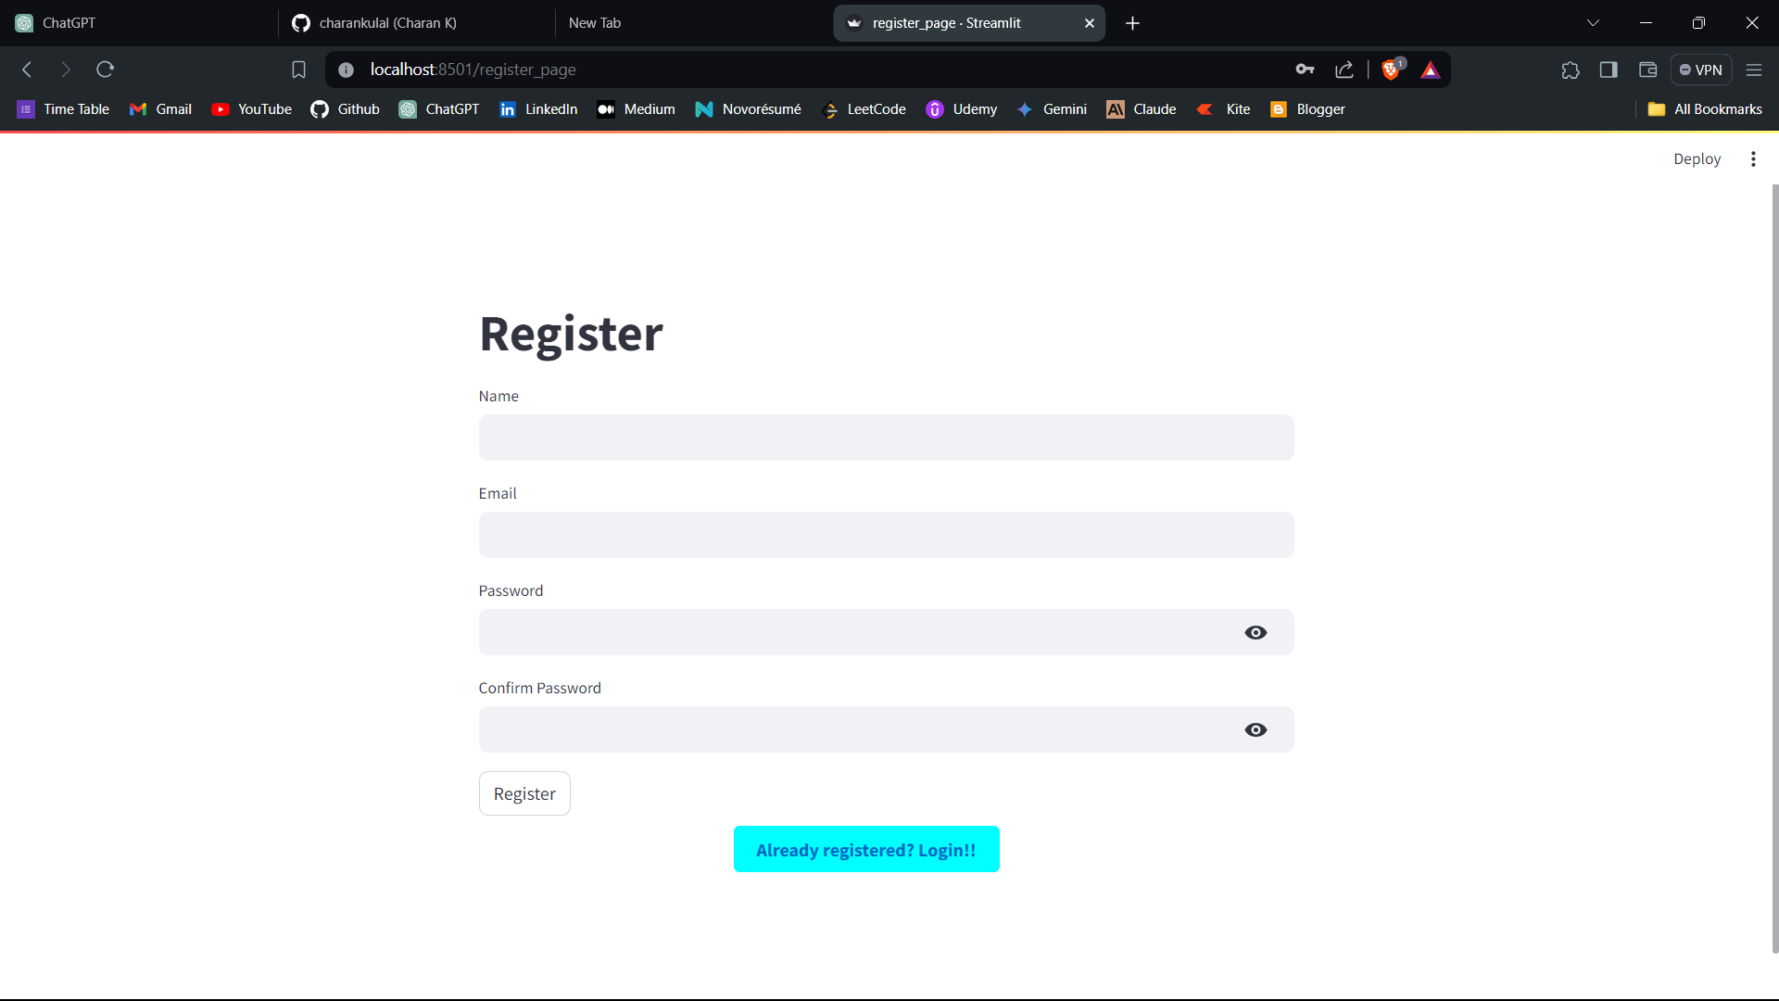
5.SNAPSHOTS
Registration Page
Figure 5.3 Registration Page

Slide 11
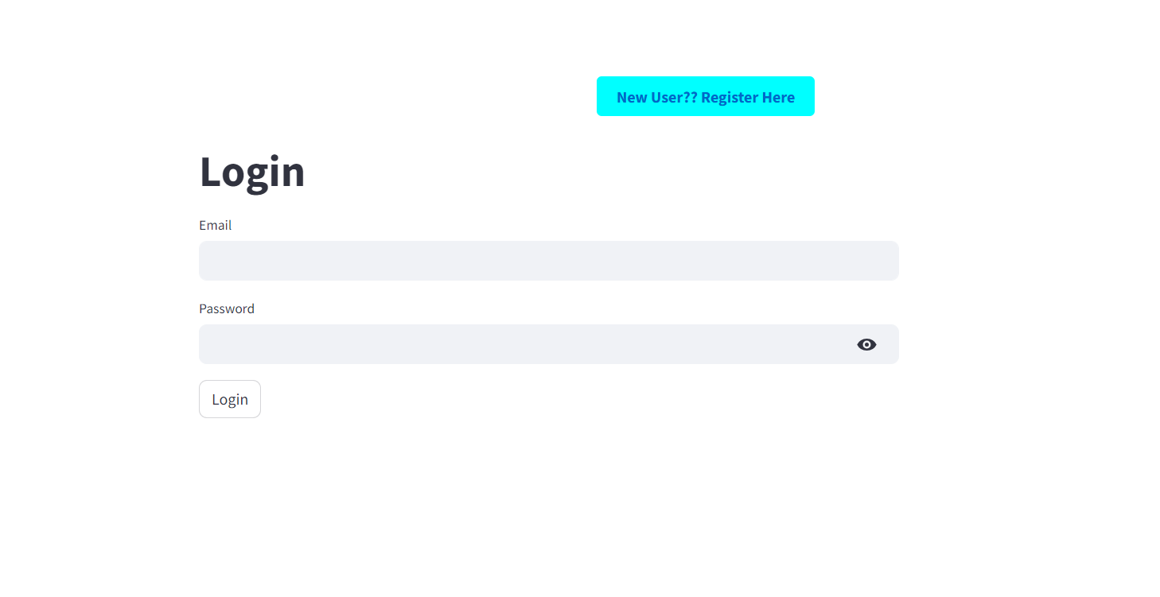
5.SNAPSHOTS
Login Page
Figure 5.2 Login Page

Slide 12
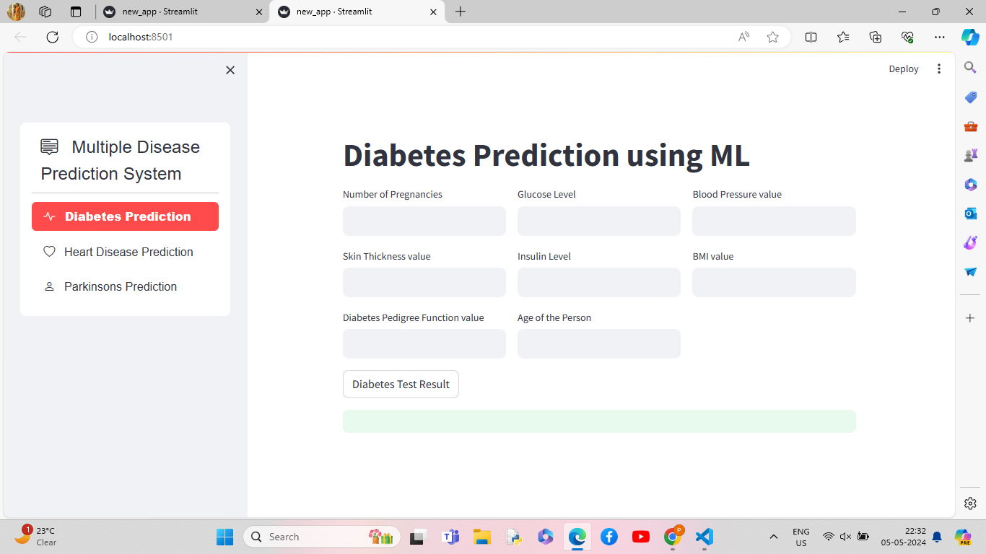
5.SNAPSHOTS
Diabetes Prediction Page
Figure 5.4 Diabetes Prediction Page

Slide 13
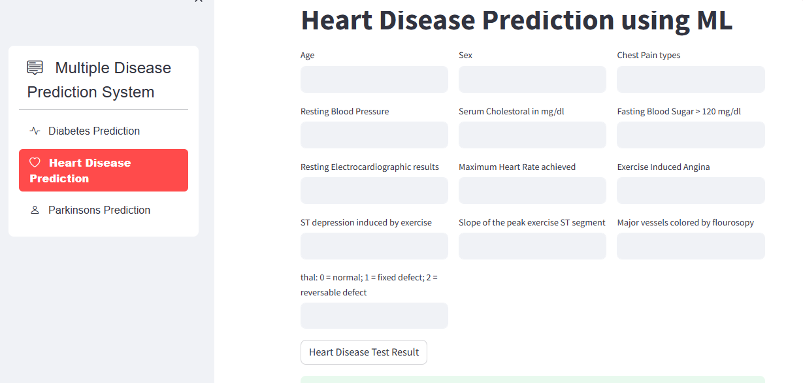
5.SNAPSHOTS
Heart Disease Prediction page
Figure 5.5 Heart Disease Prediction page

Slide 14
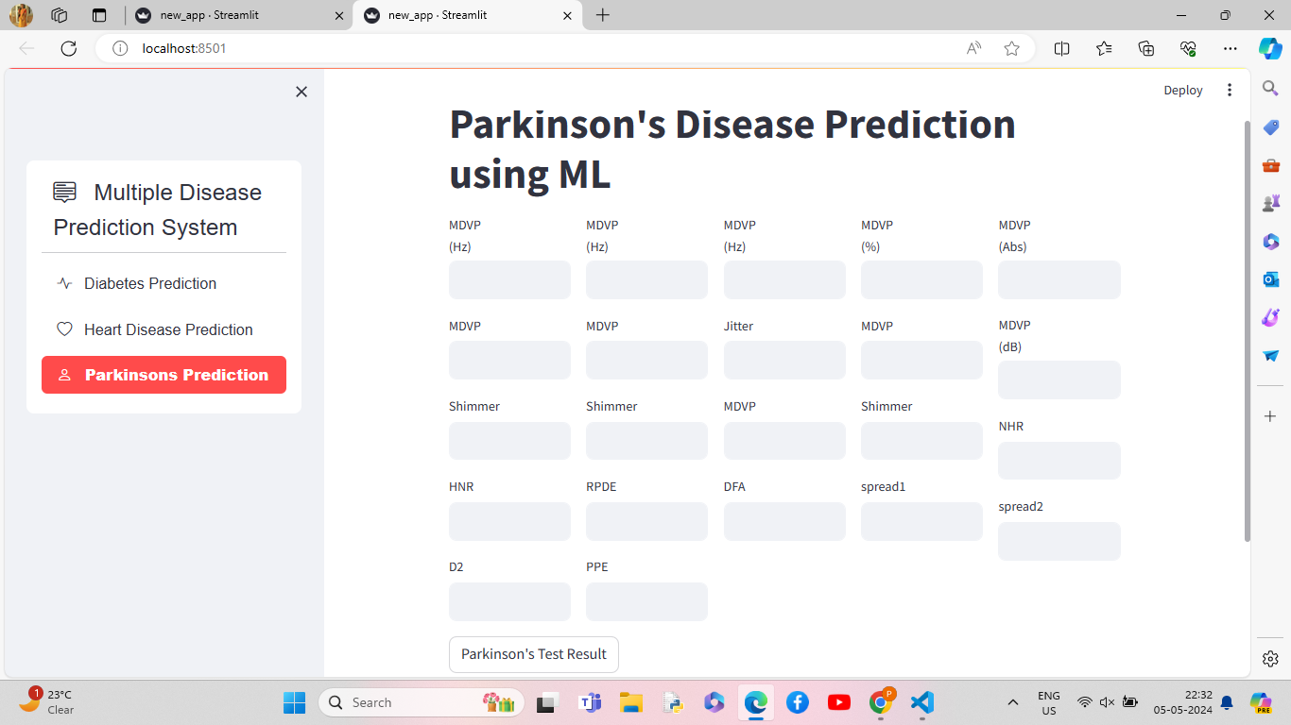
5.SNAPSHOTS
Parkinson’s Disease Prediction Page
Figure 5.6 Parkinson’s Disease Prediction Page

Slide 15
6.CONCLUSION
The internship at Techciti Software Consulting Pvt. Ltd. was a valuable opportunity for me. The experience I gained is significant and beneficial. This internship has given me a clear understanding of what to expect in my future career in the industry.
During the project, I learned about front-end basics, the Flask framework, Streamlit, and Machine Learning.
15

Slide 16
7. SCOPE FOR FUTURE WORK
The future scope involves incorporating diverse data sources such as electronic health records (EHRs), genetic data, environmental factors, and lifestyle information. This integration can provide a more comprehensive view for accurate predictions.
Additionally, exploring and developing more sophisticated machine learning algorithms, such as deep learning, ensemble methods, and reinforcement learning, can improve prediction accuracy and handle complex, high-dimensional data.
Furthermore, implementing systems for real-time monitoring of health parameters and providing personalized feedback and recommendations will be crucial.
16

Slide 17
THANK YOU

