Slide 1

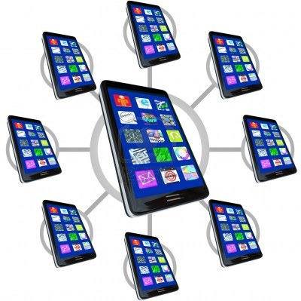
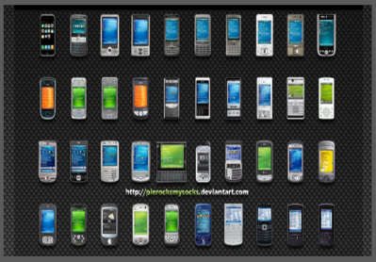
Mobile Cloud Infrastructure Development Project
Control node
Mobile network node
Wireless
Internet
Mobile
emulator
manager(s)
Mobile
device
manager(s)
Mobile Device Cloud
Remote Mobile Emulation Cloud

Slide 2
Mobile IaaS Business Service Manager
Mobile Resource Provision & Manager
Mobile Resource Provision Manager
Account Management Service
Account Bill Management Service
Mobile Resource Monitor Manager
Schedule Management Service
Mobile Device Manager
Mobile Emulator Manager
Mobile Device Manager
Mobile Emulator Manager
Mobile Device Cluster Manager
Mobile Emulator Cluster Manager
MIaaS Service Support
Mobile Network Manager
Mobile Network Service (switch/router)
Mobile Security Manager
Migration Manager
Load Balance Manager
Mobile Data Manager
Mobile Device Network Connectivity Service
Multi-tenant Manager
Mobile Device
Connectivity Service

Slide 3
Mobile Resource Provision & Manager:
This component provides on-demand or scheduled automatic mobile resource provision (and deprivation) and management for mobile devices (such as mobile phones, tablets, and so on). It should be operated in both static and dynamic modes.
Each team must design and implement at least two resource allocation algorithms.
This component must provide resource usage tracking and monitor capability.
This component must allow client users to configure and select diverse mobile devices according to require mobile device profiles in the following aspects.
Mobile connectivity (equipped network support)
Mobile storage size
Mobile platforms (Anderiod, IOS, Window OS, and so on)
Equipped mobile APIs

Slide 4
Mobile IaaS Business Service Manager:
This component provides mobile IaaS business service capability based on pre-selected pay-as-you-go billing models for both on-demand and scheduled mobile resource requests and services.
Each team must define, select, and implement your well-defined billing models and cost metrics based on
This component must provide a system administrator with a selection and configuration capability for billing models and cost metrics
In addition, this manager also provide the following service capabilities:
User account and user group management service, such as addition, update, deletion, and listing.
Billing service that generates a bill based on a request, including cost analysis report.
Two kinds of cost billing reports will be generated: a) schedule based resource usage report, and b) on-demand based resource usage report

Slide 5
Mobile Device Service Manager:
This component provides mobile device service capability to support the control, management, monitor a cluster of mobile devices (or mobile emulators).
For each mobile emulator, this component must provide the following service functions:
Download, Install and deploy one or more selected mobile emulators
Monitor and control the given mobile emulators in terms of status
Launch and control one or more selected mobile emulators
For each mobile device, this component must provide the following service functions: (Delivering this function provides certain extra credit (20%))
Select/configure/set-up a mobile platform on a selected mobile device
Control and monitor a mobile platform on a selected mobile device.
Control, launch, and monitor a mobile app on a mobile platform
Control, connect, and monitor a mobile web application on a mobile platform

Slide 6
Mobile Network Manager:
This component provides mobile network management and connectivity service for mobile cloud.
You can set up two level mobile networks:
One (or more) network router(s) – Each router control and connect the one or more mobile cluster hub via internet.
One (or more) mobile cluster hub(s) – Each control and the connectivity between one router and up-to N mobile devices (via USB connection)
You can use any open-source technology to upgrade and implement this component.
The basic network management and control and services include the following functions:
Establish, set-up, configure a network connectivity at top-level
Monitor and manage the network connectivity at top-level
Establish, set-up, and configure a network connectivity at hub level
Monitor and manage the network connectivity at hub level.

Slide 7
(a) Open-source code and technology usage:
You are allowed to use any selected cloud-based open-source technology (such as OpenStack and CloudStack) to work on your project.
(b) Cloud infrastructure set-up:
You can use your machines or amazon’s cloud infrastructure to set up
your own cloud infrastructure.
(c) Team deliverable rules:
- Two teams can work together to integrate and demo three components.
- Each team must design, complete and demo two components
- Only one component can be shared among teams
- Any team can demo more than integrated two components, it will
receive 10% extra credits for implementation.
- Any two teams can demo integrated project with more than 4 four
components will receive 10% extra credits for implementation.
Deliverable requirements:
Project analysis and design document Due to Canvas 3/25/2014
System infrastructure
Component specification and function analysis (in UML)
Service API specification
Project implementation Due to Canvas 5/6/2014
Project demo video and presentation PPTs Due to Canvas 5/6/2014

