Slide 1
AMS 572 Group 18
Clay Fan - 112633598
Priyanshu Jain - 115962613
Sai Akhil Kogilathota - 115933408
Shubo Wang - 115397952

Slide 2
Questions: what are factors associated with accident severity if a car accident occur?
Driving experience
Lanes
Education Level
Weather Conditions
Other factors considered?

Slide 3
Data Source: RTA_Data.csv
Collected by Addis Ababa Sub-city police departments for master's research work.
The data set has been prepared from manual records of road traffic accidents of the year 2017-20.
All the sensitive information has been excluded during data encoding.
32 features and 12316 instances of accident.
32 columns that describe the car accidents in terms of the
time of the accident
driver’s information
vehicle’s information
details of the accident(cause, casualty, etc.).

Slide 4
Part 1
Is shorter driving experience causing more severe car accidents, if occur?
H0: Accident Severity IS NOT associated with driver’s driving experience(in years).
Ha: Accident Severity IS associated with driver’s driving experience(in years).

Slide 5
Step 1 - Choose Statistical Inference
n>50
Chi-Square Test!
Significance Level: 0.05
Tested Columns:
“Driving_experience”
“Accident_severity”
- Omit Missing Values for now

Slide 6
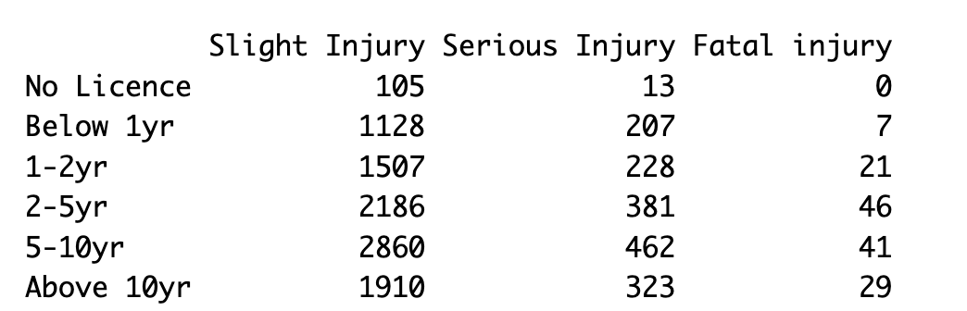
Step 3 - Count and Summarize to a table

Slide 7
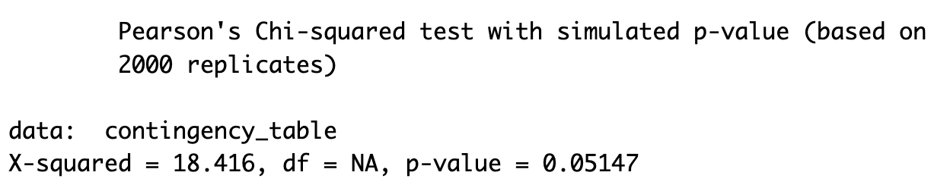
Step 4 - Chi-square Test
R-Code:
chi_square_result <- chisq. test(contingency_table, simulate.p. value = TRUE)
Output:

Slide 8
Step 4 - Chi-square Test Conclusion
P-value = 0.05147 > 0.05
Failed to reject the null hypothesis.
Conclusion: There is no significant statistical evidence under this given case and scenario that driver’s driving experience in years IS associated with the severity of accident.
Counter-intuitive!

Slide 9
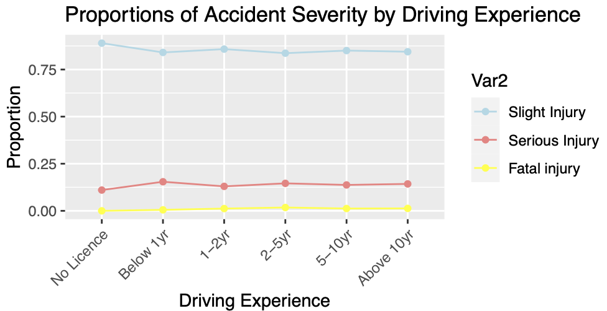
What about proportions of accident severity by driving experience?
The lines are approximately flat
so generally drivers with different driving experiences (in years) share the same probability of causing accidents of slight, severe, or fatal injuries.

Slide 10
Step 5 - Evaluation of Missing Values
862(7%) Missing Values Detected in “Driving_experience”, 0 Missing Values Detected in “Accident_severity”
Summarized P-value for each proportion of missing values considered:
Percentage of Missing Values Considered | P-Value
10% | 0.04298
20% | 0.04898
30% | 0.03448
40% | 0.04748
50% | 0.04448

Slide 11
Step 5 - Evaluation of Missing Values
Conclusion
P-values are all slightly lower than 0.05.
The significance of missing value does suggest a correlation between driving experience (in years) and accident severity.
Therefore, it is statistically explanatory to conclude that accident severity is associated with a driver’s driving experience in years if to consider the effect of missing values.

Slide 12
Part 2
Does Lanes or Medians, Educational level, Owner of vehicle, Weather conditions, or Light conditions significantly contribute to the type of injury?
H0: None of the chosen predictor variables (Lanes_or_Medians, Educational_level, Owner_of_vehicle, Weather_conditions, Light_conditions) significantly contribute to the type of injury.
Ha: The predictor variables contribute to the type of injury.

Slide 13
Step 1 - Chi-square Test to check if Missingness is Random
Chi-square Statistic: χ2=∑Ei​(Oi​−Ei​)2
5 Predictors of which 3 have null values
Output:
For Lanes_or_Medians : X-squared = 0.92879, df = 2, p-value = 0.6285
For Educational_level : X-squared = 2.613, df = 2, p-value = 0.2708
For Owner_of_vehicle : X-squared = 0.3607, df = 2, p-value = 0.835
As all the p-values are above 0.05, they indicate that the missingness is at random.

Slide 14
Step 2a - Dataset Adjustments
We remove the null values as they are at random.
Our response variable initially has 3 unique values
Slight Injury
Serious Injury
Fatal Injury
We combine Serious Injury and Fatal Injury into one kind - Heavy Injury.
Convert this to a binary column named Heavily_Injured_True.

Slide 15
Step 2b - VIF test for multicollinearity
We check if the columns selected are multicollinear or not
We do this using VIF Test:
 | GVIF | Df | GVIF^(1/(2*Df))
Lanes_or_Medians | 1.037588 | 6 | 1.00308
Educational_level | 1.018444 | 6 | 1.001524
Owner_of_vehicle | 1.027409 | 3 | 1.004517
Weather_conditions | 1.044217 | 8 | 1.002708
Light_conditions | 1.034422 | 3 | 1.005656
As all the values are less than 5, it implies that columns are not collinear.

Slide 16
Step 3 - Hypothesis Testing and Test Statistic
We choose GLM to perform our test.
After modelling using GLM we see a few columns contribute significantly to determining output variable than others.
They are as follows:
Weather_conditionsRaining (P-Value = 0.03176)
Weather_conditionsWindy (P-Value = 0.01406)
Light_conditionsDaylight (P-Value = 0.0135)
Weather_conditionsNormal (P-Value = 0.00369)
Weather_conditionsUnknown (P-Value = 0.00223)
Light_conditionsDarkness - no lighting (P-Value = 5.89E-07)

Slide 17
Step 4 - Likelihood Ratio Testing.
The Likelihood Ratio Test (LRT) is a statistical procedure used to compare the fit of two nested models: a simpler null model (null_model) and a more complex alternative model (logit_model). This test evaluates whether the inclusion of additional predictors in the null model leads to a significant improvement in model fit. It provides a formal mechanism to ascertain the value added by the extra variables in the alternative model.
Our test results:
The Chi-squared statistic for the Likelihood Ratio Test is 77.939.
The p-value for the test is 4.341e-07, which is highly significant (indicated by ***).
This result suggests that Model 2 is a significantly better fit for the data compared to Model 1, as indicated by the small p-value. The additional predictors in Model 2 appear to improve the model's fit.

Slide 18
Conclusion for Hypothesis testing.
After performing the hypothesis testing we conclude that we are going to reject the null hypothesis as the p-value is less than the significance level (0.05). This implies that our predictors are good estimators of the response variable.

Slide 19
MCAR and MNAR Effects:
MCAR:
One needs to also verify the impact of null values while performing such experiments, hence we added 10%, 20%, 30%, 40%, 50% null values to all attributes except the response variable.
Results: DA_NANs.xlsx
We Interpret as below from the results obtained:
As the no. of null values introduced increases the significance of variables contributing to the response decreases.

Slide 20
MCAR and MNAR Effects:
MNAR:
For MNAR we introduce null values based on a specific condition. In our case we introduced null values in the Lightning Conditions attribute. We made a category “Darkness - no lighting” to null.
Results: DA_NANs.xlsx
We Interpret as below from the results obtained:
Overall, while there are slight variations in the magnitude of the effects between the two datasets, the general trends and significance levels remain consistent, particularly for the key variables like weather conditions and light conditions.

