Slide 1

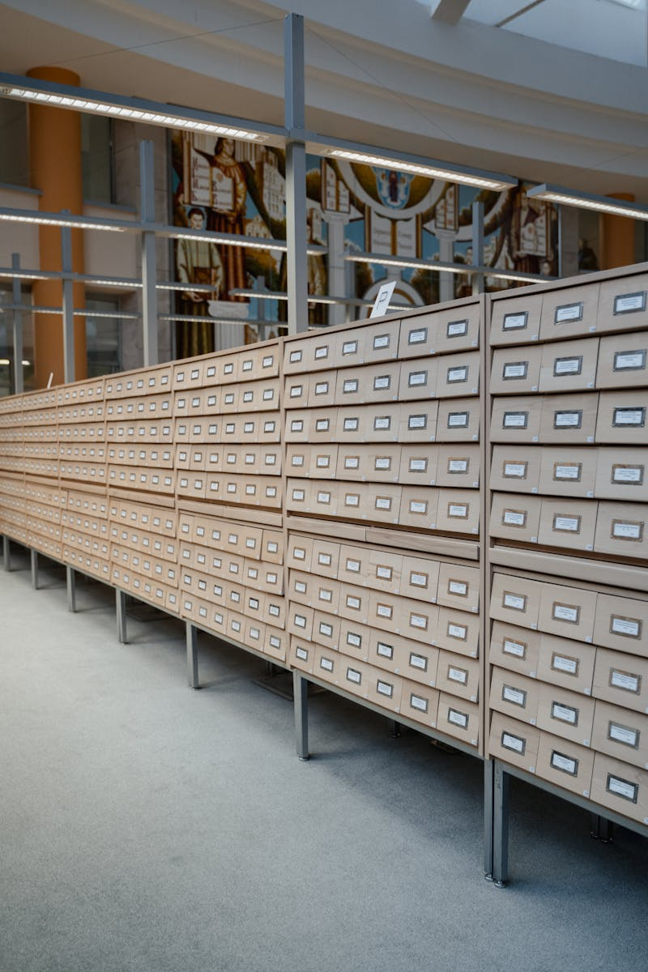
Revolutionizing Library Management: A Modern Approach
MINI PROJECT
KCA-353
SESSION 2024-2025
Ritesh Kumar 2300290140143
Pulkit Jain 2300290140130 Under the supervision of
Ritik Vihan 2300290140144 Prof. (Dr.) Sangeeta Arora

Slide 2




Table of content
01
Understanding Library Management Systems
02
Evolution of Library Management Systems
03
Current Challenges in Library Systems
04
Our Project Objectives
05
Technological Framework
06
Essential Software Requirements
07
Implementation Plan
08
Benefits of the Proposed LMS
09
The Future of Library Management Systems
10
Thank You for Your Attention!

Slide 3



Understanding Library Management Systems
A Library Management System (LMS) simplifies the management of library operations, such as cataloging and user registration.
It automates mundane tasks, allowing librarians to focus on more critical activities and user engagement.
With an LMS, resource accessibility improves significantly, offering users a seamless borrowing and returning process.
Overall, an LMS enhances the overall library experience for both staff and patrons.

Slide 4

Evolution of Library Management Systems
Traditionally, library management involved manual processes, resulting in inefficiencies and frustration.
Modern solutions like Koha and Alma have transformed libraries into digital havens, providing robust cataloging and circulation features.
Studies show that automation can cut administrative workload by a significant margin, thus increasing staff productivity.
These systems also empower users by providing self-service options, enhancing their engagement with library resources.

Slide 5
Current Challenges in Library Systems
Despite advancements, many libraries struggle with outdated technology that lacks integration with modern tools.
Poor mobile access limits user engagement, as patrons seek information via smartphones and tablets.
Inadequate training and support for library staff can hinder the effective use of current systems.
Addressing these challenges is crucial for libraries to evolve and meet user expectations.

Slide 6
Our Project Objectives
The primary objective is to create a user-friendly LMS that simplifies library operations for both staff and users.
We aim to design intuitive interfaces that enhance the browsing and borrowing experience for users.
Additionally, we're focused on providing analytical tools to help staff understand resource usage and user behaviors.
Through this project, we hope to set a new benchmark in library management efficiency.

Slide 7

Technological Framework
Our development will leverage Visual Studio Code for web applications, ensuring a robust coding environment.
For mobile applications, Android Studio will be our go-to tool, allowing us to create user-friendly apps.
The backend will be supported by MySQL or PostgreSQL, providing reliable database management solutions.
Choosing Apache or Nginx ensures that our web server runs smoothly and efficiently, serving users effectively.

Slide 8
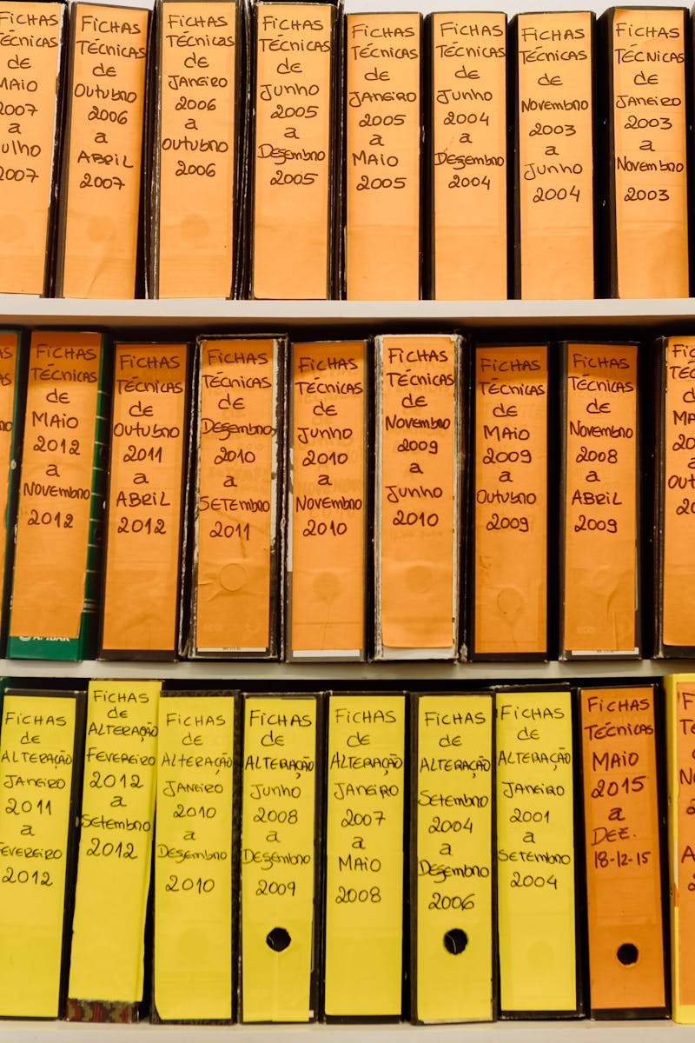
Essential Software Requirements
Frontend development will employ HTML, CSS, and JavaScript, with frameworks like React to enhance user experience.
On the backend, Python with Django or Flask will ensure robust functionality.
We will utilize Jupyter Notebook for data analysis, allowing for effective prototyping and testing of ideas.
Version control will be managed through Git, ensuring streamlined collaboration and code management.

Slide 9
Implementation Plan
Initial phases will focus on requirements gathering and system design, aligning with user needs and library functions.
Development will follow Agile methodologies, ensuring iterative progress and continuous feedback from stakeholders.
Testing will be rigorous, with user acceptance testing to ensure the system meets expectations before launch.
Post-launch, we will provide training for library staff to ensure smooth adoption and maximize system benefits.

Slide 10

Benefits of the Proposed LMS
An intuitive and easy-to-navigate interface will greatly enhance user satisfaction and engagement.
Automation of routine tasks will free up library staff to focus on user-oriented services and community engagement.
Comprehensive reporting tools will allow library staff to identify trends, usage patterns, and areas for improvement.
Ultimately, this LMS will lead to a more accessible, efficient, and user-friendly library experience for all.

Slide 11

The Future of Library Management Systems
As we advance, the integration of AI may personalize user recommendations, enhancing the discovery of resources.
Continued focus on mobile access will ensure that library resources are available anytime, anywhere.
Collaboration with other libraries may enhance resource sharing, leading to a richer user experience.
The future is bright for libraries that embrace technology and innovative solutions to connect with their communities.

Slide 12

Thank You for Your Attention!
We appreciate your time and interest in our Library Management System project.
Together, we can innovate library experiences for all users across the globe.
If you have questions or suggestions, we would love to hear them.
Let’s work towards a future where libraries become even more accessible and engaging for everyone!

