Slide 1
Capstone Project - 2
Team 3:
NYC TAXI TRIP TIME PREDICTION.
Team Members
Hrushikesh Sahu
Kartikey Sharma
Isha Kasar

Slide 2

Content
Problem Statement
Introduction
Data Summary
Data Analysis
Analysis Details
Challenges
Conclusions
Q & A

Slide 3
Problem Statement
We have the data which was originally published by the NYC Taxi and Limousine Commission (TLC), for the year 2016. This dataset consists of various trip related features and our aim is to predict the trip duration based on these features.

Slide 4
Introduction
In today’s world it has become a race to gain more and more number of customers.
To gain more number of customers companies/vendors usually try to provide their customers with more comfort to attract them.
So here we will be predicting the time of trip duration our customers will take and which algorithm is best suited for that time prediction.

Slide 5
Data Summary
id - a unique identifier for each trip
vendor_id - a code indicating the provider associated with the trip record
pickup_datetime - date and time when the meter was engaged
dropoff_datetime - date and time when the meter was disengaged
passenger_count - the number of passengers in the vehicle (driver entered value)
pickup_longitude - the longitude where the meter was engaged
pickup_latitude - the latitude where the meter was engaged
dropoff_longitude - the longitude where the meter was disengaged
dropoff_latitude - the latitude where the meter was disengaged
store_and_fwd_flag - This flag indicates whether the trip record was held in vehicle memory before sending to the vendor because the vehicle did not have a connection to the server - Y=store and forward; N=not a store and forward trip
trip_duration - duration of the trip in seconds (Dependent variable)

Slide 6
Basic Exploration
The dataset contains 1458644 rows and 11 features(columns)
Two categorical features ‘store_and_fwd_flag’ and ‘vendor_id’
Outliers present in all numerical features
Data cleaning steps required for datetime features
No null values present

Slide 7
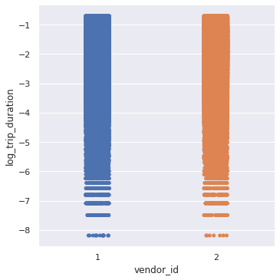
Vendor ID Analysis

Slide 8
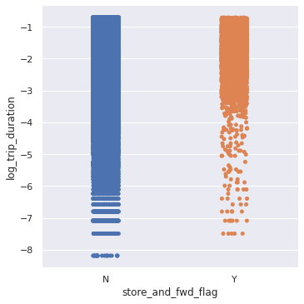
Store and forward flag

Slide 9
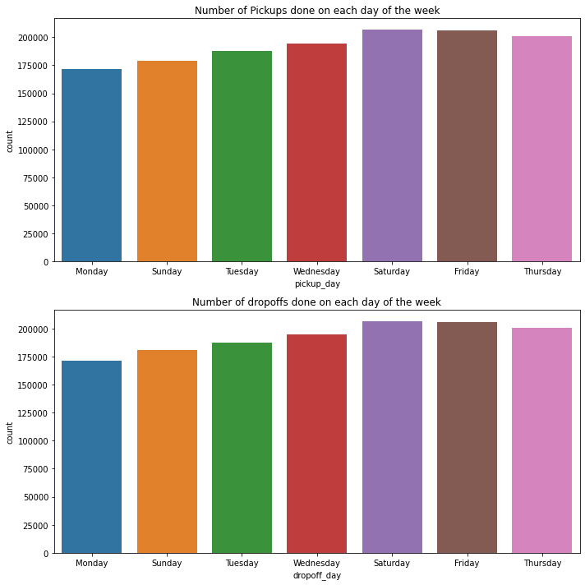
Days of the week

Slide 10
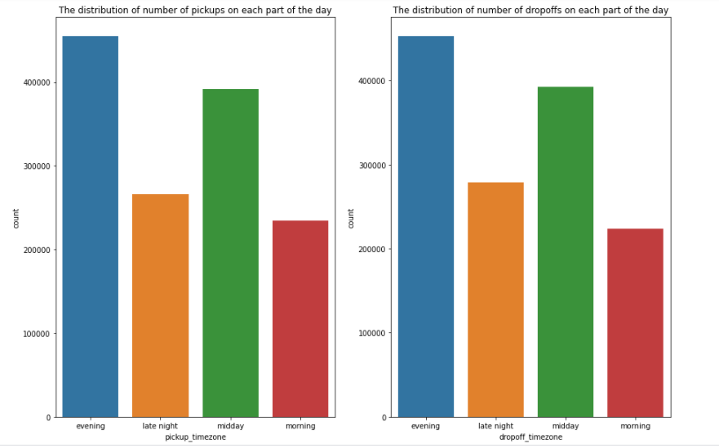
Day Segmentation

Slide 11
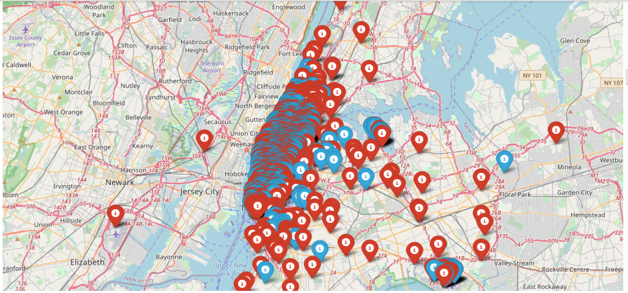
Plotting longitude and latitude

Slide 12
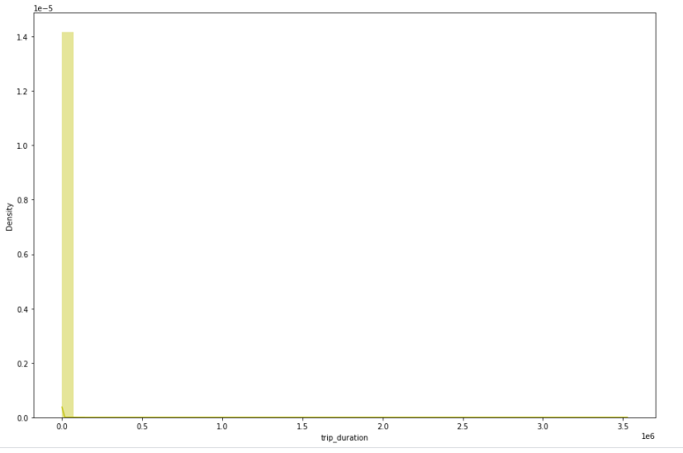
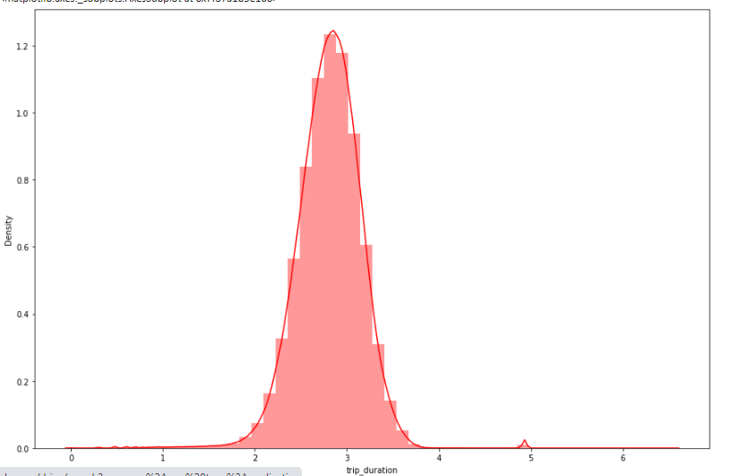
Trip Duration (dependent variable)
Data Analysis

Slide 13
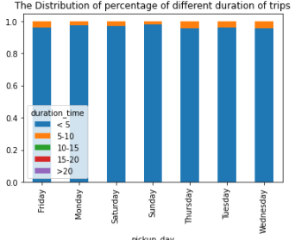
Trip Duration/Day of the week

Slide 14
Analysis Details

Slide 15
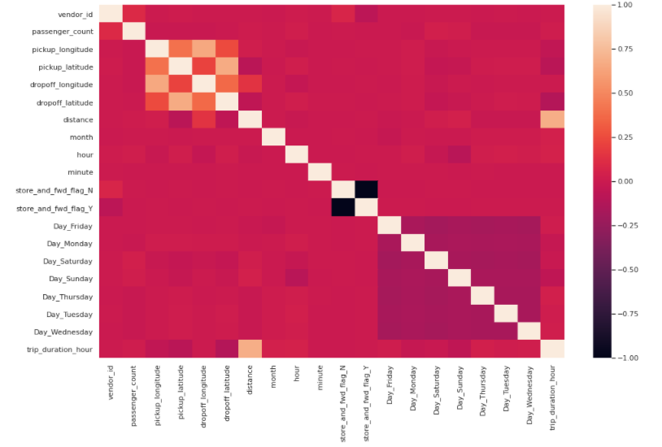
Correlation

Slide 16
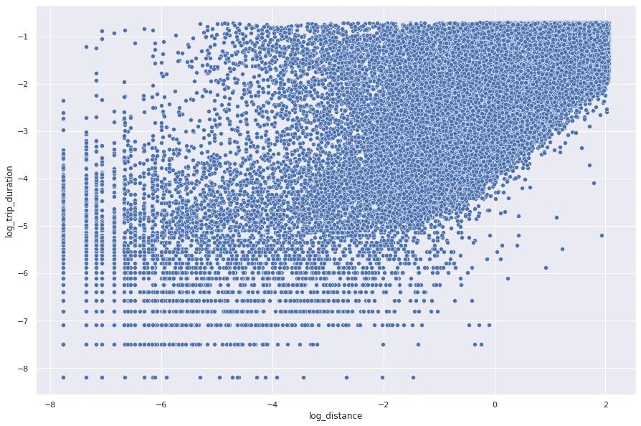
Linear Relationship between Trip Duration & Distance

Slide 17




Lasso Regression
Train set metrics Test set metrics
Ridge Regression
Train set metrics Test set metrics

Slide 18
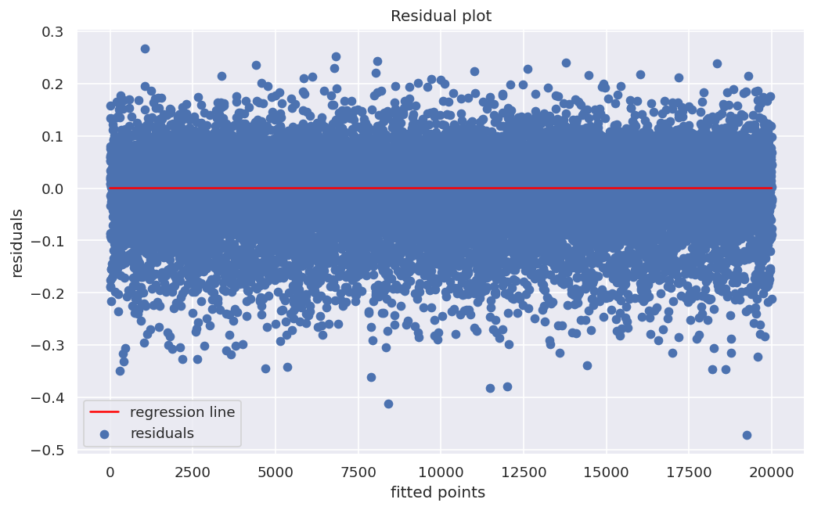
Homoscedasticity Check

Slide 19


Decision Tree
Train set metrics
Test set metrics
Parameters :
criterion=mse
max_depth=10
min_sample _leaf=20
min_sample_split=10

Slide 20
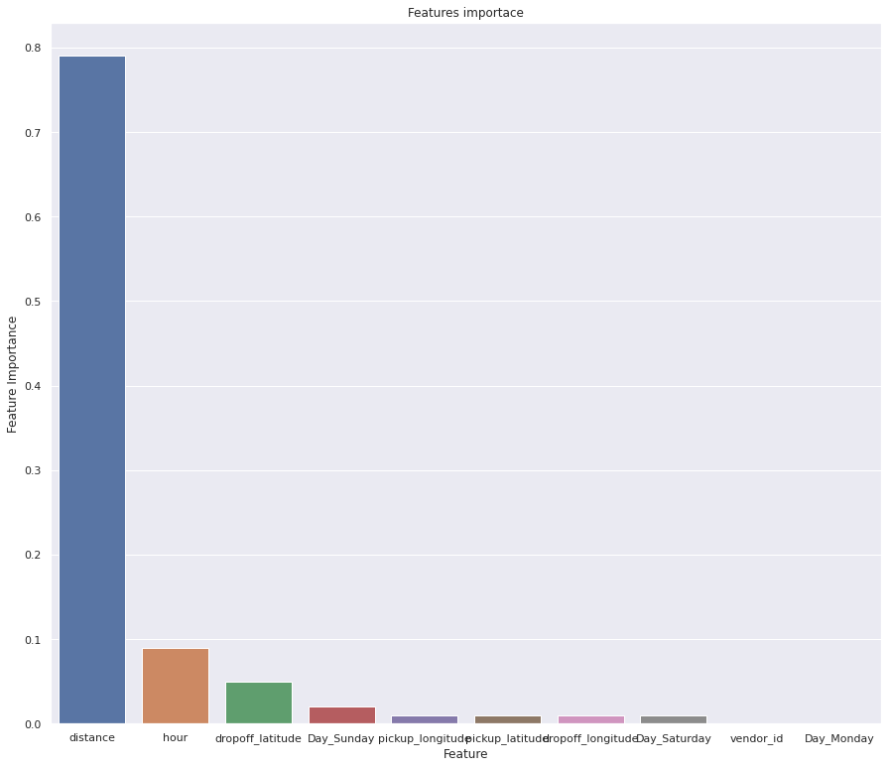
Decision Tree Feature Importance

Slide 21


Gradient Boosting
Train set metrics Test set metrics
Parameters :
alpha=0.9
max_depth=10
min_sample _leaf=50
min_sample_split=80
n_estimators=120

Slide 22
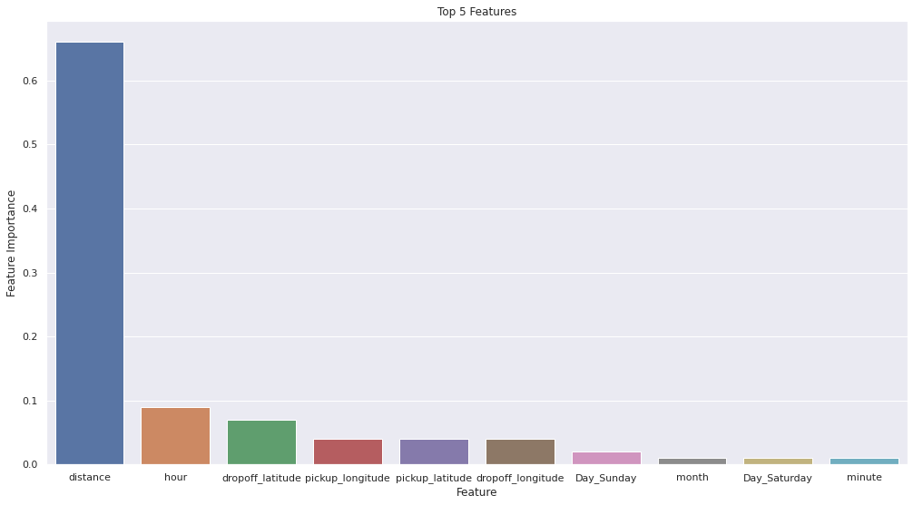
GBoost feature importance

Slide 23


XGBOOST
Train set metrics Test set metrics
Parameters :
gamma=0
learning_rate=0.1
max_depth=9
min_sample _leaf=50
min_sample_split=40
n_estimators=120

Slide 24
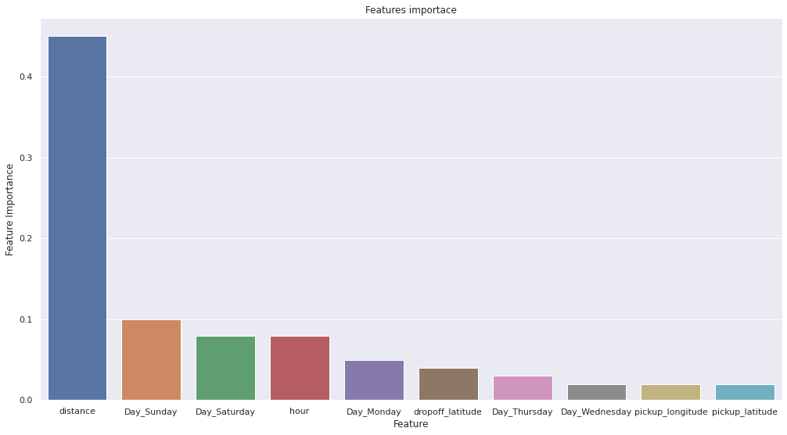
XGBoost feature importance

Slide 25
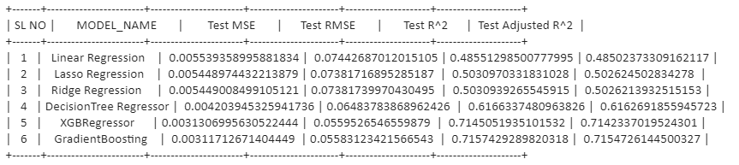
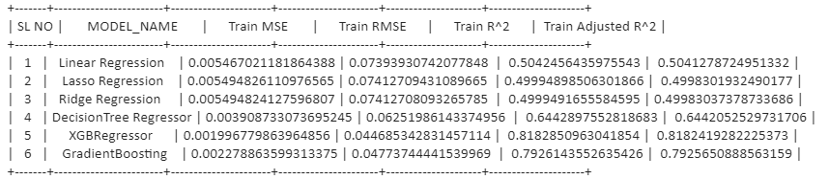
Final metrics conclusion

Slide 26
Challenges
Handling Large Dataset.
Feature Engineering.
Computation Time.
Optimising the Model.

Slide 27
Conclusion
In this project, we tried to predict the trip duration of a taxi in NYC.
We are mostly concerned with the information of pick up latitude and longitude and drop off latitude and longitude, to get the distance of the trip.
Gradient Boosting will be the best model to predict the trip duration for a particular taxi.

Slide 28
Thank You!

Slide 29
Q & A

