Slide 1
AlarmClock
- Richa Jain

Slide 2
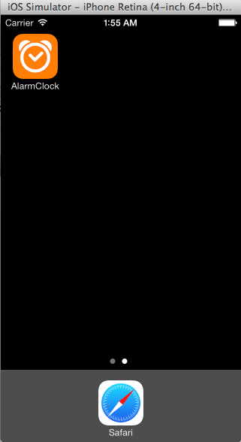
Application Launch

Slide 3
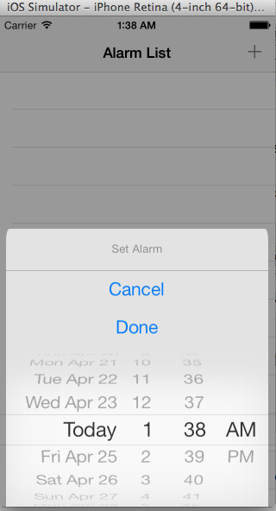
Home Screen – Add Alarm

Slide 4
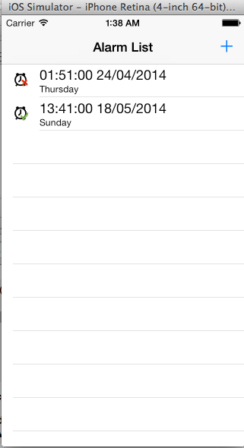


Home Screen - Alarm List
Active Alarm
Deactive Alarm

Slide 5
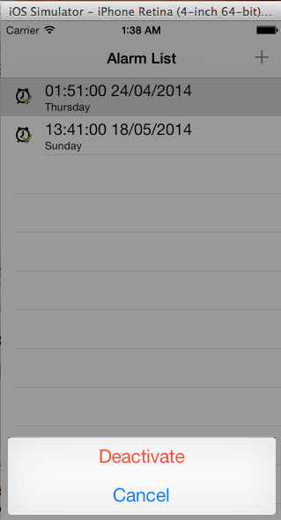
Home Screen – Activate/Deactivate alarm On Row Selection
Activate – Schedules Alarm
Deactivate - Cancel Alarm Schedule

Slide 6
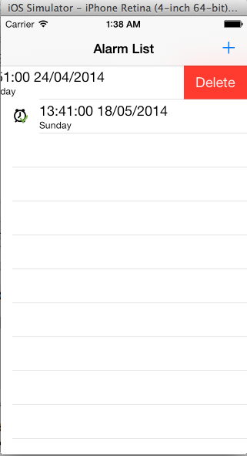
Home Screen - Delete Alarm
Swipe Delete - Removes Alarm and cancel its schedule as well

Slide 7
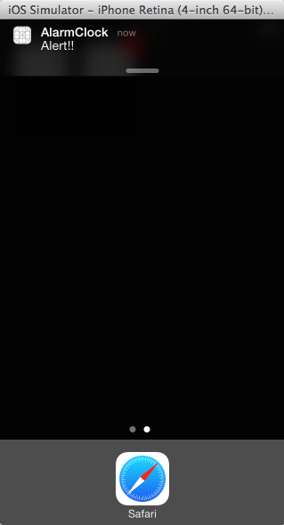
Alarm – Notification With Sound
The notification will appear on alarm event, Alarm “Stop” and “Snooze” can be performed as soon as user taps the notification area

Slide 8
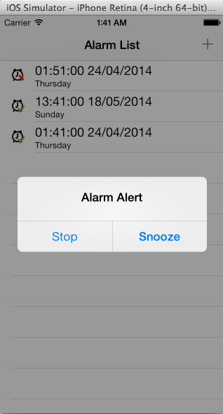
Notification - Stop/Snooze
Stop - Stops the alarm and deactivates it.
Snooze – Snooze the alarm for 2 minutes, can also be done with shake motion of the device.

Slide 9
Other Info
Language - Objective-C
Database – SQLite database (gets created into documents directory on app launch)
The app can be installed simply by specifying code signing identity in Build Settings of the project and Running it after setting appropriate target.

