Slide 1
Urban Sound Classification Using Machine Learning
Rocky Jain

Slide 2
Background
The automatic classification of environmental sound is a growing research field with multiple applications.
There is plenty of real world applications for this reasearch, some are:
Assisting deaf individuals in their daily activities.
Smart home use cases.
Content-based multimedia indexing and retrieval.

Slide 3
Challenges
There are primarily two major challenges with urban sound classification namely
Lack of labeled audio data.
Lack of common vocabulary.

Slide 4
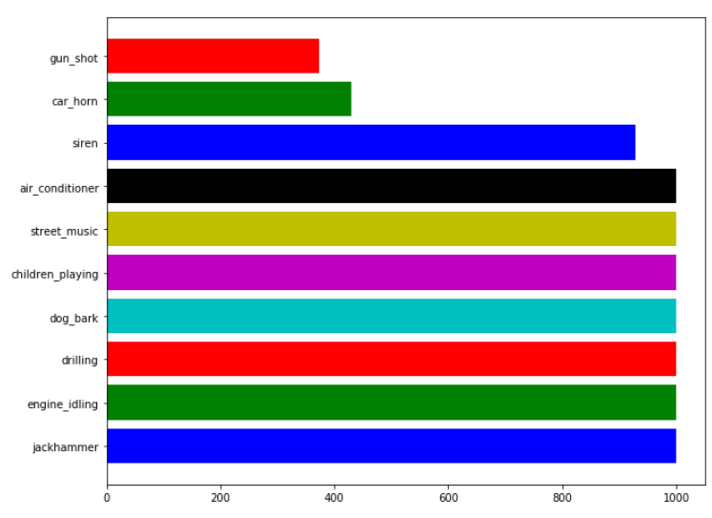
Dataset
The dataset is called UrbanSound8K and contains 8732 labeled sound excerpts (<=4s) of urban sounds from 10 classes
Air Conditioner
Car Horn
Children Playing
Dog bark
Drilling
Engine Idling
Gun Shot
Jackhammer
Siren
Street Music

Slide 5
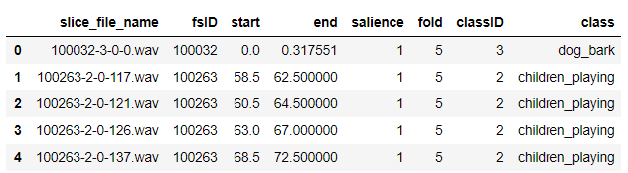
Dataset Includes
8732 audio files of urban sounds in WAV format and
Meta-data file UrbanSound8k.csv, contains meta-data information about every audio file in the dataset.
classID | class
0 | air_conditioner
1 | car_horn
2 | children_playing
3 | dog_bark
4 | drilling
5 | engine_idling
6 | gun_shot
7 | jackhammer
8 | siren
9 | street_music
UrbanSound8k.csv

Slide 6
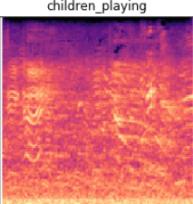
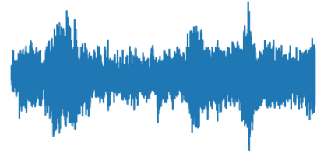
Methodology
A convolutional neural network architecture is proposed for classification of Urban sounds
The input to the networks are spectrogram images generated from the audio signal.
Dropout and weight decay regularization methods are applied and
The cross-entropy loss is optimized using Adam algorithm
Example:
children_playing
Raw data
Spectrogram Image

Slide 7
Experiments
Logistic Regression - feature length (120 x 120 x 3) trained on 70% of total data, FAILED Run out of resources.
Logistic Regression - feature length (60 x 60 x 3) trained on 70% of total data, Test Accuracy 68.78%
DecisionTreeClassifier - feature length (60 x 60 x 3) trained on 70% of total data, Test Accuracy 45.65%
Convolution Neural Network - Image size (128, 128) trained on 65% of total data, Test Accuracy 80.84%
s

Slide 8
Validation Technique Used
Random subsampling
Trainning data size - 65% (also augmented the training data-set using ImageDataGenerator.)
Validation data size - 15%
Test data size - 20%

Slide 9
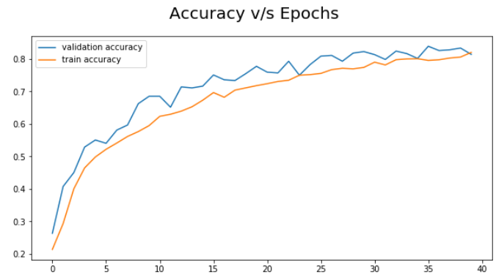
Result
The classification accuracy for the image representations of sound – Spectrograms using CNN
Total epochs: 40
Train Data accuracy: 84.94%
Validation Data accuracy: 80.70%
Test Data accuracy: 80.84%

Slide 10
Recommendations
Convolutional neural networks, which are designed specifically for object recognition in images, can be successfully trained to classify spectral images of environmental sounds.
The same technology for both object and sound recognition and classification tasks would reduce the development cost significantly.
After generation of the spectrogram images from audio signal it takes significantly less time to load the spectrogram images from the Disk.

Slide 11
Thank You

