Slide 1
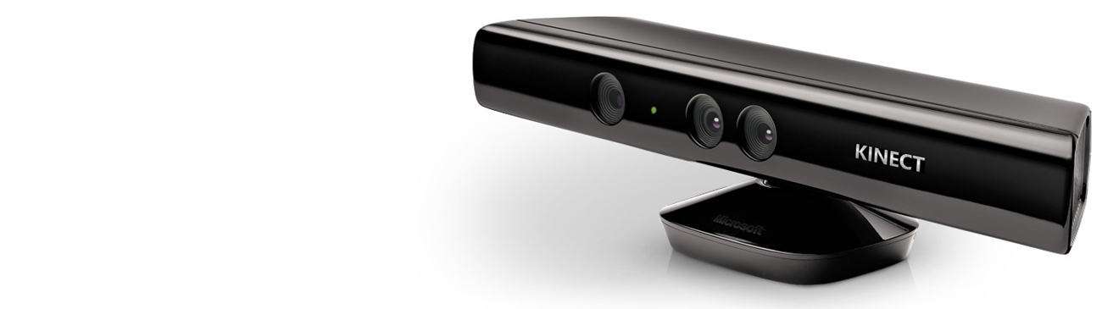

QUICKSTART SERIES

Slide 2
AUDIO
FUNDAMENTALS

Slide 3
QUICKSTART SERIES
Installing and Using the Kinect Sensor
Setting up your Development Environment
Camera Fundamentals
Working with Depth Data
Skeletal Tracking Fundamentals
Audio Fundamentals

Slide 4
SOUND POSITION
Sound Source Angle – the angle and confidence level of where audio is coming from
Beam Angle – The angle used to record audio that you can set as a “directional microphone”
-50
0
+50

Slide 5
RECORDING
KinectAudioSource audio buffer
Use Echo Cancellation to not record PC sound

Slide 6
SPEECH RECOGNITION
Grammar – What we are listening for
Code – GrammarBuilder, Choices
Note: Ensure AutomaticGainControl = false

Slide 7
GRAMMAR
<!-- Confirmation_Yes._value: string ["Yes"] -->
<rule id="Confirmation_Yes" scope="public">
<example> yes </example>
<example> yes please </example>
<one-of>
<item> yes </item>
<item> yeah </item>
<item> yep </item>
<item> ok </item>
</one-of>
<item repeat="0-1"> please </item>
<tag> out._value = "Yes";</tag>
var grammar = new Choices();
grammar.Add(“yes please");
grammar.Add(“yes");
grammar.Add(“yeah");
grammar.Add(“ok");

Slide 8

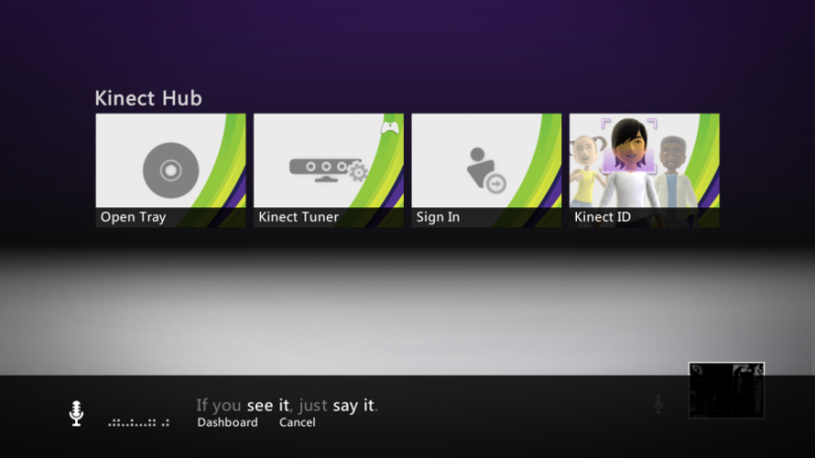
MULTI-MODAL FEEDBACK
Engagement model
Mic indicator for speech-enabled menus
Keyword to engage
Feedback and confirmation

Slide 9
AUDIO
DEMO

