Slide 1
HackFest 2021 IIT (ISM) DHANBAD Team Name – PsuedoECE Team Members – Aryan Garg (ECE) Sameer Jain (CSE) Harshit Jain (ECE) Prince Arya (ECE) Avinash K (ECE)

Slide 2

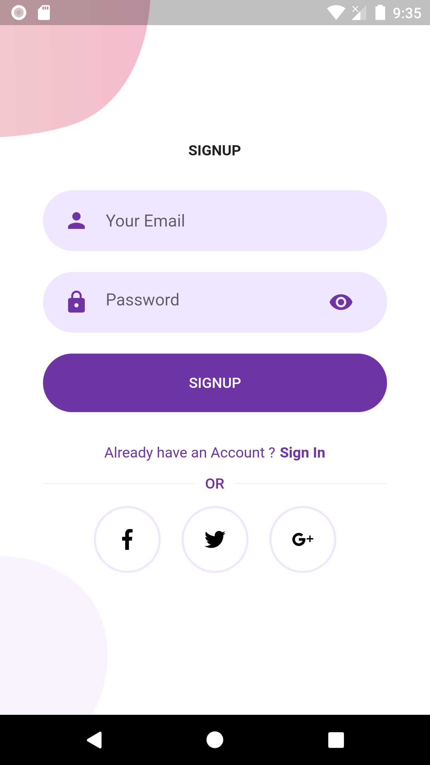
Welcome Screen Login Screen

Slide 3
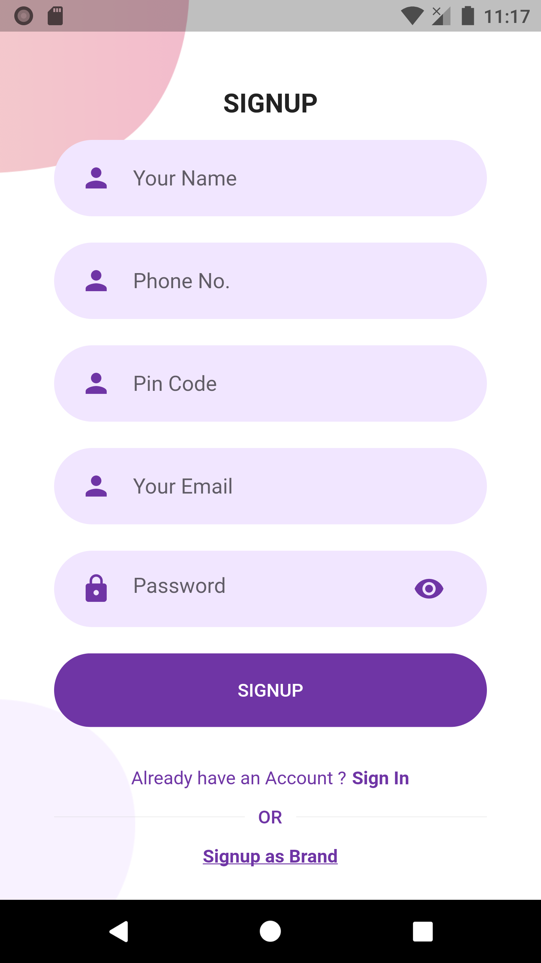

SignUp Screen Home Screen

Slide 4
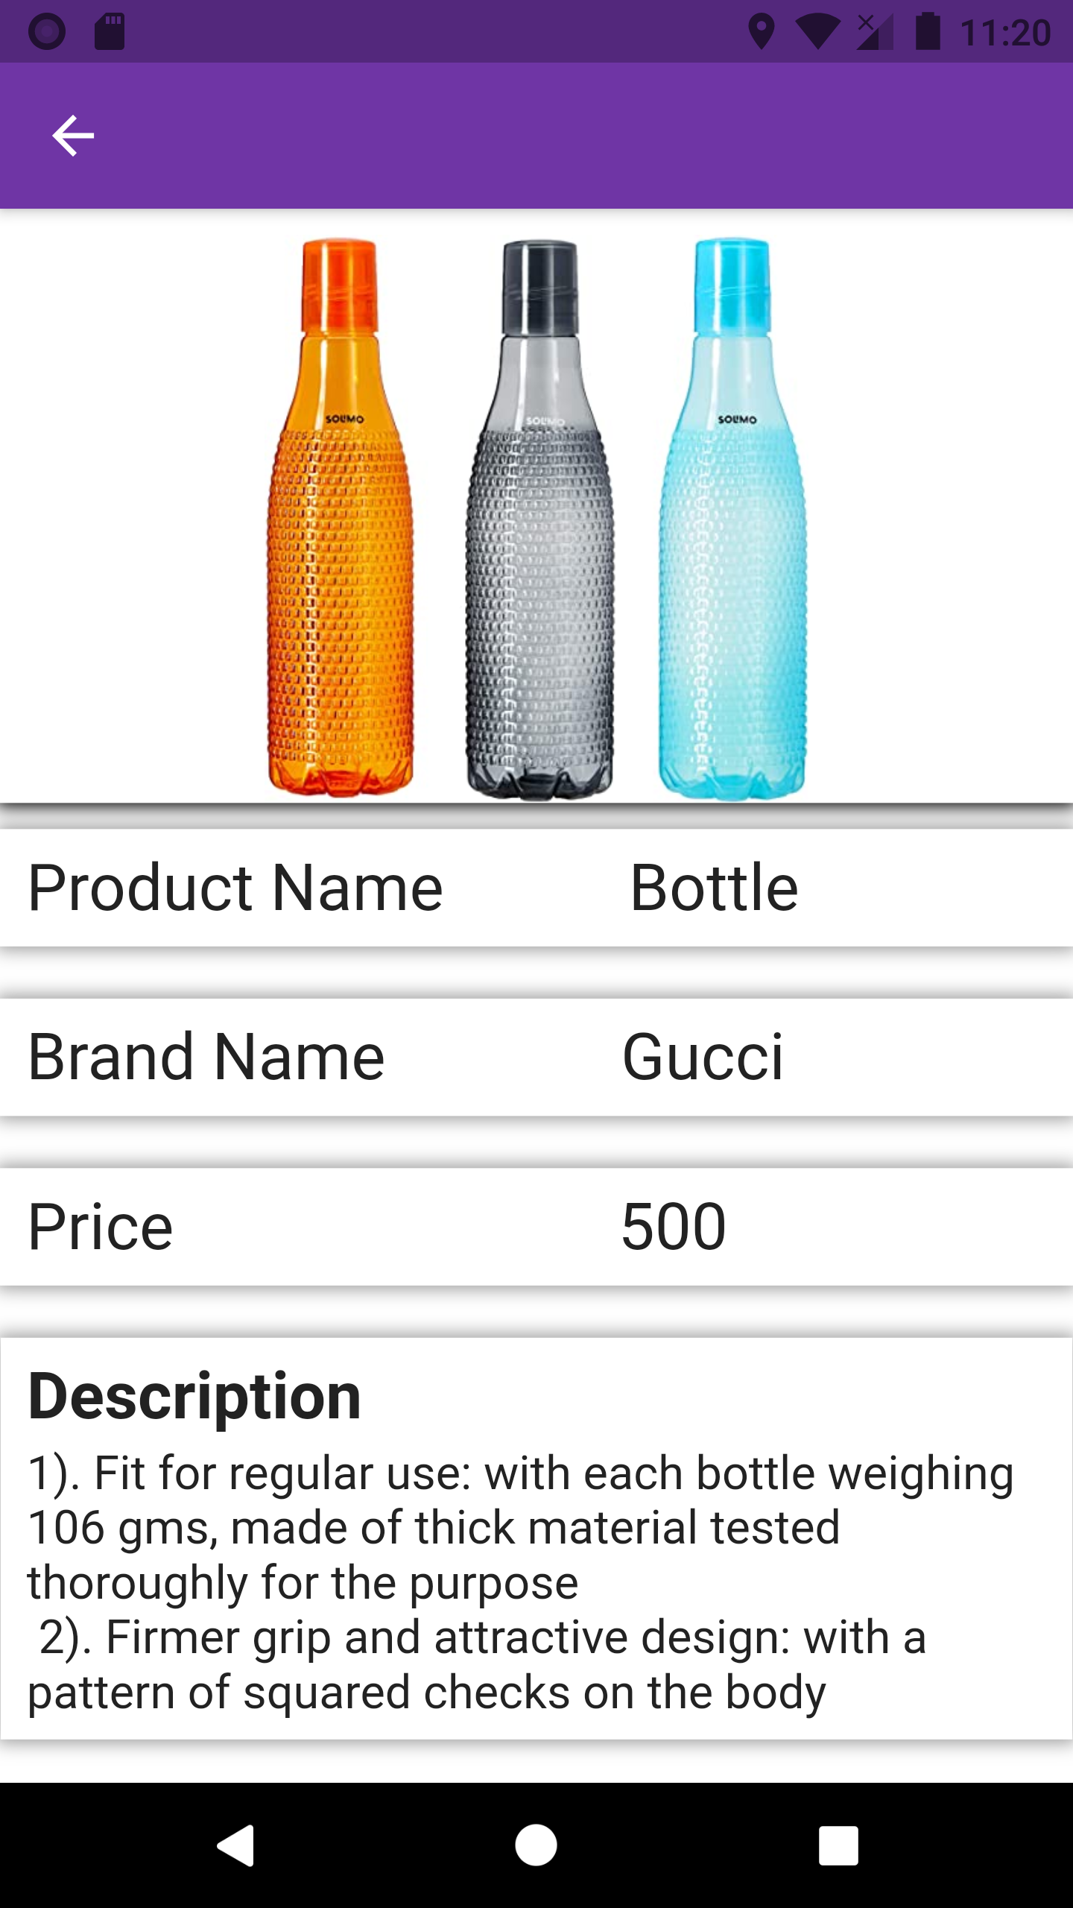

Product details screen My Cart Screen

