Slide 1

Mental Health Care

Slide 2
Problem statement In the present era, people have started building negative thoughts and emotions and developing stress, anxiety, and depression.

Slide 3
Solution
Website containing chatbot.
Also contains paid videos.
Chatbot is trained using Machine Learning.

Slide 4
What is Chatbot ?
A Chatbot is a type of bot that conducts a conversation via auditory or textual methods.

Slide 5
OR
A Chatbot is an artificial intelligence program that simulates interactive human conversations by using key pre-calculated user phrases.
It is also known as artificial conversational entity [ACE].

Slide 6
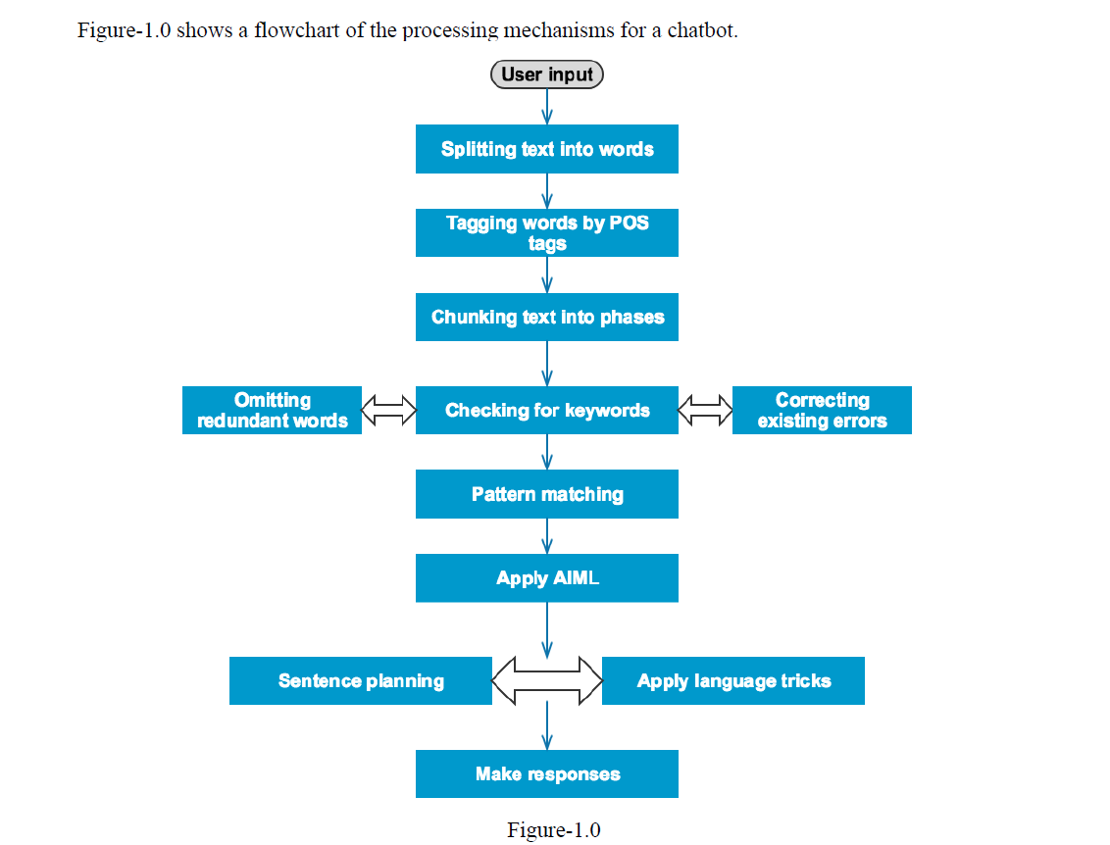

Slide 7
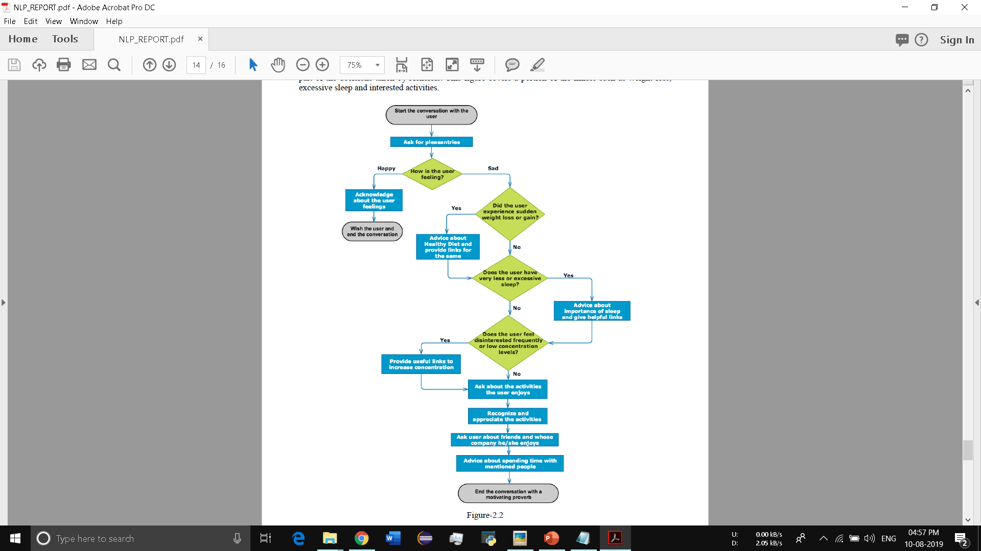
Decision Tree

Slide 8
Sources of Earning $$
Bucks for special advice from top rated paid videos.
If traffic increased on website, then Google AdSense earning will also start.

Slide 9
Developer’s Benefits
No partnership, hence maximum benefit.
Access to add special features in webpage.

Slide 10
User’s Benefits
Free access to all users.
Remove negative thoughts, emotions, stress and anxiety.
User friendly.

Slide 11
Similar Apps
Therapy apps such as Sanvello, Youper, Headspace, etc have offered quick conversation, personalized meditations, mood tracking and health monitoring .

Slide 12
Why Us ?
Doctor’s consult in low price.
One touch ambulance call and tracking facility will also be provided.
Credit points.( for monthly subscription of paid videos )

Slide 13
Promotion
Promotion in schools, coaching institutes, colleges.
Promotion through YouTube advertisement.
Promotion via social media.

Slide 14
Thank You

