Slide 1
OPSGUARD AI
Governed exception handling
for household services
AI
From helper no-show to customer recovery with bounded AI, deterministic rules, and human approval.
Sujal Jain
INTERVIEW DECK
Product and program case study | September 2026
Notes:
Introduce OpsGuard as a governed operations prototype. Emphasize that the demonstration is synthetic and no real refund or helper assignment occurred.

Slide 2
OPERATIONAL PROBLEM
02
One no-show creates five linked decisions
Synthetic case EZH-1042
A confirmed cleaner has not checked in and is 30 minutes late. The customer has a 1:00 PM deadline.
30 min
3.5 hrs
₹500
₹300
10:15
LATE
TO DEADLINE
REFUND REQUEST
AUTO LIMIT
REPLACEMENT ETA
The design challenge
Move fast enough to recover the service while preventing unverified assignments, unauthorized refunds, and inconsistent communication.
Notes:
Source: synthetic case EZH-1042 in the OpsGuard repository. The figures are test data, not production customer data.

Slide 3
SYSTEM DESIGN
03
Interpretation and authority are deliberately separated
1
2
3
4
5
Webhook intake
AI interpretation
Rules engine
Human decision
Channel orchestration
Structured case event
Intent and sentiment
Facts and eligibility
High-value approval
Email and WhatsApp
Control principle
AI proposes structured meaning. Rules and people authorize action.
Notes:
Walk left to right. AI is one bounded stage, not the system owner. The rules engine and manager decision are explicit control points.

Slide 4
GOVERNANCE MODEL
04
Every decision has a named owner
AI interprets
Rules calculate
Manager authorizes
Customer intent
Urgency language
Sentiment
Requested resolution
Minutes late
Worker eligibility
Arrival feasibility
Refund threshold
Refund above limit
Approve or decline
Consequential action
Recorded decision
Outcome
Fast automation without surrendering policy, auditability, or human control.
Notes:
Use this slide to explain the key product judgment: generative AI handles ambiguity, while deterministic code handles operational truth and humans handle material exceptions.

Slide 5
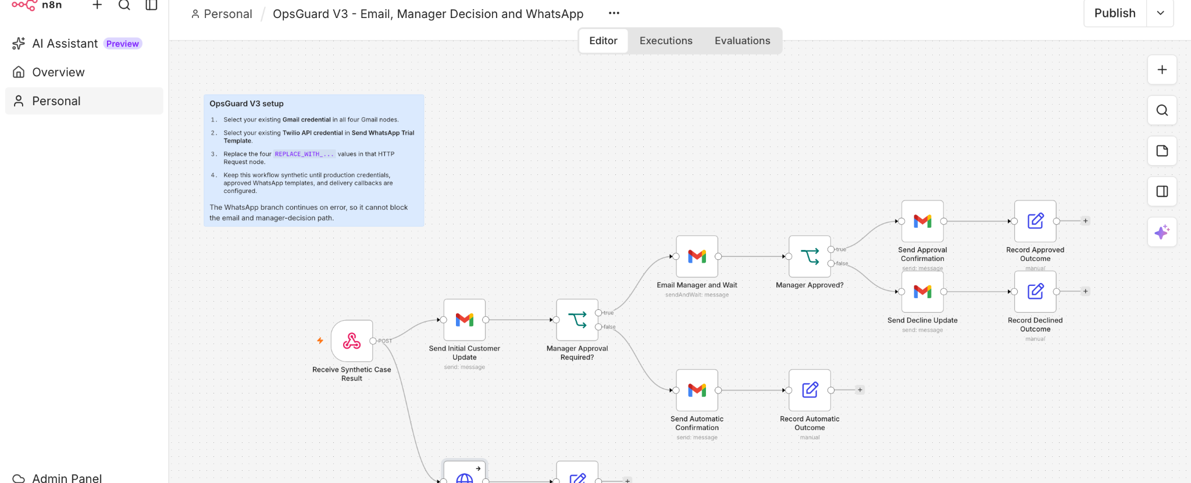
IMPLEMENTATION EVIDENCE
05
V3 orchestrates email, approval, and WhatsApp
V3 setup
5 Gmail nodes
Twilio API credential
4 sandbox placeholders
Synthetic execution only
WhatsApp runs as a non-blocking branch
Notes:
Evidence: clean n8n V3 workflow canvas captured after configuration. The lower branch sends the Twilio trial template and is configured to continue on error.

Slide 6

VALIDATED RUN
06
The full synthetic path completed
✓
✓
✓
✓
✓
Webhook received
Initial email sent
Manager approved
Final email sent
WhatsApp delivered
10 / 10
regression tests passed
Synthetic only. No real helper or refund action.
Notes:
Observed September 2026. The WhatsApp content is Twilio's trial appointment-reminder template. It proves delivery mechanics, not final production copy.

Slide 7
RISK MANAGEMENT
07
The prototype is explicit about its boundaries
Controls already present
Production gaps
✓
Synthetic execution
No real refund or assignment
→
Trial content
Replace with an approved OpsGuard template
✓
Human approval
₹500 exceeds the ₹300 auto limit
→
Fixed recipient
Retrieve the selected worker dynamically
✓
Validated candidate
Worker must exist and be eligible
→
No delivery callbacks
Add status, retries, and alerts
✓
Channel isolation
WhatsApp cannot block core resolution
→
No production APIs
Connect booking, CRM, and payments
Notes:
This slide prevents overclaiming. The prototype demonstrates orchestration and governance, while production reliability and system integration remain future work.

Slide 8
PRODUCTION ROADMAP
08
Turn the prototype into an operational loop
1
Authenticated event
Idempotent case webhook
Operating
metrics
2
Dynamic worker
Availability and eligibility API
Time to recovery
Approval latency
Worker acceptance
Delivery success
Customer resolution
3
Worker response
Accept or decline on WhatsApp
4
Atomic assignment
Update schedule and audit state
5
Customer closure
Confirmed ETA and approved refund
Notes:
The next build should close the loop with worker replies, atomic assignment, delivery callbacks, and durable state. The metric list converts the workflow into an operating system.

Slide 9
WHY THIS PROJECT MATTERS
I translated an ambiguous service failure
into a controlled, testable workflow.
Product judgment
Program design
Technical execution
Separated speed from authority
Connected rules, approval, and channels
Built, tested, and validated V3 end to end
Takeaway
The best AI workflow is not the one with the most autonomy. It is the one with the clearest accountability.
Sujal Jain | OpsGuard AI
Notes:
Close on accountability. If asked about your contribution, describe the operational framing, control model, branching workflow, testing discipline, and production roadmap.

