Slide 1

DIGITAL FOOTBALL SCORER
TRL 3 :- APPLIED RESEARCH

Slide 2
REQUIREMENT OF THE PRODUCT
The data of the matches played in the local matches are noted in a notebook and the database are not stored in a proper manner . In some cases there is no management of data .
The local team host or the management have to spend a lot of money for the advertisement and other expenses ,
by spending the money also sometimes does not works .
The player does not have a plateform to get motivated . Some time the mistakes and the demerits which the player performed will be forgot by the player .
Except the players and the team management , others does not know what is happening in the ongoing match .The stats of the match will be known by a third person when he comes to the venue where the match is played .

Slide 3
ABOUT THE PRODUCT
We have special access in our application
Management Access
Management Access we will have the page to give the input for the on-going match and a page to update the upcoming matches .
In the input we will have no of goals , no of fouls , corners , throws , penalty kicks , the perfromed the all these things .
Player access we will have the option to view the stats of the previous matches .
There is a open source where everyone can view the stats of the on-going match .

Slide 4
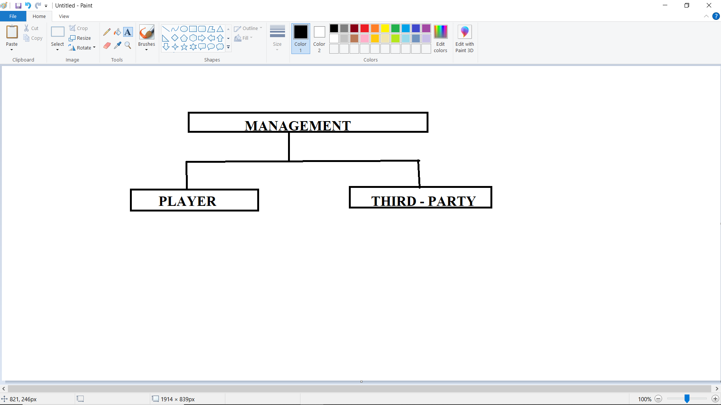
DESIGN
Management host will give the the input of the stats .
Player data-base can be viewed by anyone & anywhere .

Slide 5
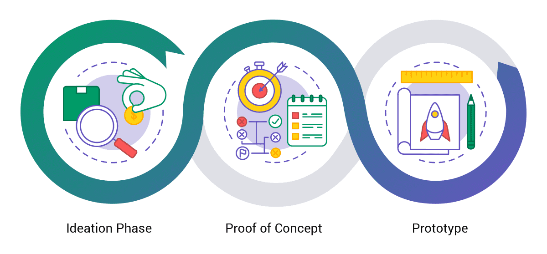
IDEA TO PROTOTYPE
Intially we start with a idea to bring up a solution for
Team management - To reduce the cost of advertisement and pass the info of upcoming matches to every players .
Local football players - To digitalize the stats of previously matches .
Third-party - To view the scores from anywhere and anytime .
Then we have decided to bring up a proof of concept of show how the data has been taken as input and stored in the database and retrived for the database
Input ( From the team management )
Database
Output ( To the Players and third party )
At the stage of prototype we would have completed our application with all the features
Login and Sign-up
Main page ( to choose the category of the user )
Management access
Live match updates
Completely user friendly interface
Upcoming match updates

Slide 6
THANK YOU

