Slide 1
UAMS
User Access Management System
LeucineTech Pvt Ltd
Intern Assessment
Jainulabedeen
B.Tech (Artificial and Machine Learning)
Hindustan Collage of Engineering- Coimbatore
Date: 28th NOV 2024

Slide 2
Description
The User Access Management System (UAMS) is a
web application designed to help organizations manage software access and user permissions easily.
It allows Admins to control who can access which software and what actions they can perform (like read-only or write access)

Slide 3
Key Features
Permission Control: Admins assign read (view-only) or write (edit) permissions to users for specific software.
Ticket System: Users can submit tickets to request access to software. Managers or admins review the requests and approve or reject them.
Admin Functionality: Admins can add new software to the system for users to request access to. Admins also manage user permissions and can modify them as needed

Slide 4
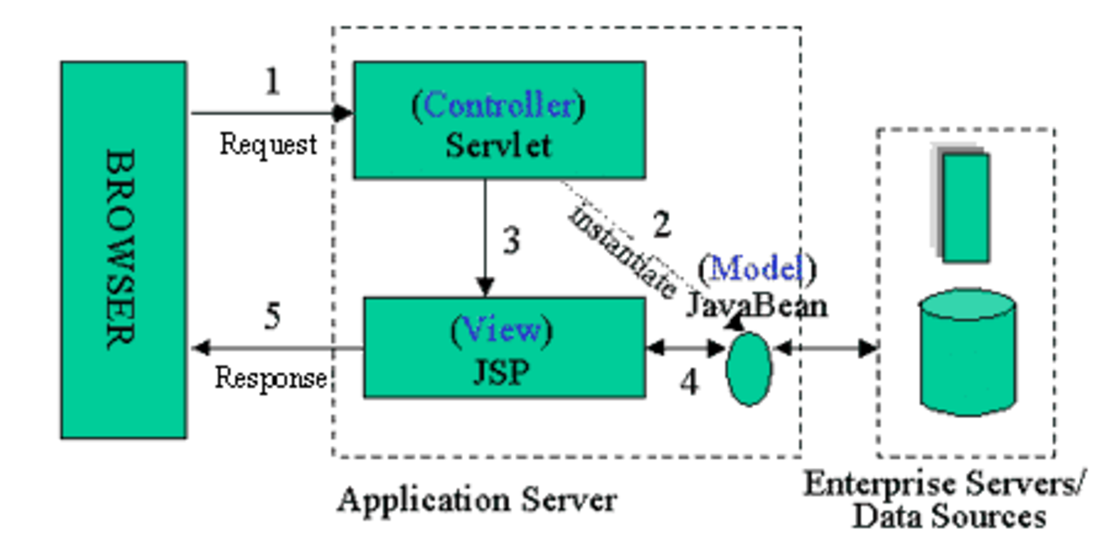
Architecture

Slide 5
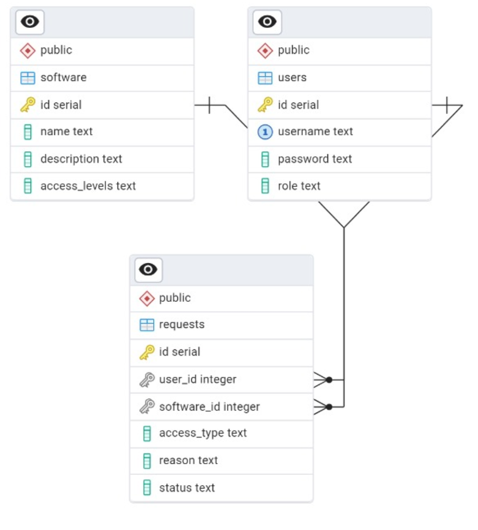
ER DIAGRAM
Visualizes database relationships:
users,
Software,
requests tables.
Foreign key relationships
(e.g., requests.user_id → users.id)

Slide 6
Application Process Flow
Configuration
Manager
Employee
Admin
Login
Servlet , JSP
JDBC
User
Sign Up
Exception Class
BackEnd
Web App
Maven
Library
Data Base

Slide 7
How It Works
User Requests: Users submit a ticket through the web application to request access to a specific software
Manager Approval: The request is reviewed by a manager or admin who decides whether to approve or reject it.
Access Granted: If approved, the system automatically updates the user’s permissions

Slide 8
Conclusion
The UAMS web application simplifies the process of managing software access and ensures that only authorized users can access certain software, enhancing security and compliance.

Slide 9
THANK YOU

