Slide 1
Know Your JAVA !!!

Slide 2
QUIZ!!!
Static / Threading / Polymorphism
Strings / Objects
Math/Collections
100
100
100
500
500
500
1000
1000
1000

Slide 3
String 100
//Which of these is better?
String str1 = “Hello”;
String str2 = new String(“Hello”);
//What is the output of:
System.out.println( str1 == str2);
System.out.println(str1.equals(str2));

Slide 4
String 100
Strings are immutable
"Hello" is already an instance of String
using new on String creates a new redundant instance
Using new to create String is not a good idea
Output will be false, true

Slide 5
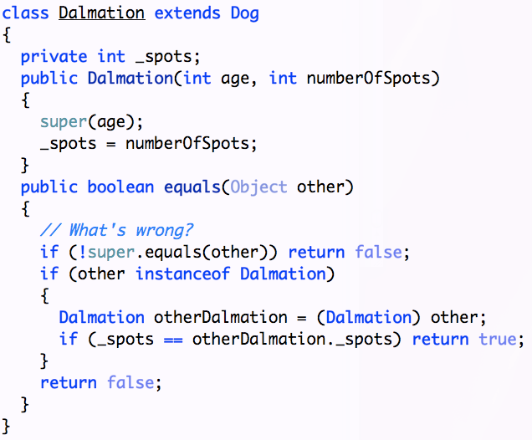
Objects 500

Slide 6
Objects 500
equals() must be symmetric, reflective, and transitive

Slide 7
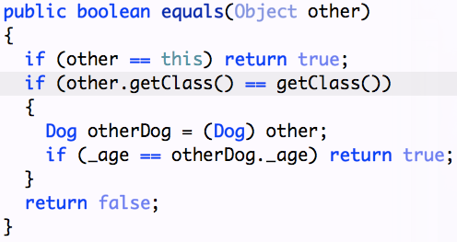
Objects 500
ensure you’re checking objects of the right type

Slide 8
Objects 500

Slide 9
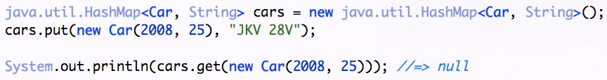
Objects 500
Equal objects are required to have equal hashCodes

Slide 10
Objects 500
If you override equals, provide hashCode() method

Slide 11
Finally 1000
//What is the output
public class ReturnExample {
private String test(){
String result = "";
try{
result = "in Try block";
return result;
}catch (Exception e){
result = result + "in catch block";
return result;
}
finally{
result = result + "in finally block";
}
}
public static void main (String[] args){
ReturnExample ex = new ReturnExample();
System.out.println(ex.test());
}
}

Slide 12
Finally 1000
in Try block
//WHY??

Slide 13
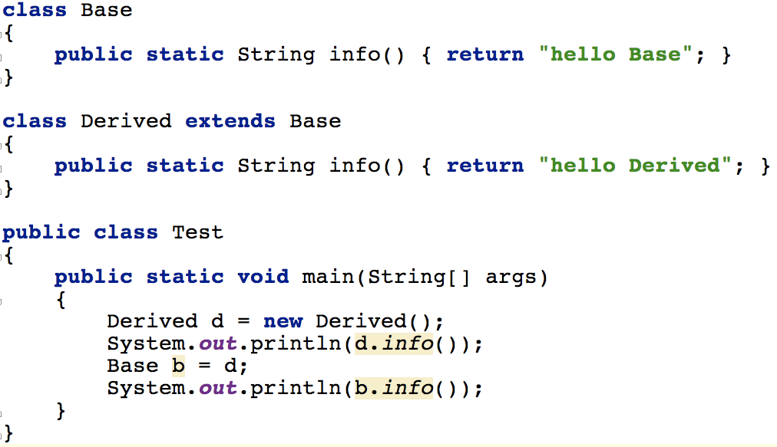
Static 100
//What is the output of:

Slide 14
Static 100
Output from above code is
static methods are not polymorphic
Don’t call static methods on instances
Avoid confusion, only call them on classes

Slide 15
Polymorphism 500

Slide 16
Polymorphism 500
Don’t call polymorphic (non-final) methods from within constructors

Slide 17
Threading 1000

Slide 18
Threading 1000
count++ is not atomic
If multiple threads invoke constructor at same time, count will be in jeopardy
Does this fix?

Slide 19
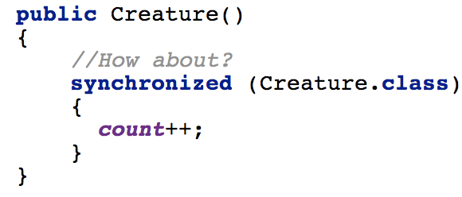
Threading 1000
Nope, not effective synchronization
How about?

Slide 20
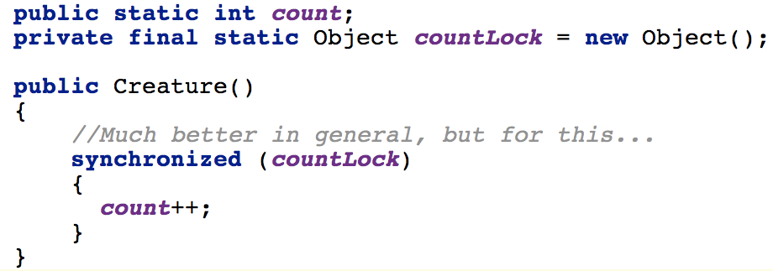
Threading 1000
Too sweeping
Generally, synchronizing on Class is not a smart idea
If another part of code synchronizes on the same, it limits concurrency
Make synchronization very specific and narrow

Slide 21
Math 100

Slide 22
Math 100
% 2 for -ve numbers does not work as you’d expect
instead ask if it is even and negate

Slide 23
Computation 500

Slide 24
Computation 500
Java reports 0.8999999999999999
float and double don’t give you as much accuracy as BigDecimal
In Java, use BigDecimal for accuracy
Note use of "" instead of new BigDecimal(2.0)
Never use BigDecimal(double) constructor–exact double representation, so in accurate

Slide 25
Math 500

Slide 26

Math 500
Initial value fits in size of int
Final result fits
But intermediate values don’t
Make type large enough to hold intermediate results

Slide 27
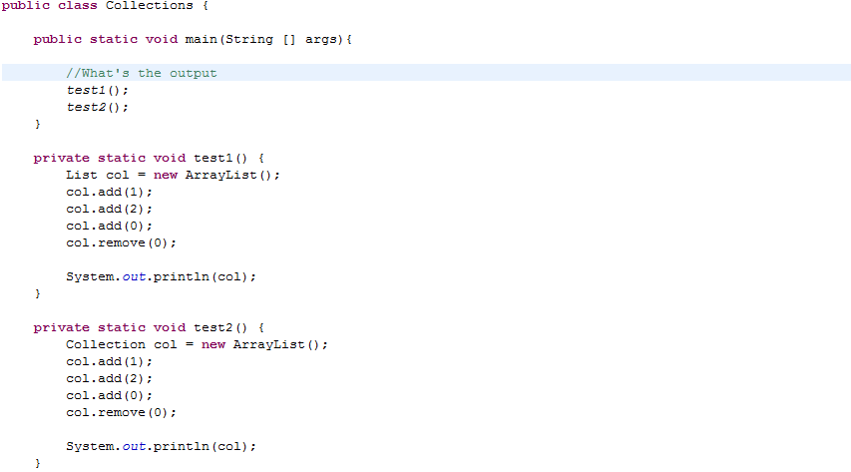
Collections 1000

Slide 28

Collections 1000

Slide 29
References
Know Your Java Presentation - Venkat Subramaniam GIDS

Slide 30
Thank YOU!!

