Slide 1

SMART INDIA HACKATHON 2026
TITLE PAGE
Problem Statement ID – SIH26024
Problem Statement Title – AI-Based Smart Governance and Compliance Monitoring System for Coal Mines
Theme – Mining and Mineral Transport Monitoring System
PS Category – Software
Team ID – SIH-S-B3-147
Team Name (Registered on portal) – Codeavengerz

Slide 2
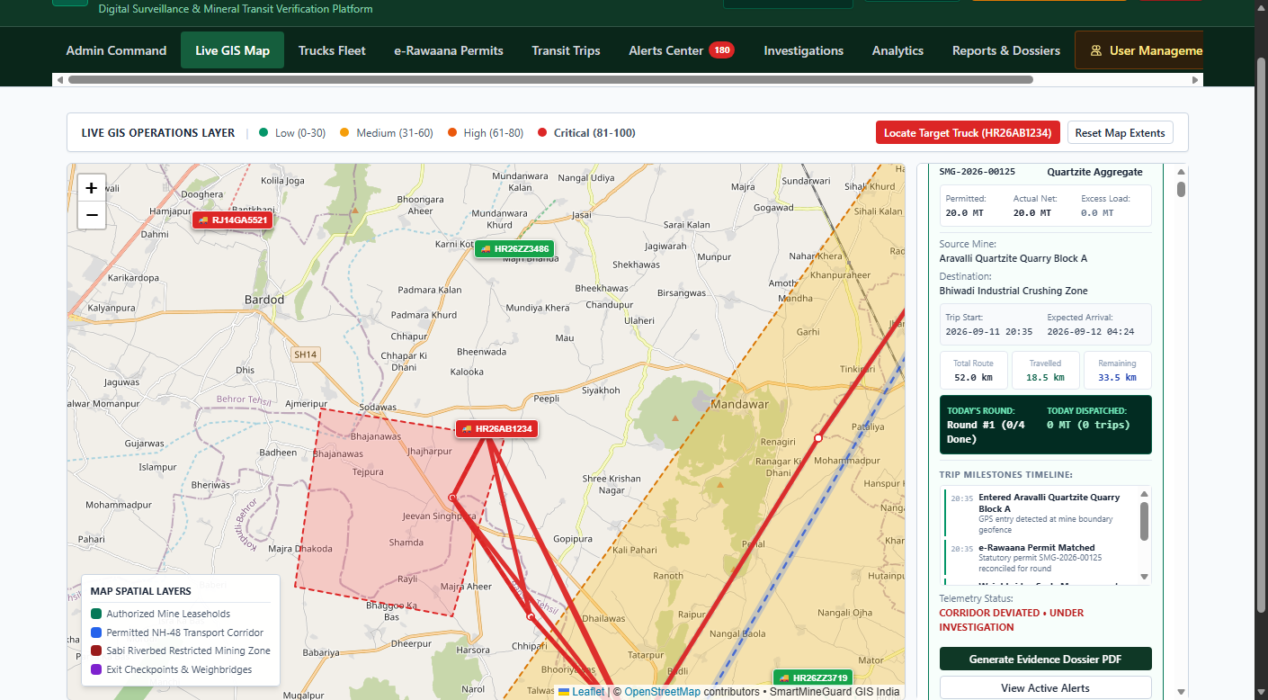
IDEA TITLE: SMARTMINEGUARD
Codeavengerz
Proposed Solution (Describe your Idea/Solution/Prototype)
• Detailed explanation of the proposed solution:
– Pure-software statutory intelligence & governance ecosystem for State Mining Depts, DGMS & Coal Controllers.
– Unifies e-Rawaana transit passes, AIS-140 GPS telematics, digital weighbridges & mine lease quotas into one digital audit trail.
– Working production-grade prototype with role-based portals (Admin, Field Officer, Mine Operator).
• How it addresses the problem:
– Eliminates Illegal Extraction: Reconciles mine lease extraction quotas against cumulative dispatch tonnage in real-time.
– Stops Transit Pass Fraud: Single-use encrypted QR tokens mark passes CONSUMED at checkposts, preventing reuse.
– Halts Mineral Theft & Deviation: Live AIS-140 GPS tracking detects corridor departures, unapproved halts & geofence breaches.
– Enforces Axle Weight Limits: Automated weighbridge integration flags gross vs. tare weight variances (>5%) before dispatch.
• Innovation and uniqueness of the solution:
– 100% Deterministic & Defensible: Explainable 6-rule scoring (0-100) compliant with MMDR Act; zero AI hallucinations.
– Instant Field Enforcement PWA: Mobile QR scanner reconciles permits in <2s with offline validation capability.
– Court-Ready Evidence Dossiers: Auto-generates cryptographically verifiable, timestamped PDF dossiers for legal prosecution.
Live GIS Fleet Surveillance & Corridor Deviation
[Working Prototype: PostGIS Spatial Corridors & Real-Time Tracking]

Slide 3
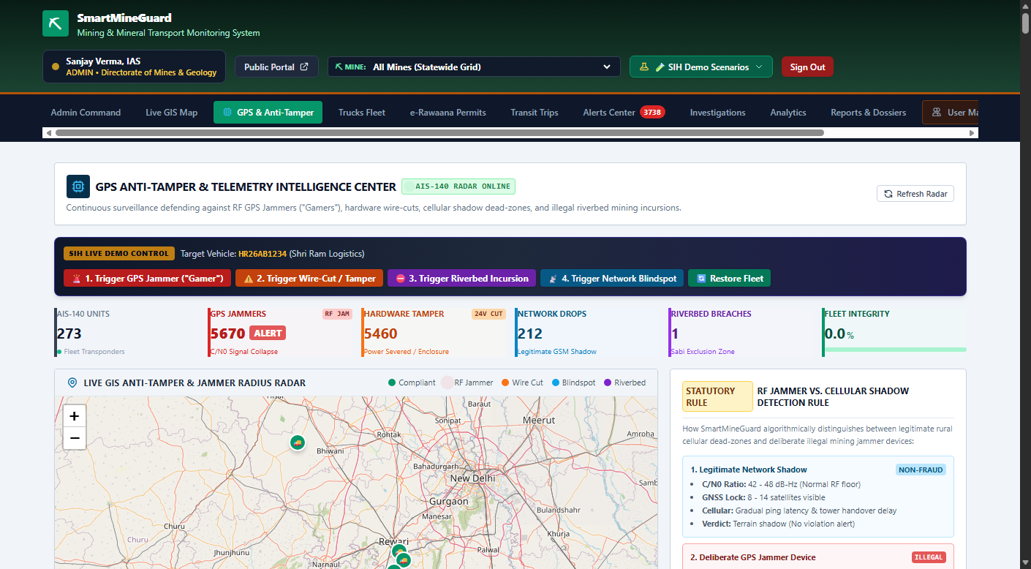
TECHNICAL APPROACH
Codeavengerz
Technologies to be used (programming languages, frameworks, hardware):
– Core Backend: Python 3.13, Flask 3.0, Flask-SocketIO (bi-directional WebSocket real-time fleet telemetry).
– Spatial Database: PostgreSQL 16 + PostGIS for spatial vector analytics (ST_Contains, ST_DWithin, corridor buffers) + zero-setup SQLite spatial fallback.
– Frontend Architecture: HTML5, Jinja2, Vanilla JavaScript (ES6), Tailwind CSS, Leaflet.js 1.9 (GIS layers), Chart.js 4.4.
– Enforcement & Security: ReportLab 5.0 (Court-ready PDF dossiers), HTML5-QRCode, Cryptographic SHA-256 tokens.
– Hardware & IoT: AIS-140 GPS telematics protocol, RS-232/IP Digital Weighbridge Scales, ANPR cameras, RFID boom barriers.
• Methodology and process for implementation (Flow Charts/working prototype):
– End-to-End Operational Pipeline:
– [Lease Quota Check] → [e-Rawaana Pass (QR)] → [IoT Weighbridge & ANPR] → [Live AIS-140 GPS Tracking] → [6-Rule Detection Engine] → [Explainable Risk Score (0-100)] → [Roadside QR Check] → [Court Evidence Dossier PDF].
– Deterministic Detection Engine: Evaluates 6 statutory rules (Route Deviation, Speed Anomaly, Lease Geofence Breach, Weighment Variance >5%, GPS Blackout, Expired Permit).
– Working Prototype: Fully implemented with 26+ screens, multi-truck GPS simulator, and court-ready PDF dossier engine.
AIS-140 GPS Telemetry & Live Telematics Terminal
[Working Prototype: SocketIO Vehicle Movement & Sensor Stream]

Slide 4
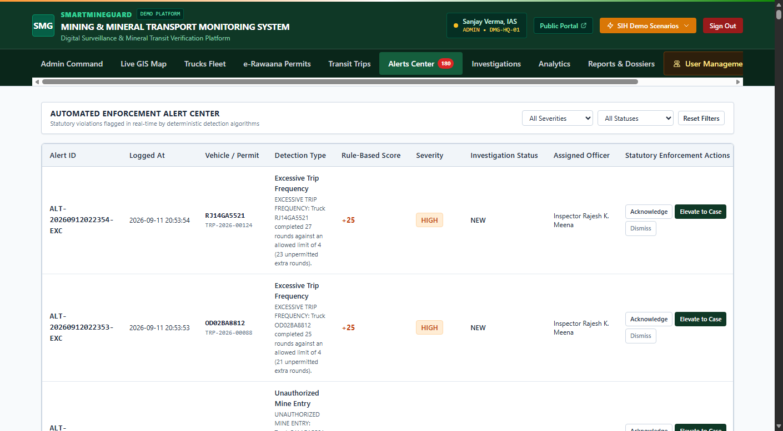
FEASIBILITY AND VIABILITY
Codeavengerz
Analysis of the feasibility of the idea:
– Technical Feasibility: Proven open-source stack (Python/PostGIS) with minimal compute footprint; runs on standard NIC/cloud servers without GPU costs.
– Operational Feasibility: REST APIs integrate seamlessly with Khanij Online, e-Challan, Parivahan Vahan/Sarathi, and existing physical weighbridges.
– Financial Viability: Zero proprietary licensing or recurring AI token fees; rapid ROI achieved by plugging royalty revenue leakage.
• Potential challenges and risks:
– Network Blindspots: Remote mining valleys and forest transit corridors experience cellular signal loss.
– Hardware Tampering: Deliberate unplugging of AIS-140 GPS trackers or weighbridge scale manipulation.
– Enforcement Resistance: Operator reluctance and attempts to pass forged physical challans.
• Strategies for overcoming these challenges:
– Store-and-Forward Telemetry: Onboard device buffers pings; offline PWA cryptographic QR verification for field officers without internet.
– Multi-Sensor Cross-Validation: Anomaly engine cross-references GPS ping continuity, velocity spikes, and scale weight variance (>5%).
– Cryptographic Lifecycle: Passes auto-expire with strict single-use states (ISSUED → IN_TRANSIT → CONSUMED).
Real-Time Alert Center & Statutory Investigation
[Working Prototype: Automated Risk Categorization & Elevation]

Slide 5
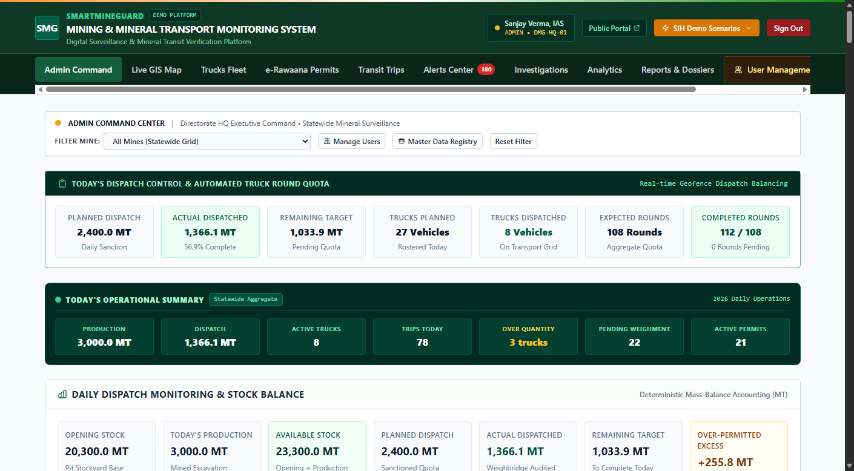
IMPACT AND BENEFITS
Codeavengerz
Potential impact on the target audience:
– State Mining Departments & Coal Controller: 100% transparent auditability of extraction vs. dispatches; stops ₹100s of Crores in royalty leakage.
– Field Enforcement Officers: Instant roadside verification in <2 seconds; automated evidence dossiers save hours of manual documentation.
– Mine Leaseholders & Transporters: Automated weighbridge clearance (<30 seconds) with automated barrier lift, eliminating transit bottlenecks.
• Benefits of the solution (social, economic, environmental, etc.):
– Economic Impact: 100% royalty recovery, elimination of transit pass recycling, and eradication of unrecorded commercial dispatches.
– Environmental Protection: Strict lease boundary geofencing halts illegal excavation in riverbeds, forest reserves & eco-sensitive zones.
– Public Safety & Infrastructure: Enforces strict Gross Vehicle Weight limits to prevent road damage and fatal overloading accidents.
– Governance & Accountability: Tamper-evident digital audit trail eliminates bribery and ensures compliance under the MMDR Act.
Executive Command & State Governance Dashboard
[Key Metrics: 100% Auditability | <2s Field Check | Zero Pass Reuse]

Slide 6
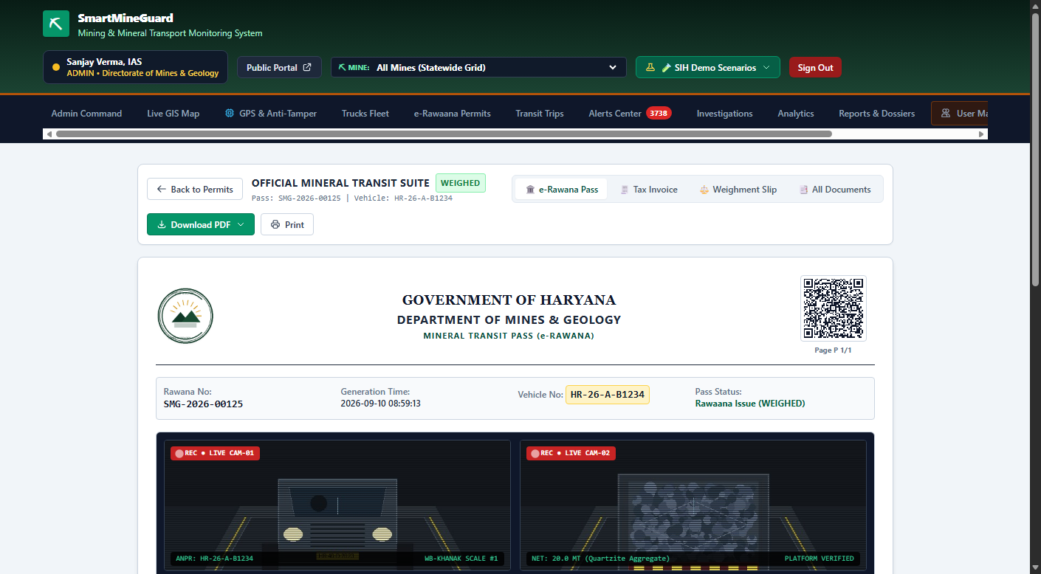
RESEARCH AND REFERENCES
Codeavengerz
Details / Links of the reference and research work:
Statutory Frameworks & Regulatory Guidelines:
– Mines and Minerals (Development and Regulation) Act (MMDR Act, 1957 & 2023 Amendment) – Statutory transit rules.
– Ministry of Coal & Ministry of Mines – Guidelines for Sustainable Mining & Dispatch Surveillance.
– Central Motor Vehicles Rules (CMVR) Rule 125H – Mandating AIS-140 Vehicle Location Tracking (VLTD).
Technical Standards & Specifications:
– AIS-140 Standard for Intelligent Transportation Systems & Telematics Protocols (ARAI / ICAT).
– Open Geospatial Consortium (OGC) Simple Features for SQL – PostGIS spatial indexing (ST_Contains, ST_DWithin).
– Legal Metrology (Enforcement) Rules – Electronic weighbridge integration & tare accuracy standards.
Working Prototype Repository & Verification:
– Complete Functional Prototype: Python/Flask, PostGIS, Leaflet GIS, SocketIO, ReportLab Dossier Engine.
– Tested on Real Mining Corridors: 26+ screens, 6 compliance algorithms, real-time telemetry & court-ready dossiers.
Official e-Rawaana Pass & Legal Dossier Reconciliation
[Statutory Audit Trail: SHA-256 Token & Legal Metrology Verification]

