Slide 1

SPRING ANOTATIONS

Slide 2
INTRODUCTION
Spring is widely used for creating scalable applications. For web applications Spring providesSpring MVC which is a widely used module of spring which is used to create scalable web applications.But main disadvantage of spring projects is that configuration is really time-consuming and can be a bit overwhelming for the new developers. Making the application production-ready takes some time if you are new to the spring.

Slide 3
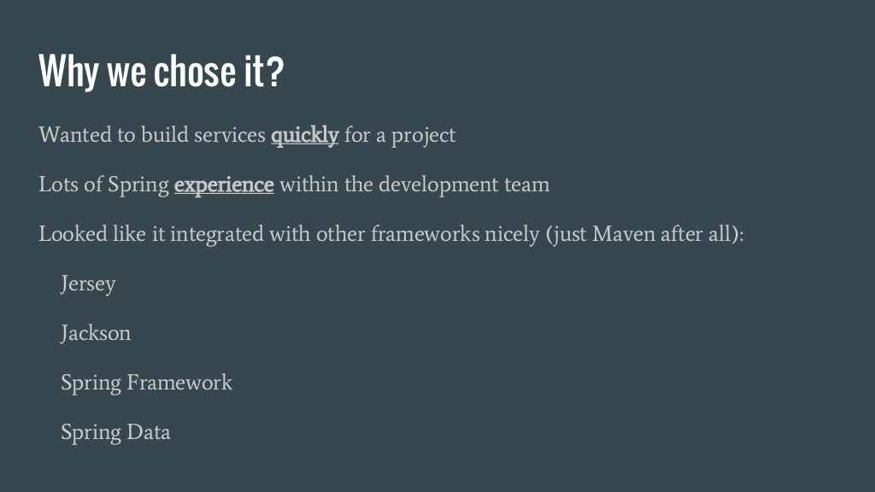
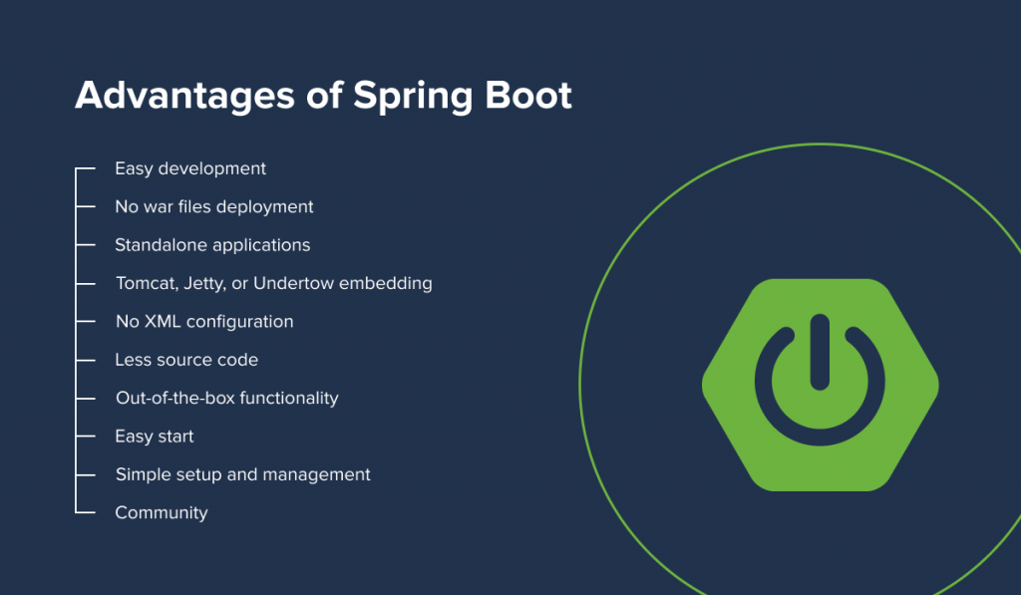

Slide 4
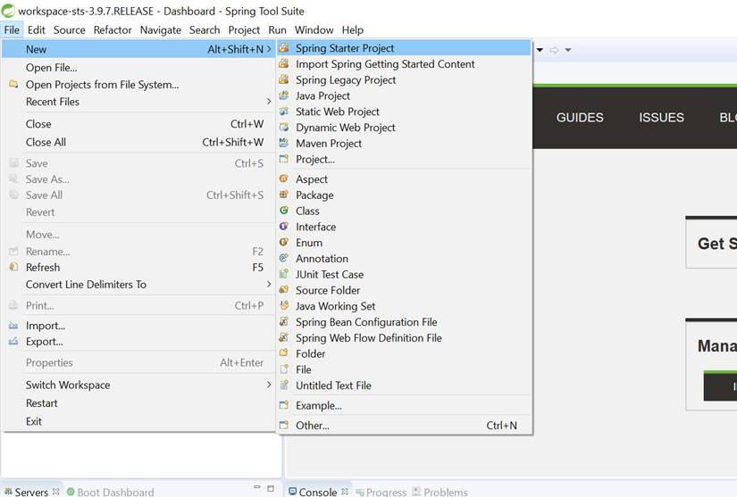
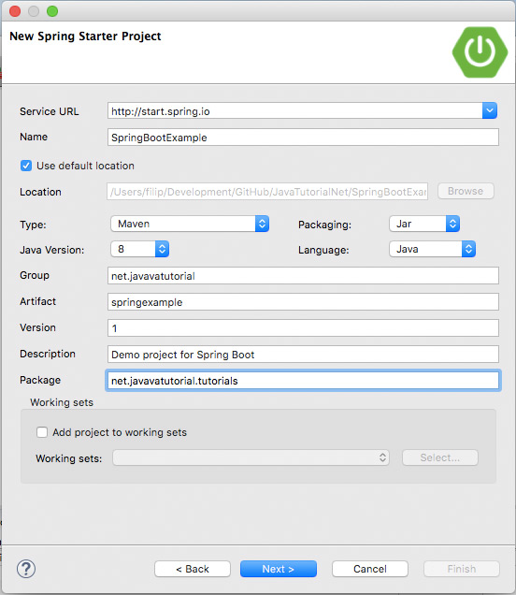
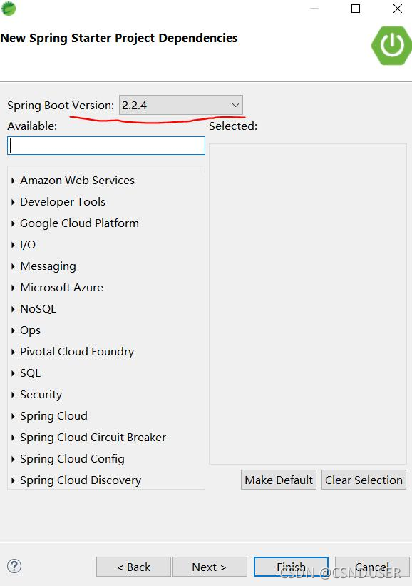
CREATEING PROJECT

Slide 5
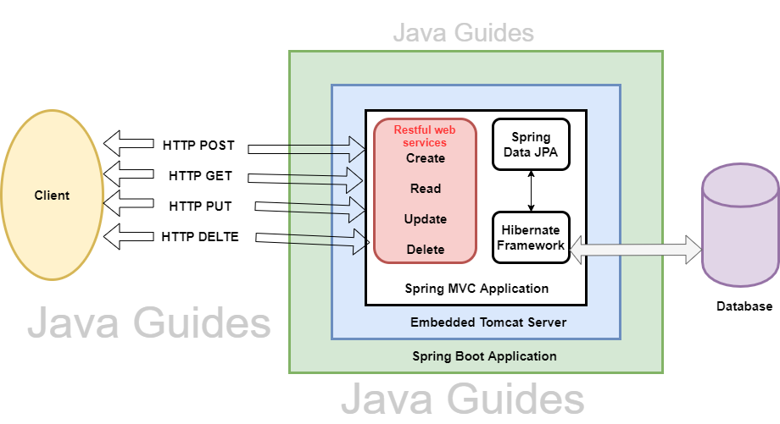

Slide 6
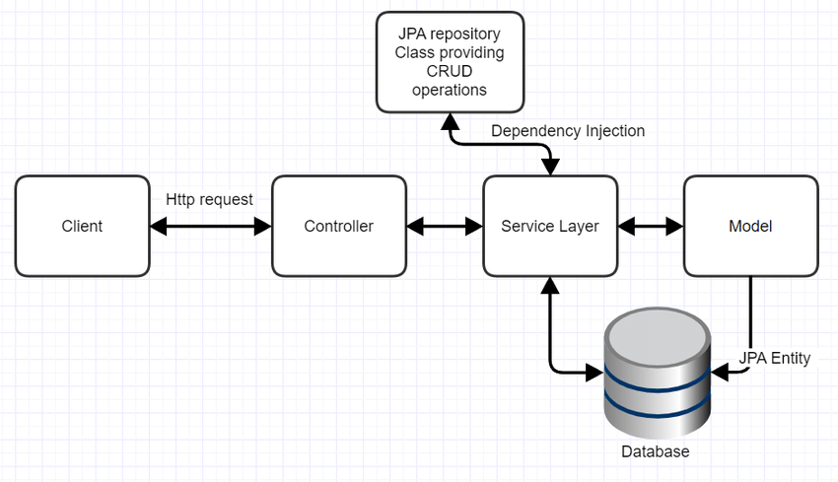
HOW IT WILL BE WORK

Slide 7
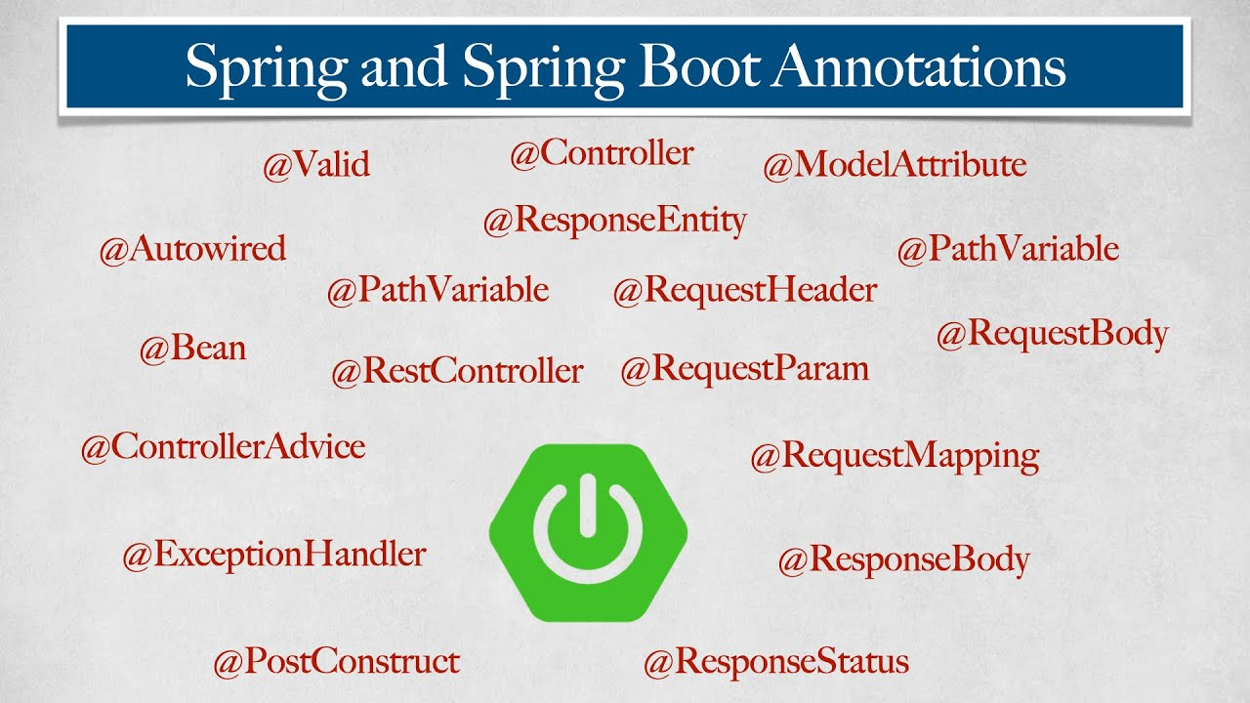

Slide 8
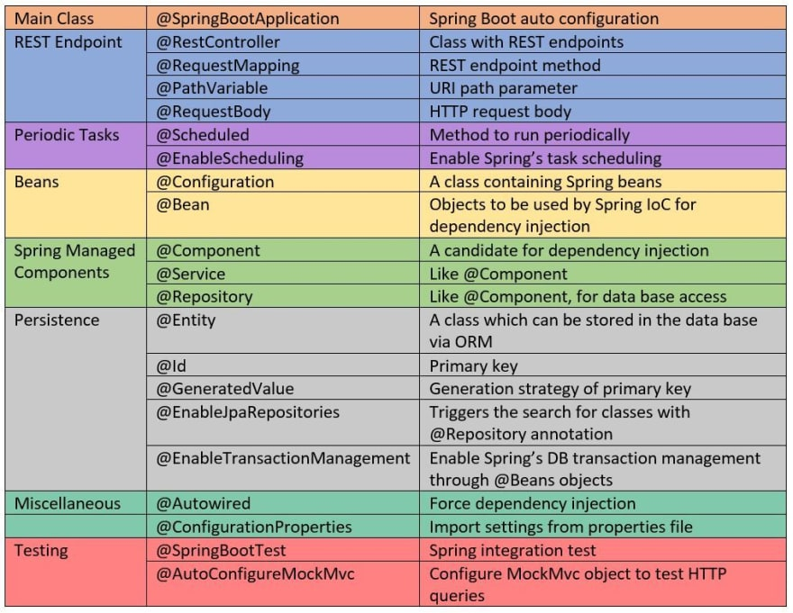

Slide 9
THANKYOU
P.JAIPAUL

