Slide 1


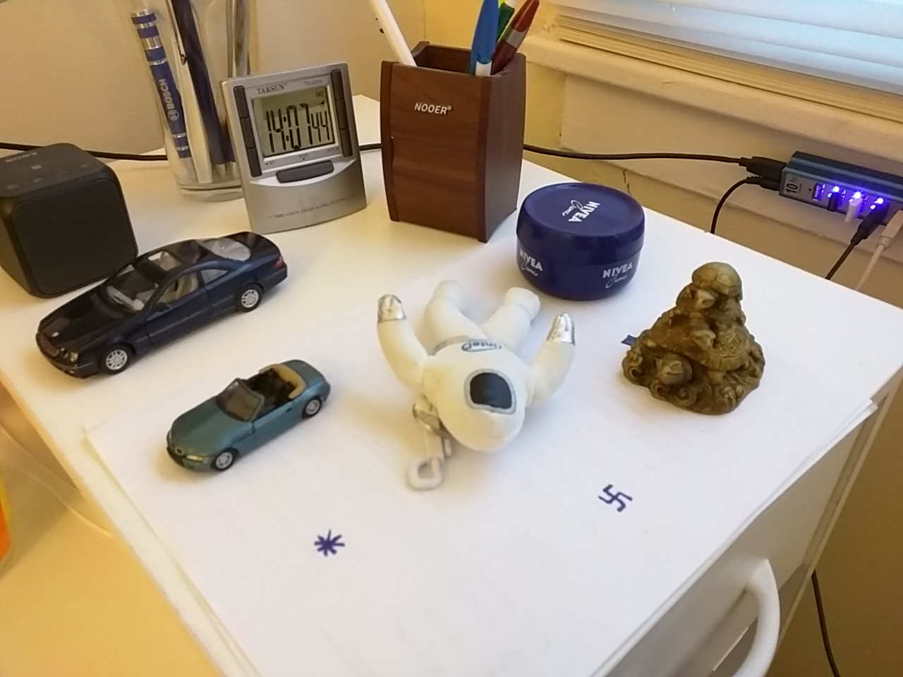
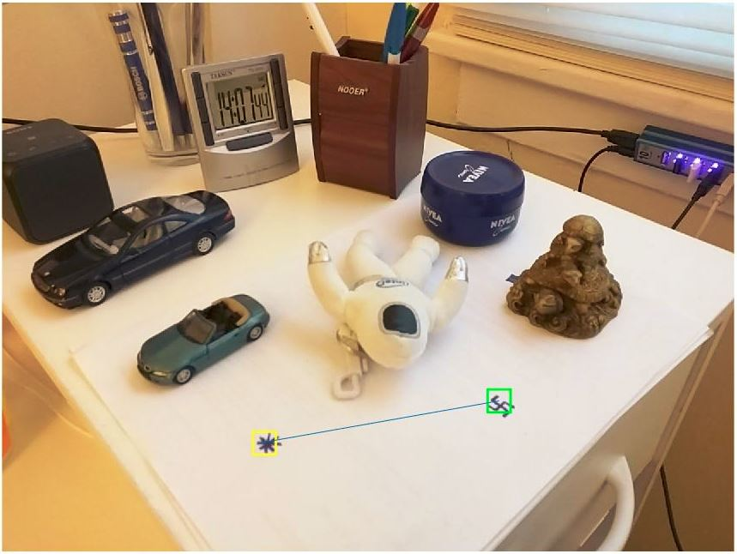
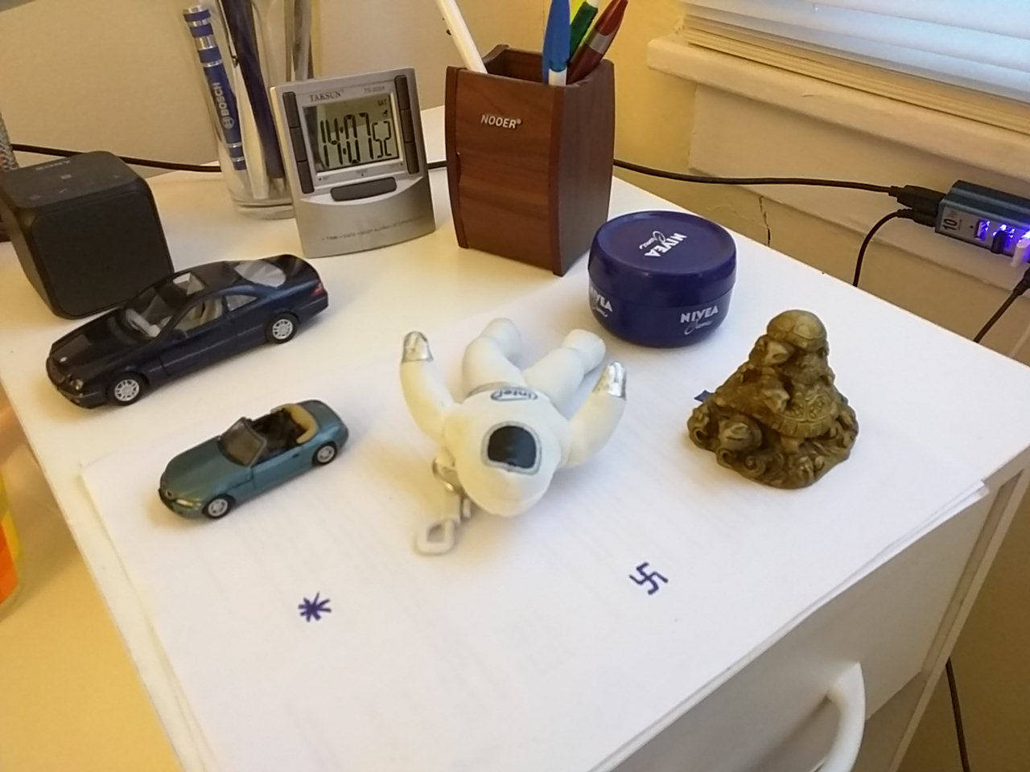
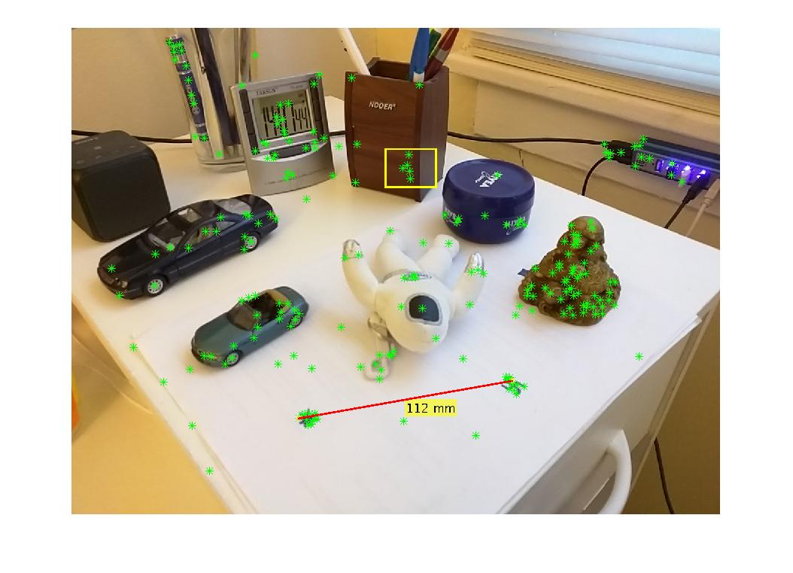
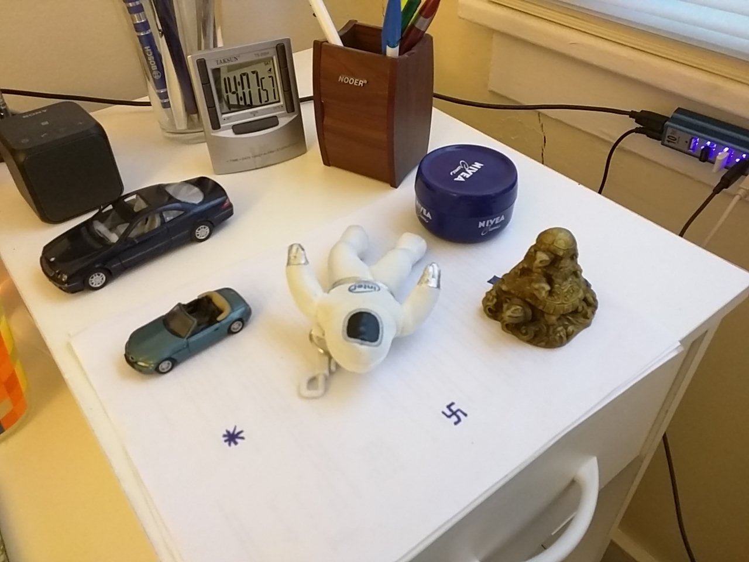
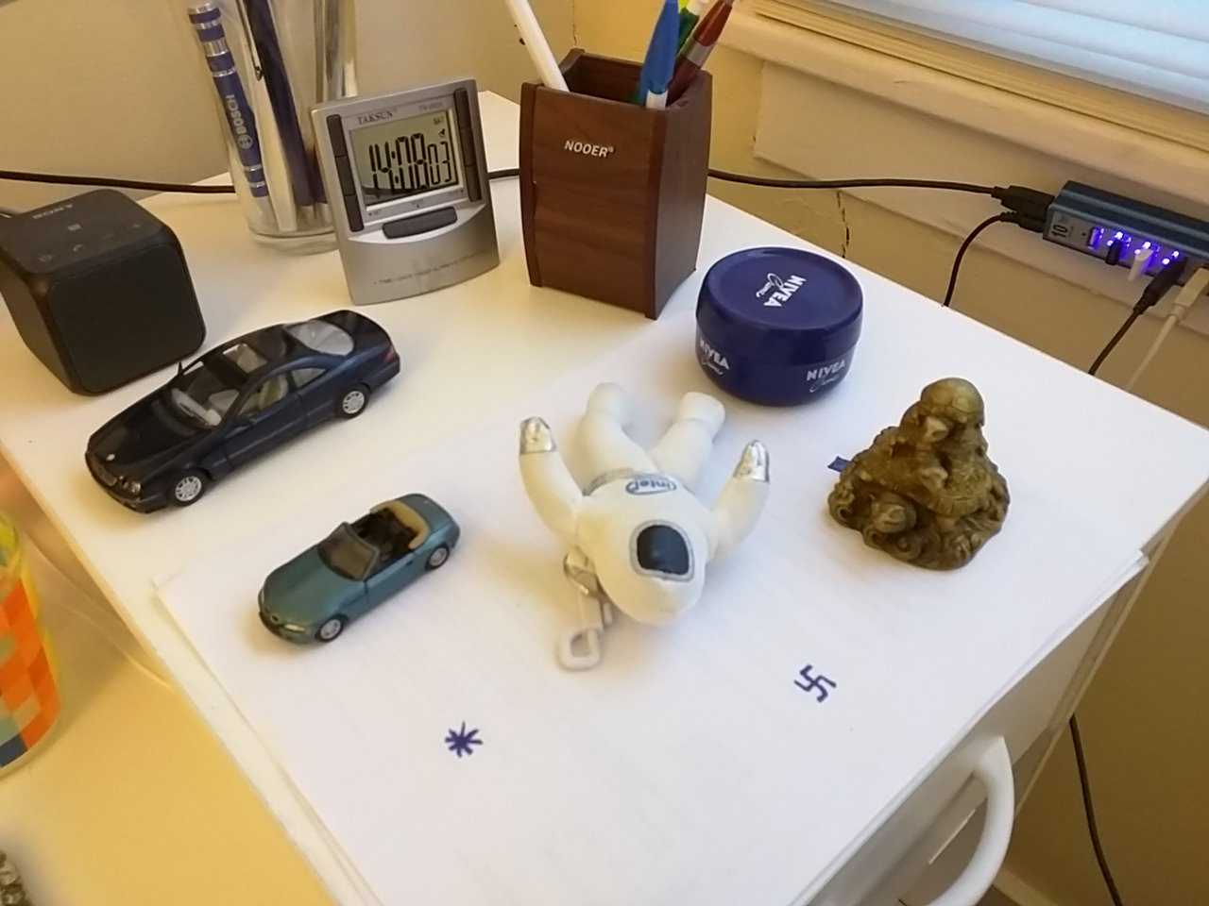


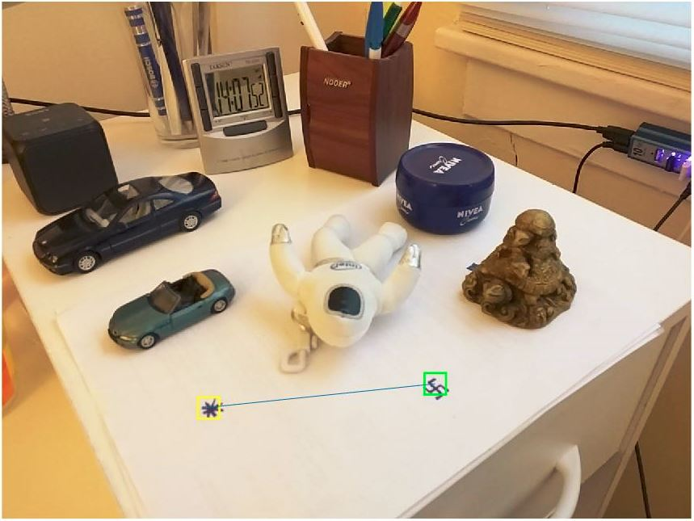
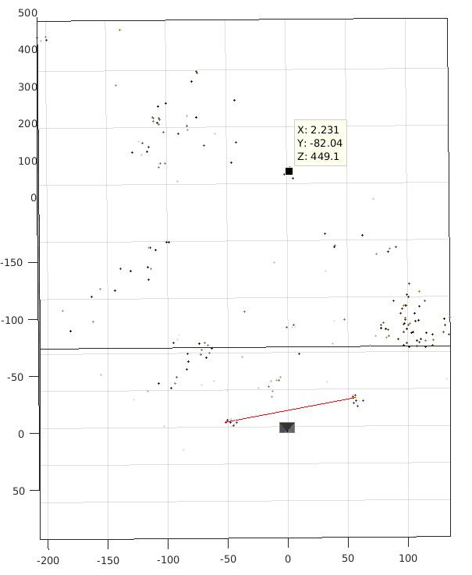
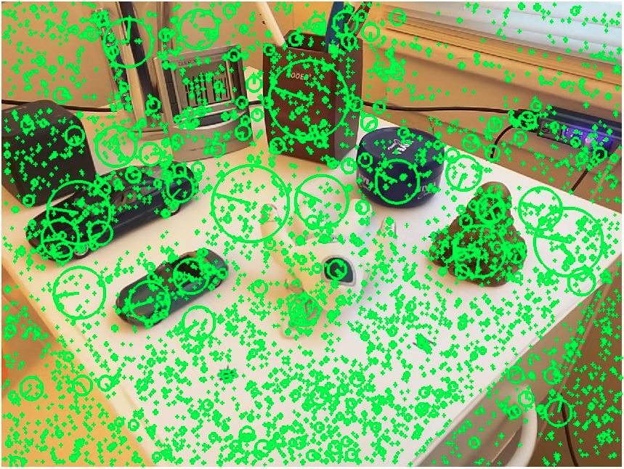
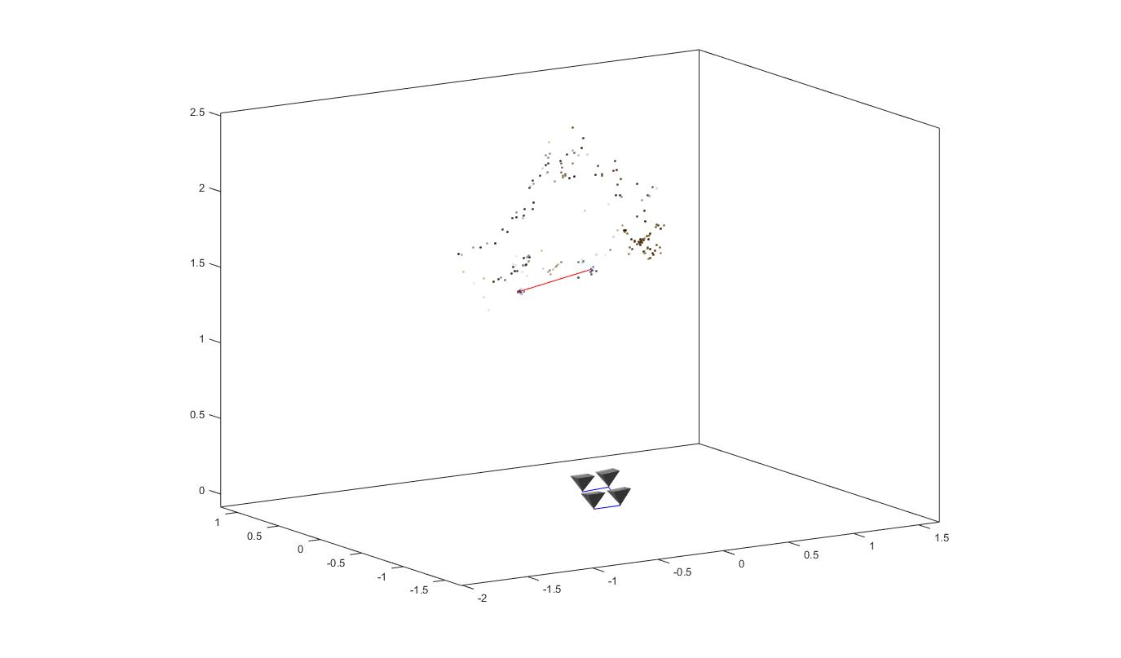
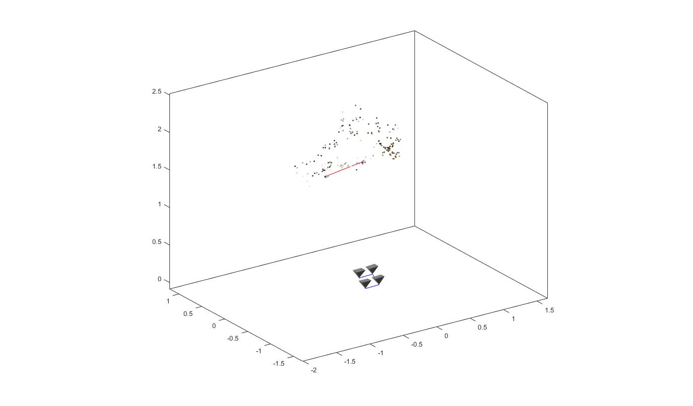
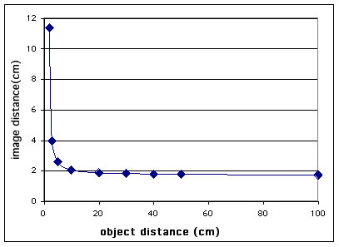
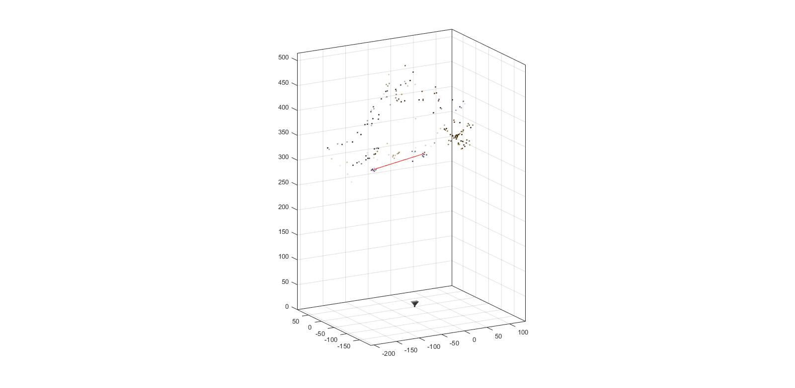
Instant Auto Focus Using Structure from Motion
Jai Prakash, Mengxin Li
Introduction
Traditional Auto Focus (AF) techniques including Range Finders, Active AF and Passive AF are not quite time efficient. In this project, we tried to use structure form motion (SFM) to recover the depth of the object in images, and use the depth to calculate the focal length needed.
Multiview 3D Reconstruction
Scale Recovery
Depth Recovery & Focal Length Calculation
Predefined feature with pre-known distance
Focus area request
Locate the predefined features in 2D image using SIFT matching
Get common SIFT feature
Recover depth
Perform triangulation to find the 3D position for predefined features
Structure from Motion with Bundle Adjustment
Calculate focal length using the focal length-object distance equation
Recover the scale using the pre-known distance of predefined features

