Slide 1


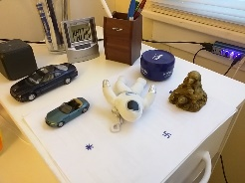
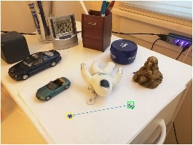
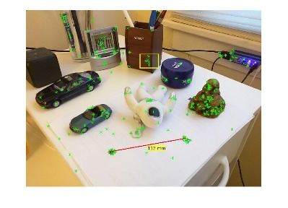
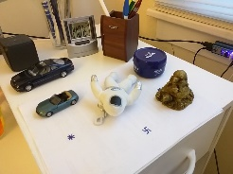
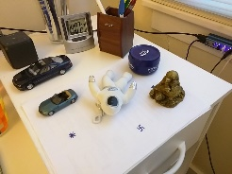
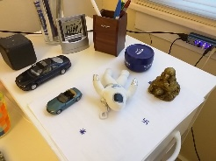

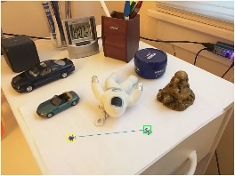

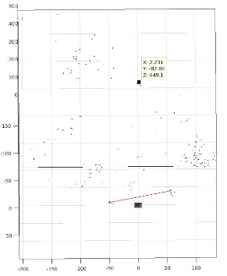
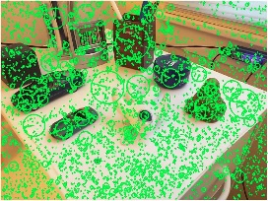
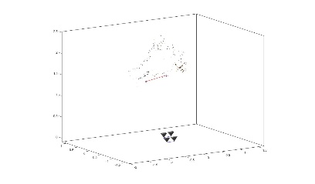
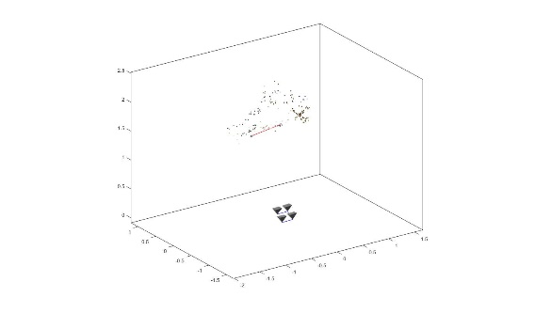
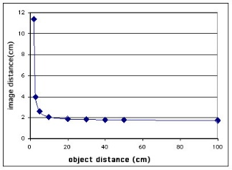
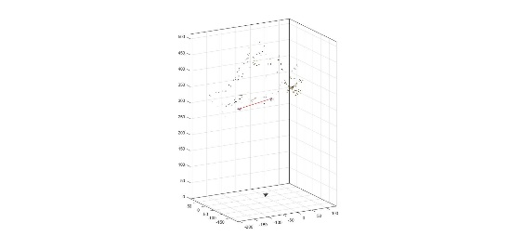
Instant Auto Focus Using Structure from Motion
Jai Prakash, Mengxin Li 068
Traditional AF technique – low time efficiency
Range Finder,
Active AF
Passive AF
SFM based AF
Scale Ambiguity
IMU
Pre-known object/feature
Multiview 3D Reconstruction
Scale Recovery
Depth Recovery & Focal Length Calculation
Predefined feature
SIFT Matching
Focus area request
Get common SIFT feature
Recover depth
Triangulation
Structure from Motion
Calculate focal length
Recover scale

