Slide 1
Apache Flink

Slide 2
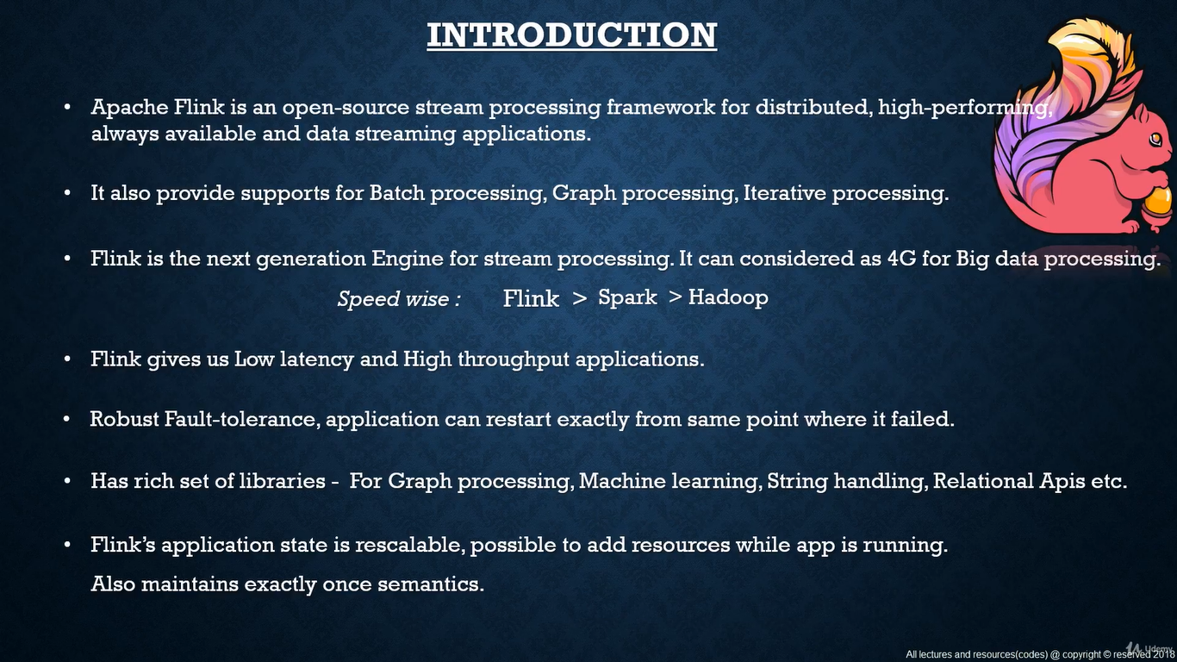

Slide 3
Notes
Apache Flink is a true streaming application unlike spark.
It provides very fast stream processing.
Flink is the best tool for stream processing of big data.
Flink gives us low latency and high throughput applications while running jobs.

Slide 4
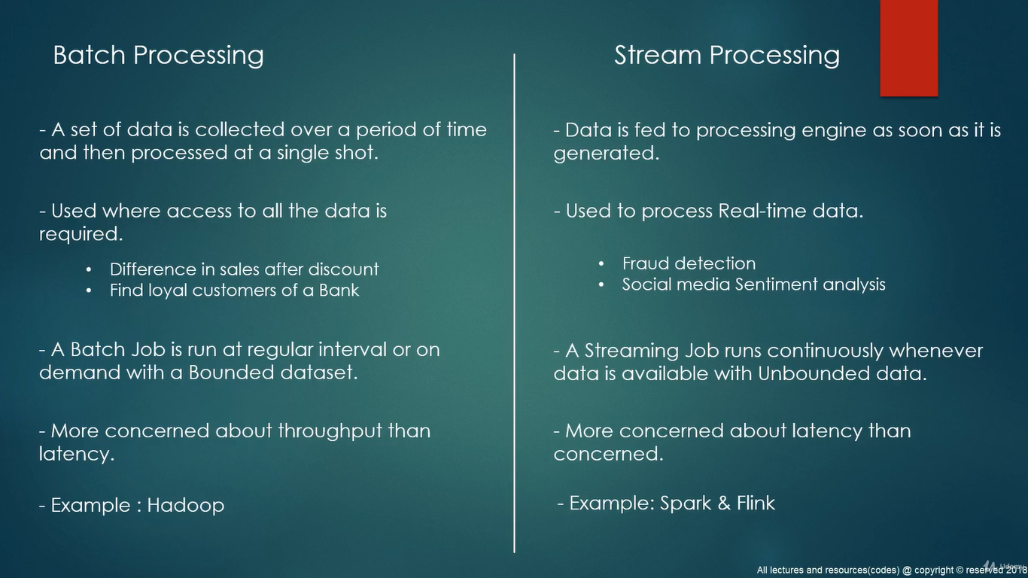

Slide 5
Hadoop vs Spark&Flink
Main difference is spark and flink do in-memory computation where as hadoop does by storing intermediate results to disk and do read/write which slows down the execution time.
Spark – RDD
Flink – Dataflows
Both have their own API libraries for machine learning, flink has flinkML and spark has Mlib
Both support iterative processing

Slide 6
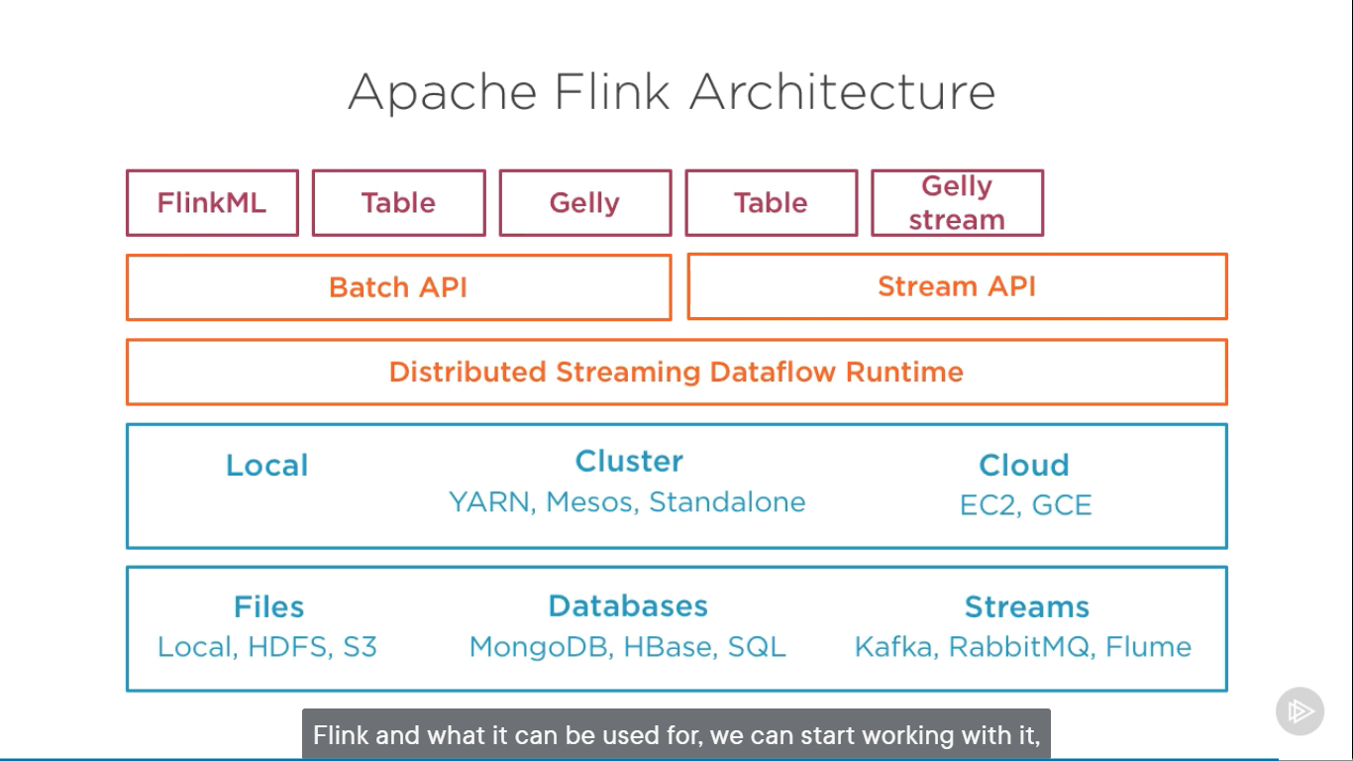

Slide 7
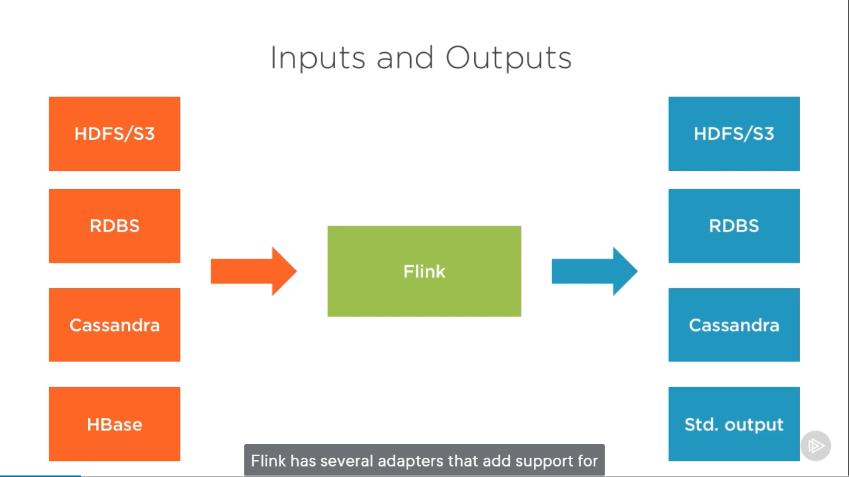

Slide 8
