Slide 1
FullStackSpringBootAngular

Slide 2
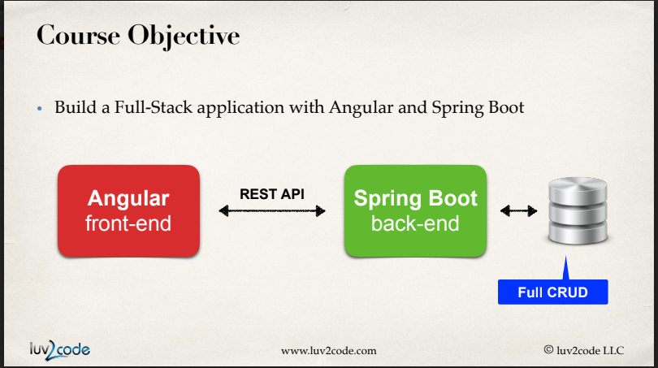

Slide 3
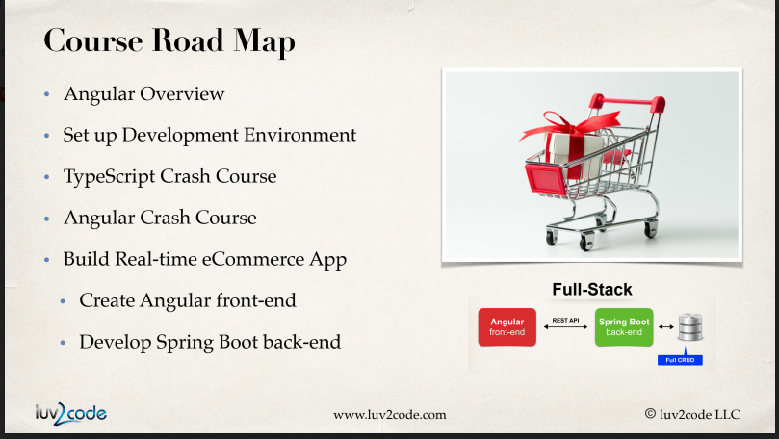

Slide 4
