Slide 1
Video Captioning Project: User Engagement
IST 659
Pratyush Kulwal
11/25/2015

Slide 2
Data Collection
Data generated is the video captions, generated by the Video Caption Generator
The Data generated by the video caption generator is not accurate as it used to be earlier (When done manually)
Therefore, the project included a feature where a user (Student) could watch a video, edit and comment on caption while watching a video
To understand which user made the edit in the caption, there must be a track of the user activity. Therefore, I will be storing all the user and tracking information in the relational database

Slide 3
Data Input
Data will be directly stored from the UI of the Video Caption Generator, where each activity of a particular user will be tracked
For demo, purposes I will be entering data using Insert statement in SQL

Slide 4
Different Users
Administrator
Administrator will query the database to track the user activities, see the current trends of the video lectures, look at pending approval for edits
Students
Students will query the database to see the current trends and videos available for them to watch

Slide 5
Major Data Questions
Why a user queries the database
The Users should be able view all the video catalogue available to him/her
This can be done by querying the Video Clip table, where all the information about the video clip is stored. The user can access the Video Clip table and see the list of available videos
Users must have the rights to comment, edit and put questions on the caption sentences.
Whenever a user comments, edits, likes or questions a caption. The record is stored in a table which depending upon what kind of activity the user has performed

Slide 6
Major Data Questions
Why an administrator queries the database
Administrators may want to query the database because they want to find out about:
Number of views for videos
This can be done by querying the ‘tracking’ table, where a select query based on Video_Clip_ID could display all the hits a video clip obtained.
Student engagement of the video
This can be done by querying the ‘tracking’ table, where a select query based on User_ID could display activity of a student.
Apart from querying ‘tracking’ table, ‘likes’, ’comment’, ‘edit’ tables will also be helpful to capture the user engagement.
Number of likes and dislikes for the video
Number of likes and dislikes can be obtained by querying the ‘video_clips’ database.
Editing requests for the captions
Whenever a user makes an edit in the captions; the data is stored in ‘Edit_captions’, now in order to know that the caption is approved or not; we can query the ‘Edit captions’ based on edit_flag field; if the field has a non-zero value then instructor can review and approve the modified caption.
As soon as instructor approves the caption, the edit_flag value changes to zero.

Slide 8
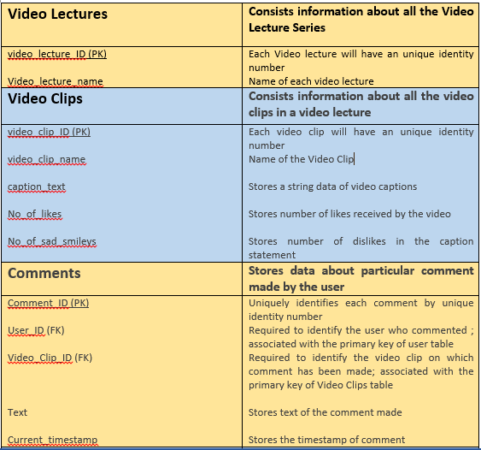
List of Tables

Slide 9
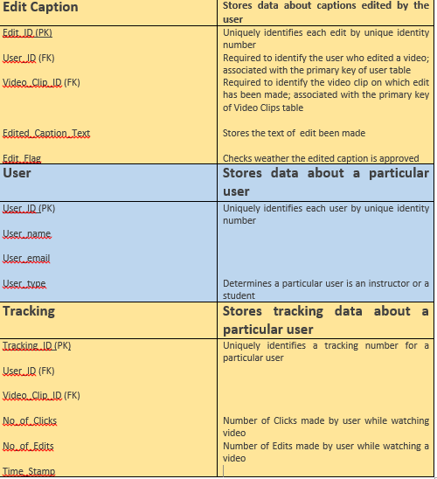
List of Tables

Slide 10
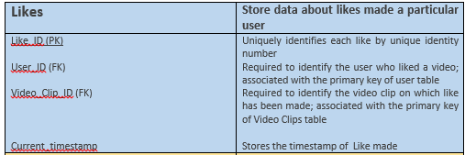
List of Tables

Slide 11
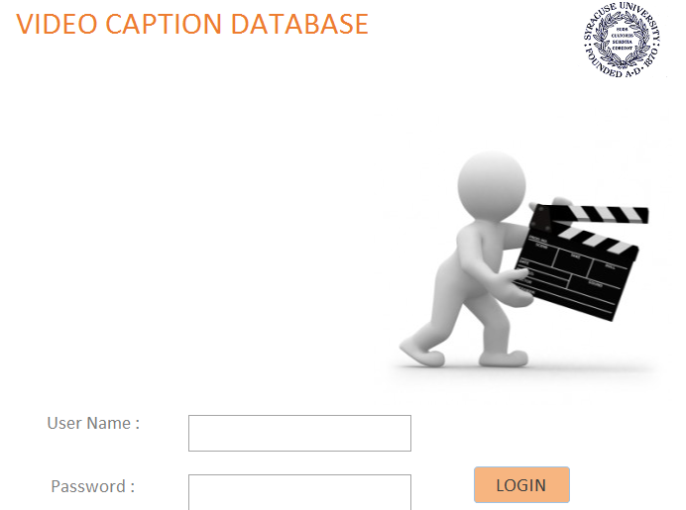
Forms : Login Form

Slide 12
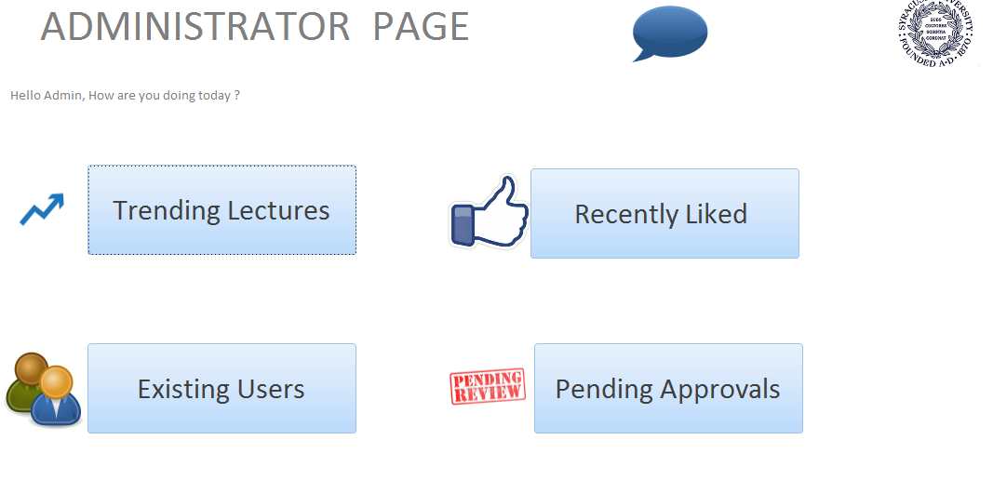
Forms : Administrator Page

Slide 13
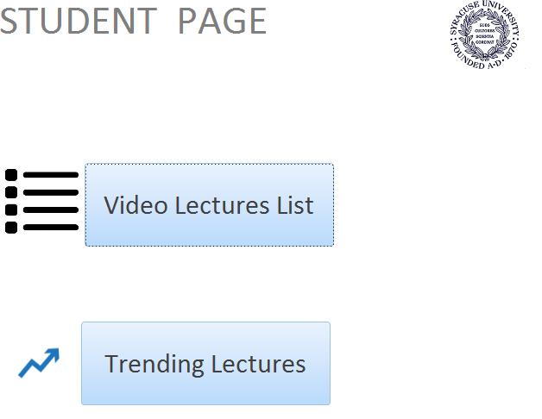
Forms: Student Page

Slide 14
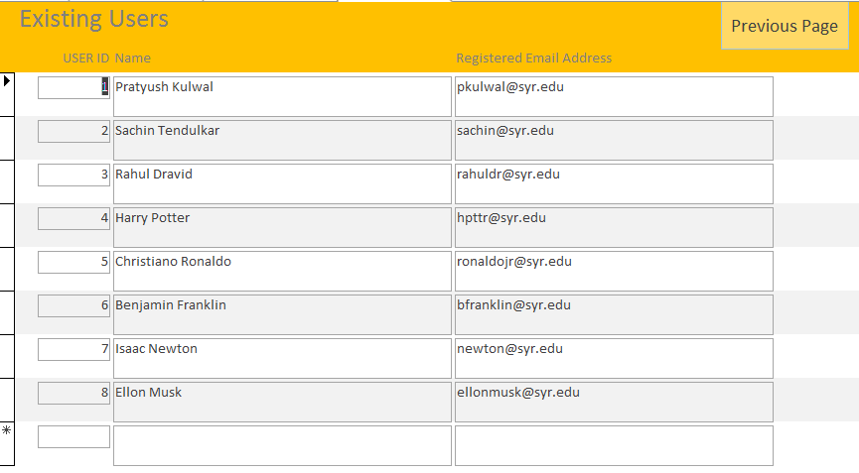
Forms : Existing Users

Slide 15
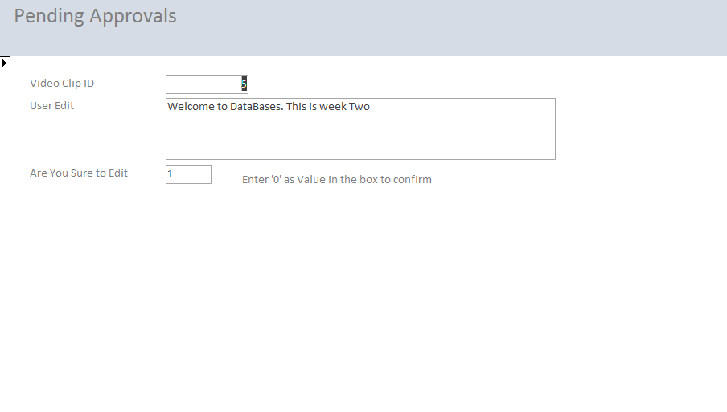
Forms : Pending Approvals

Slide 16

Forms : Report Form

Slide 17
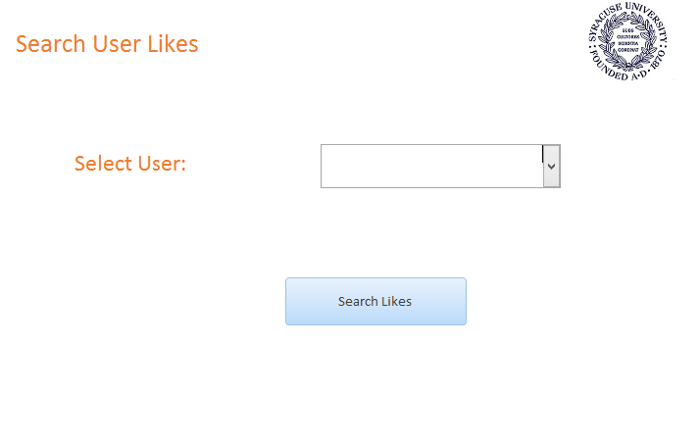
Forms : Search Activity by User (Likes)

Slide 18
Major queries
The Users should be able view all the video catalogue available to him/her
What are the current trending courses
Recently Watched Video by the users
Recently Liked Video by the users
Pending Approvals for the Administrator
Find out which student is enrolled in which course

Slide 19
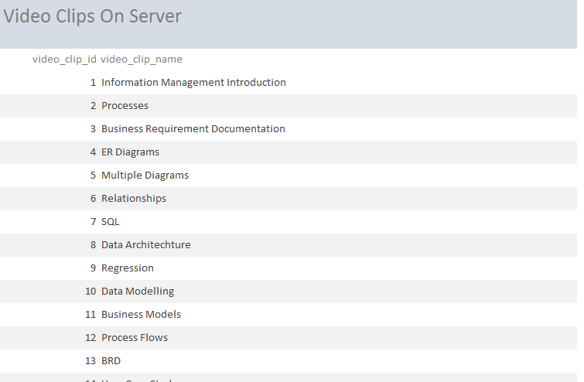
The Users should be able view all the video catalogue available to him/her

Slide 20
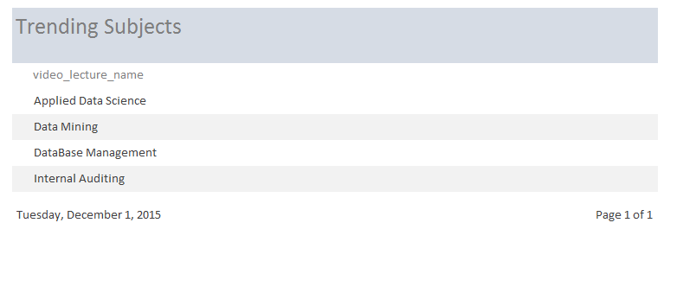
Currently Trending Courses

Slide 21
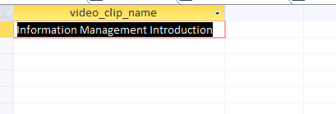
Recently Watched Video by the users

Slide 22
Trigger
Trigger to Notify the pending approval to the administrator
Logic : Whenever a new entry is added to the edit_caption table a notification is sent to notifications_table (An external Table) from where mail can be sent to the administrator

Slide 23
Trigger Code
CREATE TRIGGER notify_admin
ON edit_caption
FOR INSERT AS
IF @@ROWCOUNT >= 1
BEGIN
Insert Into notifications(message_text,message_time) values('There is a pending Approval waiting for you', getdate())
END;
select * from notifications;

Slide 24
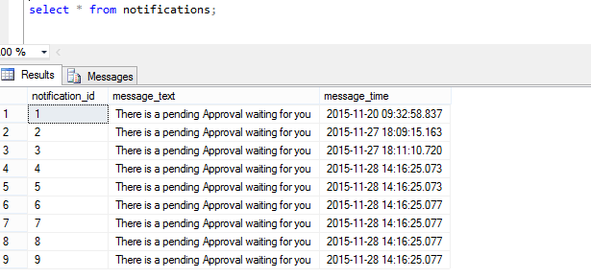
Before Running the trigger

Slide 25
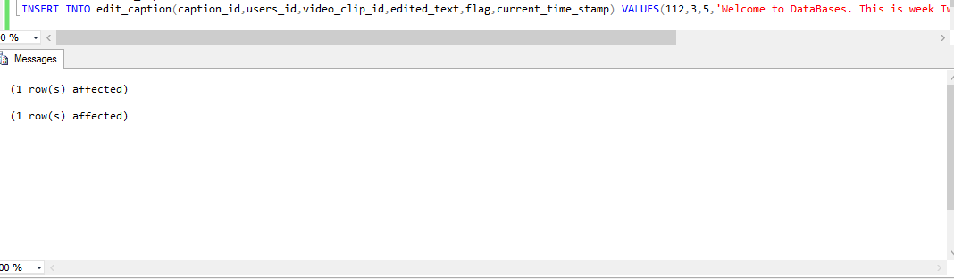
When an Entry is added to the edit_caption table

Slide 26
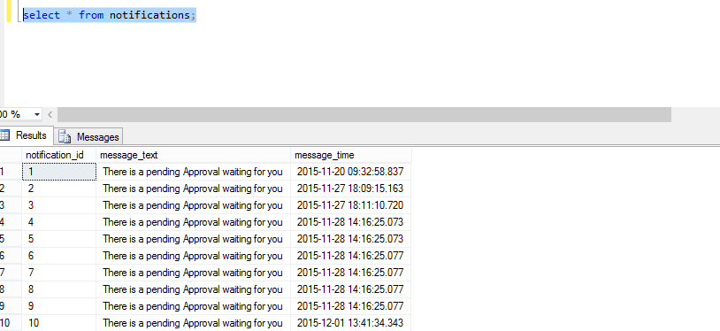
After the update

