Slide 1


AUTONOMOUS VEHICLE WITH MOBILE APP
Prepared By:
Rishabh Shah : 1620BEEC30037
Neel Patel : 1620BEEC30028
Jairaj Khatri : 1620BEEC30018
Niraj Raj : 1620BEEC30031
Group No: 20
Kadi Sarva Vishwavidyalaya
LDRP Institute of Technology & Research, Gandhinagar
Electronics & Communication Engineering Department
April-2020

Slide 2
Presentation Outline
Introduction
Block diagram
Circuit Diagram
Components Used
Application Design
2

Slide 3
INTRODUCTION
Today, the shortage of manpower has become a huge conundrum for business owners, especially in the food and beverage industry. Even with the deployment of good chefs and experienced managers, restaurants tend to run into a chaos with insufficient servers. Therefore, a quick solution may be to have servers carrying heavier loads to increase efficiency. However, this solution quickly worsens as servers become fatigue and hence, unable to continue working.
As we are emerging in the automation sector, there is an increase in the usage of robots that can work seamlessly just like a human without possibility of human error. The automation trend is going on peak for any purpose. This happen to eradicate the man power but at the same time it increases the efficiency. So we have made a robot or we can also say an automated guided vehicle to serve and fetch the dishes in a restaurant.

Slide 4
The software takes the input from user and when the robot is ordered to go to a particular place it will go to that place. We have tried to make the system more stable by making an android app that makes work easier. We have also included a real time database called Firebase which will update the order in real time and changes can be made in the system as soon as the users want to.

Slide 5
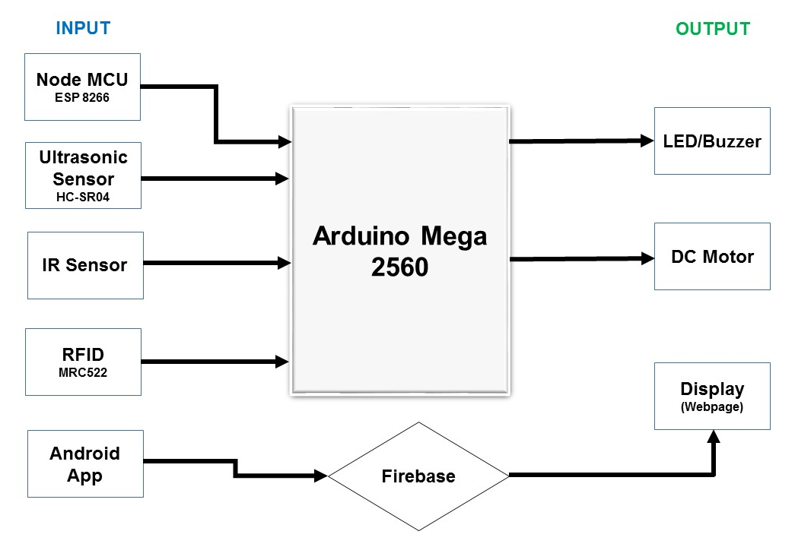
BLOCK DIAGRAM

Slide 6
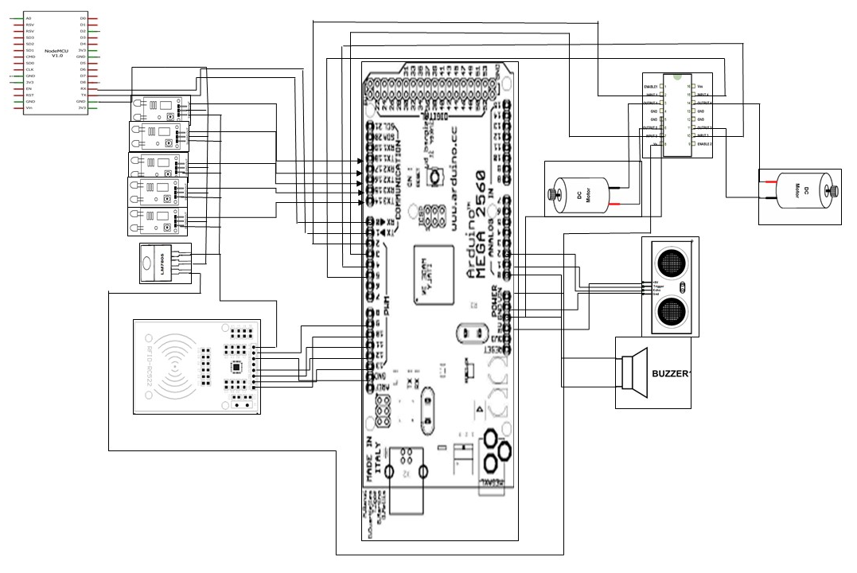
CIRCUIT DIAGRAM

Slide 7
COMPONENTS USED
Android Mobile Application of Restaurant
Controller(Arduino Mega 2560)
Wi-Fi module(ESP 8266)
RF-ID Module(MRC-522)
Ultrasonic Sensor(HC-SR04)
DC Motors
IR Sensor
12V Adapter
7805 IC

Slide 8
APPLICATION DESIGN
Application is made on app development software called MIT app inventor
.
We are using Java Script, CSS to make a Web Page.
The Web Page is used to display orders which are taken from Android application.

Slide 9
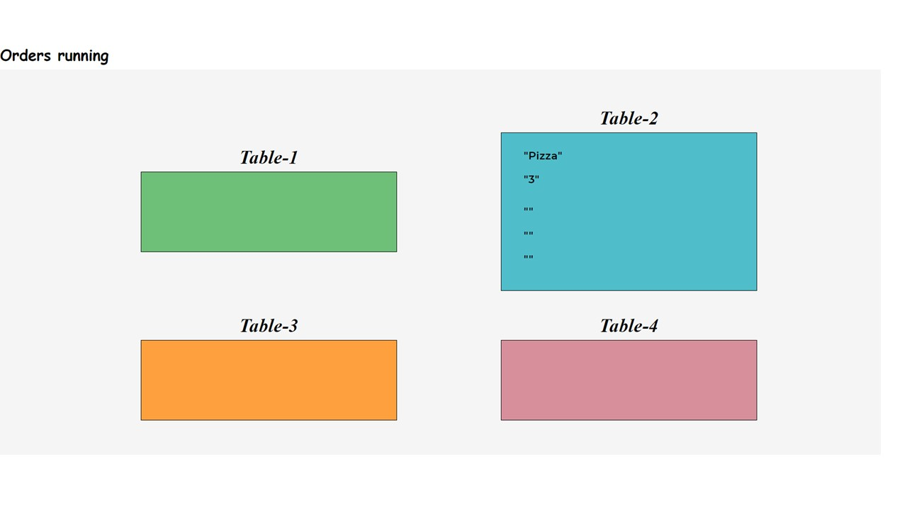

Slide 10
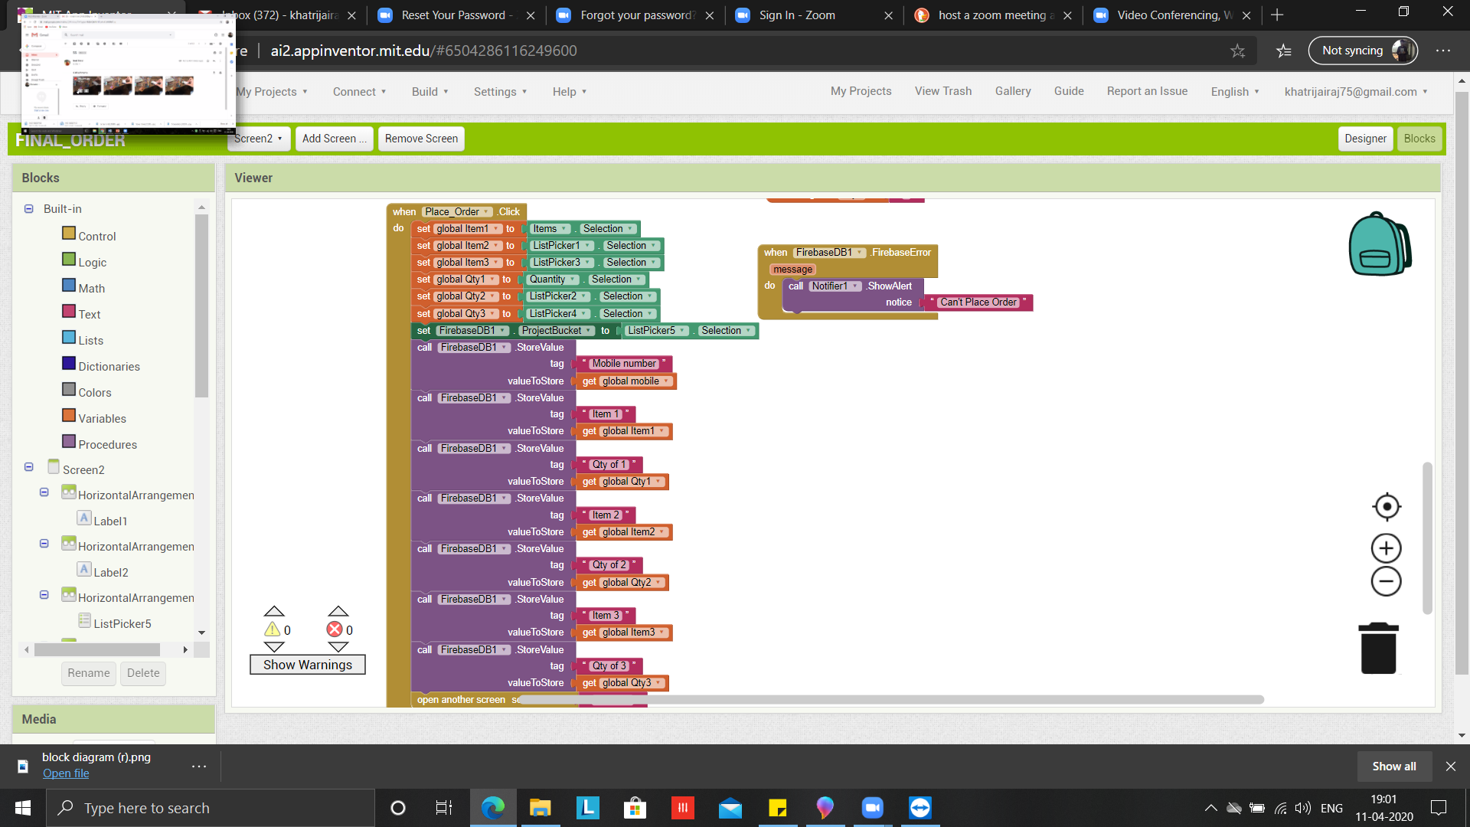

Slide 11
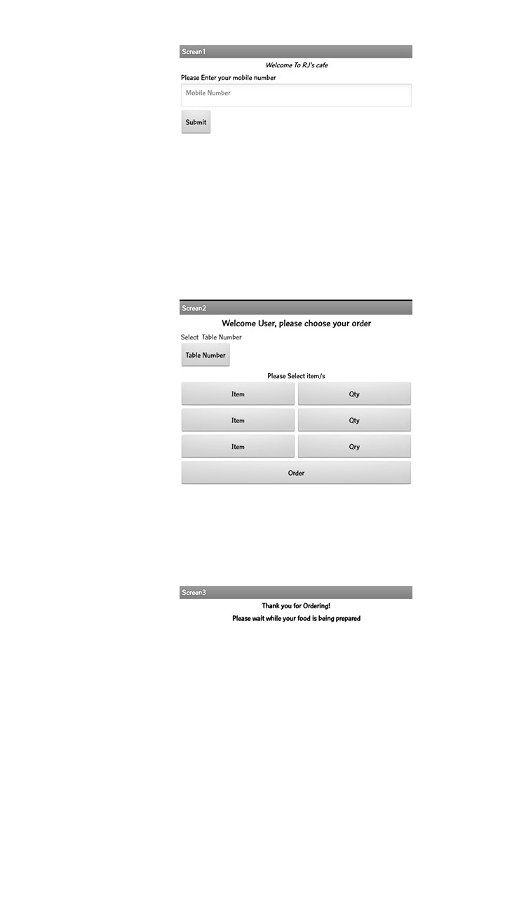

Slide 12
AGV
The first AGV was brought to market in the 1950s, by Barrett Electronics of Northbrook, Illinois, and at the time it was simply a tow truck that followed a wire in the floor instead of a rail.
We can use AGV as serving robot in hotel, material handling robot in warehouse and improve the health care system. At manufacturing area AGV are capable to transport all type of material related to manufacturing process.
AGV (Automated Geared Vehicle) is one of the remarkable machine which helps in various tasks such as fork lifting objects, towing, product transportation etc., without the continuous monitoring of human.
An AGV works with the simultaneous processing of various parts. The control device which is common to both the driving device and transfer device operates the vehicle and maintains the ultimate process of automated guided vehicle.

Slide 13
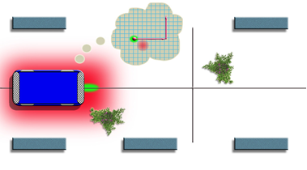
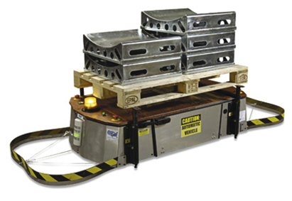
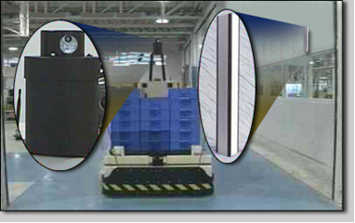
Types of Navigation
Wired navigation:
Guide tape navigation:
Laser target navigation:

Slide 14
What is Line Follower AGV?
An automated guided vehicle is a programmable mobile vehicle. The automated guided vehicle is used in industrial application to move material around a manufacturing facility.
The central processing system of AGV is issue the steering command and speed command. For the pre-defined manufacturing environment, the line follower robot is good option for choice.
A line follower robot is a robot which follows a pre-defined path controlled by a feedback mechanism. The path can be visible like a black line on a white surface (or vice versa) or it can be invisible like a magnetic field. Sensing a line and guiding the robot to stay on course, while constantly correcting.
Some of the practical applications of a line follower are industrial applications were these robots can be used as automated equipment carriers in industries replacing traditional conveyer belts in automobile.

Slide 15
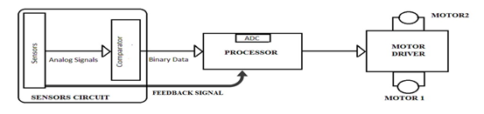
Components of Line Follower AGV
1) Sensor circuit
2) Processor
3) Driver
4) Actuators (Motors and wheels)
5) Vehicle

Slide 16
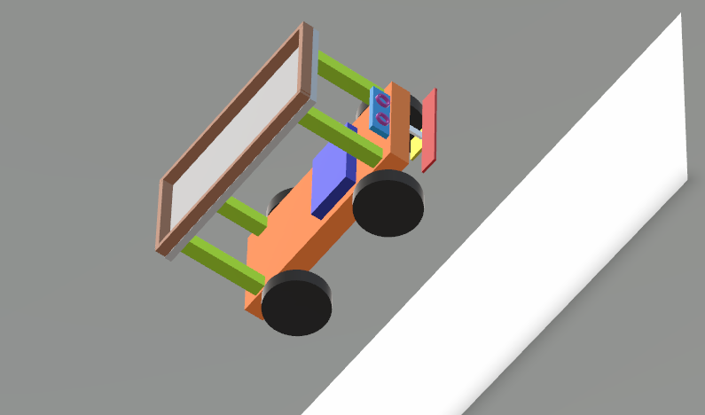

Slide 17
Application
AGV is a material handling system that uses independently operated, self-propelled vehicles guided along defined pathways.
AGVs increase efficiency and reduce costs by helping to automate a manufacturing facility or warehouse.
AGVs can carry loads or tow objects behind them in trailers. The trailers can be used to move raw materials or finished product. The AGV can also store objects on a bed. some AGVs use fork lifts to lift objects for storage. AGVs are employed in nearly every industry, including, paper, metals, newspaper and general manufacturing.

Slide 18
Any Questions?
Thank You…

