Slide 1
Census Income Prediction Using CatBoost
Predicting Annual Income (>50K or ≤50K) Using the UCI Adult Dataset
Project Information :
Dataset: UCI Adult (Census Income)
Model: CatBoostClassifier
Organization: Hero Vired
Presented By :
N. Jai Rama Srinivas
PPBDA-1

Slide 2
Problem Statement & Objectives
The goal of this project is to predict whether an individual's annual income exceeds $50,000 using demographic, educational, occupational, and financial attributes from the UCI Adult (Census Income) dataset.
Classification Classes :
Income > $50K → Positive Class
Income ≤ $50K → Negative Class

Slide 3
Dataset Overview
UCI Adult (Census Income) Dataset :
Feature Types :
Dataset Statistics | Values
Training Records | 32,561
Testing Records | 16,281
Total Records | 48,842
Features | 14
Target Variable | Income
Numerical Features (6)
Age
Fnlwgt
Education_num
Capital_gain
Capital_loss
Hours_per_week
Categorical Features (8)
Workclass
Education
Marital_status
Occupation
Relationship
Race
Sex
Native_country
Target Variable :
Income
Income > $50K → 1 (High Income)
Income ≤ $50K → 0 (Low Income)

Slide 4
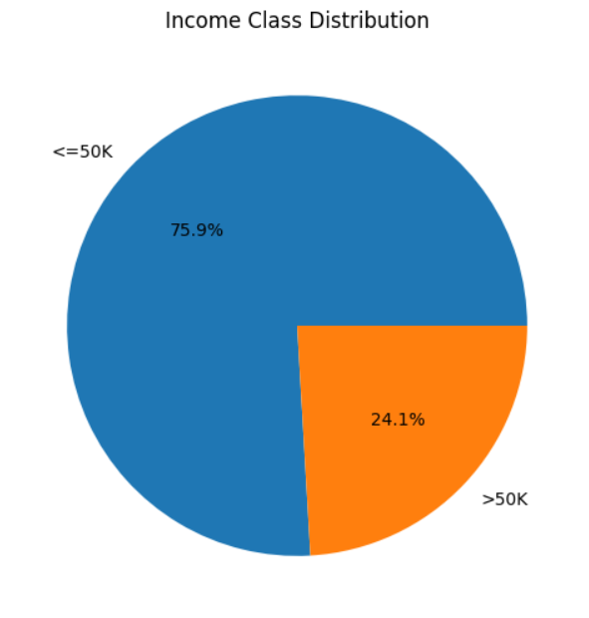
Data Validation & Exploratory Data Analysis
Data Validation :
Data Quality Checks Performed :
✅ Assigned appropriate column names
✅ Identified missing values
✅ Checked duplicate records
✅ Verified data types and feature distributions
✅ Assessed categorical feature cardinality
Key EDA Findings :
Income Distribution
Income ≤ $50K : 75.9%
Income > $50K : 24.1%
Dataset is moderately imbalanced

Slide 5
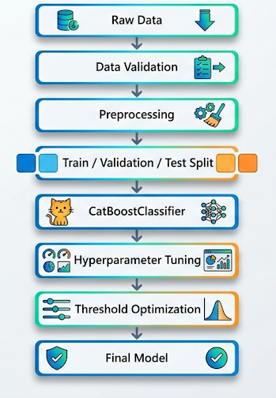
Model Development
Why CatBoost?
CatBoost was selected because:
✅ Handles categorical features natively
✅ No one-hot encoding required
✅ Reduces preprocessing complexity
✅ Strong performance on tabular datasets
✅ Built-in handling for categorical variables

Slide 6
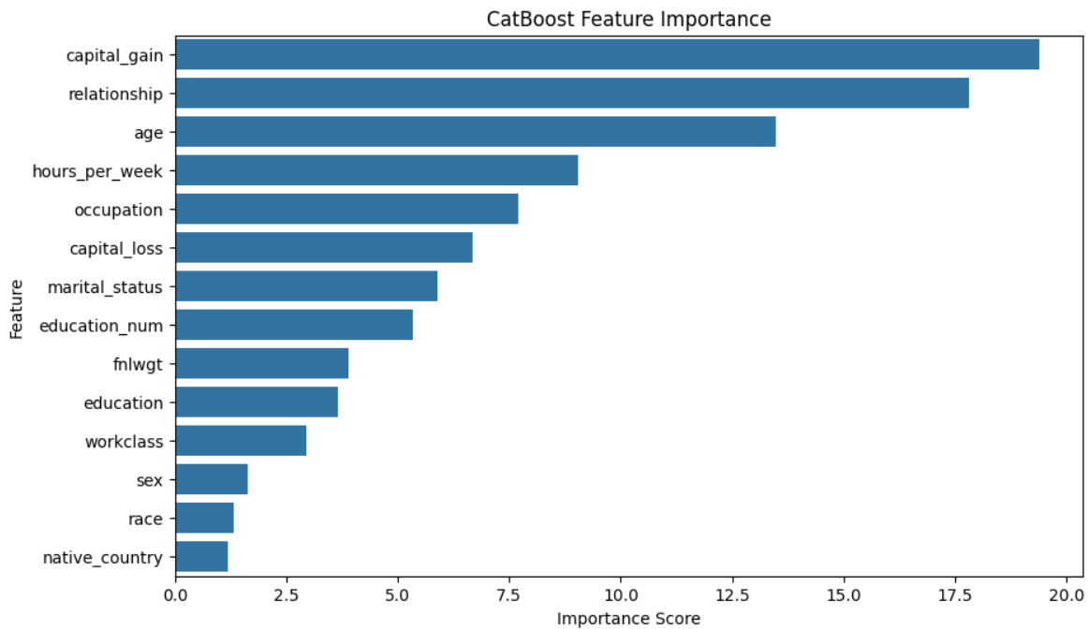
Feature Importance Analysis :
Top features influencing income prediction:
Capital Gain
Relationship
Age
Hours per Week
Occupation
These variables contributed most to distinguishing
between high-income and low-income individuals.

Slide 7
Hyperparameter Tuning
Why Hyperparameter Tuning?
The baseline CatBoost model provided strong performance, but tuning was performed to improve generalization and maximize validation AUC.
Tuning Strategy
✅ Randomized Search
✅ Validation Set Evaluation
✅ AUC as Primary Metric
✅ F1-Score as Secondary Metric
✅ Early Stopping Enabled
Parameter | Final Value
iterations | 1000
learning_rate | 0.05
depth | 6
l2_leaf_reg | 5
bagging_temperature | 0
random_strength | 1
one_hot_max_size | 2

Slide 8
Model Performance Evaluation
Baseline vs Tuned Model Comparison :
Key Takeaways :
Tuning improved all evaluation metrics.
Best Validation AUC reached 0.9332.
Early stopping prevented overfitting.
Tuned model selected for final evaluation.
Metric | Baseline | Tuned
Accuracy | 87.51% | 87.68%
Precision | 77.98% | 78.54%
Recall | 67.09% | 67.22%
F1-Score | 72.13% | 72.44%
ROC-AUC | 93.28% | 93.32%

Slide 9
Threshold Optimization & Final Evaluation
Why Threshold Optimization?
The default classification threshold of 0.50 does not always provide the best balance between Precision and Recall.
To improve classification performance, multiple thresholds were evaluated:
0.30 | 0.40 | 0.50 | 0.60 | 0.70
Selected Threshold
Final Threshold = 0.40
Reasons:
✅ Highest F1-Score (72.36%)
✅ Better balance between Precision and Recall
✅ Improved identification of high-income individuals
✅ Reduced False Negatives compared to threshold 0.50

Slide 10
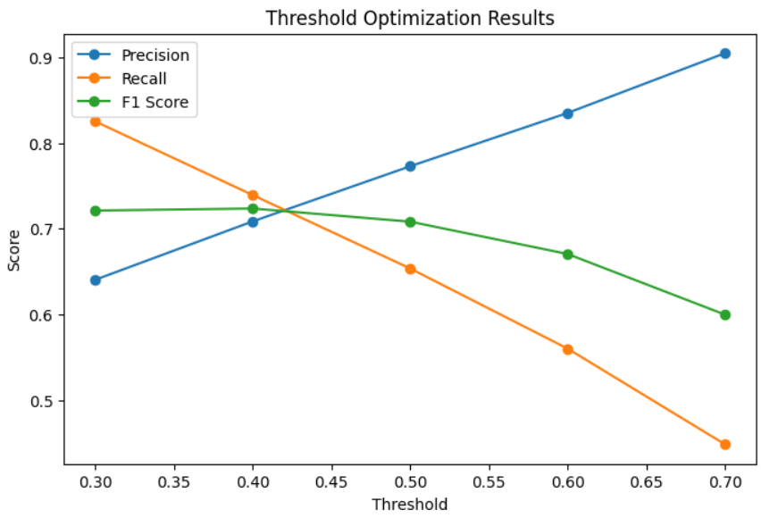
Final Test Performance
Metric | Value
Accuracy | 86.66%
Precision | 70.86%
Recall | 73.92%
F1-Score | 72.36%
ROC-AUC | 92.75%
Threshold optimization improved Recall and F1-Score,resulting in a better balance between identifying high-income individuals and controlling false predictions.

Slide 11
Error Analysis
Analyze model misclassifications to understand where prediction errors occur and identify opportunities for improvement.
False Positive Patterns
(Predicted >50K, Actual ≤50K)
Commonly observed among:
Professional-specialty occupations
Executive-managerial occupations
Sales-related occupations
Bachelor's degree holders
Married-civ-spouse individuals
Interpretation
These groups exhibit characteristics typically associated with higher income, causing the model to occasionally overestimate income class.
False Negative Patterns
(Predicted ≤50K, Actual >50K)
Commonly observed among:
Craft-repair occupations
Professional-specialty occupations
Sales occupations
High-income individuals with limited capital gain
Some Bachelor's and Master's degree holders
Interpretation
Some high-income individuals do not follow the typical income patterns learned by the model.

Slide 12
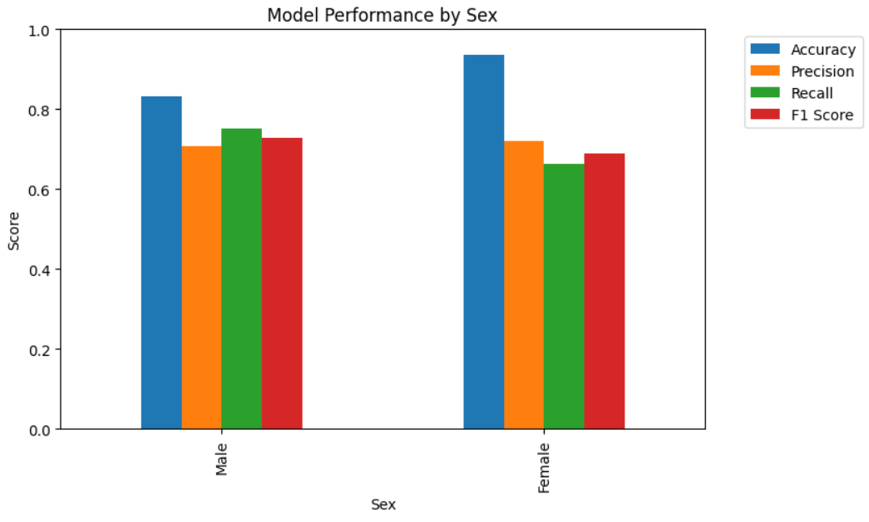
Responsible ML Checks
Evaluate model performance across sensitive demographic groups to identify potential performance differences and assess fairness considerations.
Group-wise Evaluation by Sex
Key Findings
Male group achieved higher Recall (75.31%) than Female (66.27%).
Female group achieved higher AUC (0.9460) than Male (0.9098).
Female group showed lower False Positive Rate (3.15%) compared to Male (13.38%).
Performance differences indicate that model behavior varies across demographic groups.

Slide 13
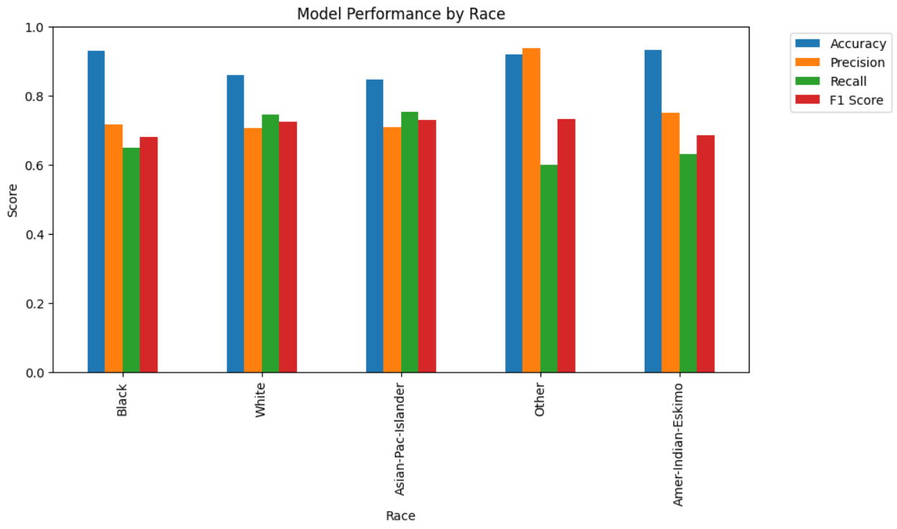
Group-wise Evaluation by Race
Key Findings
AUC values remain above 0.91 across all race groups.
Recall varies between groups (60.00% – 75.19%).
False Negative Rates differ across race categories.
Small subgroup sizes may contribute to metric variability.

Slide 14
Conclusion & Future Work
Project Conclusion
✅ Developed a complete income prediction pipeline using the UCI Adult Dataset.
✅ Implemented data validation, preprocessing, feature analysis, model training, hyperparameter tuning, threshold optimization, and responsible ML evaluation.
✅ CatBoost effectively handled categorical features without one-hot encoding.
✅ Final model achieved strong predictive performance:
ROC-AUC: 0.9275
Accuracy: 86.66%
Precision: 70.86%
Recall: 73.92%
F1-Score: 72.36%
✅ Threshold optimization (0.40) improved the balance between Precision and Recall.
Future Improvements
Collect more recent and representative data.
Perform deeper fairness and bias auditing.
Investigate additional feature engineering opportunities.
Implement model monitoring and periodic retraining.

