Slide 1

WIPRO NGA Program – 25SUB4530_CP_JAVA
Capstone Project Presentation – 9th Feb & 10th Feb 2026
Project Title Here – Order Management System
Presented by – Jairam Karthik Boddu
Challa Pintu
www.rpsconsulting.in

Slide 2

Introduction
Full-stack Order Management System built using Spring Boot and Angular
Secure REST APIs implemented with JWT-based authentication
Role-based access control for Admin and User functionalities
Features include product management, order processing, and user management
Responsive and user-friendly Angular frontend interface
Designed with a scalable and maintainable modular architecture
2024 - RPS Consulting all rights reserved

Slide 3
Technologies used:
Frontend: Angular, HTML, CSS, TypeScript
Backend: Spring Boot (Java), RESTful APIs
Security: JWT (JSON Web Token), Role-Based Access Control
Database: MySQL
Build & Dependency Management: Maven
Tools & IDEs: VS Code, IntelliJ IDEA, Postman, MySQL Workbench
2024 - RPS Consulting all rights reserved

Slide 4
Implementation:
Implemented a layered architecture using Spring Boot for better separation of concerns
Developed RESTful APIs to handle authentication, orders, products, and users
Integrated JWT-based security with role-based access control
Built an Angular frontend to interact with backend APIs dynamically
Used JPA and Hibernate for database operations with MySQL
Ensured smooth frontend–backend integration with secure API communication
2024 - RPS Consulting all rights reserved

Slide 5
Backend :
JWT-based stateless authentication with secure token validation.
Role-Based Access Control (ADMIN & CUSTOMER) using Spring Security.
RESTful APIs for authentication, products, orders, and admin management.
Secure password encryption using BCrypt.
Database integration using JPA & Hibernate with entity relationships.
Global exception handling with standardized API error responses.
2024 - RPS Consulting all rights reserved

Slide 6
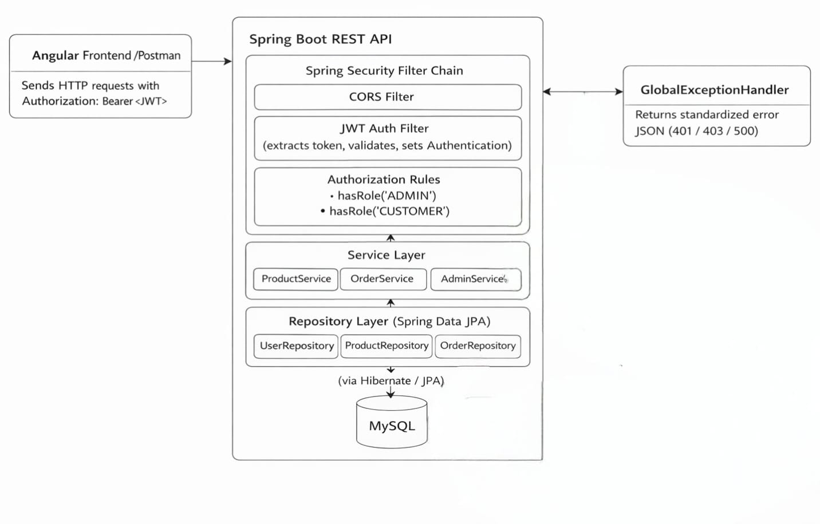
Backend architecture:
2024 - RPS Consulting all rights reserved

Slide 7
Frontend :
JWT token is securely stored in localStorage after successful login.
AuthService manages authentication state, login/logout, and role checks.
HTTP Interceptor automatically attaches JWT to all outgoing API requests.
AuthGuard protects routes based on user role (ADMIN or CUSTOMER).
Angular Router controls navigation and blocks unauthorized access.
Role-based menu rendering dynamically shows UI options based on user role.
2024 - RPS Consulting all rights reserved

Slide 8
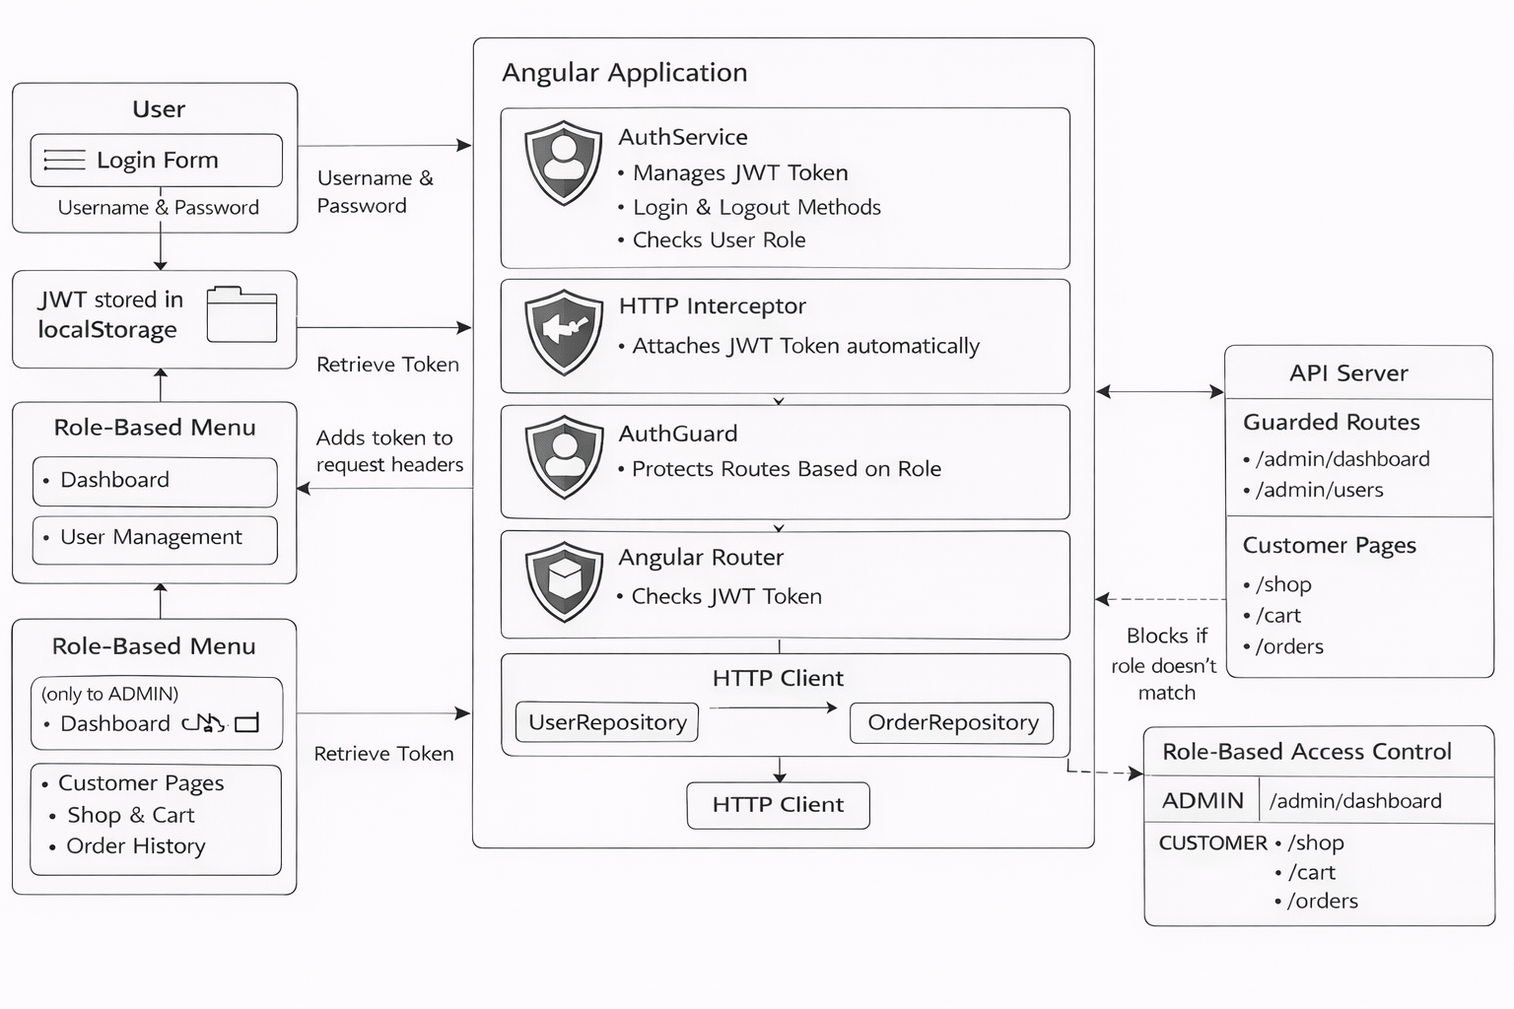
Frontend architecture:
2024 - RPS Consulting all rights reserved

Slide 9
Docker & Azure Deployment
Created Docker images for backend and frontend applications.
Used Docker containers to ensure consistent runtime environment.
Backend and frontend services containerized independently.
Deployed Docker containers on Microsoft Azure.
Azure services used for hosting and container management.
2024 - RPS Consulting all rights reserved

Slide 10
Challenges & Learnings
Managing role-based access for Admin and Customer users.
Integrating Angular frontend with Spring Boot backend APIs.
Docker image creation and container troubleshooting.
Understanding Azure deployment workflow.
Improved knowledge of full-stack development and DevOps practices.
2024 - RPS Consulting all rights reserved

Slide 11
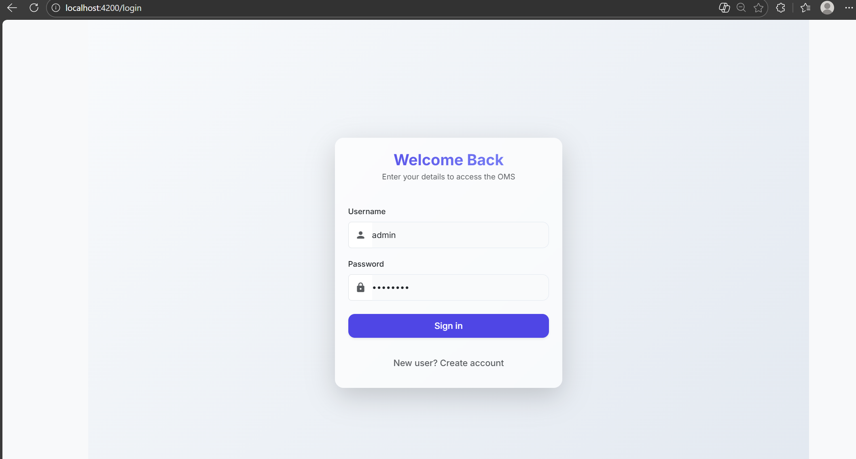
Login Page
2024 - RPS Consulting all rights reserved

Slide 12
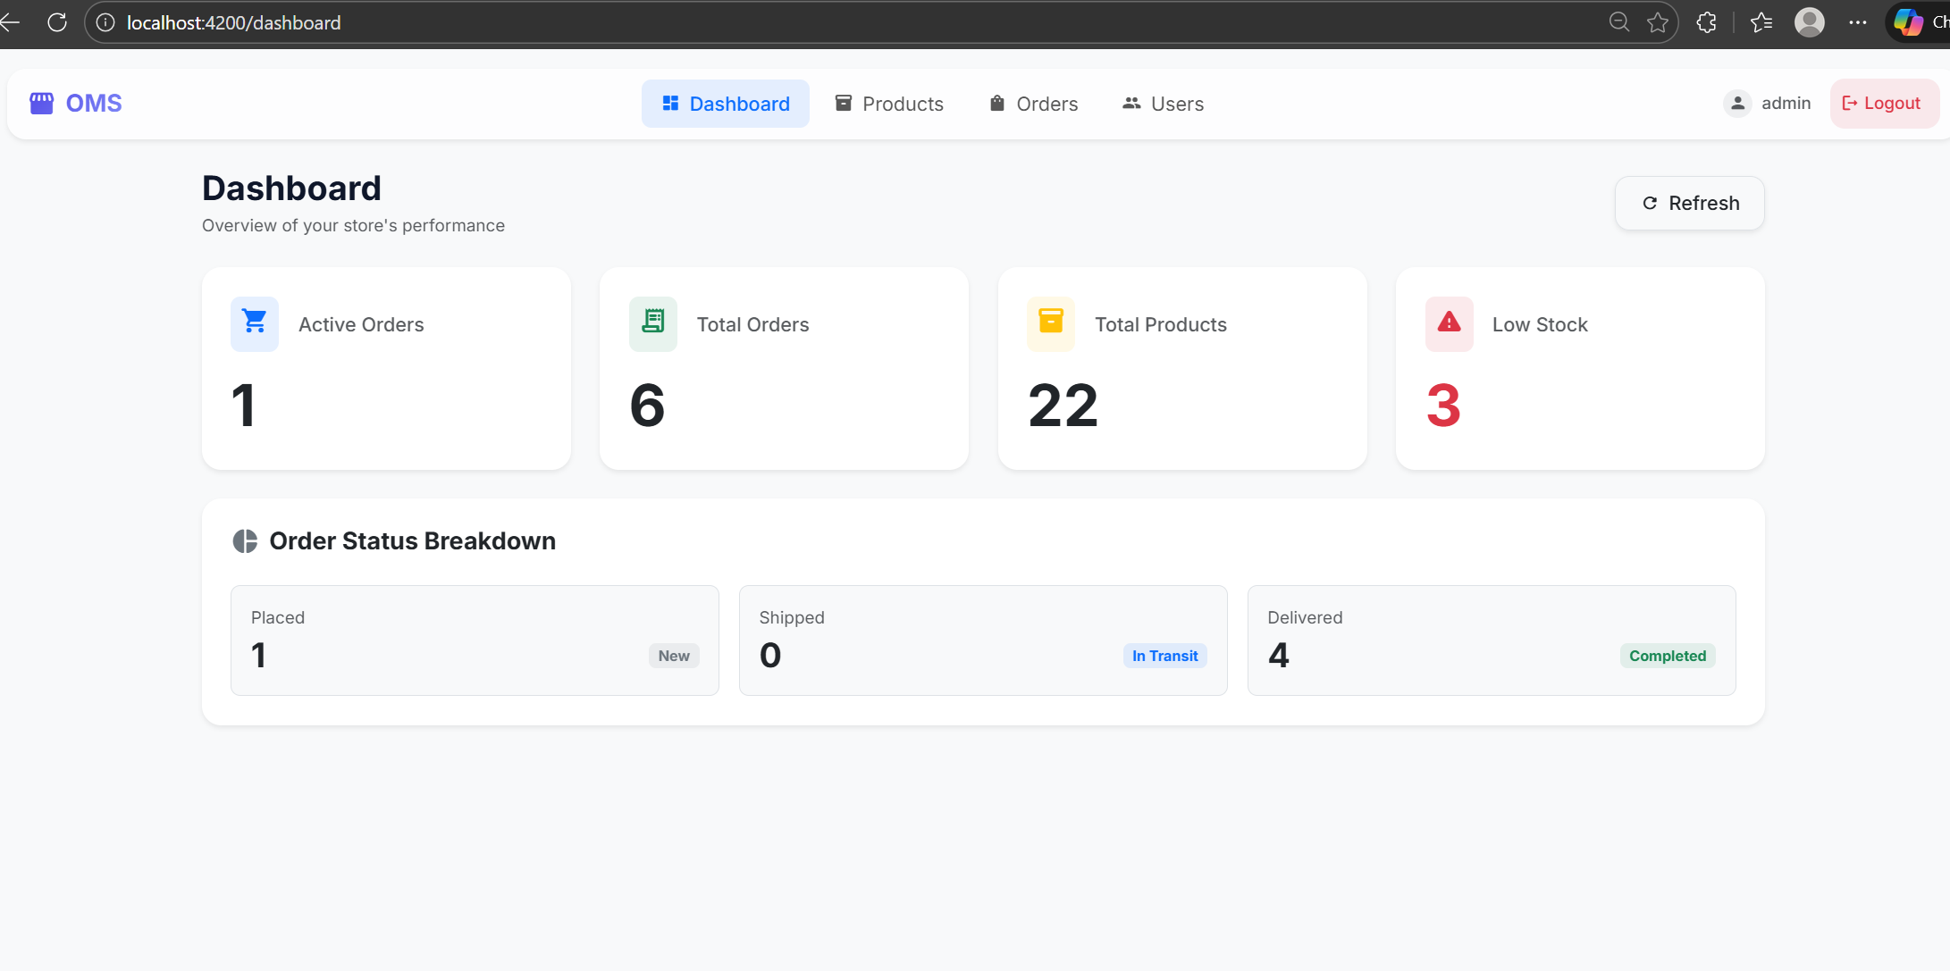
Dashboard
2024 - RPS Consulting all rights reserved

Slide 13
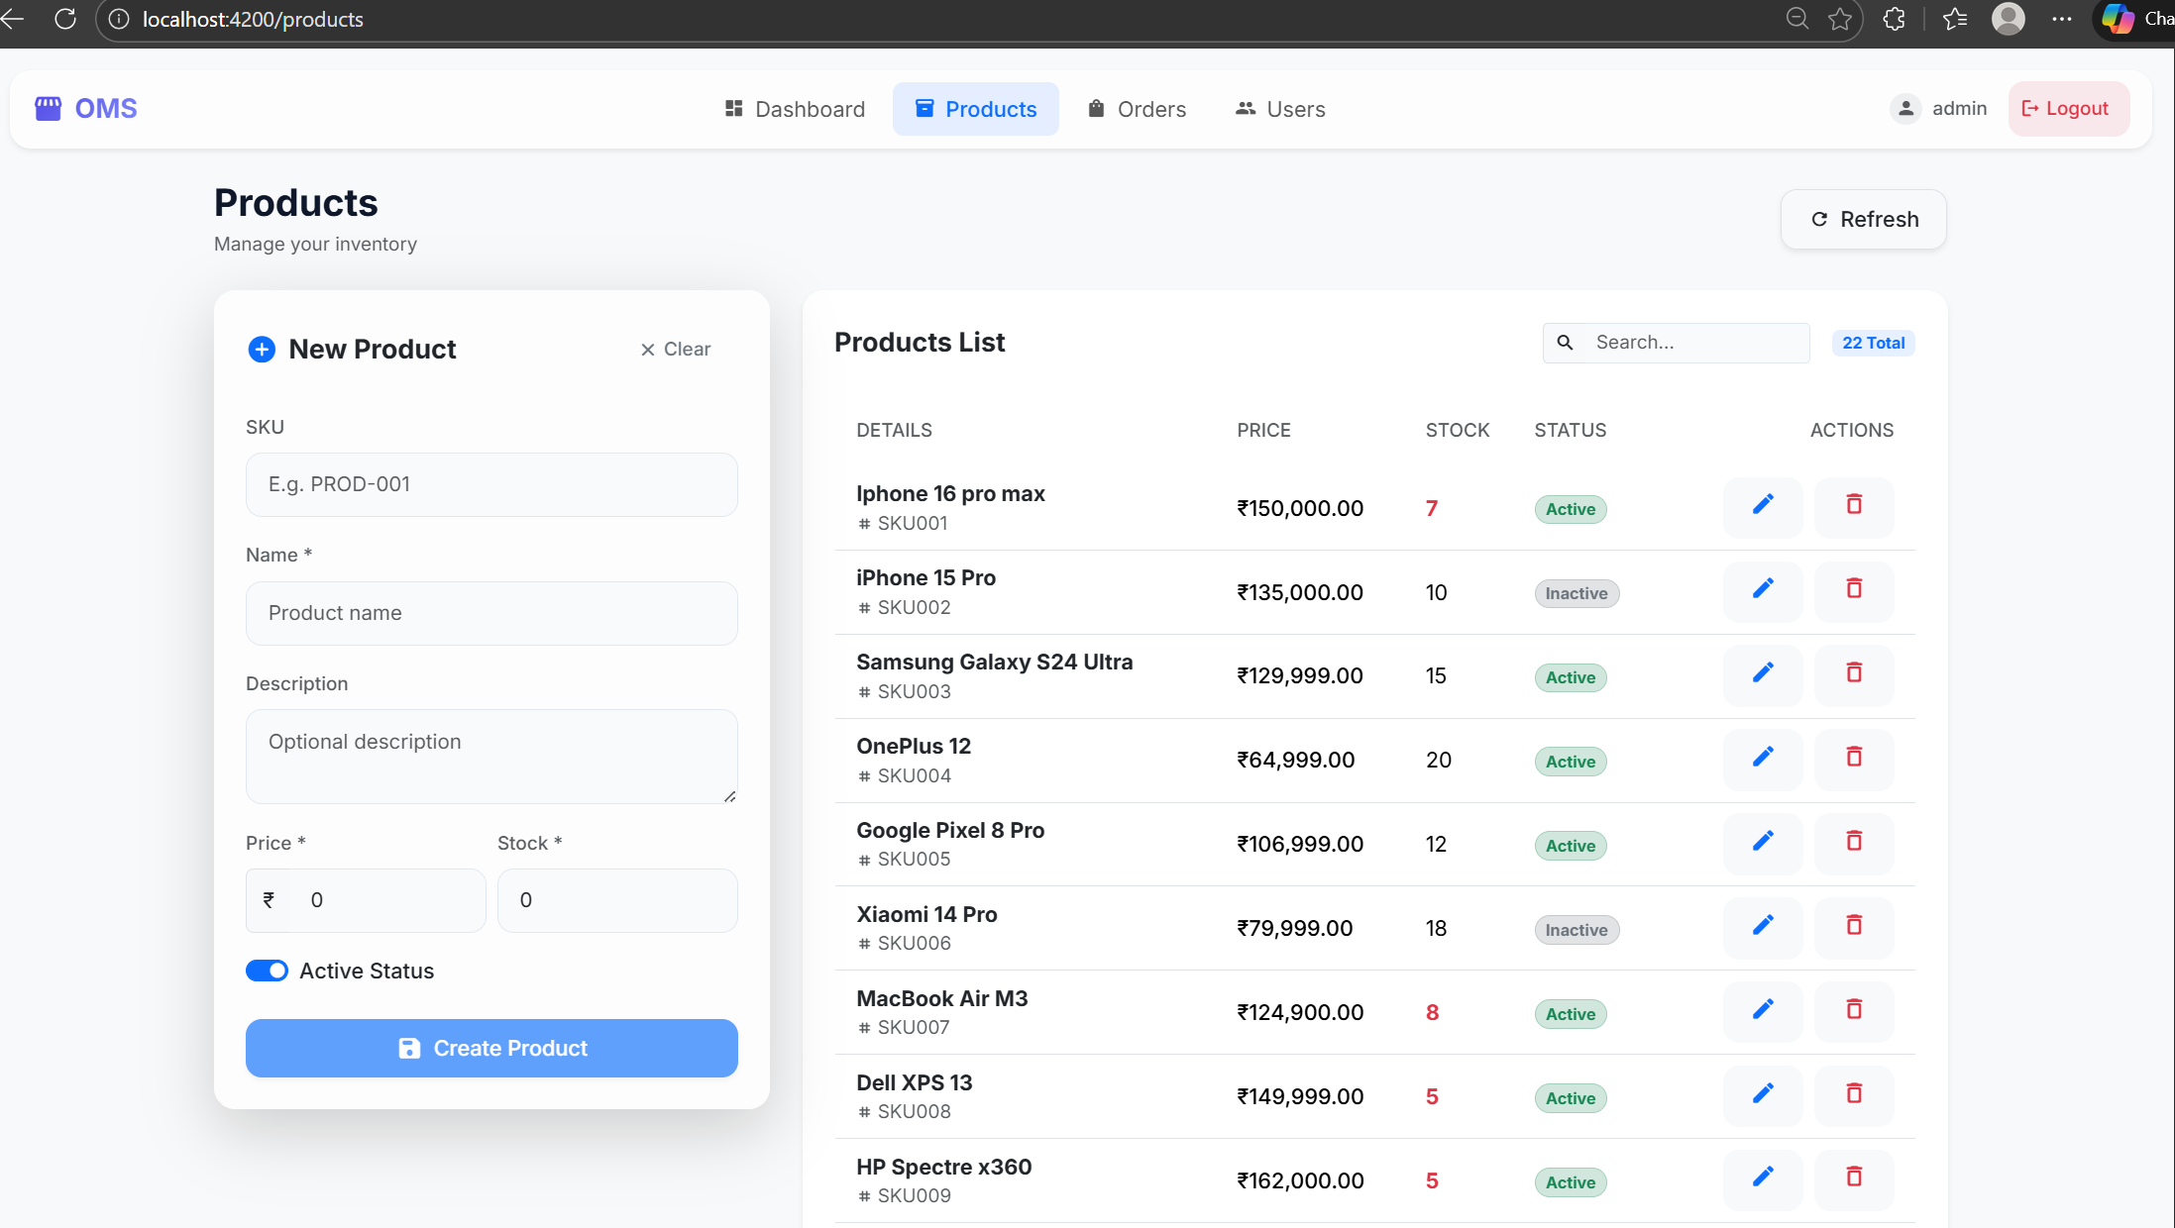
Products Page
2024 - RPS Consulting all rights reserved

Slide 14
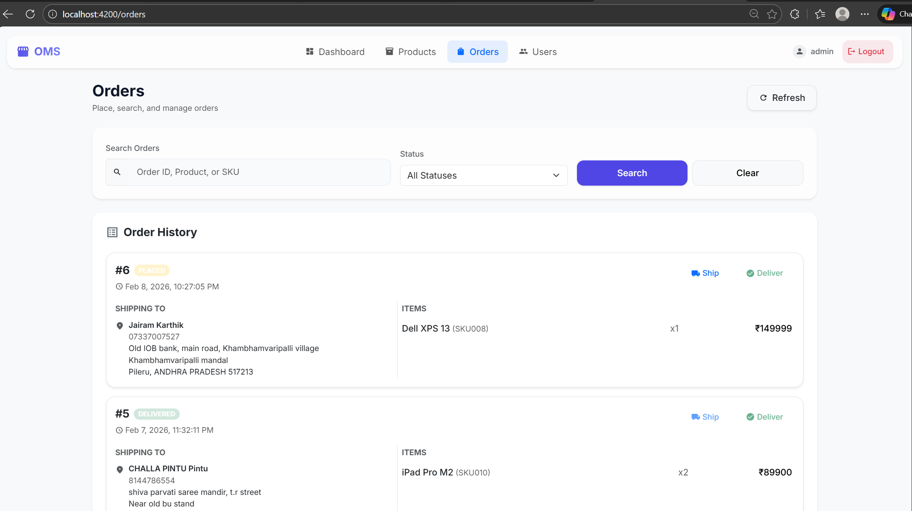
Orders Page
2024 - RPS Consulting all rights reserved

Slide 15
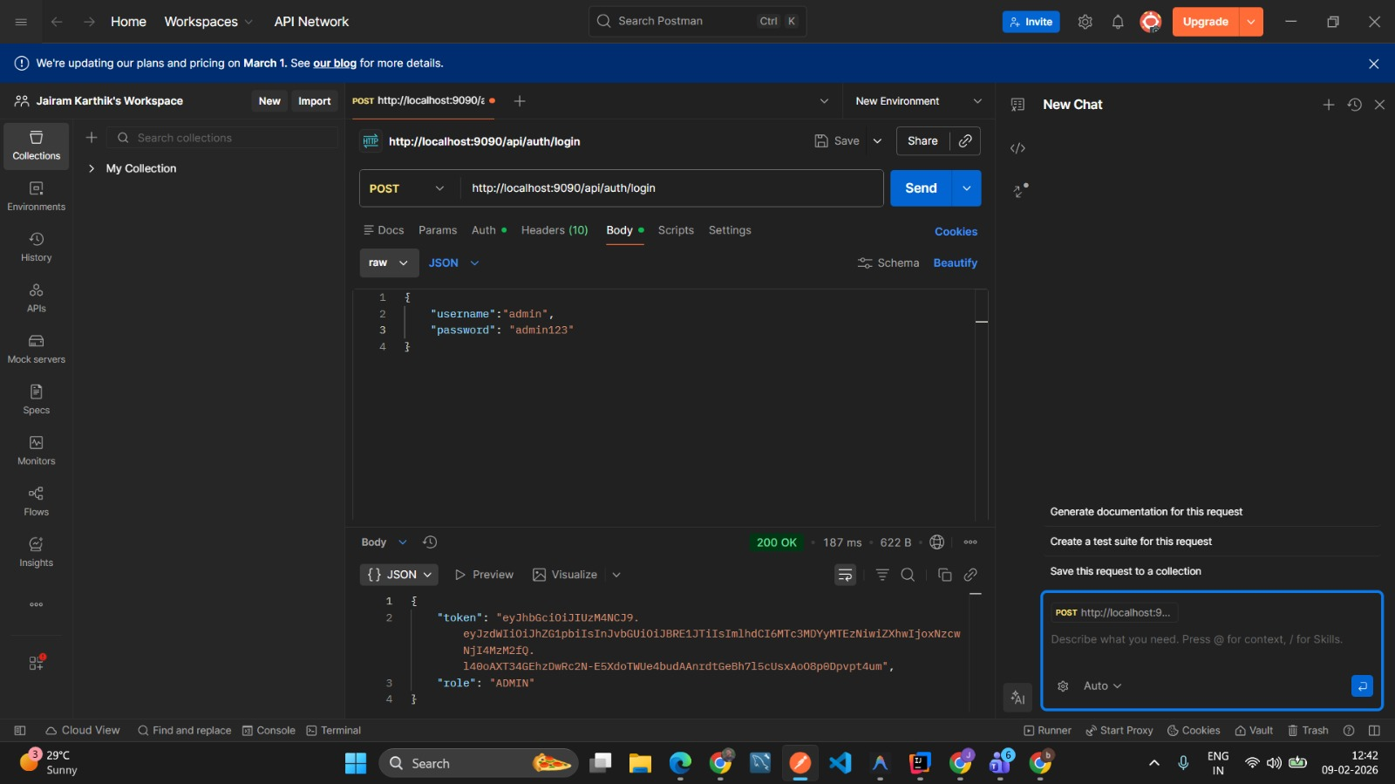
Postman testing
Bearer token has admin jwt
2024 - RPS Consulting all rights reserved

Slide 16

Postman testing
Bearer token has user jwt
2024 - RPS Consulting all rights reserved

Slide 17
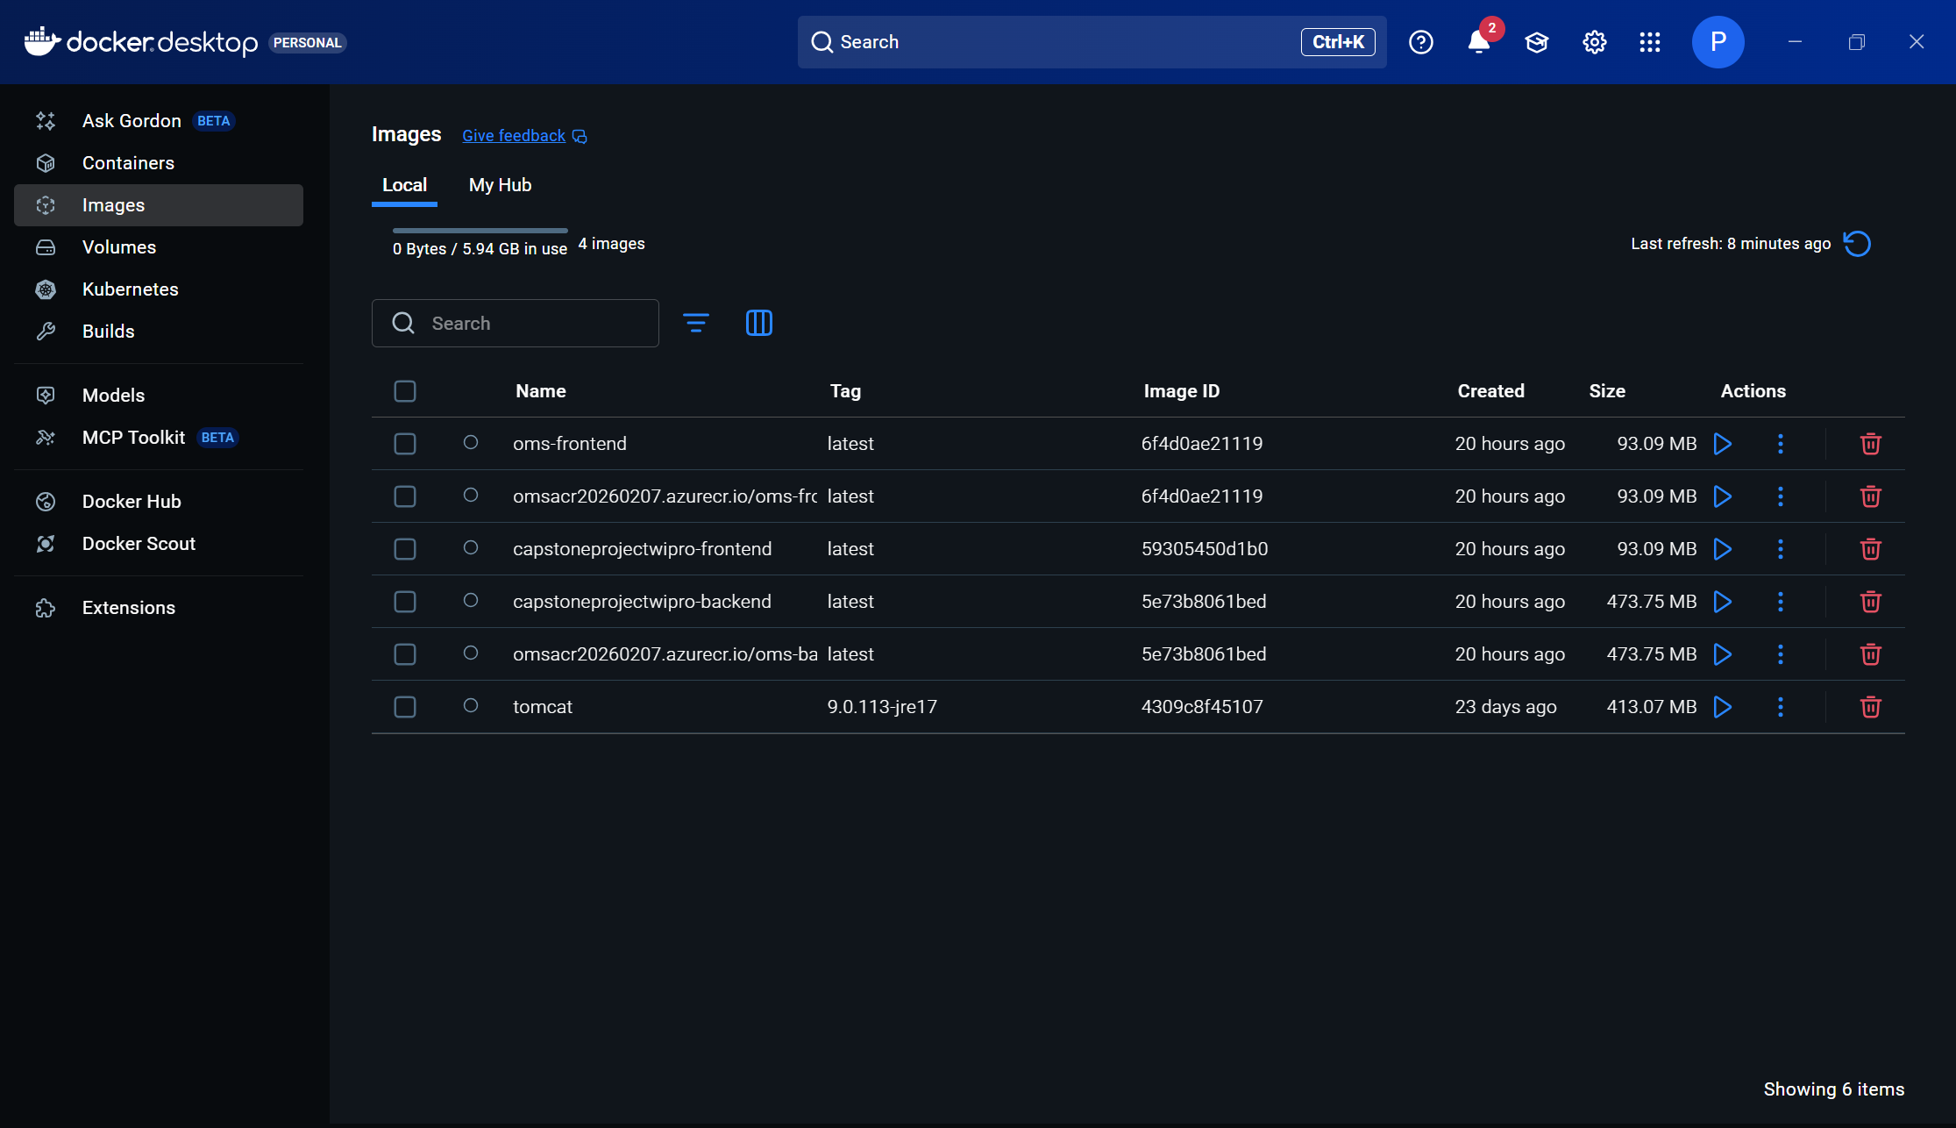
Docker Implementation
2024 - RPS Consulting all rights reserved

Slide 18
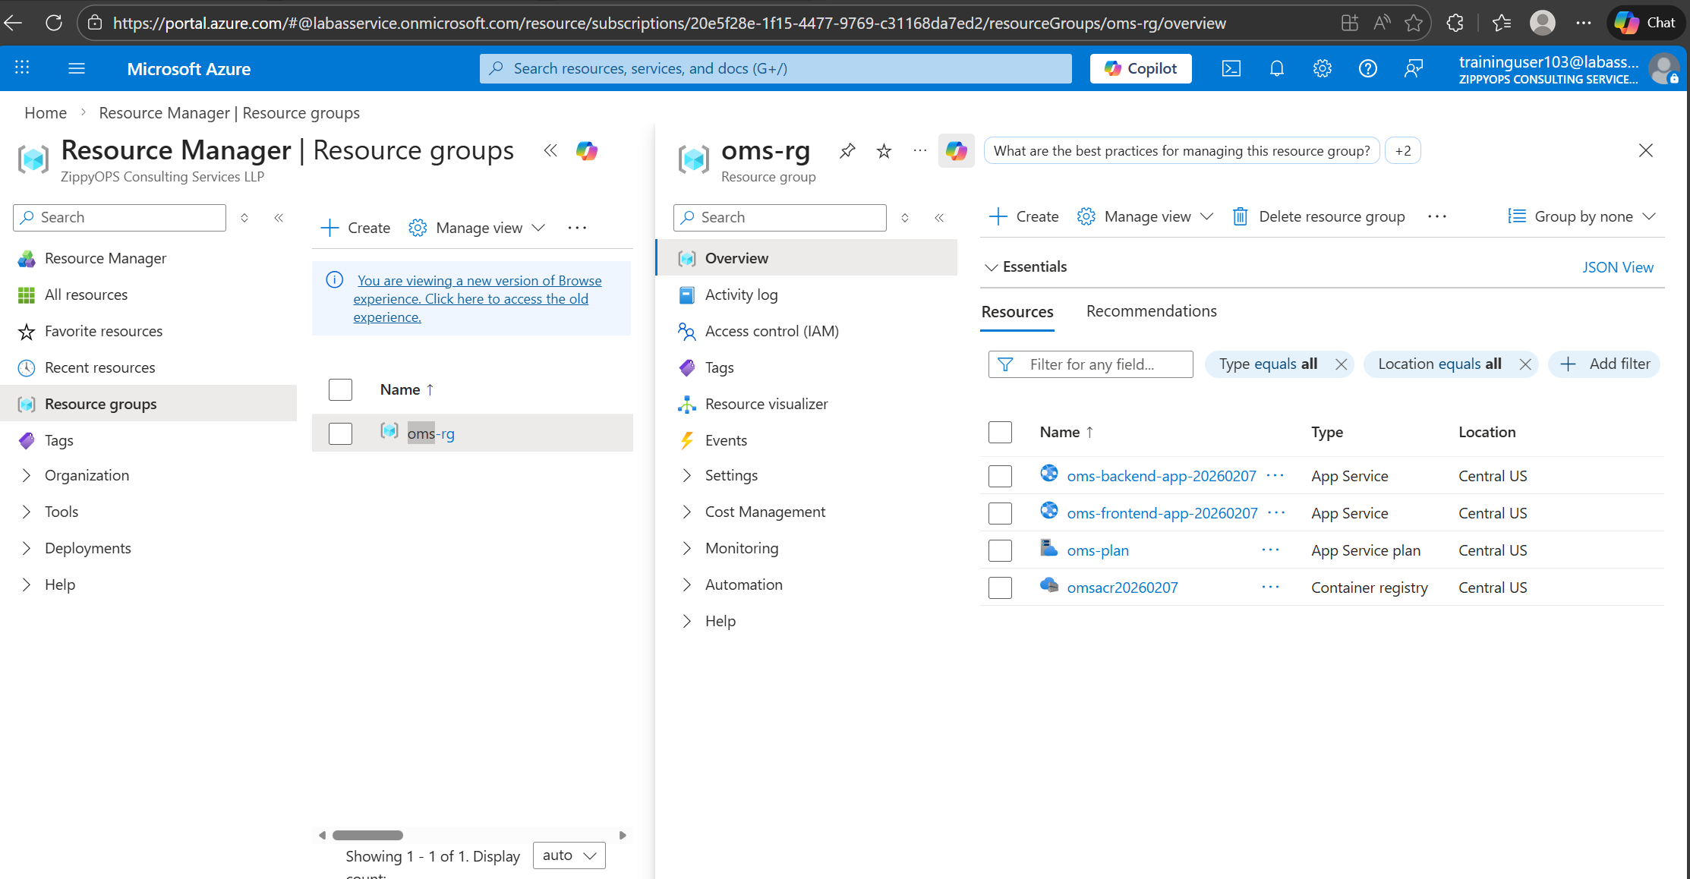
Azure Deployment
2024 - RPS Consulting all rights reserved

Slide 19
Conclusion
Successfully developed a full-stack Order Management System.
Implemented secure authentication and role-based access.
Deployed application using Docker and Microsoft Azure.
Gained hands-on experience in full-stack and cloud technologies.
2024 - RPS Consulting all rights reserved

