Slide 2
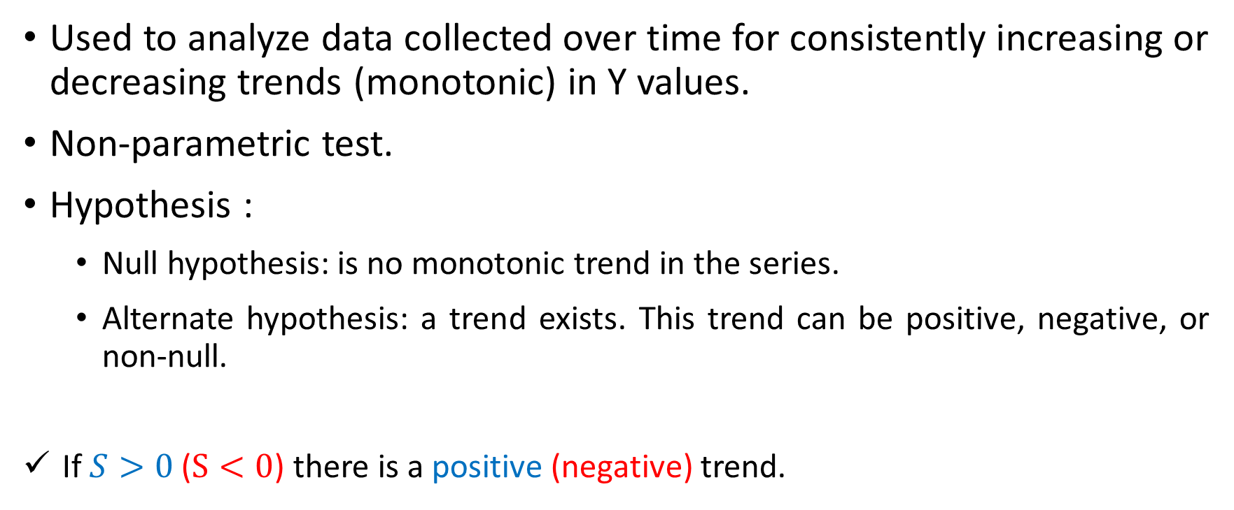
Mann-Kendall Trend Test
Used to analyze data collected over time for consistently increasing or decreasing trends (monotonic) in Y values.
Non-parametric test.
Hypothesis :
Null hypothesis: is no monotonic trend in the series.
Alternate hypothesis: a trend exists. This trend can be positive, negative, or non-null.
If $S>0$ ($S<0$) there is a positive (negative) trend.

Slide 3








$$ω=3$$
$$α=0.05$$
$$CL≅0$$
$$CL≅NEG$$
$$CL≅POS$$
$$CL≅0$$
$$CL≅0$$
$$CL≅0$$

Slide 4

Trend analysis
IF (p-value $>α$) {
Trend = “NONE”
} ELSE {
IF($S > 0$){
Trend = “POSITIVE”
}ELSE{
Trend = “NEGATIVE”
}
}

Slide 5

$$ω=21$$
$$α=0.05$$

Slide 6
$$ω=21$$
$$α=0.05$$

Slide 7
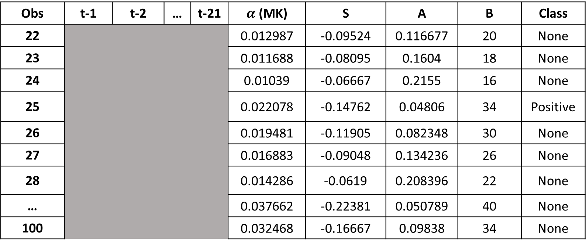
Obs | t-1 | t-2 | … | t-21 | $α$ (MK) | S | A | B | Class
22 |  |  |  |  | 0.012987 | -0.09524 | 0.116677 | 20 | None
23 |  |  |  |  | 0.011688 | -0.08095 | 0.1604 | 18 | None
24 |  |  |  |  | 0.01039 | -0.06667 | 0.2155 | 16 | None
25 |  |  |  |  | 0.022078 | -0.14762 | 0.04806 | 34 | Positive
26 |  |  |  |  | 0.019481 | -0.11905 | 0.082348 | 30 | None
27 |  |  |  |  | 0.016883 | -0.09048 | 0.134236 | 26 | None
28 |  |  |  |  | 0.014286 | -0.0619 | 0.208396 | 22 | None
… |  |  |  |  | 0.037662 | -0.22381 | 0.050789 | 40 | None
100 |  |  |  |  | 0.032468 | -0.16667 | 0.09838 | 34 | None

