Slide 1


Concept drift analysis
Training phase
Test phase
DB
Split (70/30)
Denormalisation
Running mean ($φ$)
Normalisation
Performance analysis
Sliding window ($ω$)
SVM
MLP
LSTM
ELM
ARIMA
RMSE
MAPE
MAE
ARV
Mann-Kendal test
Instance classification

Slide 2
SVM

Slide 3
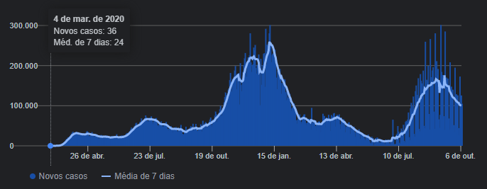
US

Slide 4
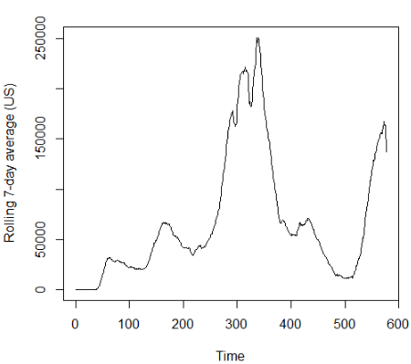
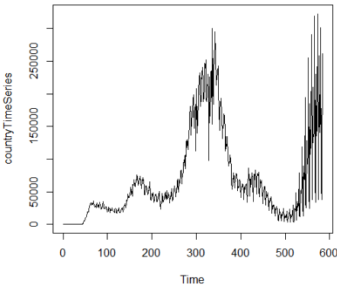



US
$$φ=7$$
$$ω=21$$
$$α=0.1$$
TS
phi=7

Slide 5
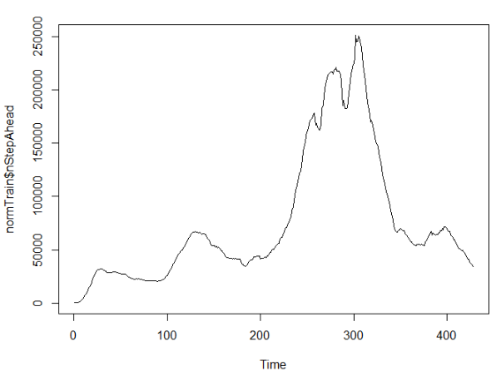
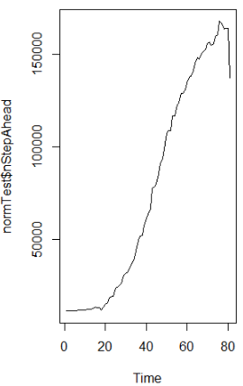

Slide 6
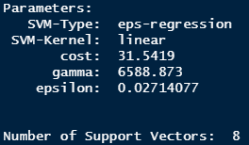
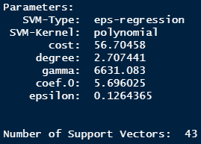
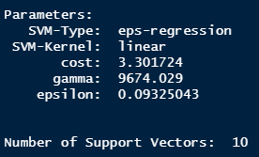
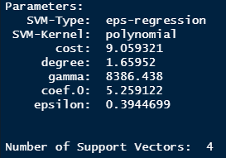
noneTrendTrain
positiveTrendTrain
normTrain
negativeTrendTrain
1-step ahead

Slide 7
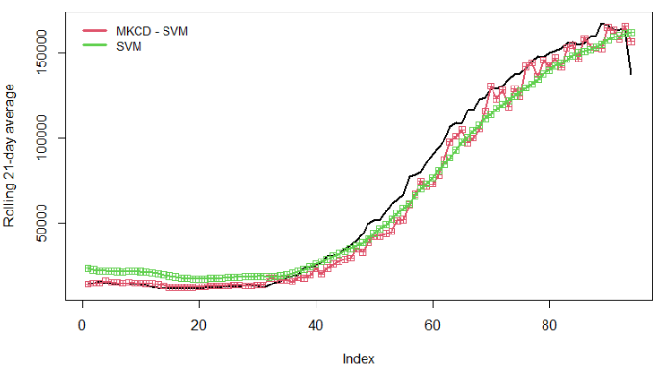




$$φ=7$$
$$ω=21$$
1-step ahead
$$α=0.1$$

Slide 8
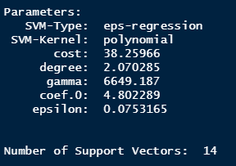
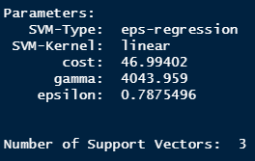
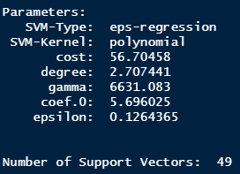
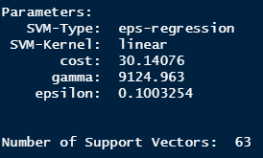
7-step ahead
noneTrendTrain
positiveTrendTrain
normTrain
negativeTrendTrain

Slide 9
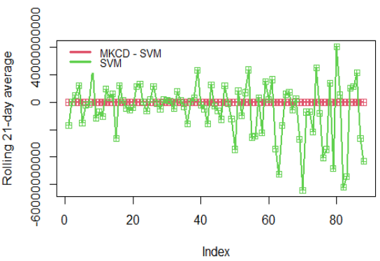

Slide 10
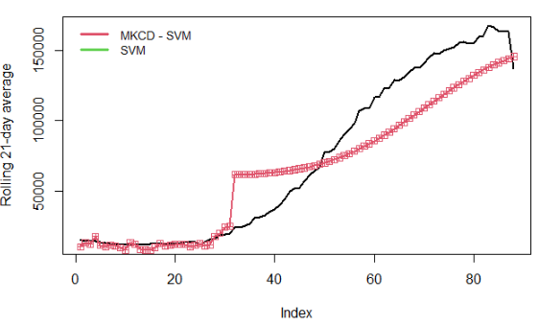




$$φ=7$$
$$ω=21$$
$$α=0.1$$
7-step ahead

Slide 11
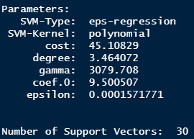
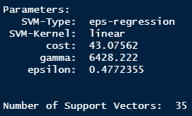
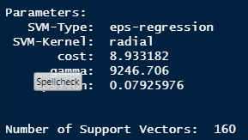
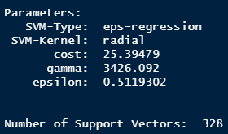
14-step ahead
noneTrendTrain
positiveTrendTrain
negativeTrendTrain
normTrain

Slide 12
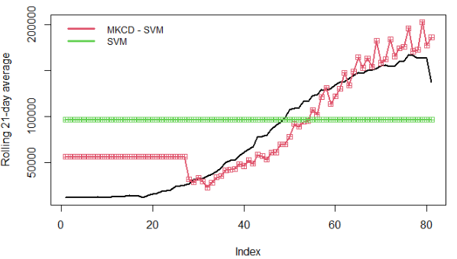

$$φ=7$$
$$ω=21$$
$$α=0.1$$
14-step ahead

Slide 13
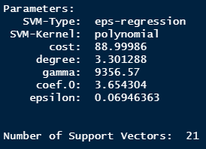
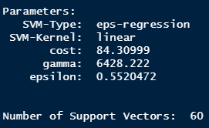
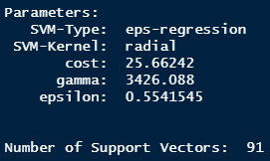
21-step ahead
noneTrendTrain
positiveTrendTrain
normTrain
negativeTrendTrain

Slide 14
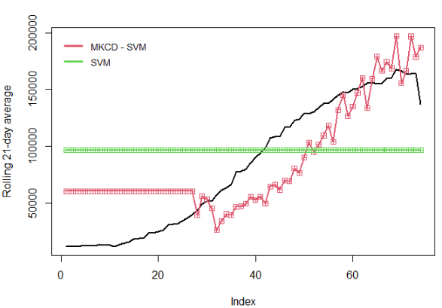

$$φ=7$$
21-step ahead
$$ω=21$$
$$α=0.1$$

Slide 15
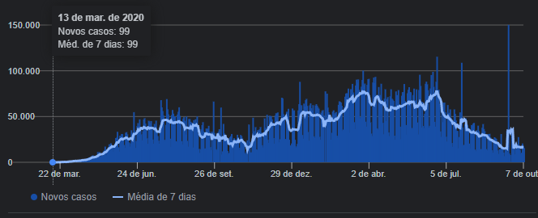
Brazil

Slide 17
Brazil
$$φ=7$$
$$ω=21$$
$$α=0.1$$
TS
phi=7

Slide 18
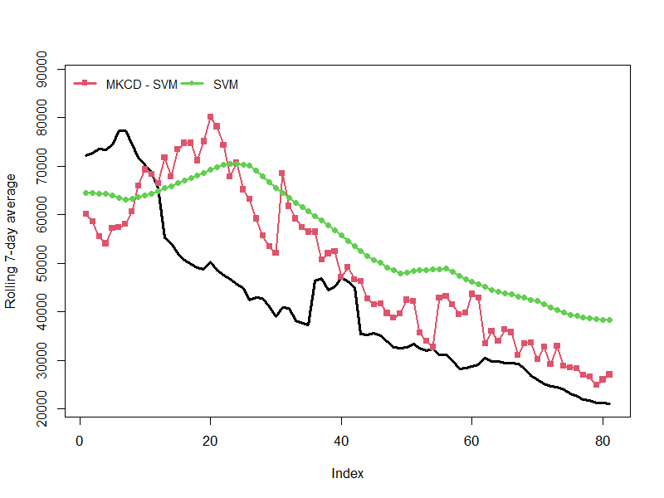
$$φ=7$$
$$ω=21$$
14-step ahead
$$α=0.1$$
Metric | MKCD-SVM | SVM
RMSE | 13904 | 16956
MAE | 11432 | 16104
MAPE | 27.96 | 45.49
ARV | 1.74 | 9.61

Slide 19
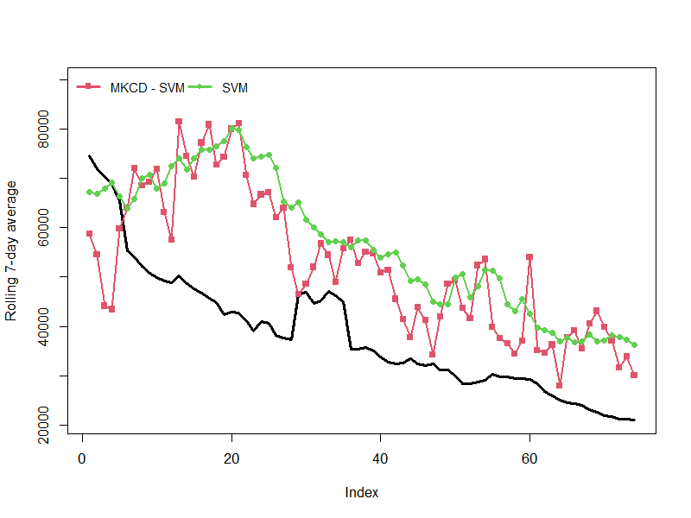
$$φ=7$$
$$ω=21$$
21-step ahead
$$α=0.1$$
Metric | MKCD-SVM | 20469SVM
RMSE | 18612 | 20469
MAE | 16338 | 18710
MAPE | 44.86 | 53.23
ARV | 2.69 | 3.44

Slide 20
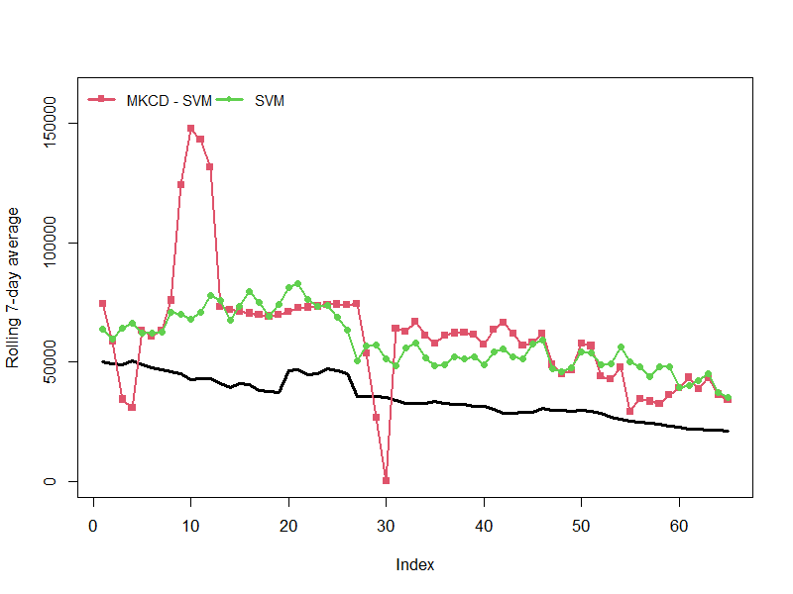
$$φ=7$$
$$ω=21$$
30-step ahead
$$α=0.1$$
Metric | MKCD-SVM | SVM
RMSE | 33731 | 23945
MAE | 28014 | 22968
MAPE | 80.18 | 68.98
ARV | 1.30 | 1.73

Slide 21
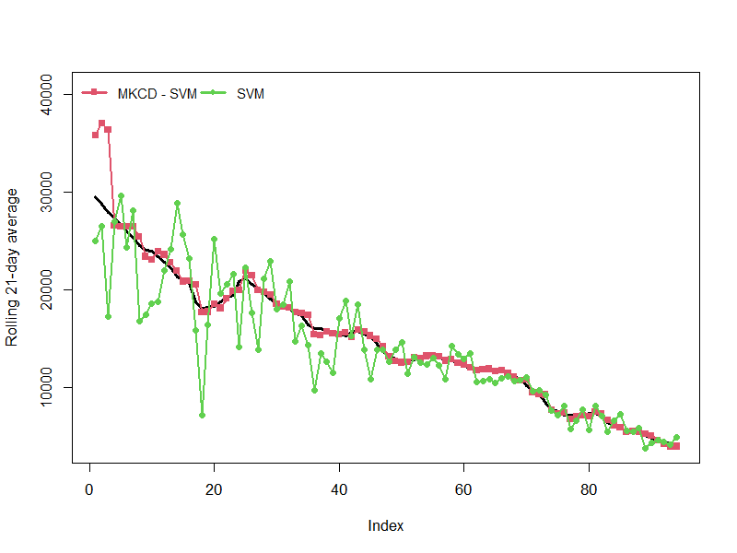

Slide 22
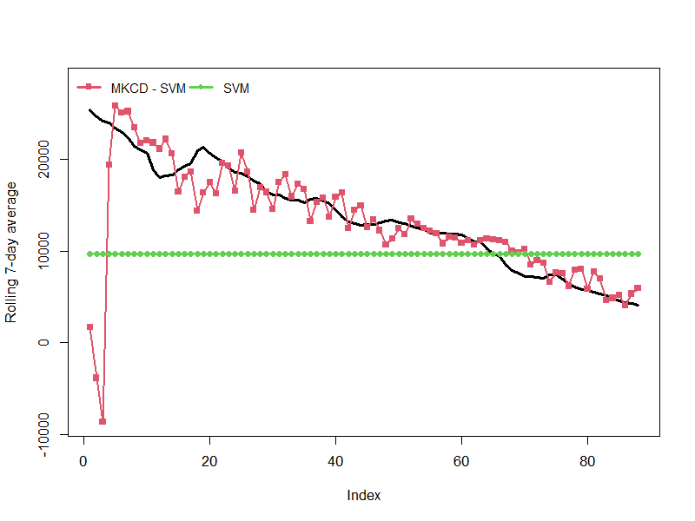

Slide 23
MLP

Slide 24
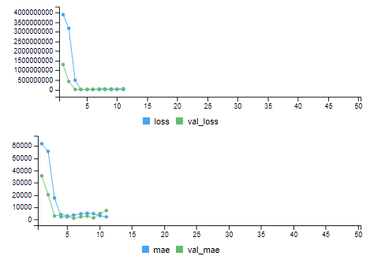
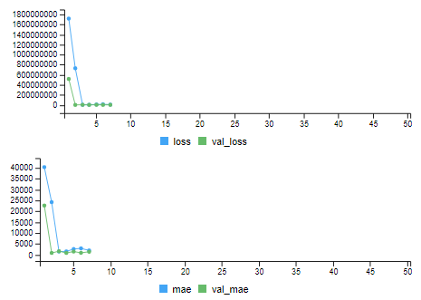
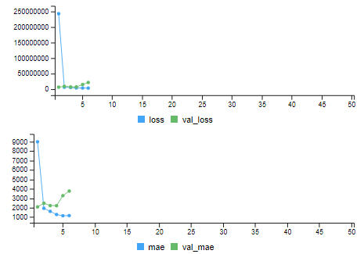
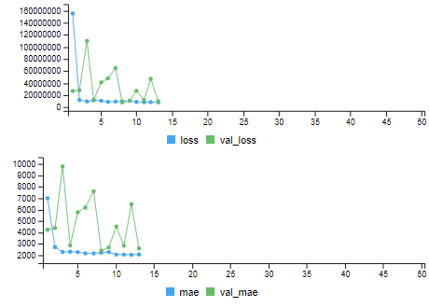



None
Negative
$$φ=14$$
$$ω=10$$
$$α=0.01$$
Positive
Normal

Slide 25
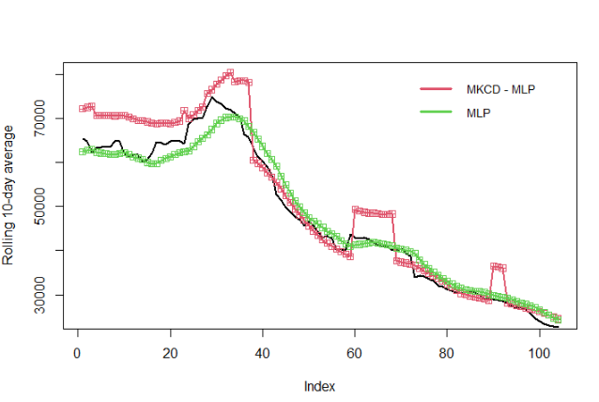
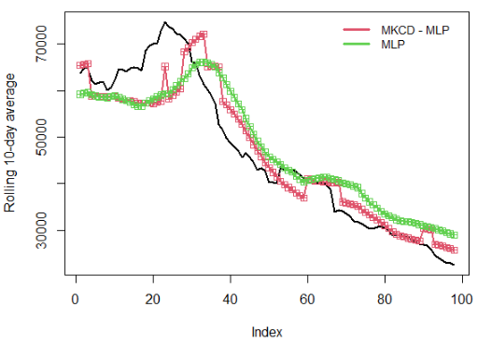
1-step ahead
Metric | MLP | MKCD-MLP
RMSE | 2749.97 | 4903.73
MAE | 2212.96 | 3786.96
MAPE | 4.76 | 7.66
ARV | 0.0354 | 0.0984
7-step ahead
Metric | MLP | MKCD-MLP
RMSE | 6689.58 | 5817.11
MAE | 5650.90 | 4433.61
MAPE | 12.74 | 8.91
ARV | 0.2891 | 0.1611

Slide 26
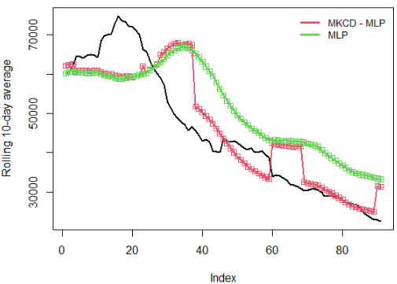
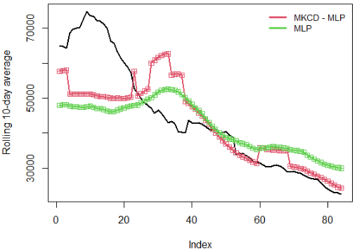
14-step ahead
Metric | MLP | MKCD-MLP
RMSE | 11171.15 | 8359.70
MAE | 9977.75 | 6305.13
MAPE | 25.13 | 13.76
ARV | 1.8956 | 0.3651
21-step ahead
Metric | MLP | MKCD-MLP
RMSE | 11717.19 | 10576.01
MAE | 8945.54 | 7669.64
MAPE | 18.86 | 15.16
ARV | 0.5495 | 0.4640

Slide 27
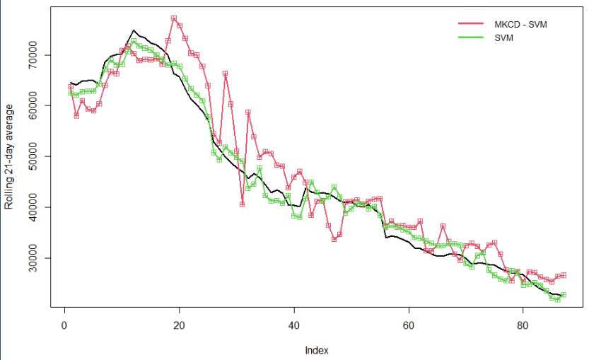

$$φ=14$$
$$ω=21$$
$$α=0.1$$
7-step ahead
Metric | MKCD-SVR | SVR
RMSE | 5148.0 | 1730.3
MAE | 4058.2 | 1609.2
MAPE | 9.227 | 3.851
ARV | 0.134 | 0.012

Slide 29
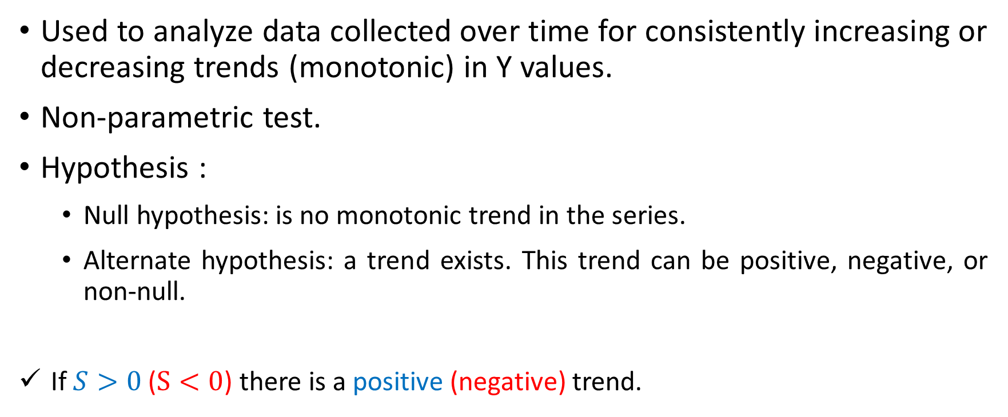
Mann-Kendall Trend Test
Used to analyze data collected over time for consistently increasing or decreasing trends (monotonic) in Y values.
Non-parametric test.
Hypothesis :
Null hypothesis: is no monotonic trend in the series.
Alternate hypothesis: a trend exists. This trend can be positive, negative, or non-null.
If $S>0$ ($S<0$) there is a positive (negative) trend.

Slide 30








$$ω=3$$
$$α=0.05$$
$$CL≅0$$
$$CL≅NEG$$
$$CL≅POS$$
$$CL≅0$$
$$CL≅0$$
$$CL≅0$$

Slide 31

Trend analysis
IF (p-value $>α$) {
Trend = “NONE”
} ELSE {
IF($S > 0$){
Trend = “POSITIVE”
}ELSE{
Trend = “NEGATIVE”
}
}

Slide 32

$$ω=21$$
$$α=0.05$$

Slide 33
$$ω=21$$
$$α=0.05$$

Slide 34
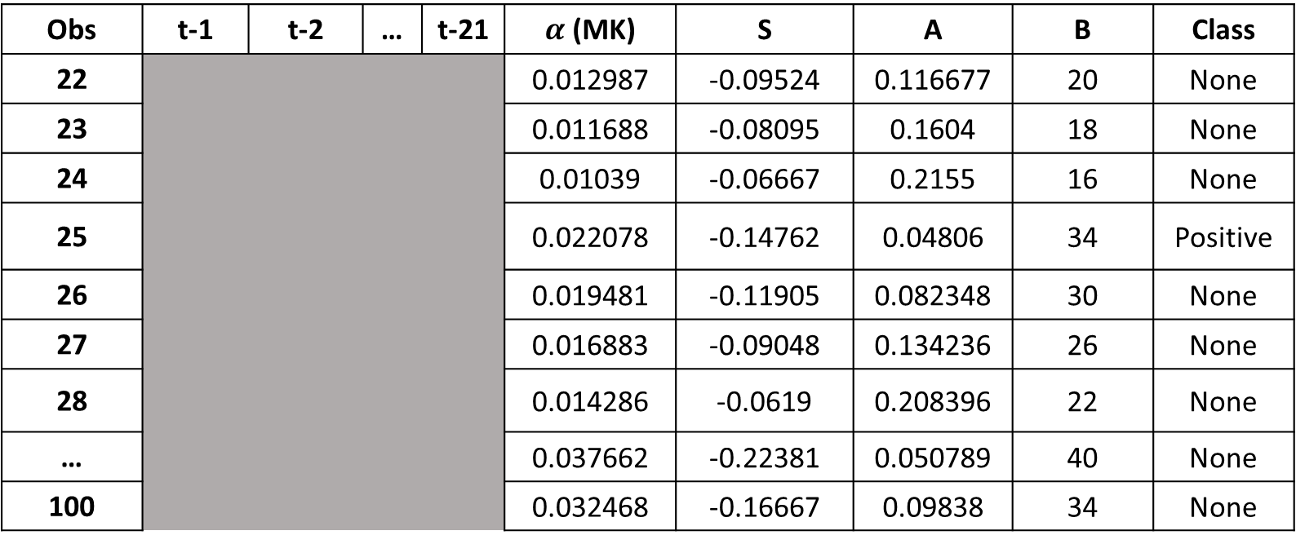
Obs | t-1 | t-2 | … | t-21 | $α$ (MK) | S | A | B | Class
22 |  |  |  |  | 0.012987 | -0.09524 | 0.116677 | 20 | None
23 |  |  |  |  | 0.011688 | -0.08095 | 0.1604 | 18 | None
24 |  |  |  |  | 0.01039 | -0.06667 | 0.2155 | 16 | None
25 |  |  |  |  | 0.022078 | -0.14762 | 0.04806 | 34 | Positive
26 |  |  |  |  | 0.019481 | -0.11905 | 0.082348 | 30 | None
27 |  |  |  |  | 0.016883 | -0.09048 | 0.134236 | 26 | None
28 |  |  |  |  | 0.014286 | -0.0619 | 0.208396 | 22 | None
… |  |  |  |  | 0.037662 | -0.22381 | 0.050789 | 40 | None
100 |  |  |  |  | 0.032468 | -0.16667 | 0.09838 | 34 | None

Slide 35
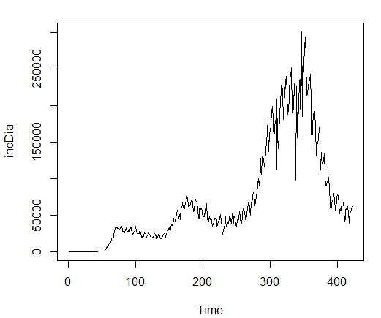
Experimento 1
País: US
TS: Incidência diária
Período: US – 23/Jan/2020 – 19/mar/2021
n: 422 observações

Slide 36
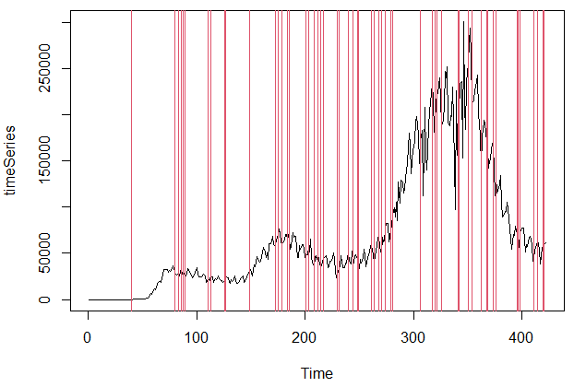
n: 14
alpha: 0.05
positiveTrend: 121
negativeTrend: 53
none: 234

Slide 37
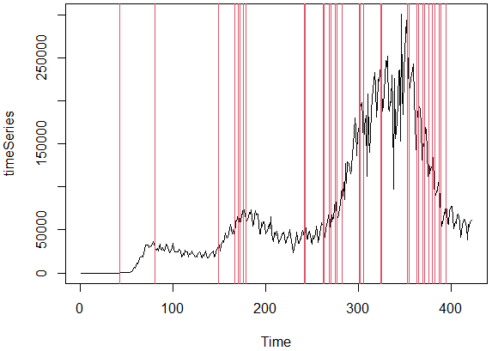
n: 14
alpha: 0.01
positiveTrend: 89
negativeTrend: 17
none: 302

Slide 38
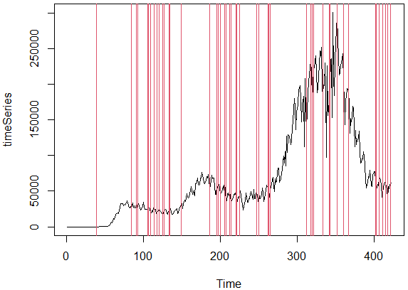
n: 21
alpha: 0.05
positiveTrend: 155
negativeTrend: 84
none: 162

Slide 39
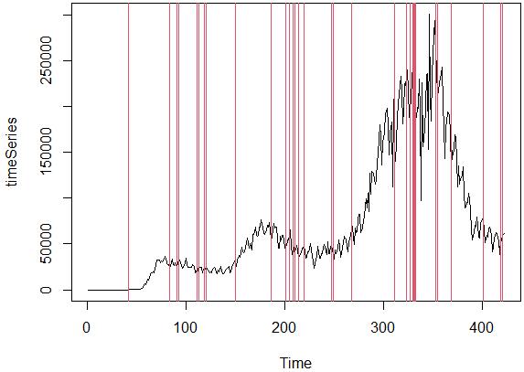
n: 21
alpha: 0.05
positiveTrend: 131
negativeTrend: 51
none: 219

Slide 40

Experimento 1
País: US
TS: Log da Incidência diária
Período: US – 23/Jan/2020 – 19/mar/2021
n: 422 observações

Slide 41

n: 14
alpha: 0.05
positiveTrend: 121
negativeTrend: 53
none: 234

Slide 42

n: 14
alpha: 0.01
positiveTrend: 89
negativeTrend: 17
none: 302

Slide 43

n: 21
alpha: 0.05
positiveTrend: 155
negativeTrend: 84
none: 162

Slide 44

n: 21
alpha: 0.01
positiveTrend: 131
negativeTrend: 51
none: 219

Slide 45

Experimento 3
País: US
TS: MM14 da Incidência diária
Período: US – 23/Jan/2020 – 19/mar/2021
n: 408 observações

Slide 46

n: 14
alpha: 0.05
positiveTrend: 194
negativeTrend: 174
none: 26

Slide 47

n: 14
alpha: 0.01
positiveTrend: 188
negativeTrend: 165
none: 41

Slide 48

n: 21
alpha: 0.05
positiveTrend: 196
negativeTrend: 162
none: 29

Slide 49

n: 21
alpha: 0.01
positiveTrend: 189
negativeTrend: 157
none: 41

Slide 50
Experimento 4
País: US
TS: Log da MM14 da Incidência diária
Período: US – 23/Jan/2020 – 19/mar/2021
n: 408 observações

Slide 51

n: 14
alpha: 0.05
positiveTrend: 197
negativeTrend: 171
none: 26

Slide 52

n: 14
alpha: 0.01
positiveTrend: 191
negativeTrend: 167
none: 36

Slide 53

n: 21
alpha: 0.01
positiveTrend: 196
negativeTrend: 161
none: 30

Slide 54

n: 21
alpha: 0.05
positiveTrend: 189
negativeTrend: 156
none: 42

Slide 55
TS (US) | ID | ID | ID | ID
w | 14 | 14 | 21 | 21
alpha | 05 | 01 | 05 | 01
posTrend | 121 | 89 | 155 | 131
negTrend | 53 | 17 | 84 | 51
none | 234 | 302 | 162 | 219
TS (US) | LID | LID | LID | LID
w | 14 | 14 | 21 | 21
alpha | 05 | 01 | 05 | 01
posTrend | 121 | 89 | 155 | 131
negTrend | 53 | 17 | 84 | 51
none | 234 | 302 | 162 | 219
TS (US) | M14 | M14 | M14 | M14
w | 14 | 14 | 21 | 21
alpha | 05 | 01 | 05 | 01
posTrend | 194 | 188 | 196 | 189
negTrend | 174 | 165 | 162 | 157
none | 26 | 41 | 29 | 41
TS (US) | LM14 | LM14 | LM14 | LM14
w | 14 | 14 | 21 | 21
alpha | 05 | 01 | 05 | 01
posTrend | 197 | 196 | 196 | 189
negTrend | 171 | 167 | 161 | 156
none | 26 | 36 | 30 | 42

Slide 56


$$nsa=21$$

Slide 57


Slide 58



DB
Treinamento (80/20)
Desempenho
Média móvel ($φ$)
MLP
LSTM
ELM
RBF
RMSE
MAPE
MAE
ARV
Janela deslizante ($ω$)
Teste de Mann-Kendal ($p$)
Split (70/30) e Normalização
Teste

