Slide 1

User Score
User Rank

Slide 2
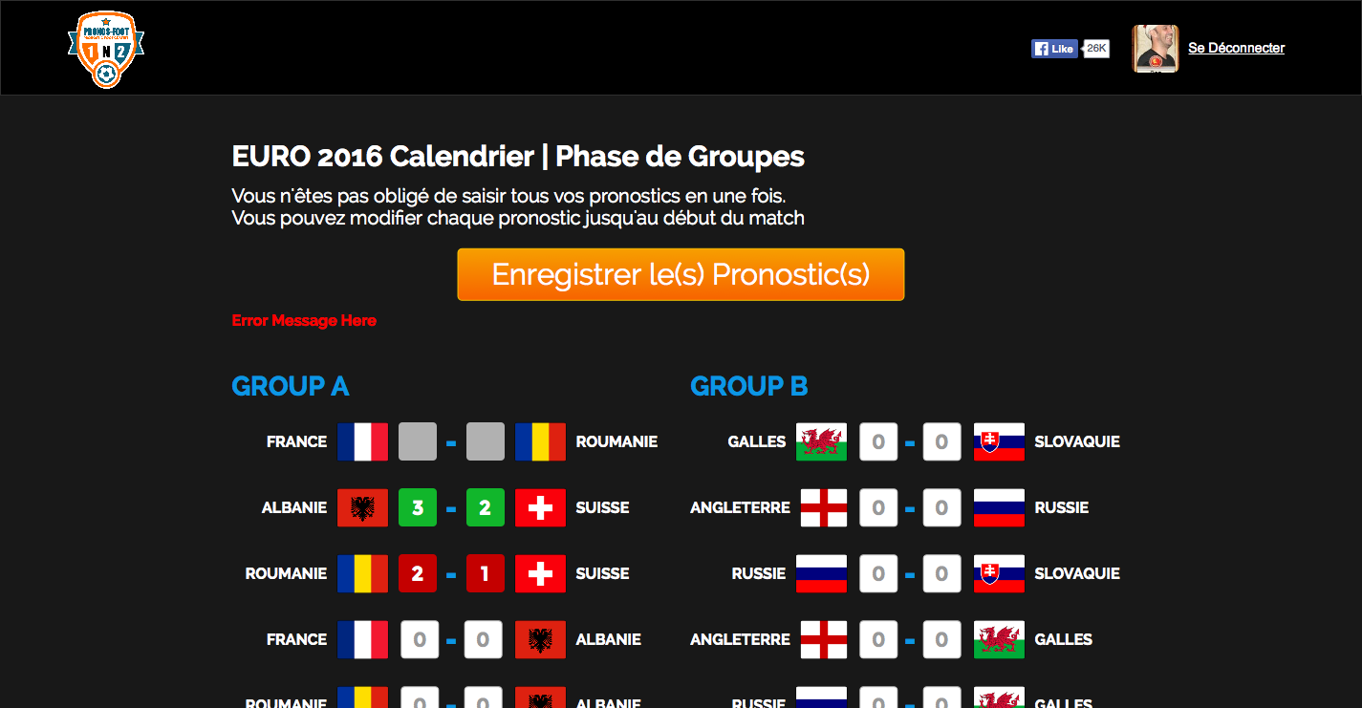
Previous Game. User did not play
Previous Game. (green) User found the result of the game (Exact Score or not)
Previous Game. (red) User played but he did not guess right the result
Upcoming games. Only 2 digits number max can be input. If 1 field has number and the other one does not have, the predicted score wont be saved.

Slide 3
User has to guess if at the end of the game the team A on the left will win (ex: 3 – 0) or if the team B on the right will win (ex: 1 -2) or if there will be a draw between the 2 teams (ex: 1 -1)
If the user guess right between the 3 options (Team A wins, Team B wins, Draw) he will get points. (10 points) He will get extra points if he guess the exact score at the end of the game. Ex1: User put a score of 3 – 0. Team A wins 1 – 0. User will get 10 points. Ex: 2. User put a score of 2-2. At the end of the game the score is 2 -2. User will get 30 points.
During the First Phase (Groups), We will display Groups in 2 Columns in the Desktop View. For the other Phases (1/8 Final; 1/4 Final Etc…). We will display Games in 1 Column in the Desktop View.

Slide 4
User can input the score of one game 1 hour before the kickoff.
We should develop the code to populate the groups. Past games are inactive and depending on the result they will be green or red. They will be grey if the user did not enter any scores.
We should develop the code in order to save the score of the player in DB. The player during 1 session can enter the score of few games or all the games. When the user clicks on the orange button, only the games containing a score for Team A and Team B will be saved. Ex: 3 - null or null - null or null - 1 wont be saved. 0 - 0 or 1 - 0 or 0 - 2 or 2 - 1 will be saved.
We should develop the backend where the admin can: 1. Create Games 2. Create Phase; Groups
2.1 First Phase: 6 Groups of 4 Teams. 36 Games
2.2 1/8 Finale: 16 Teams; 8 Games
2.3 1/4 Finale: 8 Teams; 4 Games
2.4 1/2 Finale: 4 Teams; 2 Games
2.5 Finale: 2 Teams; 1 Game
3. Create Points per Game/Phase: Group Phase: 10points Good Result; 30points Exact Score;
1/8 Final: 20points Good Result; 60points Exact Score;
4. Enter Games Result
Points and Ranking for all the users will be computed. If the admin enters an incomplete score. Ex: 3 – null or null – null or null, we wont use this game for score and ranking computation.

Slide 5
In Order to develop Quickly; Point 1;2 and 3 can be directly setup in Database without an Interface in the Backend. In the user Ranking we should be able to add +1 if needed. Ranking #1 will be #2.

