Slide 1
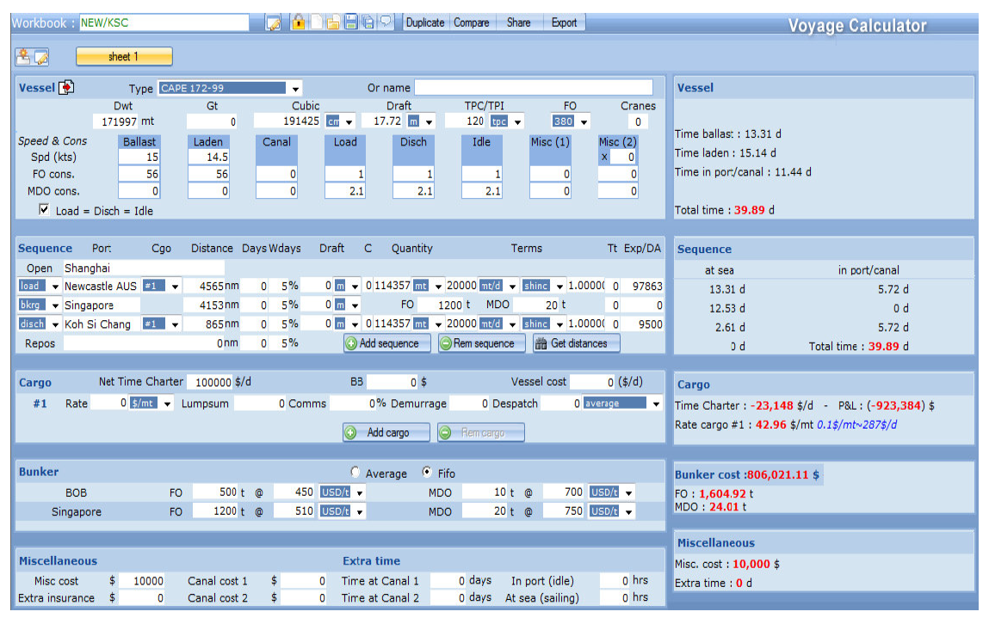
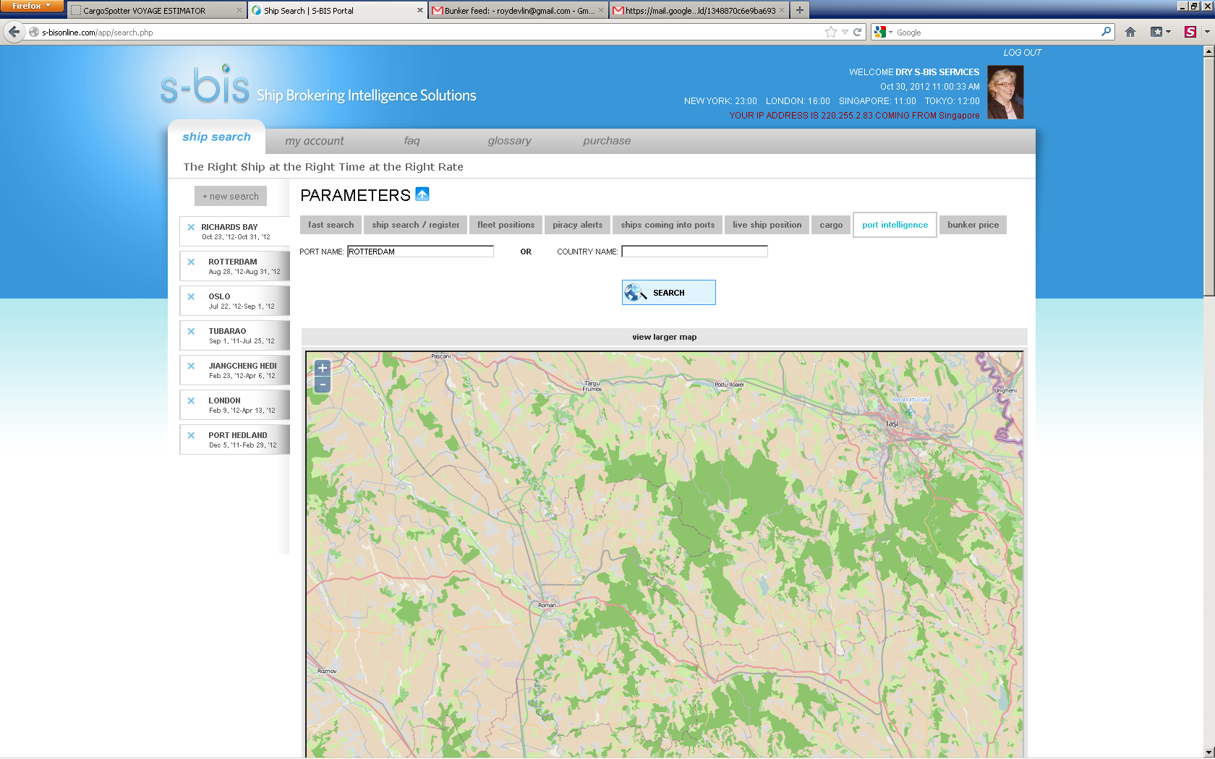
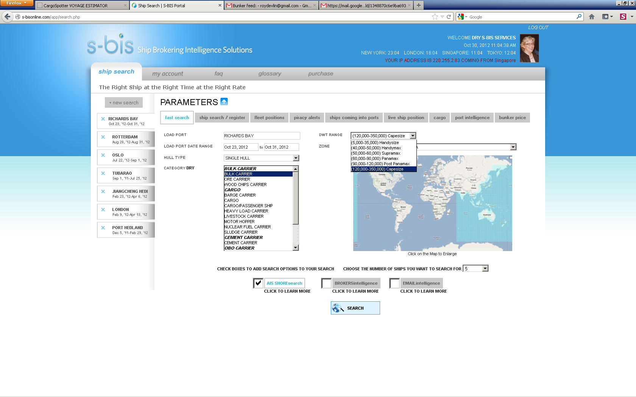
Export or email the data
Scenario name is saved future use
Saved Scenarios
Tabs for Piracy – Port Intelligence and Bunker Pricing use what we have in S-BIS
Duplicate is the same sheet so you can try alternative data
Dropdown to do VE for DWT Range no data is filled in
Voyage Estimate
Port Hedland /WCI
IMO #

