Slide 1
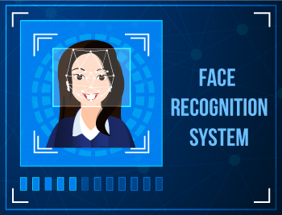
FACE-RECOGNITION BASED
ATTENDANCE SYSTEM
Presented To:-
Dr. Rakhi Garg
Dr. Awadhesh Kumar
Dr. Sarvesh Pandey
Presented By:-
SAKSHI JAISWAL(21229CMP003)
&
SUSHMA VERMA (21229CMP005)

Slide 2
Objective:
Spots the presence of attending students and providing the timing of the attendance marked.
Capable of storing maximum records and no need of manual attendance.
Only students are responsible for making attendance of their own

Slide 3

Introduction
What is Face Recognition?
“ Face recognition is a method of identifying or verifying the identity of an individual using their face. Face recognition systems can be used to identify people in photos, video, or in real-time.
”

Slide 4
Algorithms Used For Face- Recognition System
Haarcascade
Eigen values
Support vector machines
Fisher face algorithm
Viola-Jones Algorithm

Slide 5
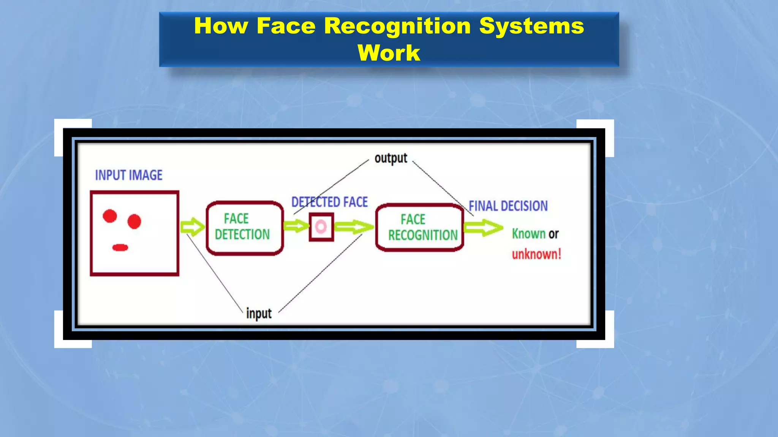
Planning : How Facial Recognition System Works
Capture: A physical or behavioural sample is captured by the system during Enrollment and also in the identification or verification process.
Extraction: Unique data is extracted from the sample and a template is created.
Comparison: The template is then compared with a new sample.
Match/non-match: The system decides if the features extracted from the new Samples are a match or a non-match.

Slide 6
Requirements
HARDWARE
SOFTWARE
Computer(i5,8GB)
Webcam
Hard disk (1 TB)
Windows Server 2016 or Windows 10
Python programming language.
HTML, CSS.
OpenCV library.
Facial Recognition Algorithms.

Slide 7
Requirement Analysis:
Functional
Only authorized users must login to the system.
The system must be attached to a webcam and face recognition should be smooth.
The information must be entered and managed properly.
The administrator or the user who will use this system must login before using it.
Non- Functional
Accuracy and precision must be processed to avoid the problems of system performance.
The system is easy to use.
The system is secured and privacy of the student's details.

Slide 8
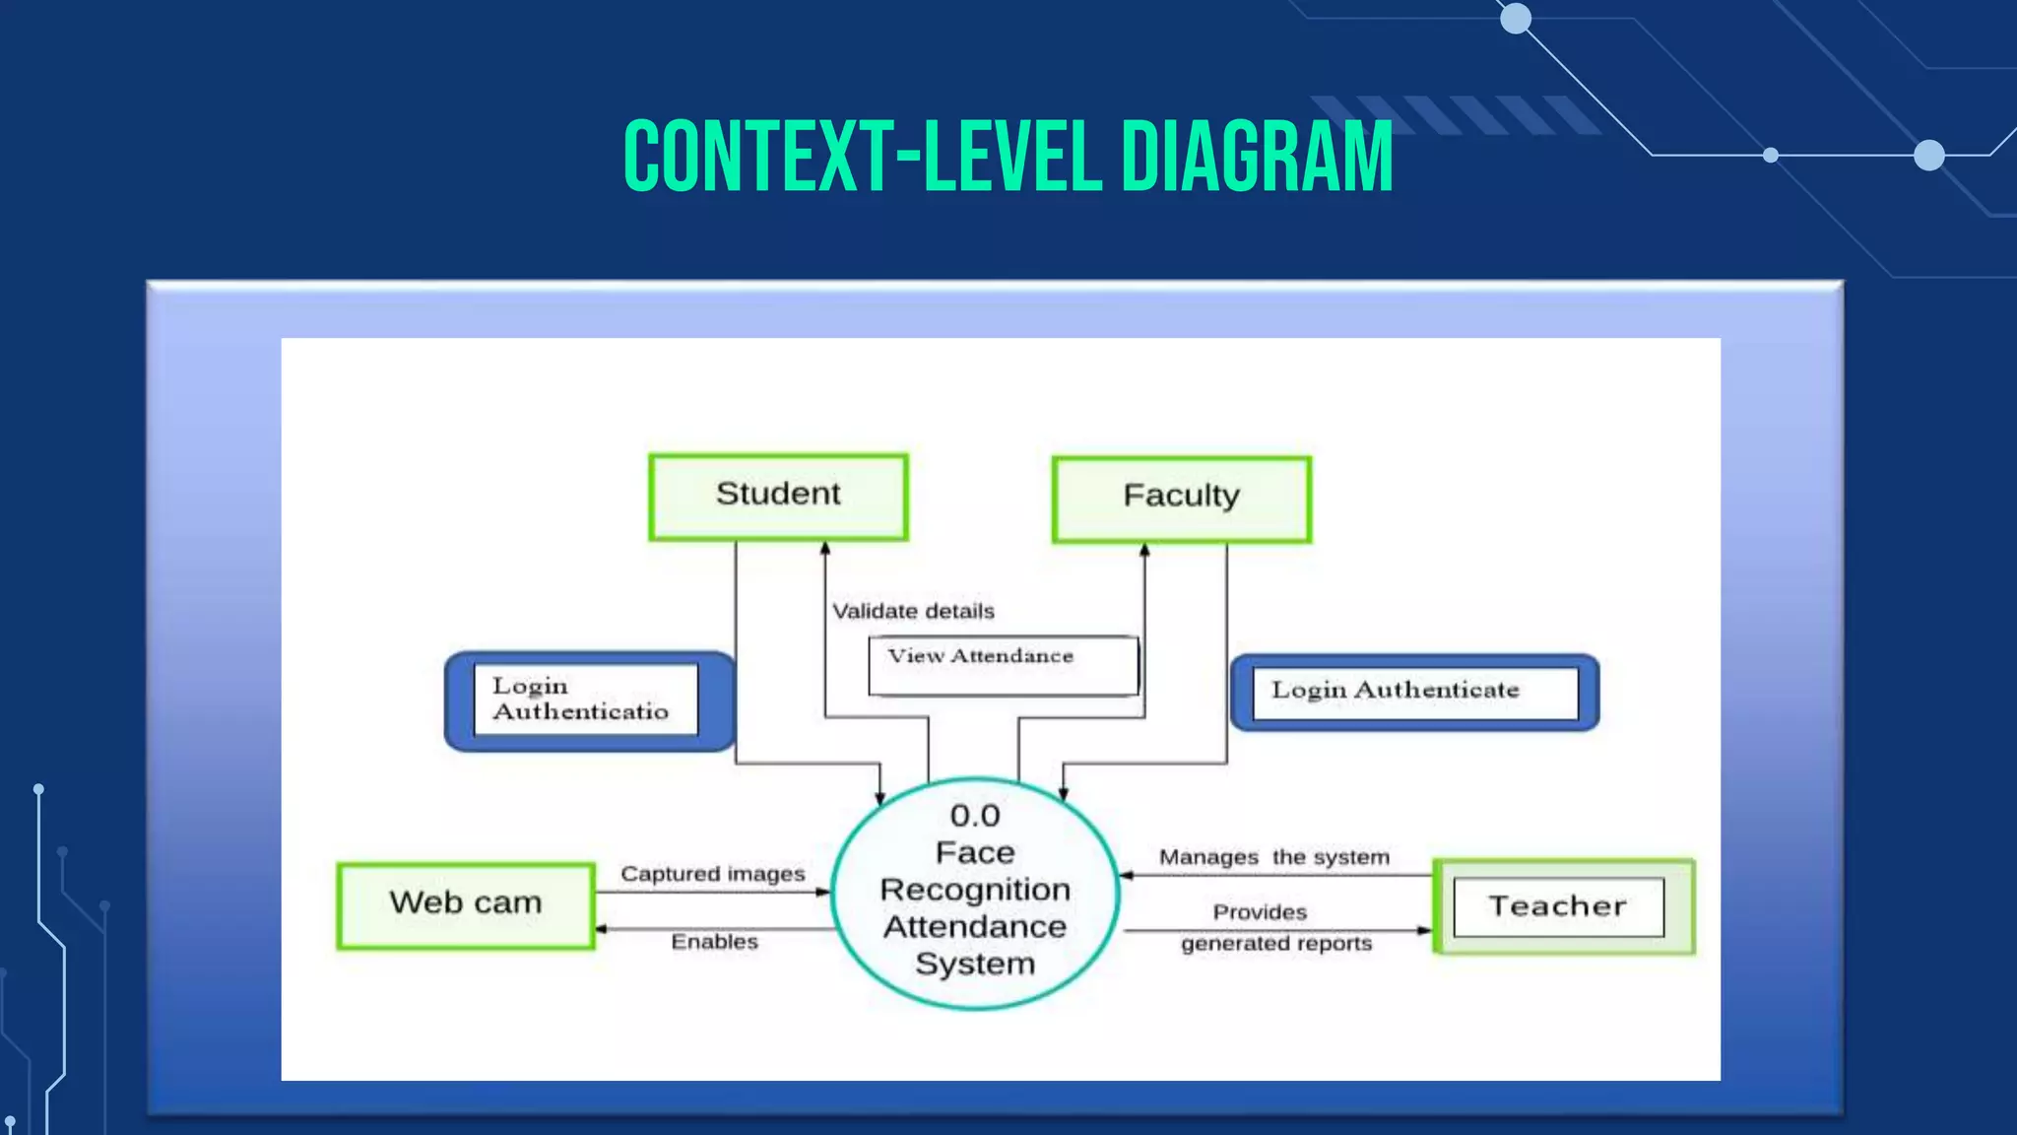
Design: Context Level Diagram

Slide 9
Future Scope :
Some of the future enhancements that can be done to this system are as follows:
Facility of Defaulter list in which system update the defaulter student.
For students, we can develop a dedicated login page in which they can see their details and attendance record .
In future we can update the modules like notices for student and many more.

Slide 10
Thank You !

