Slide 1
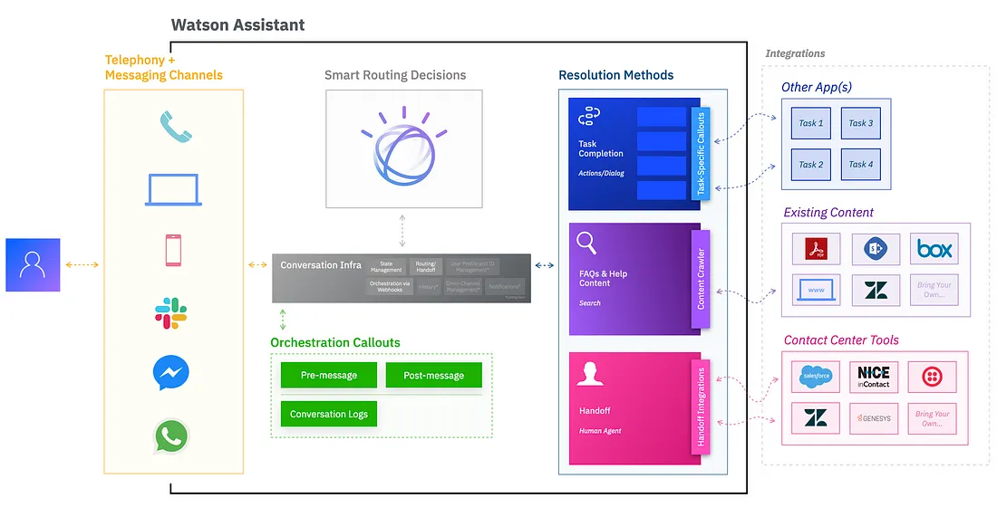
Build a chatbot project by using Watson Assistant

Slide 2
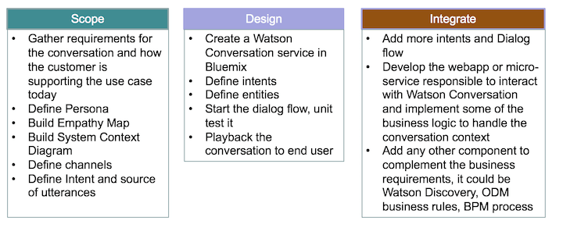
Chatbot projects that use Watson Assistant involve three phases:

Slide 3
Task 1: Create the Assistant service
Task 2: Create a workspace
Task 3: Create intents
Task 4: Test the intents
Task 5: Add entities
Task 6: Build the dialog
Task 7: Complete advanced dialog work
Task 8: Use the API

