Slide 1
Symfony architecture

Slide 2

Symfony Architecture
How works
Bundles (kata)
Components (kata)
Bridges (overview)

Slide 3
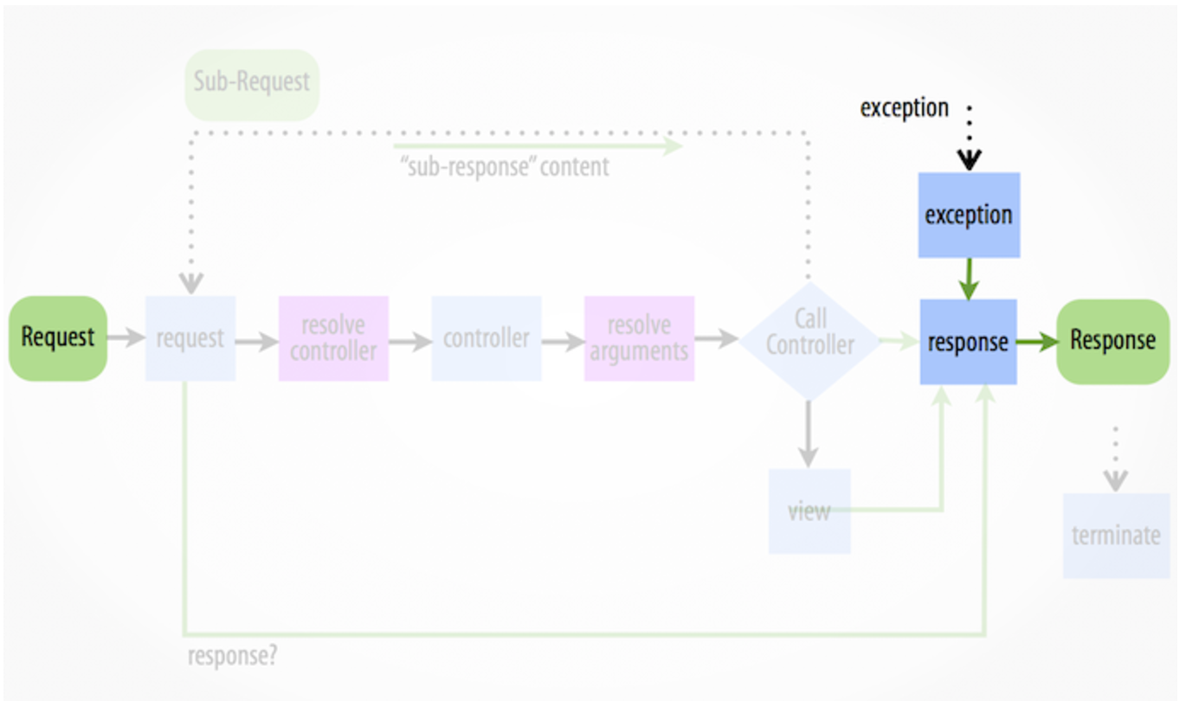
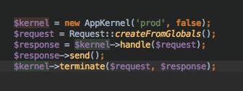
How works
Symfony Architecture
Structure process by HttpKernel driven by events
Kernel uses HttpKernel::handle() in order to dispatch events.

Slide 4
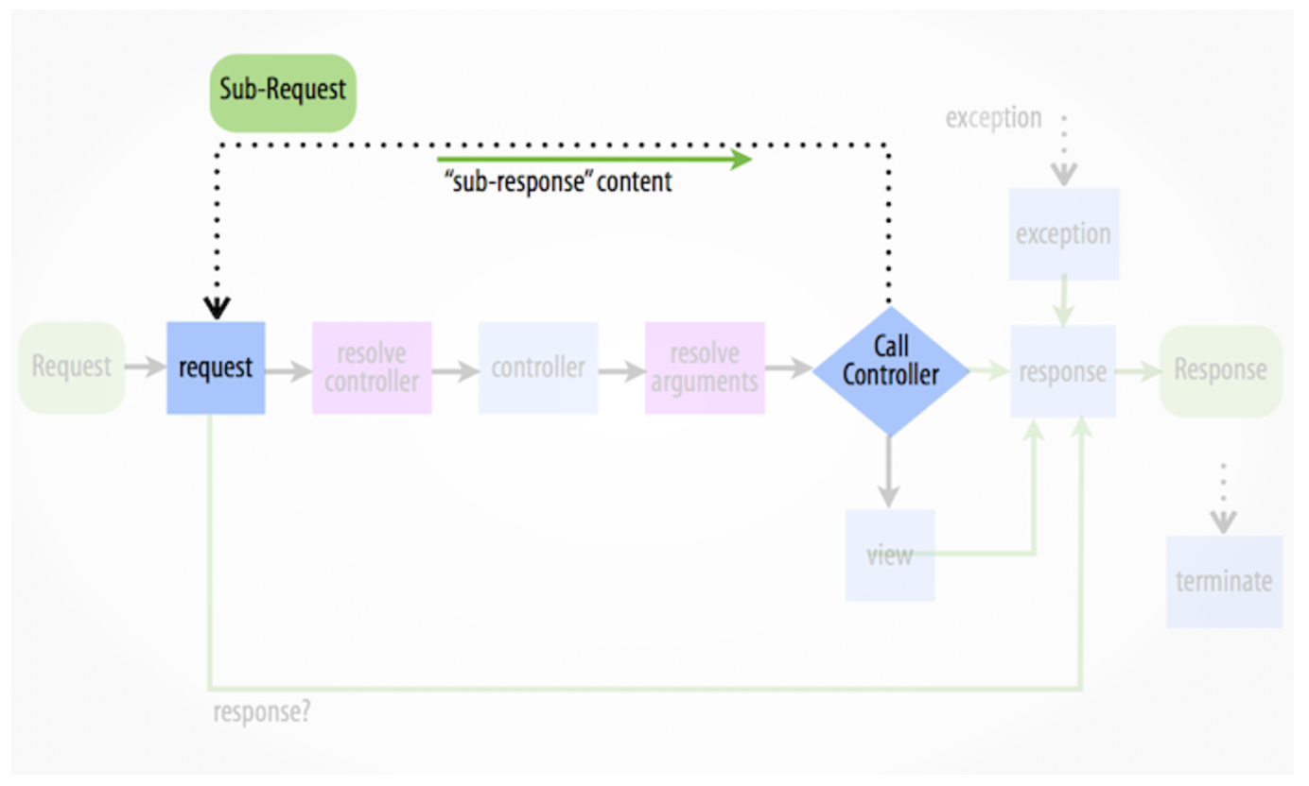
Request handling
Symfony Architecture
Step 1: Request
Event:
kernel.request
Typical Purposes:
To add more information to the Request, initialize parts of the system, or return a Response if possible.
Examples of listeners:
Security component
Routing component

Slide 5
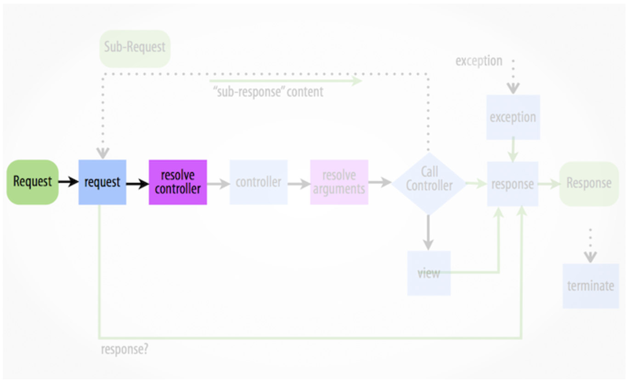
Request handling
Symfony Architecture
Step 2: Resolve controller
Event:
nothing
Purpose:
Instantiate the controller that is responsible for creating and returning the Response for a specific page.
What you need:
ControllerResolverInterface

Slide 6
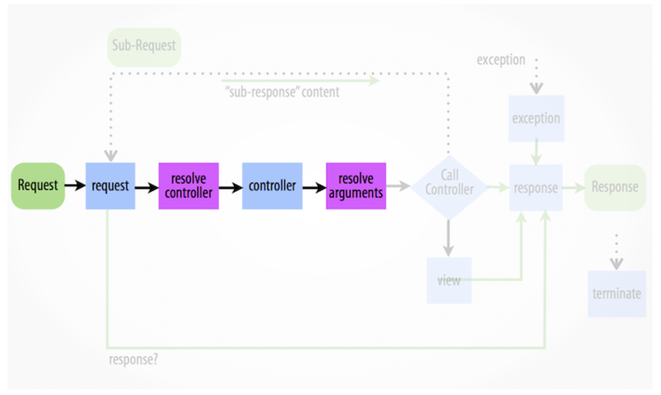
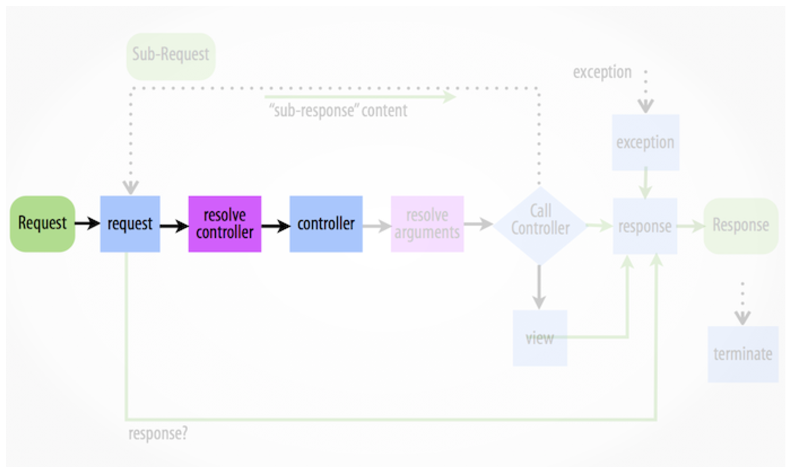
Request handling
Symfony Architecture
Step 3: Before load controller
Event:
kernel.controller
Typical purposes:
Initialize things or change the controller just before the controller is executed.
Examples of listeners:
Sensio framework extra bundle with its ParamConverter. Use complete objects instead of scalar values.

Slide 7
Request handling
Symfony Architecture
Step 4: Resolve arguments
Event:
nothing
Purpose:
Resolves the arguments passed to the controller resolver.
Things of Symfony framework:
Uses reflection to return an array of the names of each of the arguments
If Request (or child) is type-hinted, includes it.

Slide 8
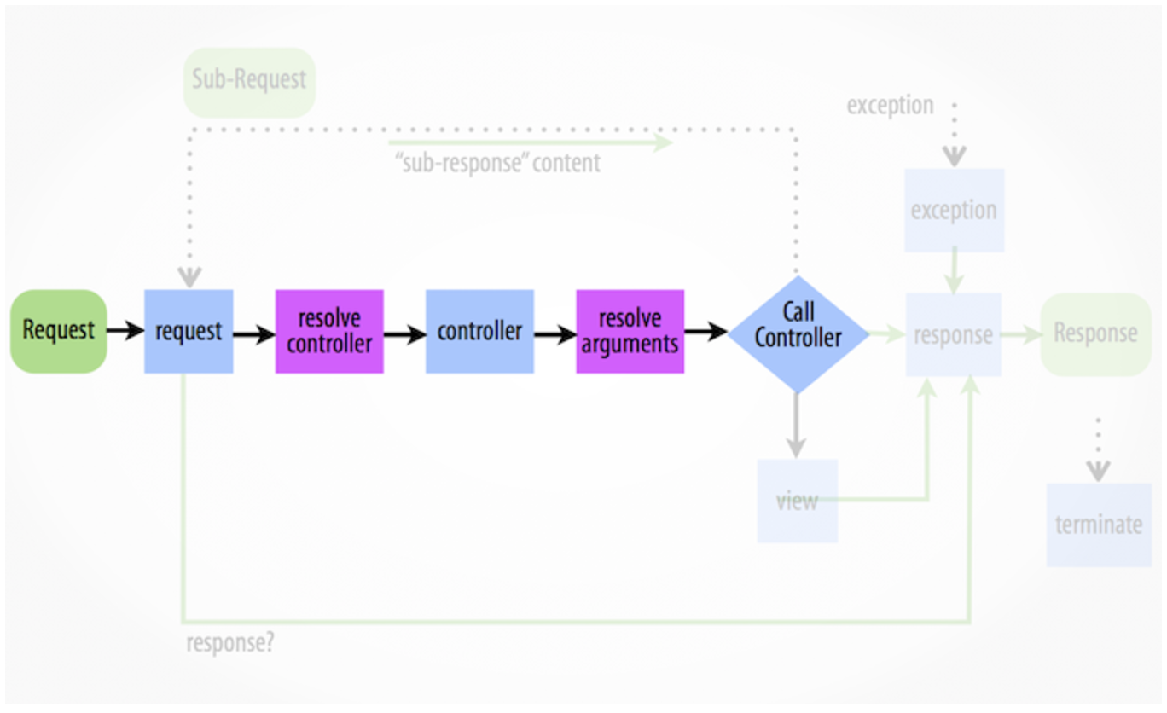
Request handling
Symfony Architecture
Step 5: Calling controller
Event:
nothing
Purpose:
Resolver your business logic and return a Response object that could be a JSON, HTML, etc.

Slide 9
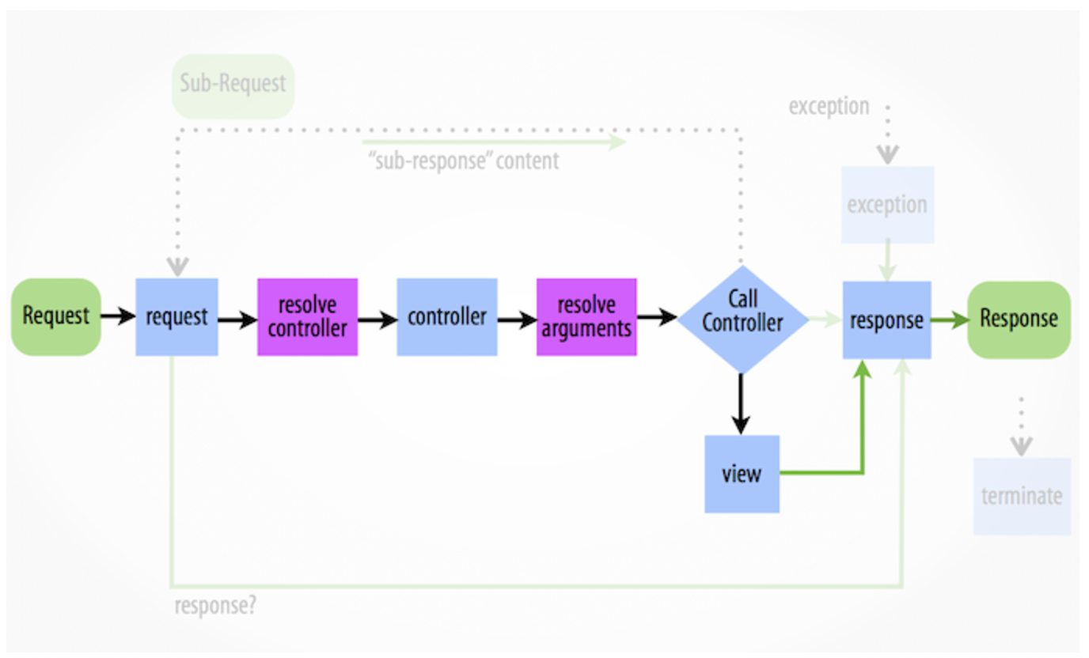
Request handling
Symfony Architecture
Step 5.1: Non Response object
Event:
kernel.view
Purpose:
Transform a non-Response return value from a controller into a Response. Maybe you want that controllers return only data.

Slide 10

Request handling
Symfony Architecture
Step6: Response
Event:
kernel.response
Typical purposes:
Modify the Response object just before it is sent
Example by Symfony documentation:
Inject JS before </body>

Slide 11
Request handling
Symfony Architecture
Step7: Terminable Interface (Optional)
Event:
kernel.terminate
Typical purposes:
To perform some "heavy" action after the response has been streamed to the user.
What it does:
Call fastcgi_finish_request PHP function.
Blocks response (you won't send nothing else)
Listeners will work in background

Slide 12
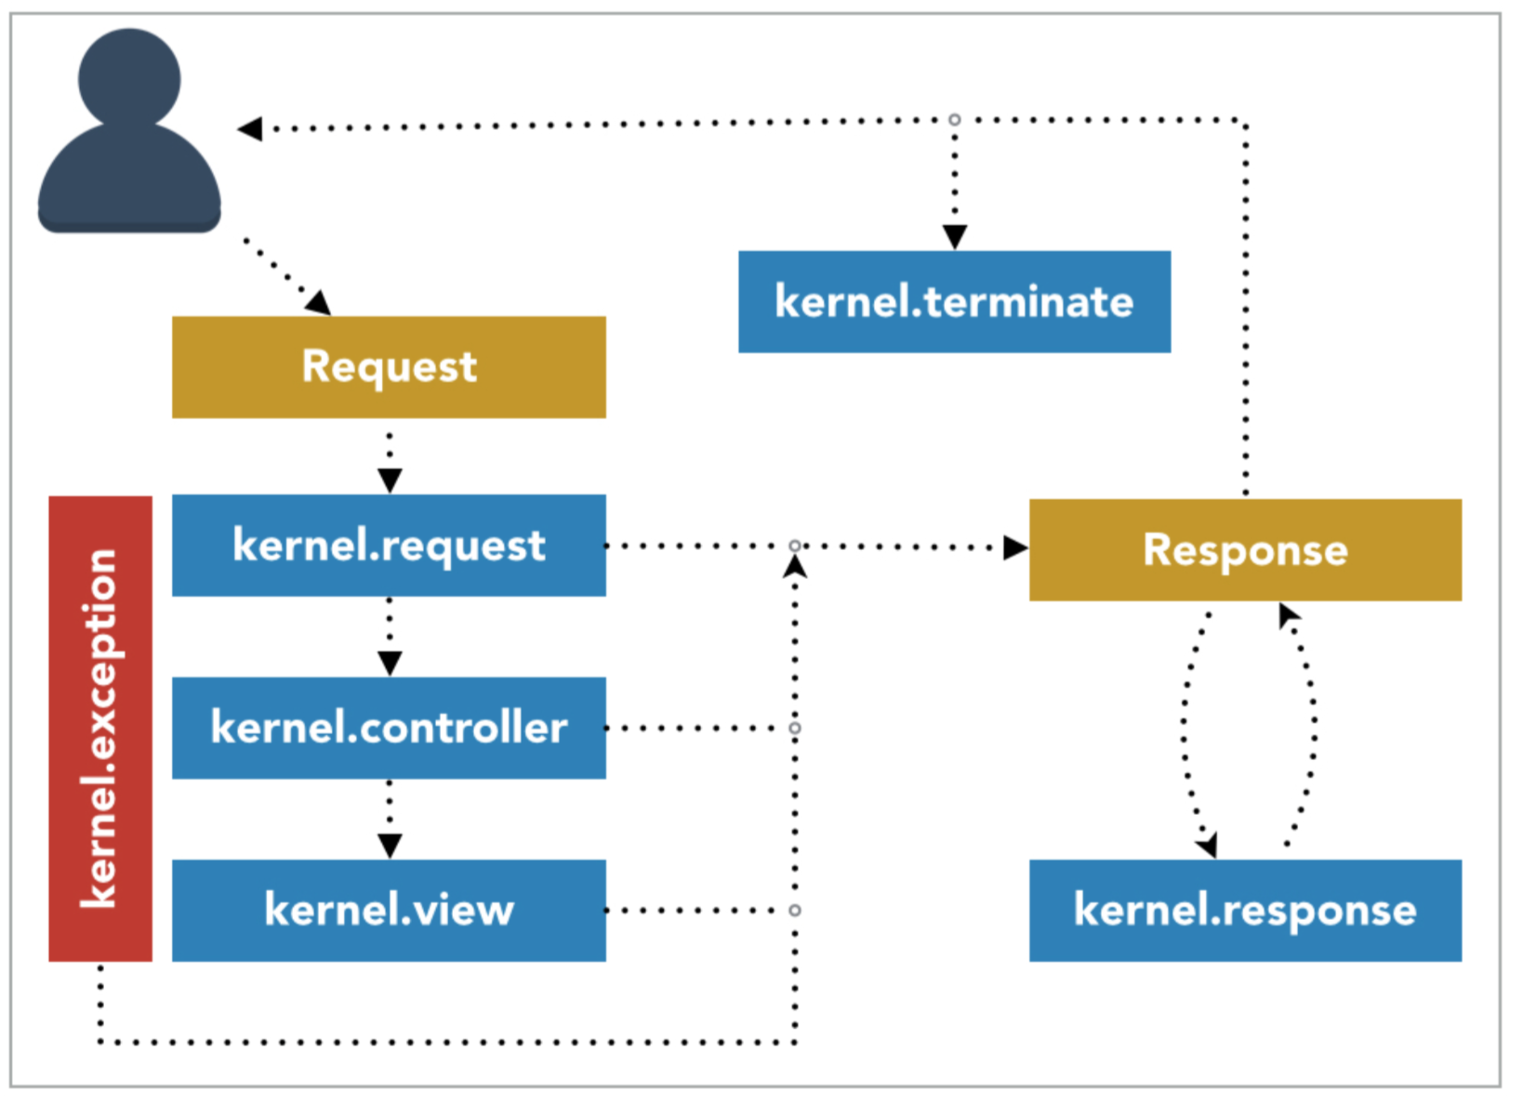
Driven by events: Kernel events
Symfony Architecture
Event | When | Why
kernel.request | At the very beginning of request dispatching. | Create a response for a request before any other code in the framework is executed
kernel.controller | Controller was found for handling a request. | Change the controller that will handle the request
kernel.view | Return value of a controller is not a Response. | Allows you to create a response for the return value of the controller
kernel.response | A response was created for replying to a request | Allows you to modify or replace the response that will be replied
kernel.finish_request | A response was generated for a request | Reset the global and environmental state of the application, when it was changed during the request
kernel.terminate | A response was sent | Run heavy post-response jobs
kernel.exception | Uncaught exception appears | Create a response for a thrown exception or to modify it
Notes:
kernel.terminate is optional. You have to use only if Kernel implements TerminableInterface (Default Kernel implements)

Slide 13
Driven by events
Symfony Architecture
Driven by events
EventDispatcher

Slide 14
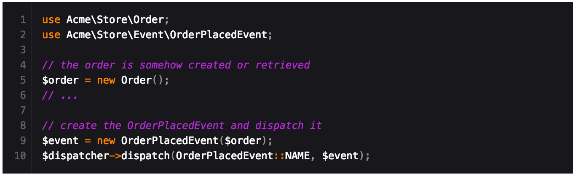
Driven by events: Mediator pattern
Symfony Architecture
FinishRequest
Event
RequestEvent
Listener
PostResponse
Event
EventDispatcher
OtherRequestEventListener
….
addListener()
dispatch()

Slide 15
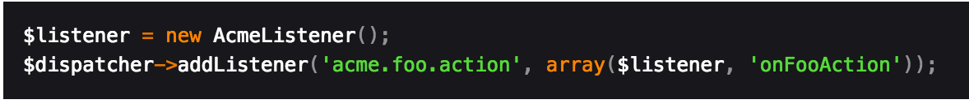
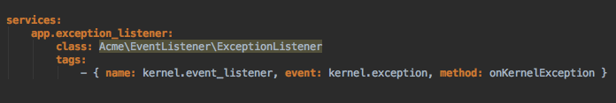
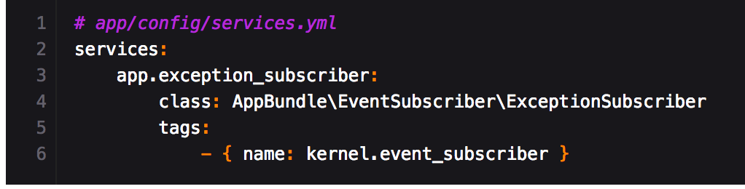
Driven by events: How to add consumers?
Symfony Architecture
Add your listener on the fly ...
or using the container...
… and don’t forget of your subscribers
Notes:
“method” tag can be removed. By defect uses on + “CamelCase Event Name”

Slide 16

Driven by events: Listeners and Subscribers
Symfony Architecture
Event Listener OR Event Subscriber

Slide 17
Driven by events: Listeners and Subscribers
Symfony Architecture
Event Listener
Event Subscriber
Decoupled:
Listener does know about event names
Flexibles:
For example, can be enabled or disabled by a service depending of a parameter.
Reusable:
Subscriber knows about events. Symfony uses internally.
Events as you want:
You can subscribe for events with one or more methods ordered by priority. All in one class.

Slide 18
Driven by events: Dispatcher variants.
Symfony Architecture
And besides of EventDispatcher….
ContainerAwareEventDispatcher
Has injected the container service (only public services will be available)
InmutableEventDispatcher
It’s a proxy of the original event dispatcher. The difference is that it’s not modificable.
TraceableEventDispatcher
can then be used to determine which event listeners have been called by the dispatcher

Slide 19
Driven by events
Symfony Architecture
kata
What will we see?

Slide 20
Symfony Standard Edition
Symfony Architecture
Symfony Standard Edition
Minimal features with Symfony Bundles
Standalone components ready to be used
An AppBundle where you can start coding

Slide 21

Symfony code organization
Symfony Architecture
Symfony code organization
You already know it

Slide 22




Symfony code organization: Best practices
Symfony Architecture

Slide 23
Symfony Architecture
First-class citizens
Symfony Bundles

Slide 24
Symfony Architecture
What are?
Structured set of files
Single feature (BlogBundle, UserBundle…)
Can be override

Slide 25
Components
Symfony Architecture
PHP
Filesystem
Applications
Web applications
Framework
Communication
Symfony components

Slide 26
Components
Symfony Architecture
Making life easier I
Components for PHP

Slide 27
Components: PHP
Symfony Architecture
ClassLoader
Provides tools to autoload your classes and cache their locations for performance
DEPRECATED at 3.3. REMOVED at 4.0
Expression
Language
Can compile and evaluate expressions. An expression is a one-liner that returns a value (mostly, but not limited to, Booleans).
Intl
A PHP replacement layer for the C intl extension that also provides access to the localization data of the ICU library (Only English)
PropertyAccess
Read and write from/to an object or array using a simple string notation
PropertyInfo
Get information about class properties by using different sources of metadata
Serializer
Used to turn objects into a specific format (XML, JSON, YAML, ...) and the other way around
Options
Resolver
array_replace on steroids. It allows you to create an options system with required options, defaults, validation (type, value), normalization and more.

Slide 28
Components
Symfony Architecture
Making life easier II
File System

Slide 29
Components: File System
Symfony Architecture
Filesystem
Provides basic utilities for the filesystem: mkdir, cp, etc...
Finder
Finds files and directories via an intuitive fluent interface

Slide 30
Components
Symfony Architecture
Making life easier III
Applications

Slide 31
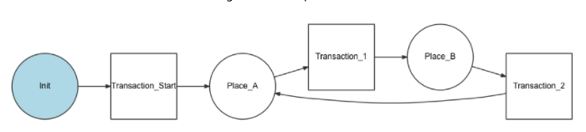
Components: Applications
Symfony Architecture
Translation
Provides tools to internationalize your application
Validator
Provides tools to validate values following the JSR-303 Bean Validation specification
Workflow
Tools for managing a workflow or finite state machine. New in version 3.2

Slide 32
Components
Symfony Architecture
Making life easier IV
Web applications

Slide 33
Components: Web applications
Symfony Architecture
Form
Allows you to easily create, process and reuse forms. (You can use with an API also)
Asset
Manages URL generation and versioning of web assets such as CSS stylesheets, JavaScript files and image files
CssSelector
Component converts CSS selectors to XPath expressions
Templating
Provides all the tools needed to build any kind of template system

Slide 34
Components
Symfony Architecture
Making life easier V
Framework components

Slide 35
Components: Framework
Symfony Architecture
Dependency
Injection
Standardize and centralize the way objects are constructed in your application
Event
Dispatcher
Allow your application components to communicate with each other by dispatching events and listening to them
Cache
Implements PSR-6 and PSR-16 caching mechanisms and provides adapters for popular caching backends (Redis, Memcache, APCu, etc.)
HttpKernel
Process for converting a Request into a Response by making use of the EventDispatcher component
Security
HTTP, interactive form, X.509 certificates or your own strategy for user authentication. Furthermore, the component provides ways to authorize based on roles, and it contains an advanced ACL system
Ldap
Connect to an LDAP server (OpenLDAP or Active Directory).

Slide 36
Components
Symfony Architecture
Question
How can we interact?

Slide 37
Components: Input
Symfony Architecture
HTTP
Command line
HttpFoundation
Routing
Process
Console

Slide 38
Components: HTTP requests
Symfony Architecture
HttpFoundation
Routing
Object-oriented layer for the HTTP specification
Request, Session, File, Response
Maps an HTTP request to a set of configuration variables
Routes
Load by PHP or from a file like yml, xml..

Slide 39
Components: Command line
Symfony Architecture
Console
Process
Creation of beautiful and testable command line interfaces
Create your application and add commands many as you want.
Executes commands in sub-processes
Takes care of the subtle differences between the different platforms
Real time output
Run asynchronous processes

Slide 40
Bridges
Symfony Architecture
Extending bundles and components
Symfony Bridges

Slide 41



Bridges
Symfony Architecture
Bridge Pattern
Execute the abstraction and forget the implementation
Monolog

Slide 42
Symfony Architecture
No more theory
Keep coding
Notes:
kernel.terminate is optional. You have to use only if Kernel implements TerminableInterface (Default Kernel implements)

