Slide 1

Stock Market Analysis using Hadoop Ecosystem
Team
Jaisekhar Koya
Sri Sai Nikhil Kantipudi
Sai Rohith Guntupally
Arthi Nagireddy

Slide 2

Introduction
Studying the stock market with graphs, news, important dates, and many more is always hard which leads to inaccuracy in analysis and investment in particular stock. This project helps to analyze the stock market using stock market data and twitter data using Hadoop ecosystem. It collects the twitter data associated with the stock symbols and analyze/predict the stock movement.

Slide 3
Motivation
We have tried hard to study the stock market with graphs, news, important dates, and many more, but we failed many times which leads to loss of profits and sometimes even the investments. We always have an extremely hard time analyzing that huge amount of data and coming to a decision based on the analysis. And analyzing that huge data takes a lot of time and got to concentrate on various works too. So, to do this task for us we need some sort of Big data tools to analyze and give us filtered results which we can cross-check and invest in that stock confidently. Not only that as big data tools analyze data extremely fast, but we can also make decisions quicker than we do. We can also avoid human error using these tools.

Slide 4
Significance
As more than half of the population are investing in stocks it is one of the most significant topics to be considered.
30% of investors failing to analyze the stock and predicting the uptrend or downtrend of stock is one of the major reasons.
Big data tools help to analyze the huge data which helps to provide the efficient results.
It reduces the analysis time of investors and helps in making decisions faster and error free.

Slide 5

Objectives
To create a stock market analysis system, we will be collecting the twitter data using NLP techniques and processing the data. Different tools in Hadoop ecosystem will be used to analyze the data and help in predicting the movement of the stock.

Slide 6
Features
The main features of this project is twitter data extraction, sentimental analysis on the extracted data. Using HDFS to store the data. Apache spark to process the data and Hive for querying the data. A visualization tool for showing out the results.

Slide 7
Story (Life)
Why?
Who?
What?
Where?
When?
How?

Slide 8
Architecture

Slide 9
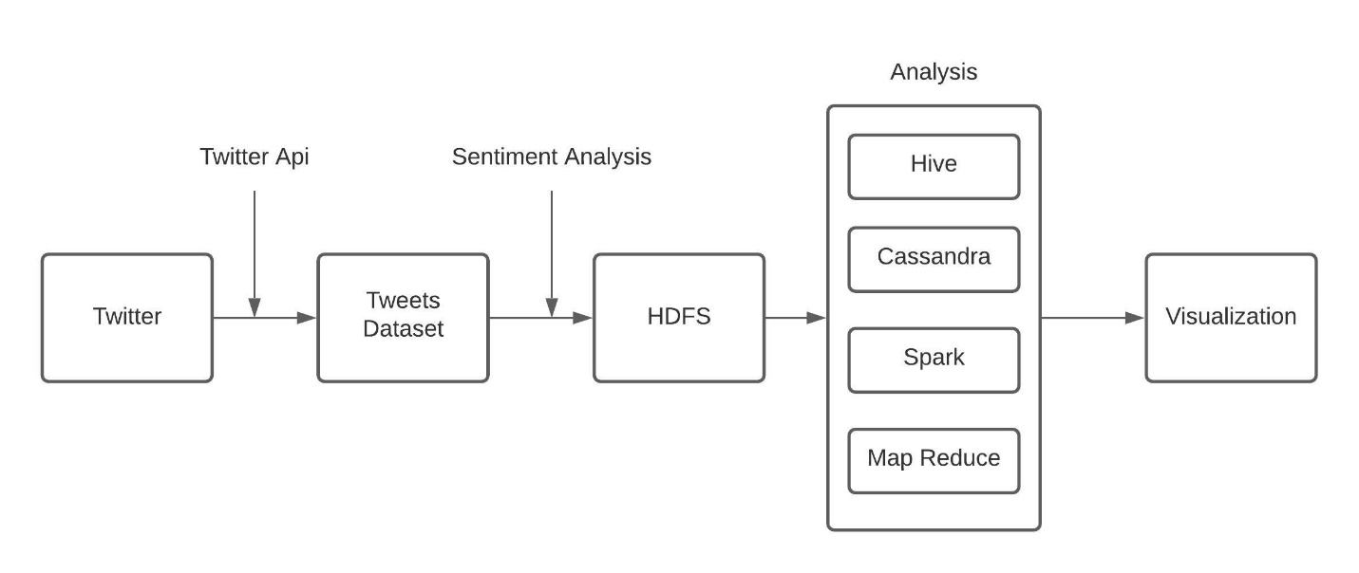
Design

Slide 10
Tools and Technology
Python for Data Extraction
NLP techniques
Apache spark to process the data
Tableau for Data visualization
HDFS to store the data
Hive & Cassandra for querying the data

Slide 11
Data
Source: Twitter API
Stock Ticker: AAPL
Date Range: 10/01 – 10/28
Number of tweets: More than 100k

Slide 12
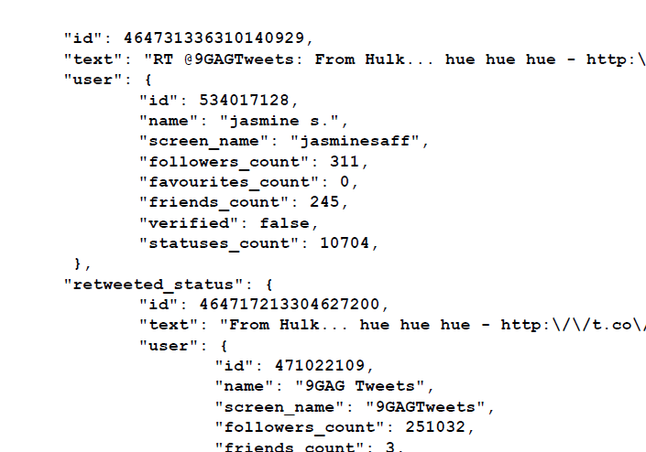
Tweet Object
We are using the following Tweet Objects
Text
Text is the user Tweet
Entities
Contains Hashtags and URLs
User object
Contains user details like
- Time and date of the tweet
- Screen Name
- Followers Count

Slide 13
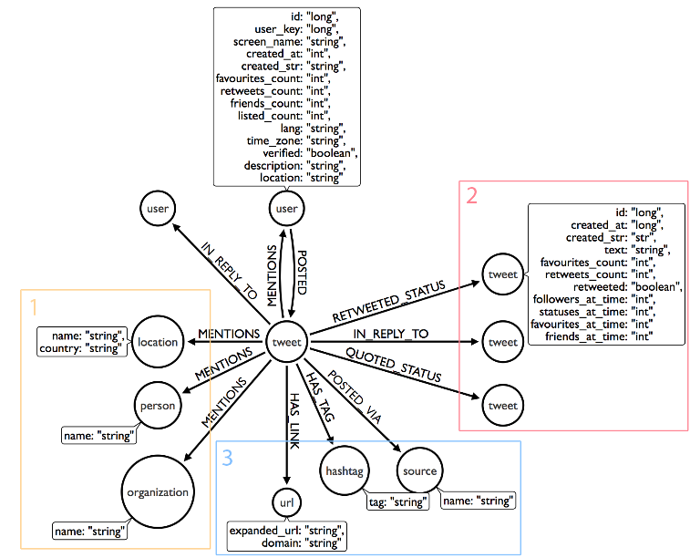
Dataset Features

Slide 14
Story (Data)
Why?
Who?
What?
Where?
When?
How?

Slide 15
Implementation
Tweets Extraction
Storing in HDFS
Hive operations: (initialization and loading Data)
MapReduce-wordcount;
Hive Analysis
Cassandra Analysis
SPARK analysis
Visuslization and result evaluation
Technical analysis

Slide 16
Tweets Extraction
Used python to call the twitter API.
Extracted more than 100k tweets.
Used keyword AAPL
Extracted tweets from 10/01 – 10/28
Data has been stored in HDFS.

Slide 17
MapReduce
Python code is used to extract the hashtags and tweets from the tweet object dataset.
Stored output of the extracted data in HDFS.
Performed wordcount using jar which contains Map and Reduce functions.
Output has been saved in HDFS for later analysis.

Slide 18
Sentiment Analysis
Created table in Hive using dataset stored in HDFS with the help of JSONserde dependency jar.
Used AFINN Dictionary for sentiment analysis which polarity value range from -5.0 to +5.0.
Initially we split the words and mapped to AFINN dataset.
Finally, joined the mapped polarity values to original table of tweets.

Slide 19
Hive Analysis
Querying
the screenname of the user and there followers count
Finding
the number if positive tweets which contains the keyword ‘iPhone’.
Finding
the number of negative tweets which contains the keyword ‘Event’.
Finding
the user’s name whose tweets has maximum number of retweet count.
Getting
User’s name and their total number of tweets

Slide 20
Cassandra Analysis
Creating
table with required fields from tweets json.
Querying
the count of number of most positive tweets.
Querying
the count of total negative tweets.
Querying
the count of number of positive tweets.

Slide 21
Spark Analysis
Creating
two data frames which is twitter data and data with polarity value.
Querying
the number of records in the data frame dataset.
Querying
the number of tweets from different countries.
Querying
the count of tweets based on a day.
Querying
the user with more number of tweets.
Querying
for users with more follower count

Slide 22
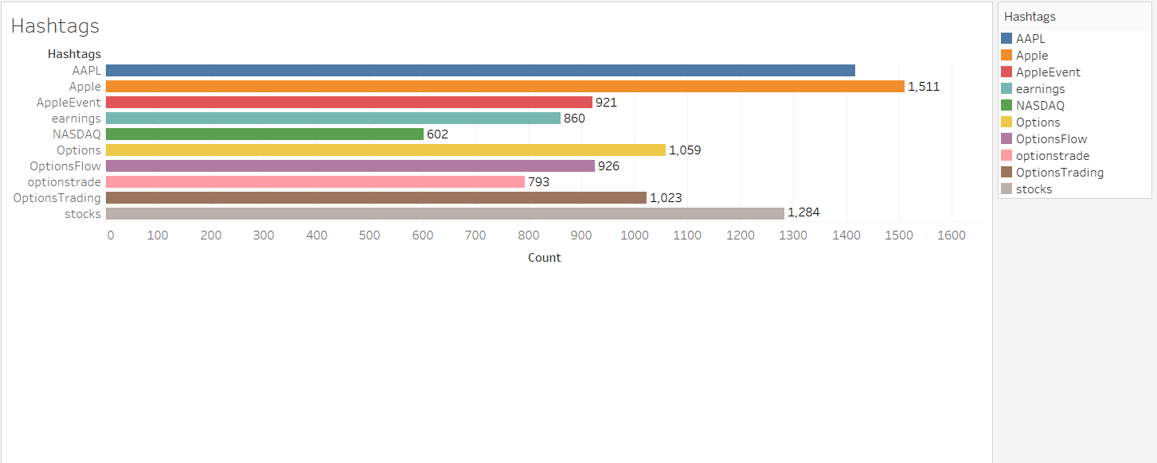
Visualization

Slide 23
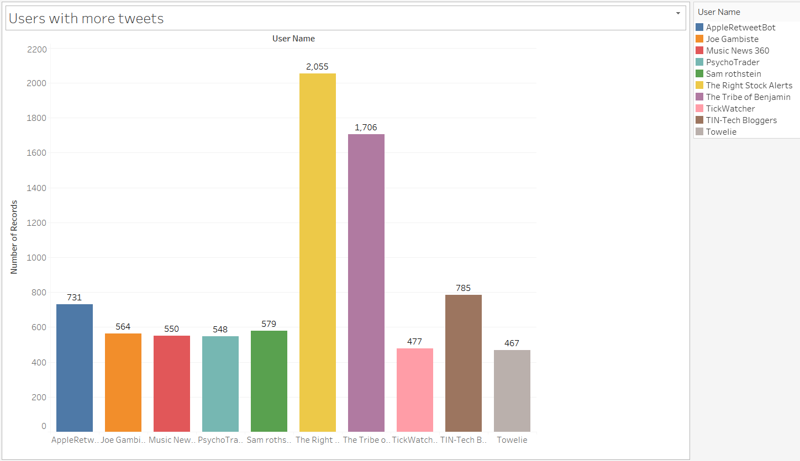
Visualization (Contd..)

Slide 24
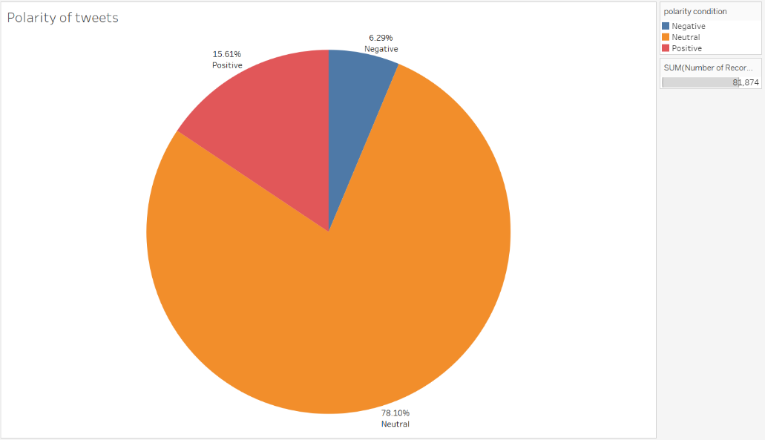
Visualization (Contd..)

Slide 25
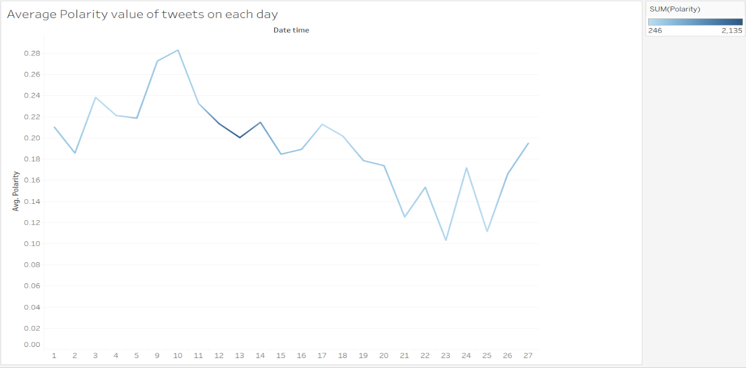
Visualization (Contd..)

Slide 26
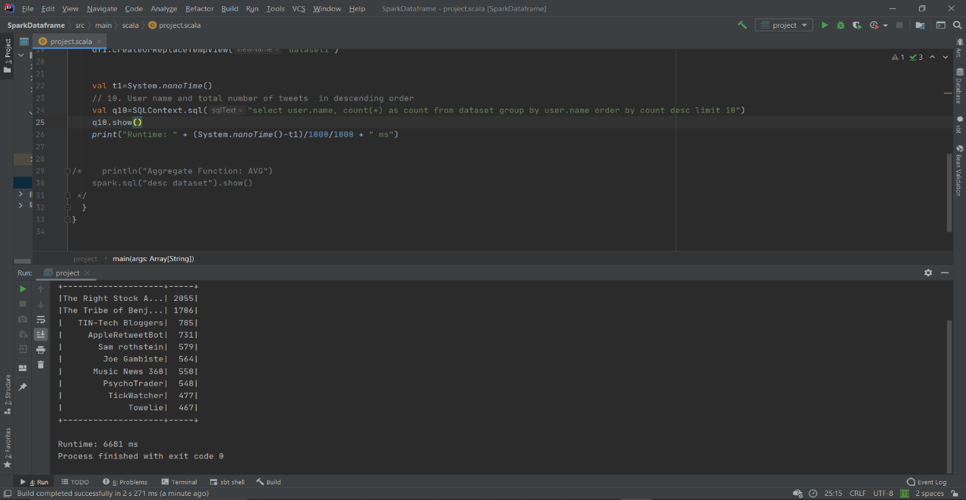
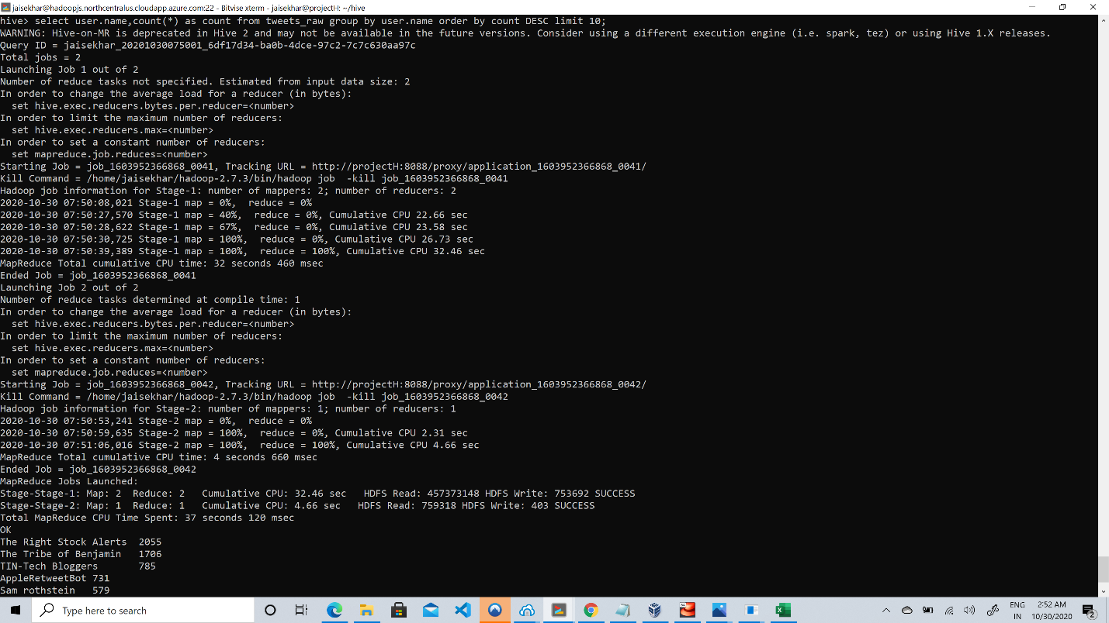
Technical Analysis
Spark SQL
Hive

Slide 27
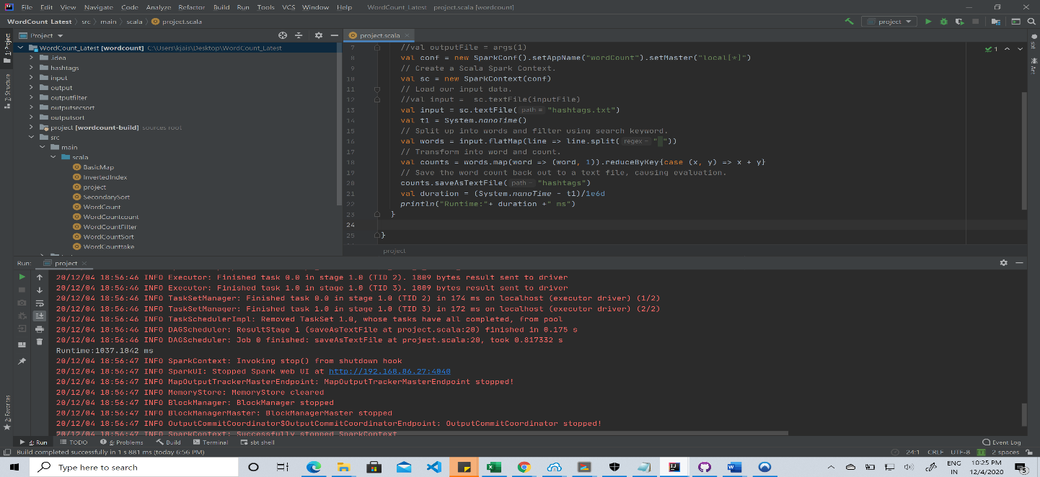
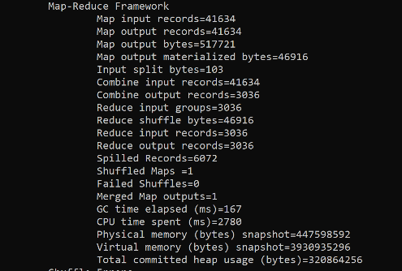
Technical Analysis (Contd..)
Spark
MapReduce

Slide 28

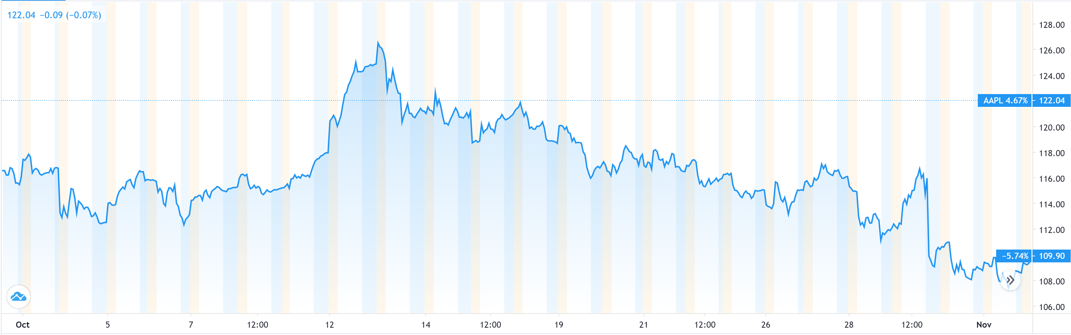
Technical Analysis (Contd..)
Our System Trend
Real Trend

Slide 29
Conclusion
Using this system, we successfully analyzed the data extracted from the twitter social opinions based on stock ticker with the help of hadoop ecosystem. In the above results, we able to get the trend after analysis which can be used for predictions of movement of stock. This trend might help for the investors in future investments. These trends are giving early signs for the investments which might help to gain the profits. Right now, this system might be only for one stock and for one month but it can be extended for future usge. Thus, we can say that we successfully achieved our goal using this system.

Slide 30
Applications
This model can be used as stock auto bot.
Can be used by the trader as a tool to analyze the stock
Used by stock analyst for prediction

Slide 31
Future Work
In this system, we analyzed only AAPL stock ticker, which we extracted based on this keyword from the twitter for one month.
In future, we can extend this range of extraction on keywords on time frames accordingly which might be dynamic in nature.
Our system is based on historical data but we can also try to analyze the live data with proper models.

Slide 32

Project Management
Extracted tweets using python and twitter API for the dataset.
Loading the data into the HDFS.
Sentiment Analysis done on every tweet in the dataset.
Wordcount on hashtags using mapreduce.
Creation of table and loading of data into Hive.
Analysis of data using Hive
Analysis of data using Cassandra
Visualization using Tableau.
Initialization and loading the data into Apache Spark.
Analysis of data using SparkSQL
Technical analysis by comparing Apache Spark, Mapreduce and Hive
Final comparison between our system trend and real trend of stock (success)

Slide 33
Contribution
Jaisekhar Koya : 25% Extracting tweets using Python. Done sentimental analysis using AFINN dictionary which gives polarity value. Extracted tweets were stored in HDFS. Created and loaded data to hive. Performed few queries in Hive and also Cassandra. Drawn the comparison between Apache Spark and Mapreduce. Contributed in drawing the comparison between trends of system and real.
Sri Sai Nikhil Kantipudi: 25% Helped in doing sentimental analysis on every tweet in the dataset. Done wordcount on extracted hashtags using MapReduce. Contributed in loading and analysing the data in Hive. Performed few queries in Hive and also in Cassandra. Analyzed the data using Spark SQL. Also contributed to work for comparing system vs real trends.

Slide 34
Contribution(contd.)
Sai Rohith Guntupally: 25% Tweets extracted and parsed for hashtags using python. Done hdfs operations on the extracted dataset. Performed few queries on the dataset using hive and Cassandra. Part of visualization in tableau. Wrote few queries in apache spark. Drawn the comparison between Apache Spark and Hive.
Aarthi Nagireddy: 25% Sentiment Analysis using dictionary system. Hive initialization and loading of data of the dataset. Performed few queries in Hive and Cassandra for data analysis. Part of Visualization work in tableau. Initialization and loading the data into Apache Spark. Wrote few queries in apache spark.

Slide 35
References
Z. Peng, "Stocks Analysis and Prediction Using Big Data Analytics," 2019 International Conference on Intelligent Transportation, Big Data & Smart City (ICITBS), Changsha, China, 2019, pp. 309-312, doi: 10.1109/ICITBS.2019.00081. •
G. V. Attigeri, Manohara Pai M M, R. M. Pai and A. Nayak, "Stock market prediction: A big data approach," TENCON 2015 - 2015 IEEE Region 10 Conference, Macao, 2015, pp. 1-5, doi: 10.1109/TENCON.2015.7373006.

Slide 36


Thank you

