Slide 1
Set up Nagios on AWS

Slide 2
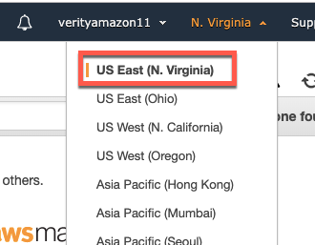
Login to AWS and Launch the following link
https://console.aws.amazon.com/ec2/home?region=us-east-1#s=Images
Ensure region is one of the following
USEast(N.Virginia&Ohio),USWest(N.California&Oregon)
Canada(Central)
EU(Frankfurt,Ireland,London
AsiaPacific(Mumbai,Seoul,Singapore,Sydney,Tokyo)
S.America(SaoPaulo)

Slide 3
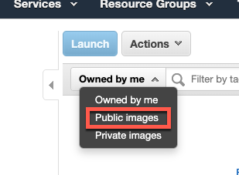
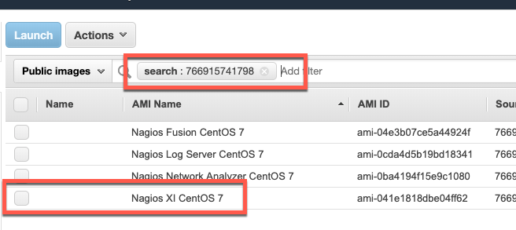
Set Filter to Public Images
Search for 766915741798
We will see Nagios XI CentOS 7 in the results

Slide 4
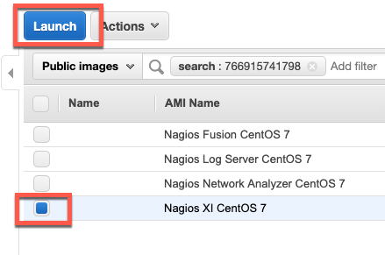
Click on the Check box for Nagios XI CentOS 7 and click on Launch

Slide 5
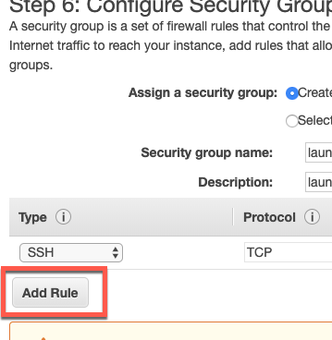
Take default options (free tier) and click on Configure Instance Details
Click on Add Storage
Click on Add Tags
Click on Configure Security Groups
Click on Add Rule

Slide 6
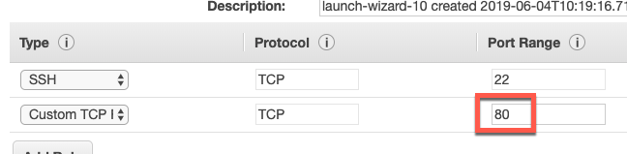
In Port Range enter 80, enter 0.0.0.0/0 in Source and click on Review and Launch
Click on Launch

Slide 7
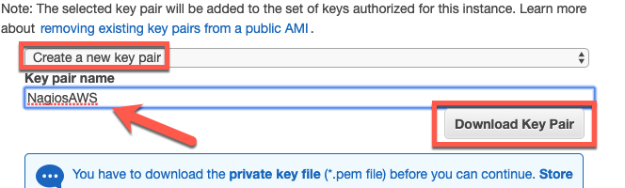
We would be prompted to Select or create a key pair
Click on the dropdown and select Create a new key pair
In Key Pair name, enter an easy to remember name
Click on Download Key pair.
Save the file on your desktop
Launch Instances
Go to running
instance

Slide 8
Launching Nagios
In the AWS session, we have already learnt how to find the IP address of an instance. Open a new browser and launch the following URL
http://<<IP address>>/nagiosxi/
Nagios XI UI may take 10-15 min to be up on browser

Slide 9
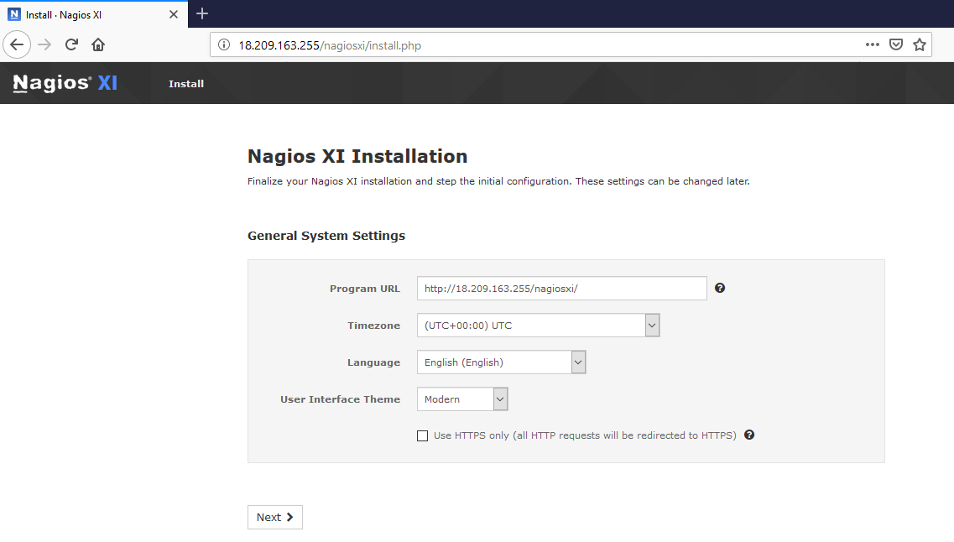
Setup Nagios XI UI
Click Next

Slide 10
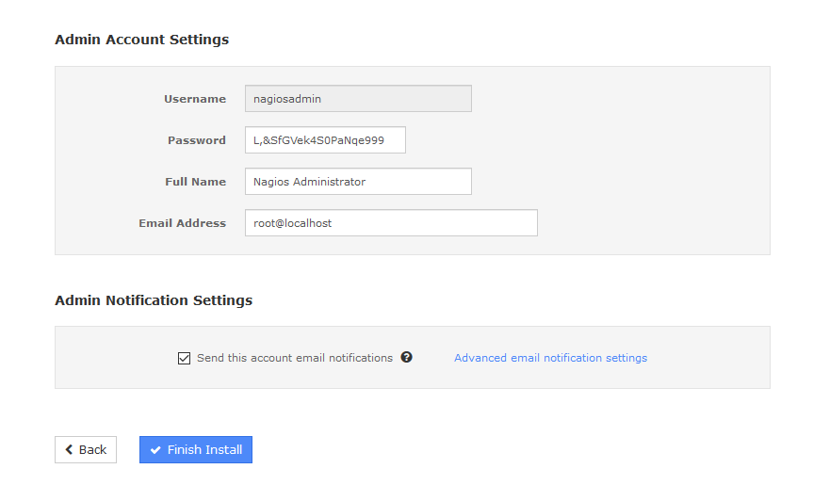
Setup Nagios XI UI
Click Finish Install
Note: You can change the password & note it down for future use

Slide 11
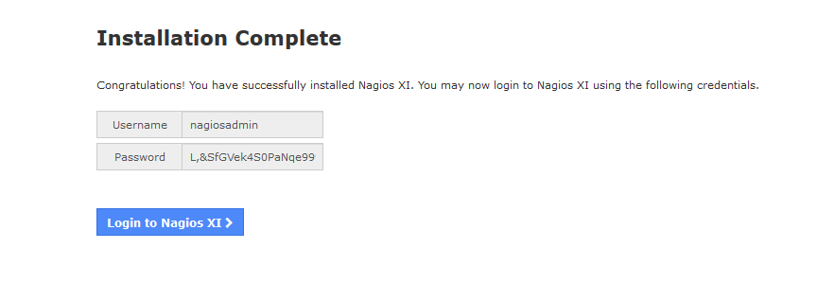
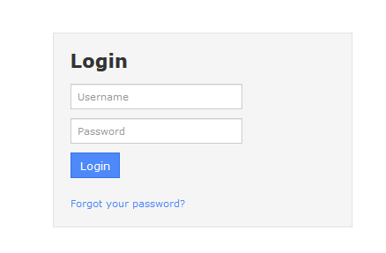
Setup Nagios XI UI
Click Login to Nagios XI
Login to Nagios XI
Accept the License
Click Submit

Slide 12
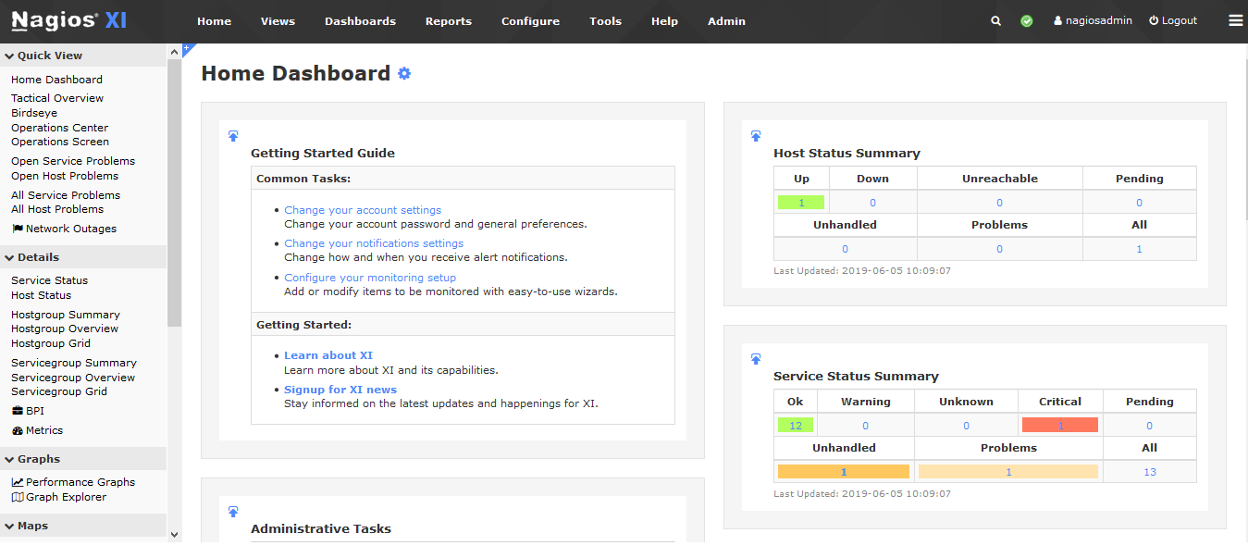
Nagios XI Dashboard

Slide 13
Set up Windows Instance on AWS

Slide 14
Steps to be done
TBD

Slide 15
Set up Nagios client & server on AWS windows instance

Slide 16
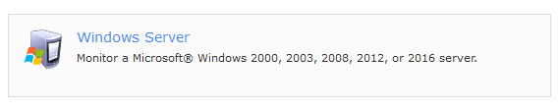
Windows server setup
Go to Nagios XI dashboard
Click Configure at top bar
Click Configuration Wizards
Search & Select Windows Server
Enter ip address of Windows Server
Click Next
Copy 64 Bit Agent download link
https://assets.nagios.com/downloads/nagiosxi/agents/NSClient++/NSCP-0.4.4.23-x64.msi

Slide 17
Windows client setup
Go to AWS windows UI
Launch the browser
Run below URL to download Agent
https://assets.nagios.com/downloads/nagiosxi/agents/NSClient++/NSCP-0.4.4.23-x64.msi
Once file is downloaded, run the installer to install it
Note: During installation, you may need to enter ip address & enter a secure password
Once installation finished, make sure your service status is running
[Launch Run > Launch services.msc > Go to NSClient++ (x64)]

Slide 18
Setup Windows Desktop
TBD

Slide 19
Windows Monitoring
TBD

