Slide 1
INTERNATIONAL INSTITUDE OF PROFESSIONAL STUDIES
DIGITAL COMPUTER ORGAINIZATION
Submitted To:- Shaligram Prajapat sir
Submitted By:- Jaishree Gullani

Slide 2
Contents
Introduction to computer
Input output organization
Control unit
Memory Organization
High speed memories and secondary memories
CPU Organization

Slide 3
INTRODUCTION TO COMPUTER ORGANIZATION
Computer organization and architecture is the study of internal working ,structuring and implementation of a computer system.

Slide 4
Architecture : It refers to those attributes of a system visible to a programmer or those attributes that have a direct impact on the logical execution of a programmer.
Organization: It refers to the operational units and their interconnections thst realize the architectureal specifications .

Slide 5
VON NEUMANN ARCHITECTURE
->Von neumann architecture also kniwn as the von neumann model,the computer consisted of a cpu,memory and i/o devioces.
->The CPU fetches an instruction from the memory at a time and executes it.thus ,the instructions are executed sequentially which is a slow process.
->It is a design model for a stored program digital computer that uses a processing unit and a single separate storage structure to hold both instructions and data.

Slide 6
KEY CONCEPTS OF VEN NEUMANN ARCHITECTURE
Data and instructions are stored in a single read write memory.
The contents of this memory are addressable by locations,without regard to the type of data contained there.
Execution occurs in a sequential fashion(unless explicitly modified)from one instruction to the next.

Slide 7
COMPUTUTER COMPONENTS
Programming in hardware
DATA
Sequence of arthmetic and logic functions
RESULTS
Programming in software
Instruction code
Instructions interpreter
Data
Result
General purpose arithmetic and logic functions

Slide 8
INTERCONNECTON STRUCTURES
The collection of paths connecting the various modules is called interconnection structures.
The design of this structures will depend on the exchanges that must me made among modules.

Slide 9
Read
Write
Memory
N words
0
.
.
.
N-1;
Address
Data
Data

Slide 10
t/o module
I/O Module
M Port
Read
Write
Internal Bus
Address
External Bus
Internal Bus
Interrupt Signals
External Bus

Slide 11
C.P.U
C.P.U
Address
Instructions
Data
Control Signals
Interrupt Signals
Data

Slide 12
The Interconnections structure must support the following types of transfers
Memory to Processor
Processor to memory
I/O to Processor
Processor to I/O
I/O to or from Memory

Slide 13
BUS INTERCONNECTION
A bus is a communication pathway connecting two or more devices.
One device at a time can successfully transmit signals.
Each line is capable of transmitting signals representing binary 1 and 0.

Slide 14
BUS INTERCONNECTION SCHEME
Bus
CPU
Memory
Input and Output
Control Lines
Address Lines
Data Lines

Slide 15
BUSES
System bus connects major components (processor,I/O,memory)
The data lines provides a path for moving data among system modules.These lines collectively called Data bus.
The address bus are used to designate the source or destination of the data on the data bus.
The control bus are used to control the access to and the use of the data and address lines.

Slide 16
INPUT OUTPUT RGAINIZATION

Slide 17
INTERRUPT DRIVEN I/O
It is an alternative scheme dealing with I/O.
For Input:
The device interrupts the CPU when new data has arrived and is ready to be retrieved by the system processor.
For Output:
The device delivers an interrupt either when it is ready to accept new data or to acknowledge a successful data transfer.

Slide 18
PRIORITY INPUTS
Priority inputs are systems tha establishes a priority over the various sources to determine which condition is to be serviced first when two or more requests arrive simaltaneously.

Slide 19
DIRECT MEMORY ACCESS
A data transfer technique is used in which IO devices directly access the memory and CPU is bypassed.
DMA module is capable of mimicking the processor and of taking over control of the system from thr processor.
The DMA module transfers the entire block of data,one word at a time,directly to or from memory.

Slide 20
DMA BLOCK DIAGRAM
Data lines
Address lines
Request to DMA
Ackowledge from DMA
Interrupt
Read
Write
Data count
Data register
Address register
Copntrol logic

Slide 21
I/O PROCESSOPRS
An input-output processor (IOP) is a processor with direct memory access capability. In this, the computer system is divided into a memory unit and number of processors.
Each IOP controls and manage the input-output tasks. The IOP is similar to CPU except that it handles only the details of I/O processing. The IOP can fetch and execute its own instructions. These IOP instructions are designed to manage I/O transfers only.

Slide 22
BLOCK DIAGRAM OF I/O PROCESSORS
CPU
Peripheral devices
Memory bus
PD1
PD 2
PD3
Memory unit
I/O

Slide 23
Synchronous and asynchronous data transfer
For synchronous data transfer, both the sender and receiver access the data according to the same clock.
For asynchronous data transfer, there is no common clock signal between the sender and receivers. Therefore, the sender and the receiver first need to agree on a data transfer speed.

Slide 24
Problem faced in asynchronous input output synchronization
It is not sure that the data on the data bus is fresh or not as their no time slot for sending or receiving data.
This problem is solved by following mechanism:
1)Strobe
2)Handshaking
Data is transferred from source to destination through data bus in between.

Slide 25
1. Strobe Mechanism
Source initiated Strobe – When source initiates the process of data transfer. Strobe is just a signal.
First, source puts data on the data bus and ON the strobe signal.
(ii) Destination on seeing the ON signal of strobe, read data from the data bus.
(iii) After reading data from the data bus by destination, strobe gets OFF.

Slide 26
2.Destination initiated signal
When destination initiates the process of data transfer.
(i) First, the destination ON the strobe signal to ensure the source to put the fresh data on the data bus.
(ii) Source on seeing the ON signal puts fresh data on the data bus.
(iii) Destination reads the data from the data bus and strobe gets OFF signal.

Slide 27
Problems faced in Strobe based asynchronous input output
In Source initiated Strobe, it is assumed that destination has read the data from the data bus but their is no surety.
In Destination initiated Strobe, it is assumed that source has put the data on the data bus but their is no surety.
This problem is overcome by Handshaking

Slide 28
Handshaking Mechanism
Source initiated Handshaking – When source initiates the data transfer process. It consists of signals:
DATA VALID: if ON tells data on the data bus is valid otherwise invalid.
DATA ACCEPTED: if ON tells data is accepted otherwise not accepted.

Slide 29
(i) Source places data on the data bus and enable Data valid signal. (ii) Destination accepts data from the data bus and enable Data accepted signal. (iii) After this, disable Data valid signal means data on data bus is invalid now. (iv) Disable Data accepted signal and the process ends.
Now there is surety that destination has read the data from the data bus through data accepted signals.

Slide 30
Destination initiated Handshaking
When destination initiates the process of data transfer.
REQUEST FOR DATA: if ON requests for putting data on the data bus.
DATA VALID: if ON tells data is valid on the data bus otherwise invalid data

Slide 31
(i) When destination is ready to receive data, Request for Data signal gets activated. (ii) source in response puts data on the data bus and enabled Data valid signal. (iii) Destination then accepts data from the data bus and after accepting data, disabled Request for Data signal. (iv) At last, Data valid signal gets disabled means data on the data bus is no more valid data.
Now there is surety that source has put the data on the data bus through data valid signal.

Slide 32
PERIPHERAL COMPONENT INTERCONNECT
PCI (Peripheral Component Interconnect) is an interconnection system between a microprocessor and attached devices in which expansion slots are spaced closely for high speed operation.
PCI delievers better system performance for high speed I/O subsystems.

Slide 33
MEMORY ORGANIZATION

Slide 34
Memory Hierarchy
In computer architecture, the memory hierarchy separates computer storage into a hierarchy based on response time.
Since response time, complexity, and capacity are related, the levels may also be distinguished by their performance and controlling technologies.

Slide 35
THE MEMORY HIERARCHY
Registers
Cache
Main Memory
Magnetic Memory
Magnetic Disk
CD-ROM
CD-RW
DVD-RW
Blu-Ray
Magnetic tape

Slide 36
MEMORY
Internal memory is usually chips or modules that you attach directly to the motherboard. Internal ROM is a circular disc that continuously rotates as the computer accesses its data.
External memory often comes in the form of USB flash drives; CD, DVD, and other optical discs; and portable hard drives.

Slide 37
SEMICONDUCTOR MEMORY
Semiconductor memory is a digital electronic semiconductor device used for digital data storage, such as computer memory.
It typically refers to metal-oxide-semiconductor (MOS) memory, where data is stored within MOSFET (MOS field-effect transistor) memory cells on a silicon integrated circuit chip.

Slide 38
TYPES OF MEMORY
MEMORY
ROM
PROM
EROM
RAM
SRAM
EEPROM
DRAM

Slide 39
RANDOM ACCESS MEMORY
RAM ,an acronym for random access memory, a type of computer memory that can be accessed randomly; that is, any byte of memory can be accessed without touching the preceding bytes.
RAM is found in servers, PCs, tablets, smartphones and other devices, such as printers.
Main Types of RAM:
There are two main types of RAM:
DRAM (Dynamic Random Access Memory)
SRAM (Static Random Access Memory)

Slide 40
DYNAMIC RAM
The term dynamic indicates that the memory must be constantly refreshed or it will lose its contents.
DRAM is typically used for the main memory in computing devices.
More specifically, most of the DRAM used in modern systems is synchronous DRAM, or SDRAM.
In general, the more RAM a device has, the faster it will perform.
Slower
Less expensive
Simple construction
analogue

Slide 41
STATIC RAM
While DRAM is typically used for main memory, today SRAM is more often used for system cache.
SRAM is said to be static because it doesn't need to be refreshed, unlike dynamic RAM, which needs to be refreshed thousands of times per second.
SRAM is faster than DRAM.
However, both types of RAM are volatile, meaning that they lose their contents when the power is turned off.
More expensive
digital
Notes:
While DRAM is typically used for main memory, today SRAM is more often used for system cache. SRAM is said to be static because it doesn't need to be refreshed, unlike dynamic RAM, which needs to be refreshed thousands of times per second. As a result, SRAM is faster than DRAM. However, both types of RAM are volatile, meaning that they lose their contents when the power is turned off.

Slide 42
READ ONLY MEMORY
It refers to computer memory chips containing permanent or semi-permanent data.
Unlike RAM, ROM is non-volatile; even after you turn off your computer, the contents of ROM will remain.
Almost every computer comes with a small amount of ROM containing the boot firmware
Main types are :
PROM
EPROM
EEPROM

Slide 43
PROGRAMMABLE READ ONLY MEMORY
A memory chip on which data can be written only once. Once a program has been written onto a PROM, it remains there forever.
Unlike RAM, PROMs retain their contents when the computer is turned off.
The difference between a PROM and a ROM (read-only memory) is that a PROM is manufactured as blank memory, whereas a ROM is programmed during the manufacturing process.
To write data onto a PROM chip, you need a special device called a PROM programmer or PROM burner. The process of programming a PROM is sometimes called burning the PROM.

Slide 44
ERASABLE PROGRAMMABLE READ ONLY MEMORY
EPROM is a special type of memory that retains its contents until it is exposed to ultraviolet light. The ultraviolet light clears its contents, making it possible to reprogram the memory.
To write to and erase an EPROM, you need a special device called a PROM programmer or PROM burner.

Slide 45
ELECTRICALLY ERASABLE PROGRAMMABLE READ ONLY MEMORY
EEPROM is a special type of PROM that can be erased by exposing it to an electrical charge.
Like other types of PROM, EEPROM retains its contents even when the power is turned off.
Also like other types of ROM, EEPROM is not as fast as RAM

Slide 46
HIGH SPEED MEMORIES

Slide 47
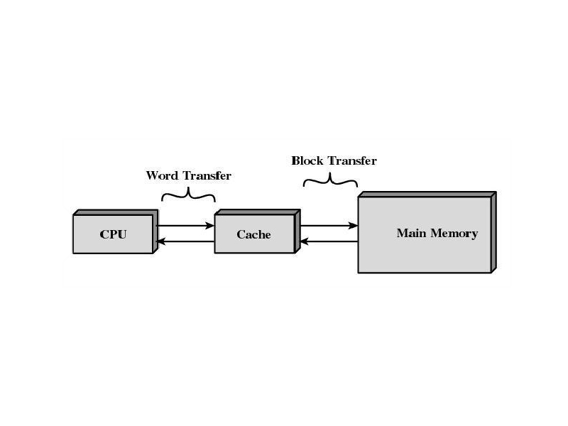
CACHE MEMORY
Cache memory is intended to give memory speed approaching that of the fastest memories available, and at the same time provide a large memory size at the price of less expensive types of semiconductor memories. The concept is illustrated in Figure below. There is a relatively large and slow main memory together with a smaller, faster cache memory. The cache contains a copy of portions of main memory. When the processor attempts to read a word of memory, a check is made to determine if the word is in the cache. If so, the word is delivered to the processor. If not, a block of main memory, consisting of some fixed number of words, is read into the cache and then the word is delivered to the processor.

Slide 48
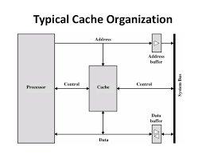
Cache organization
s. In this organization, the cache connects to the processor via data, control, and address lines.The data and address lines also attach to data and address buffers, which attach to a system bus from which main memory is reached. When a cache hit occurs, the data and address buffers are disabled and communication is only between processor and cache, with no system bus traffic. When a cache miss occurs, the desired address is loaded onto the system bus and the data are returned through the data buffer to both the cache and the processor. In other organizations, the cache is physically interposed between the processor and the main memory for all data, address, and control lines. In this latter case, for a cache miss, the desired word is first read into the cache and then transferred from cache to processor.

Slide 49
Mapping Techniques
Direct Mapping
Associative Mapping
Set-associative Mapping

Slide 50
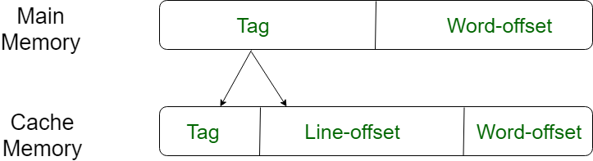
Direct mapping
The simplest technique, known as direct mapping, maps each block of main memory into only one possible cache line. or In Direct mapping, assigne each memory block to a specific line in the cache. If a line is previously taken up by a memory block when a new block needs to be loaded, the old block is trashed. An address space is split into two parts index field and a tag field. The cache is used to store the tag field whereas the rest is stored in the main memory. Direct mapping`s performance is directly proportional to the Hit ratio.

Slide 51
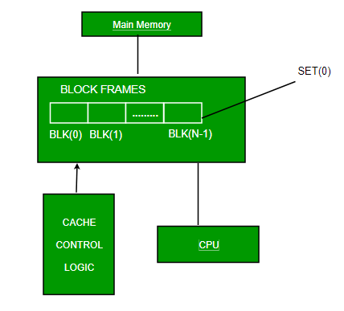
Associative Mapping
In this type of mapping, the associative memory is used to store content and addresses of the memory word. Any block can go into any line of the cache. This means that the word id bits are used to identify which word in the block is needed, but the tag becomes all of the remaining bits. This enables the placement of any word at any place in the cache memory. It is considered to be the fastest and the most flexible mapping form

Slide 52
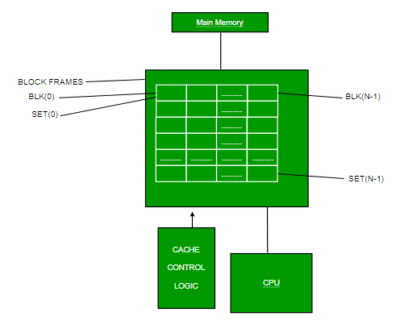
Set-associative Mapping
This form of mapping is an enhanced form of direct mapping where the drawbacks of direct mapping are removed. Set associative addresses the problem of possible thrashing in the direct mapping method. It does this by saying that instead of having exactly one line that a block can map to in the cache, we will group a few lines together creating a set. Then a block in memory can map to any one of the lines of a specific set..Set-associative mapping allows that each word that is present in the cache can have two or more words in the main memory for the same index address. Set associative cache mapping combines the best of direct and associative cache mapping techniques.

Slide 53
Virtual Memory
Virtual memory as an alternate set of memory addresses.
Programs use these virtual addresses rather than real addresses to store instructions and data.
When the program is actually executed, the virtual addresses are converted into real memory addresses.

Slide 54
Why is it needed….
Before the development of the virtual memory technique, programmers in the 1940s and 1950s had to manage directly two-level storage such as main memory or ram and secondary memory in the form of hard disks or earlier, magnetic drums.
Enlarge the address space, the set of addresses a program can utilize.
Virtual memory might contain twice as many addresses as main memory.

Slide 55
Secondary memories

Slide 56
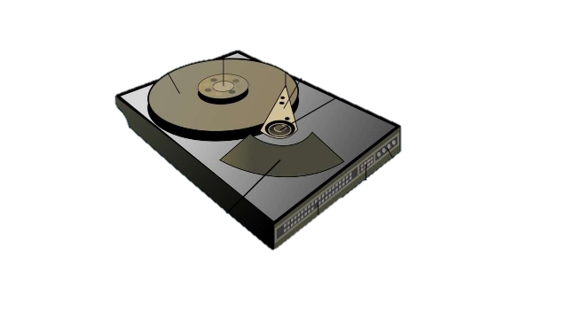
Magnetic disk
A disk is a circular platter constructed of nonmagnetic material, called the substrate,
coated with a magnetizable material. Traditionally, the substrate has been an aluminum
or aluminum alloy material. More recently, glass substrates have been introduced.
The glass substrate has a number of benefits, including the following:
• Improvement in the uniformity of the magnetic film surface to increase disk
reliability
• A significant reduction in overall surface defects to
• Ability to support lower fly heights (described subsequently)
• Better stiffness to reduce disk dynamics
• Greater ability to withstand shock and damage

Slide 57
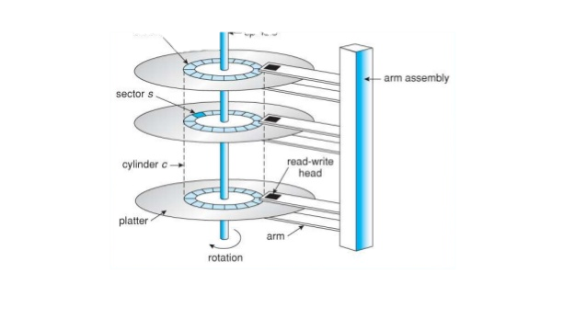

Slide 58
Working mechanism
To write
Electronic pulse is send to head
Produce magnetic field
Resulting magnetic field are recorded
To read
Suface under head produces current
Produce current is os same polarity as recorded

Slide 59
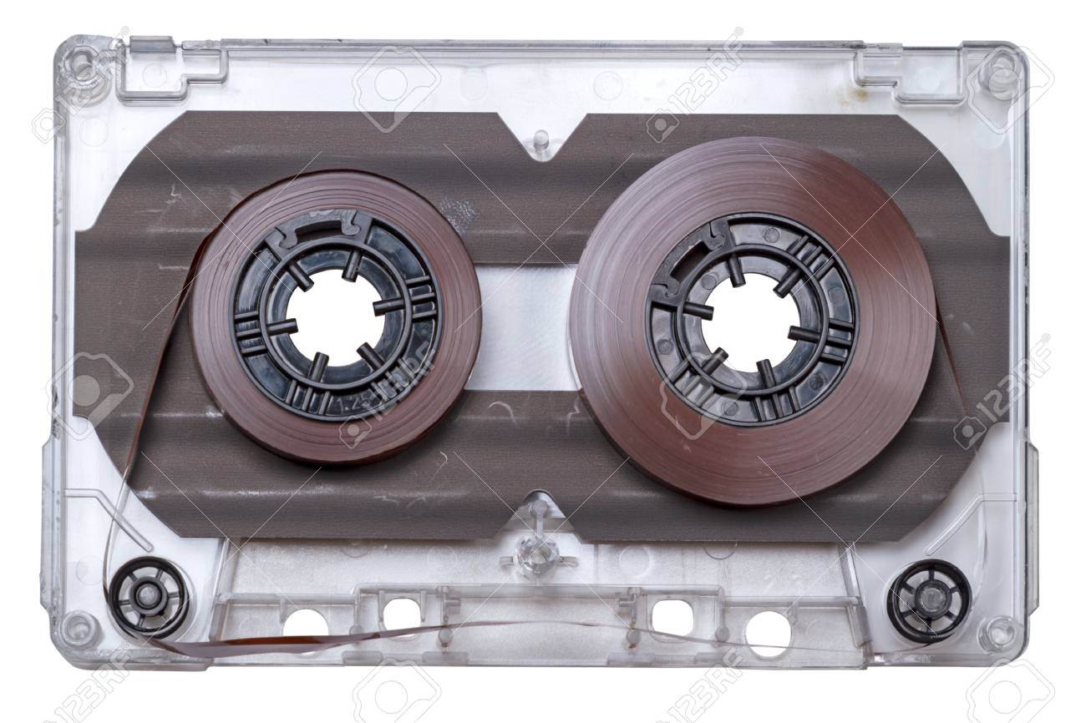
Magnetic tape
Tape systems use the same reading and recording techniques as disk systems. Themedium is flexible polyester (similar to that used in some clothing) tape coated withmagnetizable material.The coating may consist of particles of pure metal in special binders or vapor-plated metal films. The tape and the tape drive are analogous to ahome tape recorder system. Tape widths vary from 0.38 cm (0.15 inch) to 1.27 cm (0.5 inch).Tapes used to be packaged as open reels that have to be threaded through a second spindle for use.Today, virtually all tapes are housed in cartridges.
Data on the tape are structured as a number of parallel tracks running lengthwise. Magnetic tape was the first kind of secondary memory. It is still widely used as the lowest-cost, slowest-speed member of the memory hierarchy.

Slide 60

Optical Disk
In computing and optical disc recording technologies, an optical disc (OD) is a flat, usually circular disc which encodes binary data (bits) in the form of pits (binary value of 0 or off, due to lack of reflection when read) and lands (binary value of 1 or on, due to a reflection when read) on a special material (often aluminium) on one of its flat surfaces.

Slide 61
CDROM
CD-ROMBoth the audio CD and the CD-ROM (compact disk read-only memory)
share a similar technology. The main difference is that CD-ROM players are more
rugged and have error correction devices to ensure that data are properly transferred
from disk to computer. Both types of disk are made the same way.The disk is formed
from a resin, such as polycarbonate. Digitally recorded information (either music or
computer data) is imprinted as a series of microscopic pits on the surface of the polycarbonate.This is done, first of all, with a finely focused, high-intensity laser to create amaster disk.The master is used, in turn, to make a die to stamp out copies onto polycarbonate.The pitted surface is then coated with a highly reflective surface, usually
aluminum or gold.This shiny surface is protected against dust and scratches by a top
coat of clear acrylic. Finally, a label can be silkscreened onto the acrylic.

Slide 62
Advantages and Disadvantage
Compared with traditional magneticdisks, the CD-ROM has two advantages:
• The optical disk together with the information stored on it can be mass
replicated inexpensively—unlike a magnetic disk. The database on a magnetic
disk has to be reproduced by copying one disk at a time using two
disk drives.
• The optical disk is removable, allowing the disk itself to be used for archival
storage. Most magnetic disks are nonremovable. The information on nonremovable
magnetic disks must first be copied to another storage medium before
the disk drive/disk can be used to store new information.
The disadvantages of CD-ROM are as follows:
• It is read-only and cannot be updated.
• It has an access time much longer than that of a magnetic disk drive, as much
as half a second.

Slide 63
DVD
With the capacious digital versatile disk (DVD), the electronics industry has at lastfound an acceptable replacement for the analog VHS video tape. The DVD has replacedthe videotape used in video cassette recorders (VCRs) and, more importantfor this discussion, replace the CD-ROM in personal computers and servers. TheDVD takes video into the digital age. It delivers movies with impressive picture quality,and it can be randomly accessed like audio CDs, which DVD machines can alsoplay. Vast volumes of data can be crammed onto the disk, currently seven times asmuch as a CD-ROM.With DVD’s huge storage capacity and vivid quality, PC games have become more realistic and educational software incorporates more video. Followingin the wake of these developments has been a new crest of traffic over the Internetand corporate intranets, as this material is incorporated into Web sites.

Slide 64
Comparision with CD
The DVD’s greater capacity is due to three differences from CDs (Figure 6.12):
1. Bits are packed more closely on a DVD. The spacing between loops of a spiral
on a CD is 1.6 m and the minimum distance between pits along the spiral is
0.834 m.TheDVDuses a laser with shorter wavelength and achieves a loop spacing
of 0.74 mand a minimum distance between pits of 0.4 m.The result of these
two improvements is about a seven-fold increase in capacity, to about 4.7GB.
2. The DVD employs a second layer of pits and lands on top of the first layer.A duallayer
DVD has a semireflective layer on top of the reflective layer, and by adjusting
focus, the lasers in DVD drives can read each layer separately.This technique
almost doubles the capacity of the disk, to about 8.5 GB.The lower reflectivity of
the second layer limits its storage capacity so that a full doubling is not achieved.
3. The DVD-ROM can be two sided, whereas data are recorded on only one side
of a CD.This brings total capacity up to 17 GB.

Slide 65
CPU Organization

Slide 66
General register organization
A computer system employs a memory hierarchy. At higher levels of the hierarchy, memory is faster, smaller, and more expensive (per bit).Within the processor, there is a set of registers that function as a level of memory above main memory and cache in the hierarchy.
The registers in the processor perform two roles:
• User-visible registers: Enable the machine- or assembly language programmer
to minimize main memory references by optimizing use of registers.
• Control and status registers: Used by the control unit to control the operation
of the processor and by privileged, operating system programs to control the
execution of programs.

Slide 67
User-Visible Registers
A user-visible register is one that may be referenced by means of the machine language
that the processor executes.We can characterize these in the following categories:
• General purpose
• Data
• Address
• Condition codes
Control and status registers
There are a variety of processor registers that are employed to control the operation
of the processor. Most of these, on most machines, are not visible to the user. Some
of them may be visible to machine instructions executed in a control or operating
system mode.
Of course, different machines will have different register organizations and
use different terminology. We list here a reasonably complete list of register types,
with a brief description.
Four registers are essential to instruction execution:
• Program counter (PC): Contains the address of an instruction to be fetched
• Instruction register (IR): Contains the instruction most recently fetched
• Memory address register (MAR): Contains the address of a location in memory
• Memory buffer register (MBR): Contains a word of data to be written to
memory or the word most recently read

Slide 68
STACK ORGANIZATION AND ACCUMULATOR TYPE ORGANIZATION
STACK ORGANIZATION
Stack is a storage structure that stores information in such a way that the last item stored is the first item retrieved. It is based on the principle of LIFO (Last-in-first-out). The stack in digital computers is a group of memory locations with a register that holds the address of top of element. This register that holds the address of top of element of the stack is called Stack Pointer.
Stack Operations
The two operations of a stack are:
Push: Inserts an item on top of stack.
Pop: Deletes an item from top of stack.
Implementation of Stack
In digital computers, stack can be implemented in two ways:
Register Stack
Memory Stack

Slide 69
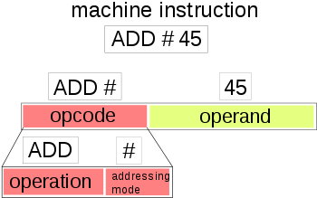
ACCUMULATOR TYPE ORGANIZATION
The computers, present in the early days of computer history, had accumulator based CPUs. In this type of CPU organization, the accumulator register is used implicitly for processing all instructions of a program and store the results into the accumulator. The instruction format that is used by this CPU Organisation is One address field. Due to this the CPU is known as One Address Machine.
The main points about Single Accumulator based CPU Organisation are:
In this CPU Organization, the first ALU operand is always stored into the Accumulator and the second operand is present either in Registers or in the Memory.
Accumulator is the default address thus after data manipulation the results are stored into the accumulator.
One address instruction is used in this type of organization.
The format of instruction is: Opcode + Address

Slide 70
Mainly two types of operation are performed in single accumulator based CPU organization:
Data transfer operation-
In this type of operation, the data is transferred from a source to a destination.
ALU operation – In this type of operation, arithmetic operations are performed on the data.

Slide 71
Instruction formats
Computer perform task on the basis of instruction provided. A instruction in computer comprises of groups called fields. These field contains different information as for computers every thing is in 0 and 1 so each field has different significance on the basis of which a CPU decide what so perform. The most common fields are:
Operation field which specifies the operation to be performed like addition.
Address field which contain the location of operand, i.e., register or memory location.
Mode field which specifies how operand is to be founded.
On the basis of number of address instruction are classified as:
Zero Address Instructions
One Address Instructions
Two Address Instructions
Three Address Instructions

Slide 72
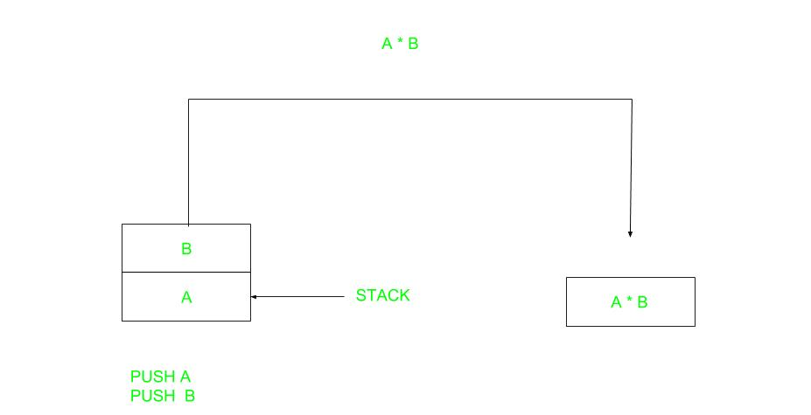
Zero Address Instructions –
A stack based computer do not use address field in instruction.To evaluate a expression first it is converted to revere Polish Notation i.e. Post fix Notation.
Expression: X = (A+B)*(C+D)
Postfixed : X = AB+CD+*
TOP means top of stack M[X] is any memory location
PUSH | A | TOP = A
PUSH | B | TOP = B
ADD |  | TOP = A+B
PUSH | C | TOP = C
PUSH | D | TOP = D
ADD |  | TOP = C+D
MUL |  | TOP = (C+D)*(A+B)
POP | X | M[X] = TOP

Slide 73

One Address Instructions –
This use a implied ACCUMULATOR register for data manipulation.One operand is in accumulator and other is in register or memory location.Implied means that the CPU already know that one operand is in accumulator so there is no need to specify it.
Expression: X = (A+B)*(C+D)
AC is accumulator
M[] is any memory location
M[T] is temporary location
LOAD | A | AC = M[A]
ADD | B | AC = AC + M[B]
STORE | T | M[T] = AC
LOAD | C | AC = M[C]
ADD | D | AC = AC + M[D]
MUL | T | AC = AC * M[T]
STORE | X | M[X] = AC

Slide 74
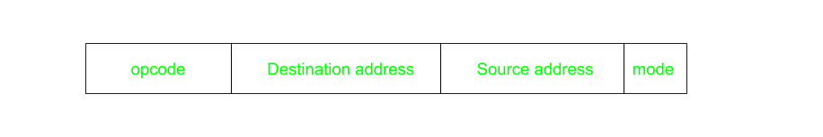
Two Address Instructions
This is common in commercial computers.Here two address can be specified in the instruction.Unlike earlier in one address instruction the result was stored in accumulator here result cab be stored at different location rather than just accumulator, but require more number of bit to represent address.
Here destination address can also contain operand.
Expression: X = (A+B)*(C+D)
R1, R2 are registers
M[] is any memory location
MOV | R1, A | R1 = M[A]
ADD | R1, B | R1 = R1 + M[B]
MOV | R2, C | R2 = C
ADD | R2, D | R2 = R2 + D
MUL | R1, R2 | R1 = R1 * R2
MOV | X, R1 | M[X] = R1

Slide 75
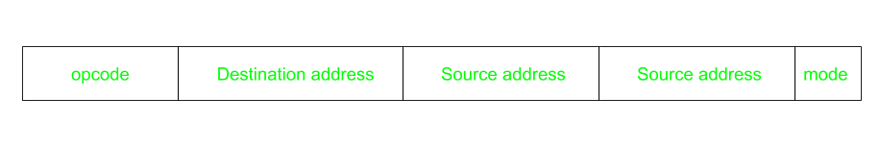
Three Address Instructions
his has three address field to specify a register or a memory location. Program created are much short in size but number of bits per instruction increase. These instructions make creation of program much easier but it does not mean that program will run much faster because now instruction only contain more information but each micro operation (changing content of register, loading address in address bus etc.) will be performed in one cycle only.
Expression: X = (A+B)*(C+D)
R1, R2 are registers
M[] is any memory location
ADD | R1, A, B | R1 = M[A] + M[B]
ADD | R2, C, D | R2 = M[C] + M[D]
MUL | X, R1, R2 | M[X] = R1 * R2

Slide 76
Addressing Modes
The term addressing modes refers to the way in which the operand of an instruction is specified. The addressing mode specifies a rule for interpreting or modifying the address field of the instruction before the operand is actually executed.
Addressing mode
Immediate
Direct
Indirect

Slide 77

Direct addressing/ Absolute addressing Mode (symbol [ ]): The operand’s offset is given in the instruction as an 8 bit or 16 bit displacement element. In this addressing mode the 16 bit effective address of the data is the part of the instruction. Here only one memory reference operation is required to access the data.
Indirect addressing Mode (symbol @ or () ):In this mode address field of instruction contains the address of effective address.Here two references are required. 1st reference to get effective address. 2nd reference to access the data.Based on the availability of Effective address, Indirect mode is of two kind:
Register Indirect:In this mode effective address is in the register, and corresponding register name will be maintained in the address field of an instruction. Here one register reference,one memory reference is required to access the data.
Memory Indirect:In this mode effective address is in the memory, and corresponding memory address will be maintained in the address field of an instruction. Here two memory reference is required to access the data.
Indexed addressing mode: The operand’s offset is the sum of the content of an index register SI or DI and an 8 bit or 16 bit displacement

Slide 78
Control unit

Slide 79
Fetch Execute Cycle
Step | Fetch execute cycle steps | Simplified description
1 | The PC contains the address of the memory location that has the next instruction which has to be fetched | PC has address of next instruction
2 | This address is then copied from the PC to the MAR via the address bus | PC copied to the MAR
3 | The contents (instruction) at the memory location (address) contained in MAR are then copied into the MDR | Lookup MAR and get contents. Copy contents into the MDR
4 | The contents (instruction) in the MDR is then copied and placed into the CIR | Copy MDR contents into the CIR
5 | The value in the PC is then incremented by 1 so that it now points to the next instruction which has to be fetched | PC is then incremented by 1
6 | The instruction is finally decoded and then executed by sending out signals (via control bus) to the various components of the computer | The instruction is decoded and then executed
7 | Repeat
The fetch execute cycle is the basic operation (instruction) cycle of a computer (also known as the fetch decode execute cycle).
During the fetch execute cycle, the computer retrieves a program instruction from its memory. It then establishes and carries out the actions that are required for that instruction.
The cycle of fetching, decoding, and executing an instruction is continually repeated by the CPU whilst the computer is turned on.

Slide 80
Microprogramming concepts:-
Basis Concepts
Micro-operations: We have already seen that the programs are executed as a sequence of instructions, each instruction consists of a series of steps that make up the instruction cycle fetch, decode, etc. Each of these steps are, in turn, made up of a smaller series of steps called micro-operations.
Micro-operation execution: Each step of the instruction cycle can be decomposed into micro-operation primitives that are performed in a precise time sequence. Each micro-operation is initiated and controlled based on the use of control signals / lines coming from the control unit.
- Controller the data to move from one register to another
- Controller the activate specific ALU functions
Micro-instruction: Each instruction of the processor is translated into a sequence of lower-level micro-instructions. The process of translation and execution are to as microprogramming
Microprogramming: The concept of microprogramming was developed by Maurice Wilkes in 1951, using diode matrices for the memory element. A microprogram consist of a sequence of micro-instructions in a microprogramming.
Microprogrammed Control Unit is a relatively logic circuit that is capable of sequencing through micro-instructions and generating control signal to execute each micro-instruction.
Control Unit: The control Unit is an important portion of the processor.

Slide 81
Microprogrammed Control Unit
The ideal of microprogrammed Control Unit is that the Control Unit design must include the logics for sequencing through micro-operations, for executing micro-operation, for executing micro-instructions, for interpreting opcodes and for making decision based on ALU flags. So the design is relatively inflexible. It is difficul to change the design if one wishes to add a new machine instruction.
The principal disadvantage of a microprogrammed control unit is that it will be slower than hardwired unit of comparable technology. Despite this, microprogramming is the dominant technique for implementing control unit in the contemporary CISC processor, due to its ease of implementation.
The control unit operates by performing consecutive control storage reads to generate the next set of control function outputs. Performing the series of control memory accesses is, in effect, executing a program for each instruction in the machine’s instruction set -- hence the term microprogramming.
The two basic tasks performed by a microprogrammed control unit are as follows:
- Micro-instruction sequencing: the microprogrammed control unit get the next mico-instruction from the control memory
- Micro-instruction execution: the microprogrammed control unit generate the control signals needed to execute the micro-instruction.
The control unit design must consider both affect the format of the micro-instruction and the timing of the control unit.

Slide 82

THANKS FOR WATCHING

