Slide 1
Mutual Fund Analytics Dashboard
BlueStocks Data Analytics Internship
Presented By:
Vardhi Jaisimhakumar
Roll No: 24102A030134
CSE – Data Science
Mohan Babu University

Slide 2
Introduction
Mutual funds are one of the most popular investment options.
Investors need data-driven insights to compare different schemes.
This project analyzes mutual fund data and presents it through interactive dashboards.
Technologies used include Python, SQLite, and Power BI.
Problem Statement
Large mutual fund datasets are difficult to analyze manually.
Investors require quick insights into NAV, AUM, SIP, and benchmark performance.
There is a need for an automated analytics dashboard.

Slide 3
project Objectives
Build an ETL pipeline using Python.
Clean and validate mutual fund datasets.
Store data in SQLite.
Perform exploratory data analysis.
Create interactive Power BI dashboards.
Generate meaningful financial insights.

Slide 4
Python Workflow
Modules developed:
Data Ingestion
Data Validation
SQLite Loading
Exploratory Data Analysis
Risk Metrics Calculation
Libraries Used:
Pandas
NumPy
SQLite3
Matplotlib

Slide 5
Database Design
SQLite Database
Tables Used:
Fund Master
NAV History
AUM by Fund House
Monthly SIP
Category Inflows
Benchmark Indices
Purpose:
Store cleaned data.
Enable efficient querying.
Support dashboard visualization.

Slide 6
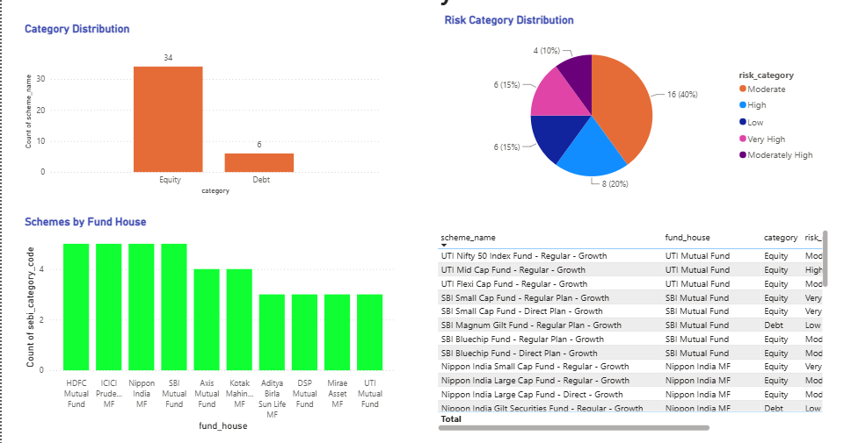
Page 1 – Market Overview
This page gives an overview of mutual funds. It shows fund categories, risk distribution, fund houses, and scheme details.

Slide 7
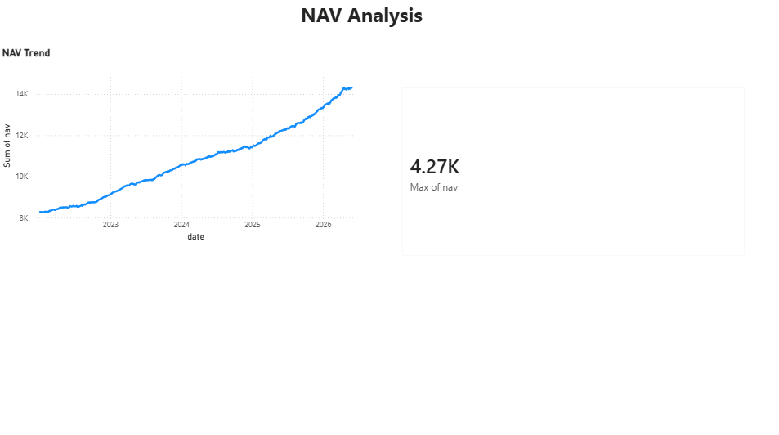
  Page 2 – NAV Analysis
This page shows the NAV trend over time and the latest NAV value. It helps analyze mutual fund performance.

Slide 8
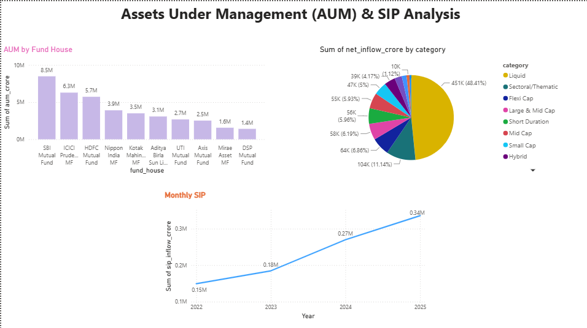
Page 3 – AUM & SIP Analysis
This page displays Assets Under Management, monthly SIP inflows, and category-wise inflows to understand investment trends.

Slide 9
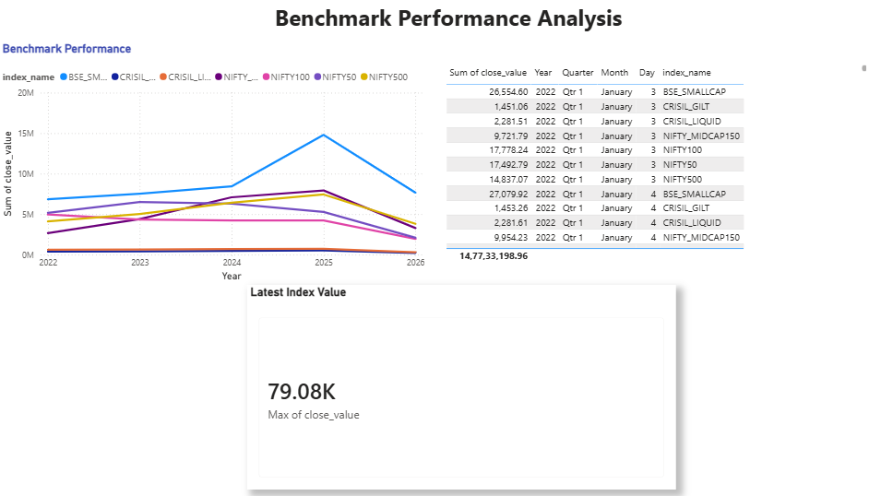
  Page 4 – Benchmark Analysis
This page compares benchmark performance over time and shows the latest benchmark value for market comparison.

Slide 10
Skills Acquired
Technical Skills:
Python
Pandas
SQLite
SQL
Power BI
Professional Skills:
Data Cleaning
Data Visualization
Problem Solving
Dashboard Design
Financial Analytics

Slide 11
Results
Key Outcomes
Developed a complete ETL pipeline.
Built an SQLite database.
Created four interactive Power BI dashboards.
Performed data analysis and risk metrics.
Gained practical experience in financial data analytics.
Conclusion
Successfully developed an end-to-end Mutual Fund Analytics Dashboard.
Improved understanding of ETL, databases, and business intelligence.
The project provides meaningful insights into mutual fund performance.

Slide 12
Thank you

