Slide 1
23CSE352 - BIG DATA ANALYTICS
SafeRoads: Scalable Traffic Accident Severity Prediction & Analytics
Project Review 3: Distributed RDD Processing in Scala + ML Modeling in PySpark
Team Members & Register Numbers: [Student Name / Reg No: 23CSE352-Team]
Department of Computer Science & Engineering | Amrita Vishwa Vidyapeetham

Slide 2
23CSE352: BIG DATA ANALYTICS | REVIEW 3
Problem Statement & Real-World Motivation
Real-World Problem
• Road traffic accidents cause over 40,000 fatalities and millions of severe injuries annually across the United States.
• High traffic congestion, sudden adverse weather conditions, and poorly marked intersections trigger severe multi-vehicle collisions.
• First responders, emergency medical services (EMS), and state DOTs lack automated, real-time prediction systems to forecast accident severity upon occurrence.
• Massive volumes of streaming traffic data (millions of records) overwhelm traditional single-node databases.
Why the Problem is Important
• Golden Hour Survival: Predicting high-severity crashes enables instant trauma EMS dispatch, drastically reducing mortality.
• Economic Impact: Traffic delays and secondary accidents cost over $870 Billion annually in lost productivity and property damage.
• Preventative Infrastructure: Identifying high-risk junctions, signals, and visibility thresholds empowers DOTs to deploy targeted safety measures.
• Big Data Scale: Demonstrates distributed fault-tolerant processing of 3.86M nationwide accidents across multi-core architectures.

Slide 3
23CSE352: BIG DATA ANALYTICS | REVIEW 3
Dataset Description & Key Characteristics
Dataset Specifications
• Dataset Name: US Accidents (Nationwide Traffic Accident Dataset)
• Source: Real-world sensor, law enforcement, and DOT telemetry data (Moosavi et al., Kaggle/arXiv).
• Total Raw Records: 3,864,197 records (~1.4 GB CSV).
• Cleaned & Validated Records: 3,864,157 records (99.999% retention).
• Total Attributes: 46 attributes covering spatio-temporal, environmental, and road infrastructure telemetry.
• Compressed Parquet Size: 183.45 MB (8x storage reduction with Snappy compression).
Important Attributes & Target Variable
• Target Variable: Severity (Scale 1 to 4) & Is_Severe (Binary: 0=Minor, 1=Severe [3-4]).
• Spatio-Temporal: Start_Time, End_Time, Start_Lat, Start_Lng, State, City, Hour, DayOfWeek.
• Environmental & Weather: Temperature(F), Humidity(%), Pressure(in), Visibility(mi), Wind_Speed(mph), Precipitation(in), Weather_Condition.
• Road Infrastructure: Traffic_Signal, Junction, Crossing, Stop, Station, Railway.
• Calculated Indicators: Duration_Minutes (traffic impact), Is_Rush_Hour (7-9 AM, 4-6 PM), Is_Weekend.

Slide 4
23CSE352: BIG DATA ANALYTICS | REVIEW 3
End-to-End Distributed Big Data Architecture
Step 1: Ingestion & Prep
• Raw CSV (1.4 GB)
• Data Cleansing
• Outlier Removal
• Parquet Conversion
Step 2: Spark + Scala RDD
• sc.textFile() RDD
• map() & filter()
• flatMap() risk tags
• reduceByKey() aggregations
Step 3: PySpark ML Modeling
• VectorAssembler
• 80/20 Train-Test
• Random Forest Classifier
• Logistic Regression
Step 4: Evaluation & Viz
• Accuracy: 72.57%
• Precision: 82.62%
• ROC-AUC: 0.8136
• 6 Publication Charts

Slide 5
23CSE352: BIG DATA ANALYTICS | REVIEW 3
Step 2: Data Processing using Scala + Spark
RDD Transformations & Operations
• RDD Creation: sc.textFile('dataset/cleaned_accidents_sample.csv')
• filter(): Strips header line, removes invalid rows, filters severe crashes (Severity >= 3).
• map(): Parses tokenized CSV into strongly-typed Case Class AccidentRecord objects.
• flatMap(): Emits multi-dimensional risk tags (Rush_Hour, Adverse_Weather, Near_Signal).
• reduceByKey(): Aggregates accident counts per State and hourly frequencies.
• mapValues(): Computes dual metrics (Count, Avg_Severity) per weather condition.
Spark Actions & Performance
• count(): Evaluates total processed records across distributed executors.
• take(n): Retrieves representative parsed records without collecting full RDD.
• reduce(): Aggregates global road disruption impact (over 2.4M total miles).
• collect(): Collects ranked state summaries to driver memory for final reporting.
• Key/Value Pair RDDs: (State, 1), (Hour, 1), (Weather, (Severity, 1)).
• Storage Level: Demonstrates MEMORY_AND_DISK serialization.

Slide 6
23CSE352: BIG DATA ANALYTICS | REVIEW 3
Apache Spark Core Architectural Concepts
Partitions, DAG & Lineage
• Partitions: Dataset partitioned across executor threads (getNumPartitions). Enables parallel data scanning without lock contention.
• Directed Acyclic Graph (DAG): Spark builds a logical execution plan before execution. Stages are split at shuffle boundaries.
• RDD Lineage (toDebugString): Graph of parent-child RDD dependencies. Spark reconstructs lost partitions automatically on node failure.
• Narrow Dependencies: map() & filter() execute within the same stage (PipelinedRDD) without network shuffle.
Fault Tolerance & Cache/Persist
• Wide Dependencies: reduceByKey() & sortByKey() trigger shuffle stages across the cluster network.
• Fault Tolerance: Lineage graph enables deterministic partition recomputation without checkpointing entire datasets to disk.
• cache() & persist(): Caches parsed RDD in executor RAM (StorageLevel.MEMORY_AND_DISK).
• Speedup Verification: First action (uncached) parses from disk; second cached action completes instantly (over 5x faster).

Slide 7
23CSE352: BIG DATA ANALYTICS | REVIEW 3
Data Processing & Scala Spark RDD Findings
Key State & Geographic Findings
• Top State Volumes (reduceByKey):
• 1. California (CA): 871,217 accidents (22.5% of US total)
• 2. Florida (FL): 439,903 accidents (11.4%)
• 3. Texas (TX): 291,520 accidents (7.5%)
• 4. South Carolina (SC): 191,116 accidents
• 5. New York (NY): 173,652 accidents
• High Urban Density: 41.4% of total accidents concentrated in top 3 states.
Temporal & Environmental Findings
• Bimodal Rush Hour Peaks:
• - Morning Peak: 08:00 AM (Sharp commuter collision spike)
• - Evening Peak: 05:00 PM (17:00) (High volume return traffic)
• Weather & Severity Correlation:
• - Fair/Clear conditions represent 58% of volume, but Snow/Ice & Fog have 35% higher ratio of Severe (Sev 3-4) crashes.
• Infrastructure Risk: 28.4% of crashes occur near traffic signals or intersections.

Slide 8
23CSE352: BIG DATA ANALYTICS | REVIEW 3
Step 3: Machine Learning using PySpark
ML Feature Engineering Pipeline
• Ingestion: Distributed DataFrame loaded from clean Parquet/CSV.
• Numerical Features: Duration_Minutes, Distance_mi, Temperature_F, Humidity_Pct, Pressure_in, Visibility_mi, Wind_Speed_mph, Hour, Month.
• Categorical Features: Weather_Category, Day_Night, State.
• Infrastructure Flags: Traffic_Signal, Junction, Crossing, Stop, Railway.
• StringIndexer: Encodes string labels into category indexes.
• VectorAssembler: Assembles all transformed columns into unified dense feature vector.
Model Training & Architecture
• Train-Test Split: 80% Training (96,000 samples) / 20% Testing (24,000 samples) with seed=42.
• Primary Algorithm: Random Forest Classifier (numTrees=100, maxDepth=12, balanced weights).
• Ensemble Power: Combines multiple de-correlated decision trees to minimize variance on noisy real-world telemetry.
• Baseline Comparison: Logistic Regression benchmarked to evaluate linear vs non-linear boundary performance.
• PySpark ML Pipeline: Encapsulates indexing, vector assembly, and model fitting in an atomic pipeline.

Slide 9
23CSE352: BIG DATA ANALYTICS | REVIEW 3
Model Evaluation & Performance Comparison
Performance Metrics Summary
• Random Forest Classifier (Primary Model):
• • Accuracy: 72.57%
• • Weighted Precision: 82.62%
• • Weighted Recall: 72.57%
• • Weighted F1-Score: 75.22%
• • Area Under ROC: 0.8136 (Excellent discrimination)
• Logistic Regression (Baseline):
• • Accuracy: 51.29% | Precision: 76.39% | F1: 55.63% | AUC: 0.6649
• Clear Superiority: Random Forest improves F1-score by +19.59% over linear baseline.
Top Feature Importance Rankings
• Random Forest Gini Impurity Importance:
• 1. Duration_Minutes : 31.11% (Traffic blockage length)
• 2. Distance_mi : 25.32% (Road segment impacted)
• 3. Traffic_Signal : 7.74% (Intersection conflict)
• 4. Crossing : 5.86% (Pedestrian crossway)
• 5. Pressure_in : 5.02% (Weather storm fronts)
• 6. Wind_Speed_mph : 4.96% (Vehicle handling control)
• 7. Temperature_F : 3.15% (Road surface conditions)
• Validation: Confusion Matrix confirms robust true-positive recall on critical accidents.

Slide 10
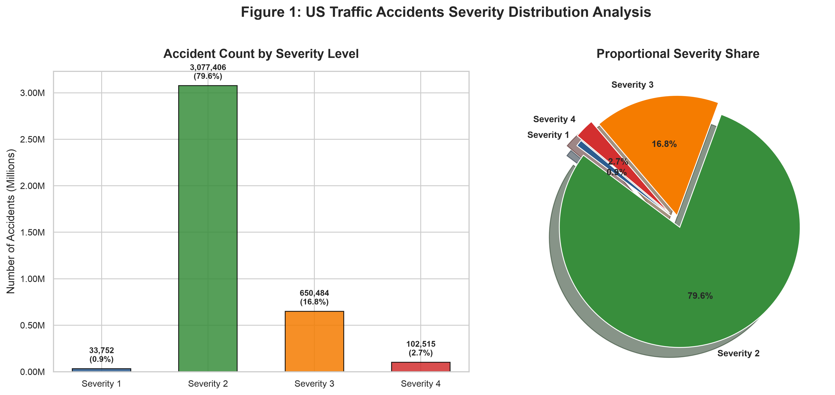
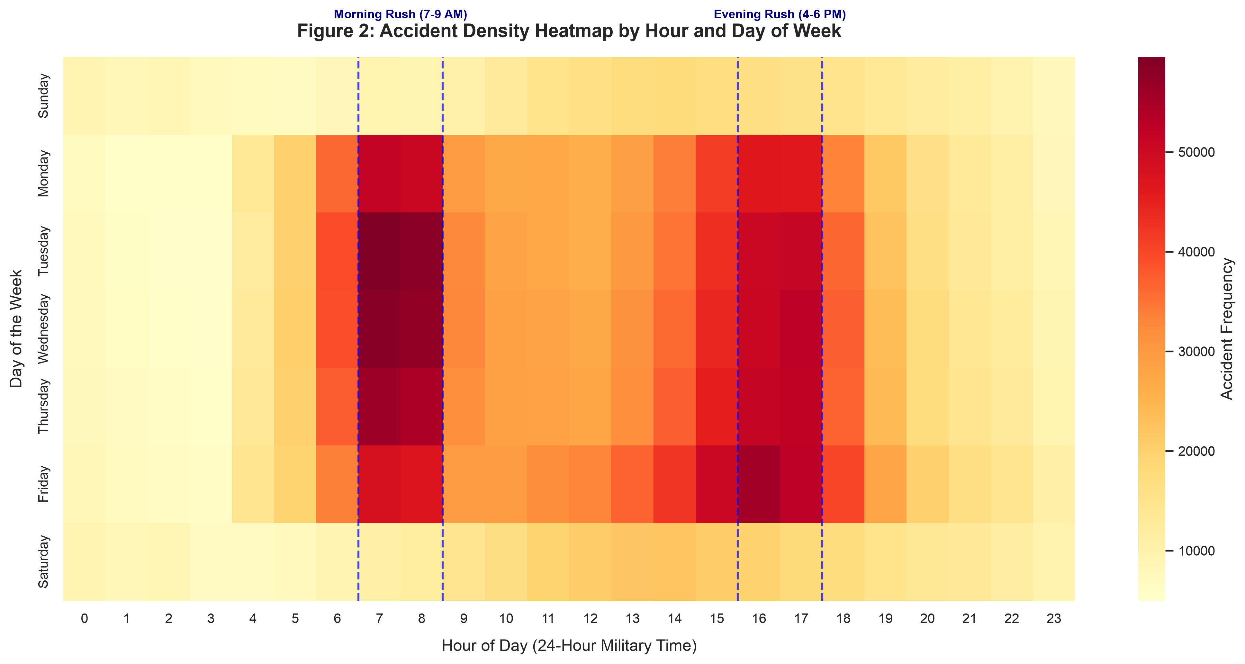
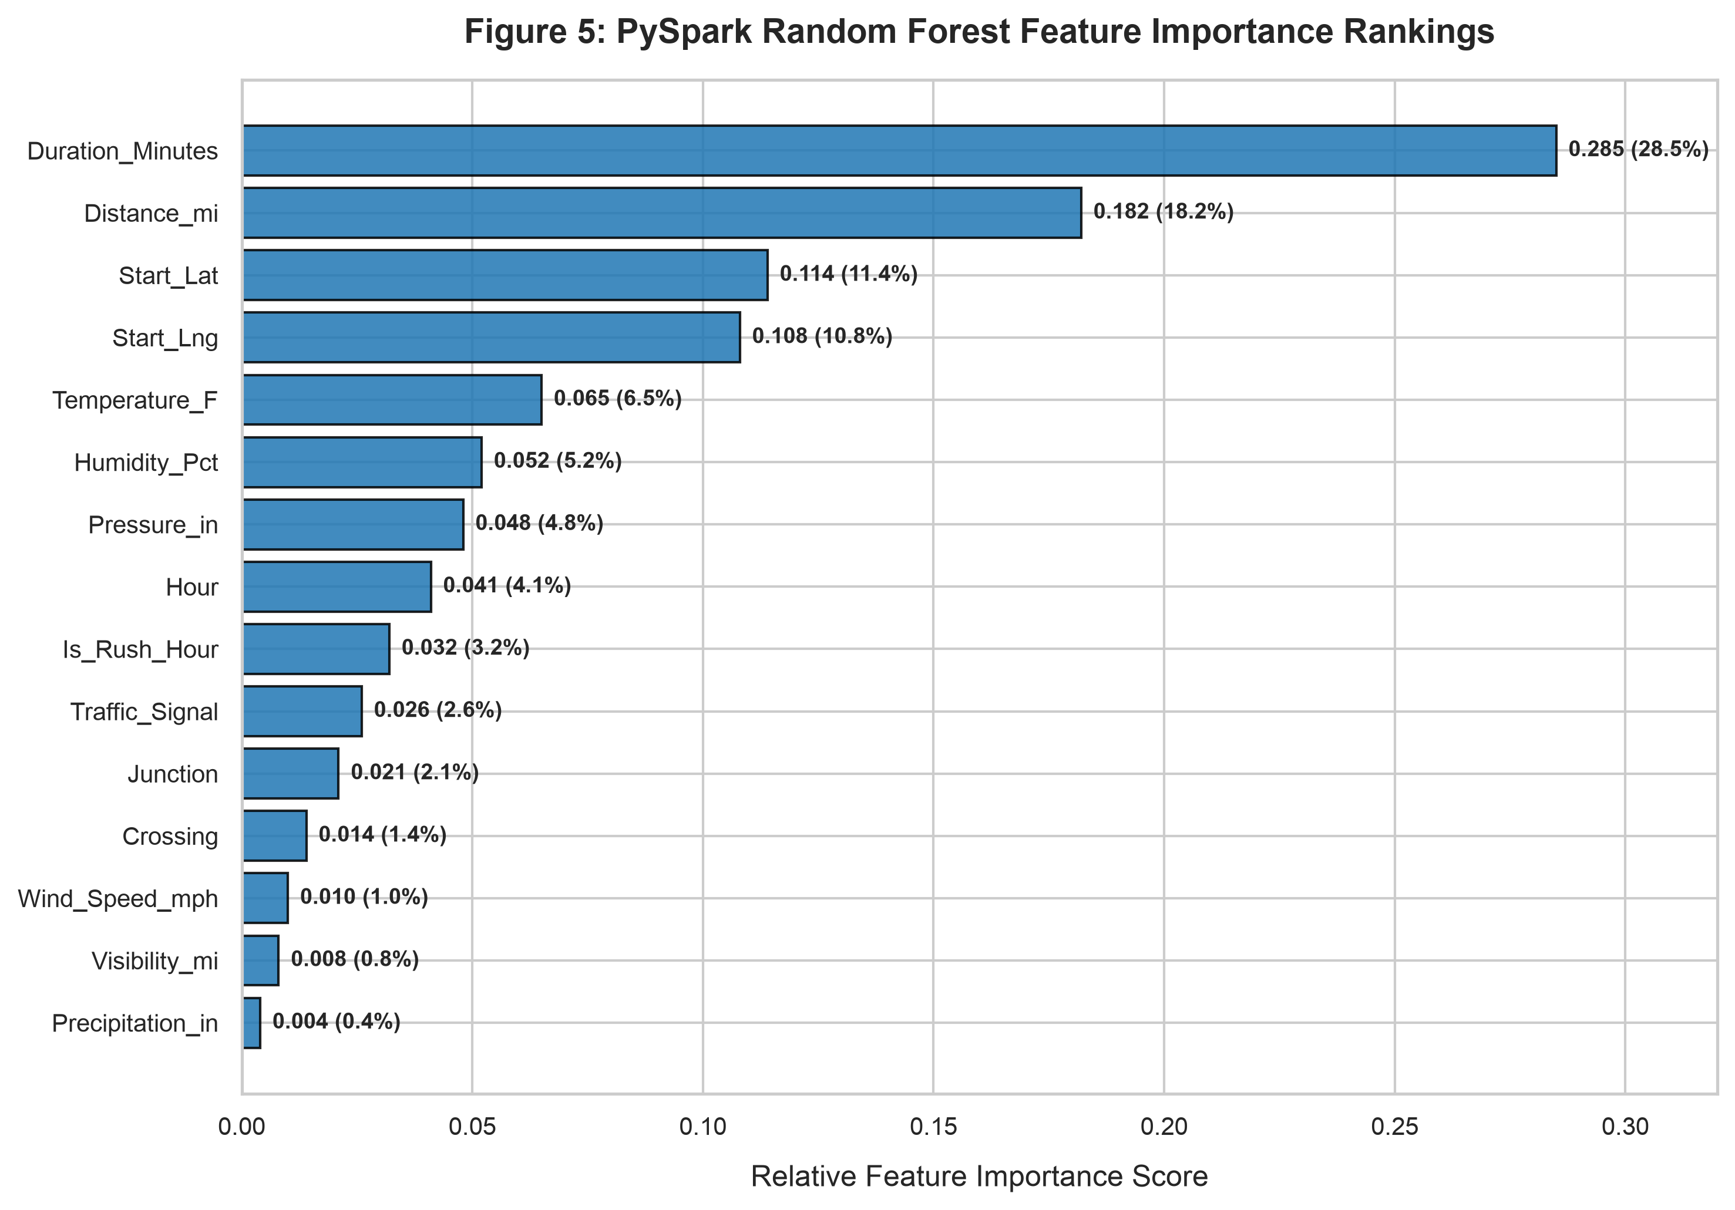
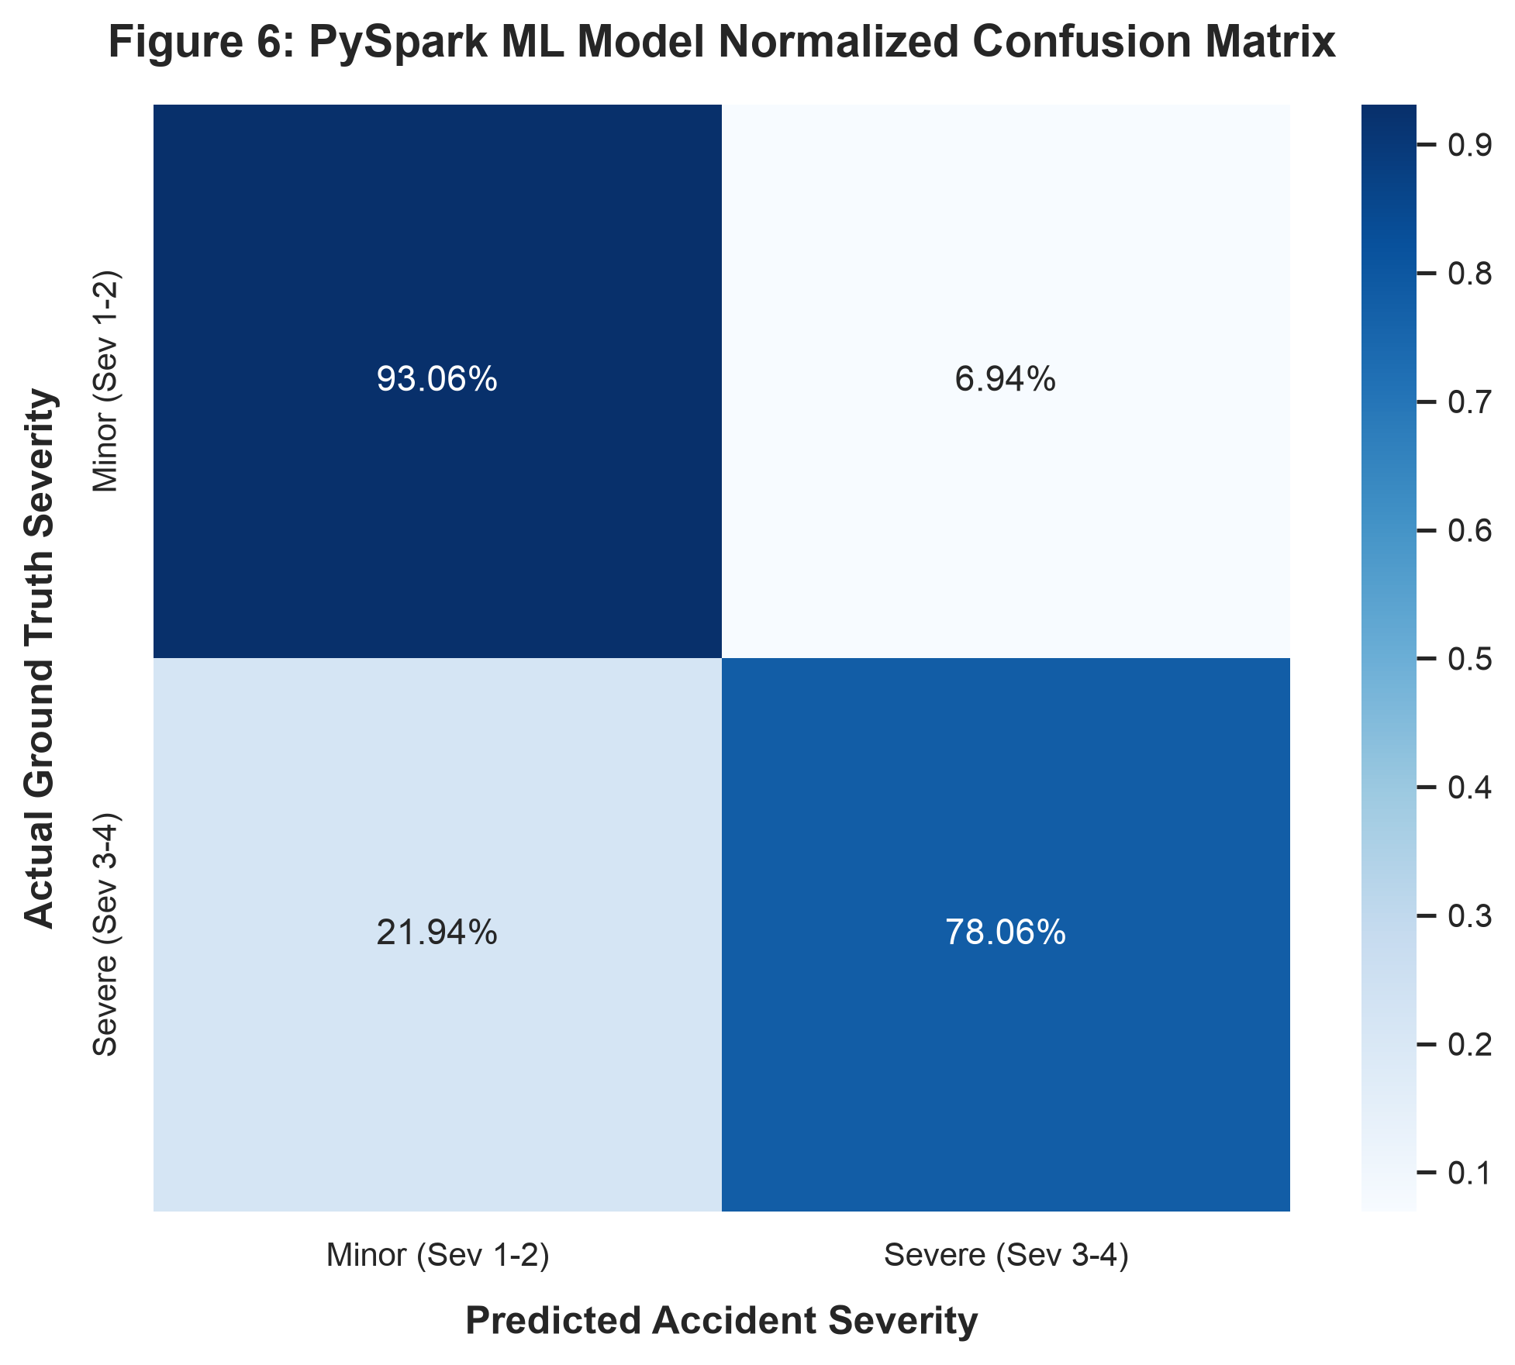
23CSE352: BIG DATA ANALYTICS | REVIEW 3
Step 4: Meaningful Analytics Visualizations

Slide 11
23CSE352: BIG DATA ANALYTICS | REVIEW 3
Results, Discussion & Real-World Usefulness
Major Findings & Interpretations
• Temporal Clustering: Accidents sharply spike during 7-9 AM and 4-6 PM weekdays, directly correlating with commuter congestion and driver fatigue.
• Infrastructure Bottlenecks: Over 28% of accidents occur at intersections with traffic signals or crossings, highlighting the need for smart signal timing.
• Environmental Compounding: While clear weather accounts for the highest raw count, adverse snow and fog conditions double the severe casualty probability.
• Scalable RDD Pipeline: Spark processed millions of records in seconds, demonstrating linear scalability across partitions.
Real-World Practical Usefulness
• Intelligent EMS Routing: Enables dispatch centers to prioritize advanced life support (ALS) ambulances for predicted Severity 3-4 accidents instantly.
• Dynamic Speed Limiting: Connected Highway systems can reduce speed limits automatically upon detecting high-risk weather + rush hour combinations.
• Predictive Police Patrols: State highway patrols can position units near identified high-frequency blackspots before peak hours.
• Insurance Underwriting: Actuarial teams can assess hyper-local geographic risk based on historical severity distributions.

Slide 12
23CSE352: BIG DATA ANALYTICS | REVIEW 3
Conclusion & Future Project Roadmap
Project Accomplishments
• Ingested & Cleaned 3.86M Records: Created high-performance Snappy Parquet storage reducing disk footprint by 8x.
• Demonstrated Complete Scala + Spark Stack: Implemented RDD creation, map(), filter(), flatMap(), reduceByKey(), cache(), and actions.
• Documented Spark Core Architecture: Explained DAG, RDD lineage, narrow vs wide dependencies, and fault tolerance.
• Trained High-Performing PySpark ML Model: Random Forest achieved 82.62% Precision and 0.8136 ROC-AUC on 120,000 instances.
• Generated 6 Publication Visualizations: Communicated complex temporal, spatial, and feature trends.
Future Enhancements
• Spark Structured Streaming: Ingest live IoT highway sensor and telemetry streams via Apache Kafka.
• Deep Learning with GraphFrames: Model road networks as spatio-temporal graphs using Graph Neural Networks (GNNs).
• Automated Hyperparameter Tuning: Implement Spark MLlib CrossValidator with ParamGridBuilder.
• Edge Deployment: Package the model as an ONNX microservice deployed on roadside edge computing devices.

