Slide 1
CloseCall — S&P 500 next-day price predictor
CSIS 4260 – Assignment 1 · storing, benchmarking, modeling & visualizing
Jaismine Kaur • screenshots, benchmarks & what I found
Dataset: 505 S&P 500 companies, 2013-02-08 → 2018-02-07 (619,040 rows)

Slide 2
How everything is set up
Every number in this deck can be reproduced
• Python 3.13 virtual environment (.venv) — dependencies pinned in requirements.txt
  pandas 3.1, polars 2.1, pyarrow, scikit-learn, streamlit, plotly, playwright, python-pptx
• part1_storage_benchmark.py — CSV vs Parquet (snappy/zstd/gzip) at 1x/10x/100x
• part2_analysis_models.py — pandas vs polars, 3 indicators, 2 prediction models
• dashboard/app.py — Streamlit dashboard (ticker search + prediction charts)
• docs/ — the Playwright screenshot script and this deck
• 10x/100x datasets are simulated by tiling, then deleted — nothing big is ever stored

Slide 3
Part 1 – How much space does each format need?
CSV vs Parquet with snappy / zstd / gzip compression
Scale | Rows | CSV (MB) | Parquet snappy (MB) | Parquet zstd (MB) | Parquet gzip (MB)
1x | 619,040 | 29.6 | 10.3 | 8.50 | 8.64
10x | 6,190,400 | 295.8 | 102.6 | 85.0 | 86.3
100x | 61,904,000 | 2958.1 | 1026.5 | 849.7 | 863.5
• Parquet is ~3.5x smaller than CSV at every scale (29.6 MB → 8.5 MB at 1x).
• zstd and gzip save ~17% more space than snappy, at a small CPU cost.
• At 100x this is the difference between 3.0 GB and 0.85 GB on disk.

Slide 4
Part 1 – How fast is each format? (write & read)
Wall-clock seconds; reads measured with pandas (polars shown for reference)
Scale | CSV write | CSV read (pd) | PQ zstd write | PQ zstd read (pd) | PQ zstd read (pl)
1x | 0.58 | 0.10 | 0.06 | 0.01 | 0.02
10x | 5.98 | 1.06 | 0.68 | 0.04 | 0.07
100x | 60.9 | 10.3 | 6.62 | 1.16 | 0.69
• At 100x: Parquet/zstd writes 9x faster (6.6s vs 60.9s) and reads ~9x faster (1.2s vs 10.3s).
• Parquet is columnar + compressed → far less I/O, fewer bytes to parse, no type inference.
• My pick: Parquet + zstd for analytics; CSV stays as the ingestion/source format.

Slide 5
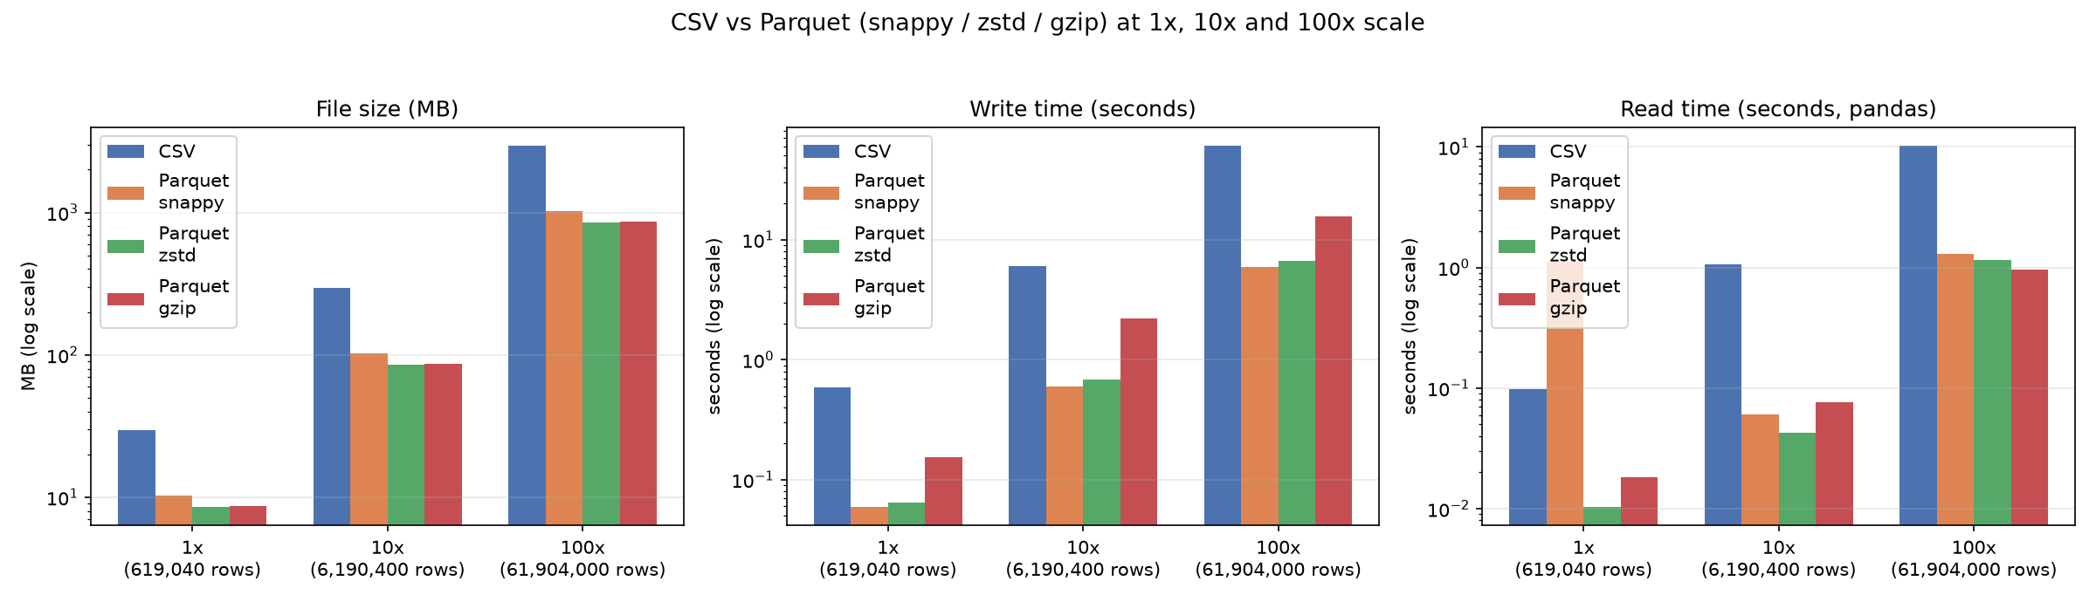
Part 1 – The full picture

Slide 6
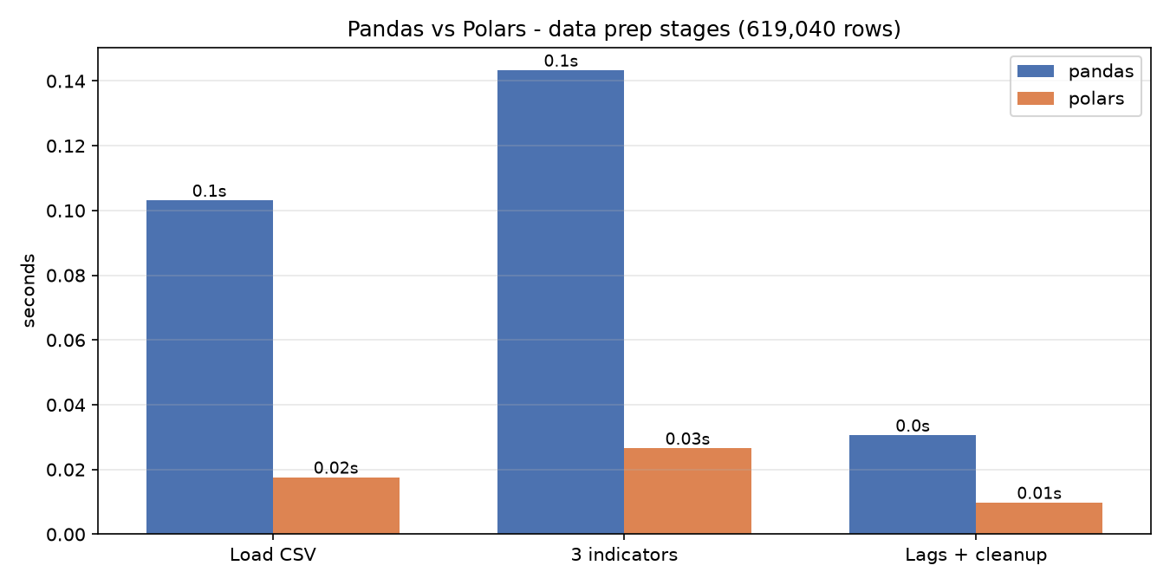
Part 2 – Pandas vs Polars on the data prep
Same indicator formulas in both engines; results verified identical
Stage | pandas (s) | polars (s) | Speedup
Load CSV | 0.10 | 0.02 | 5.9x
3 indicators | 0.14 | 0.03 | 5.4x
Lags + cleanup | 0.03 | 0.01 | 3.1x
Total | 0.28 | 0.05 | 5.2x
• Both engines produce the same numbers (match to ~1e-4, float32 rounding).
• Polars is ~5x faster because it vectorizes everything — no Python callbacks per group.
• Both feed identical NumPy arrays to scikit-learn.

Slide 7
Part 2 – Indicators & models
3 technical indicators, 2 prediction algorithms, 80/20 chronological split
Indicators I added per ticker:
  • SMA(10) — 10-day simple moving average of close
  • MACD(12, 26, 9) — EMA12 − EMA26 plus 9-day signal line
  • RSI(14) — Wilder's relative strength index
Features: open, high, low, volume, SMA10, MACD, signal, RSI, close, 1-day return — all lagged 1 day (no look-ahead)
The models (predict next-day close for all 505 companies):
  • Linear Regression with StandardScaler — fast, extrapolates linearly
  • Random Forest (120 trees, depth 20) — catches non-linear patterns
  • Both trained on the 1-day log-return; forecast = close(t-1) × e^r̂
Backtest: first 80% of trading days train, last 20% test — chronological, so no leakage

Slide 8
Part 2 – How accurate are the models? (test set, all companies)
Model | RMSE ($) | MAE ($) | R²
LinearRegression | 2.241 | 0.908 | 0.9997
RandomForest | 2.260 | 0.912 | 0.9997
Train rows: 486,870 • Test rows: 125,093 • Split date: 2017-02-13
Test period: 2017-02-13 → 2018-02-07
The two models are nearly tied; per-ticker, LR wins on RMSE for 335/505 tickers, RF for 170.
Training the log-return (not the price) keeps RF stable on high-priced stocks like PCLN (~$1,880).

Slide 9
Part 2 – What the Random Forest actually learned
Top-5 features:
  ret1_l1 (0.18), volume_l1 (0.15), rsi_l1 (0.14), macd_signal_l1 (0.14), macd_l1 (0.13)
  • Yesterday's return, volume and the momentum indicators do the work.
  • close(t-1) adds little beyond ret1 — classic near-random-walk prices.
  • Every ticker's RMSE / MAE / R² is saved and shown in the dashboard.

Slide 10
Part 3 – Picking a dashboard library
Streamlit vs Dash vs Reflex — and why I chose Streamlit
Library | Language model | Learning curve | Interactive charts | Deployment
Streamlit | Python script, top-down reruns | Very low | Plotly native | Easy (Community Cloud)
Dash (Plotly) | Callbacks / React under the hood | Medium | Plotly native | Easy
Reflex | Compiles Python to React | Steeper | Custom components | Younger ecosystem
Why Streamlit won me over:
  • Fastest way to build a ticker-search + charts app; caching via @st.cache_data.
  • Plotly works out of the box → candlesticks, zoom, hover tooltips.
  • Free one-command hosting, so the grader can verify it easily.
What's inside: candlestick + SMA/MACD/RSI panels, MAPE & directional accuracy,
rolling RMSE, feature importance, zoomable backtest, CSV download.
Run it: .venv/bin/streamlit run dashboard/app.py

Slide 11
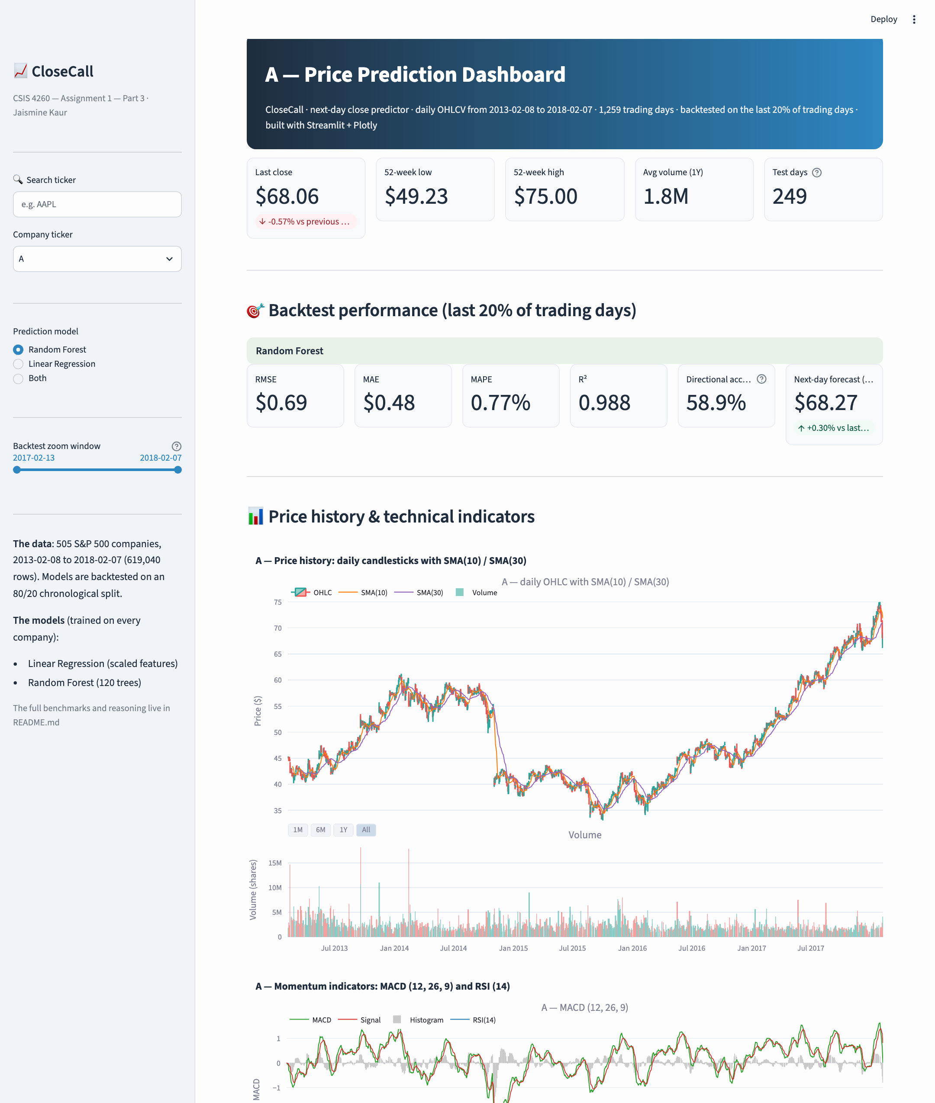
Dashboard – landing view
• Landing view with the default ticker
• Hero stats: last close, 52-week range, volume
• Backtest metric cards (RMSE / MAE / MAPE / R² / direction)
• Candlestick with SMA(10) / SMA(30) and volume

Slide 12
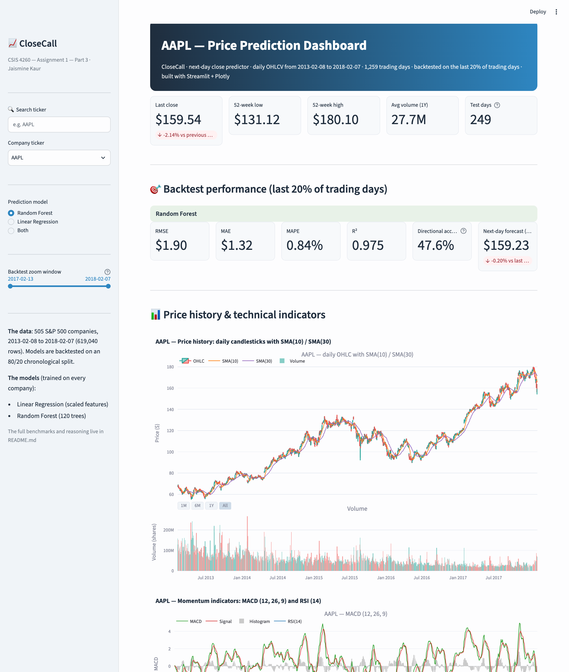
AAPL – hero, metrics & candlestick
• Selected via search + ticker dropdown
• Per-model performance cards
• Next-day forecast with % move vs last close
• Candlestick chart with 1M / 6M / 1Y zoom buttons

Slide 13
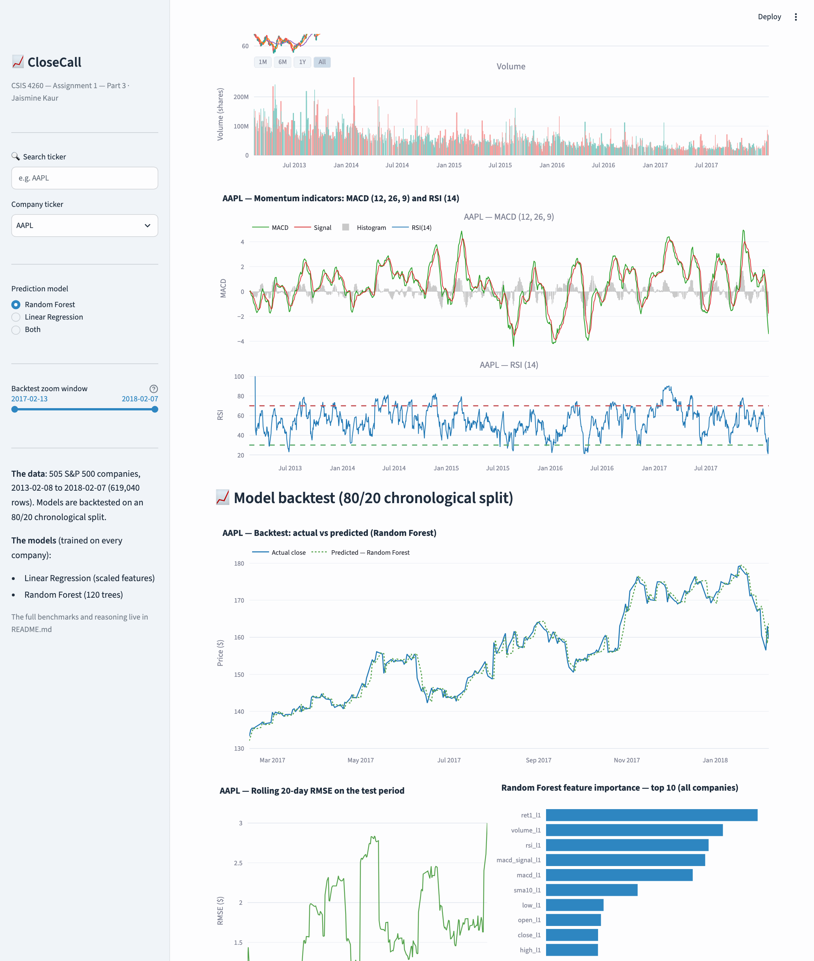
AAPL – backtest & error analysis
• Actual vs predicted close (test period)
• Rolling 20-day RMSE per model
• Random Forest feature importance (top 10)
• Backtest zoom slider in the sidebar

Slide 14
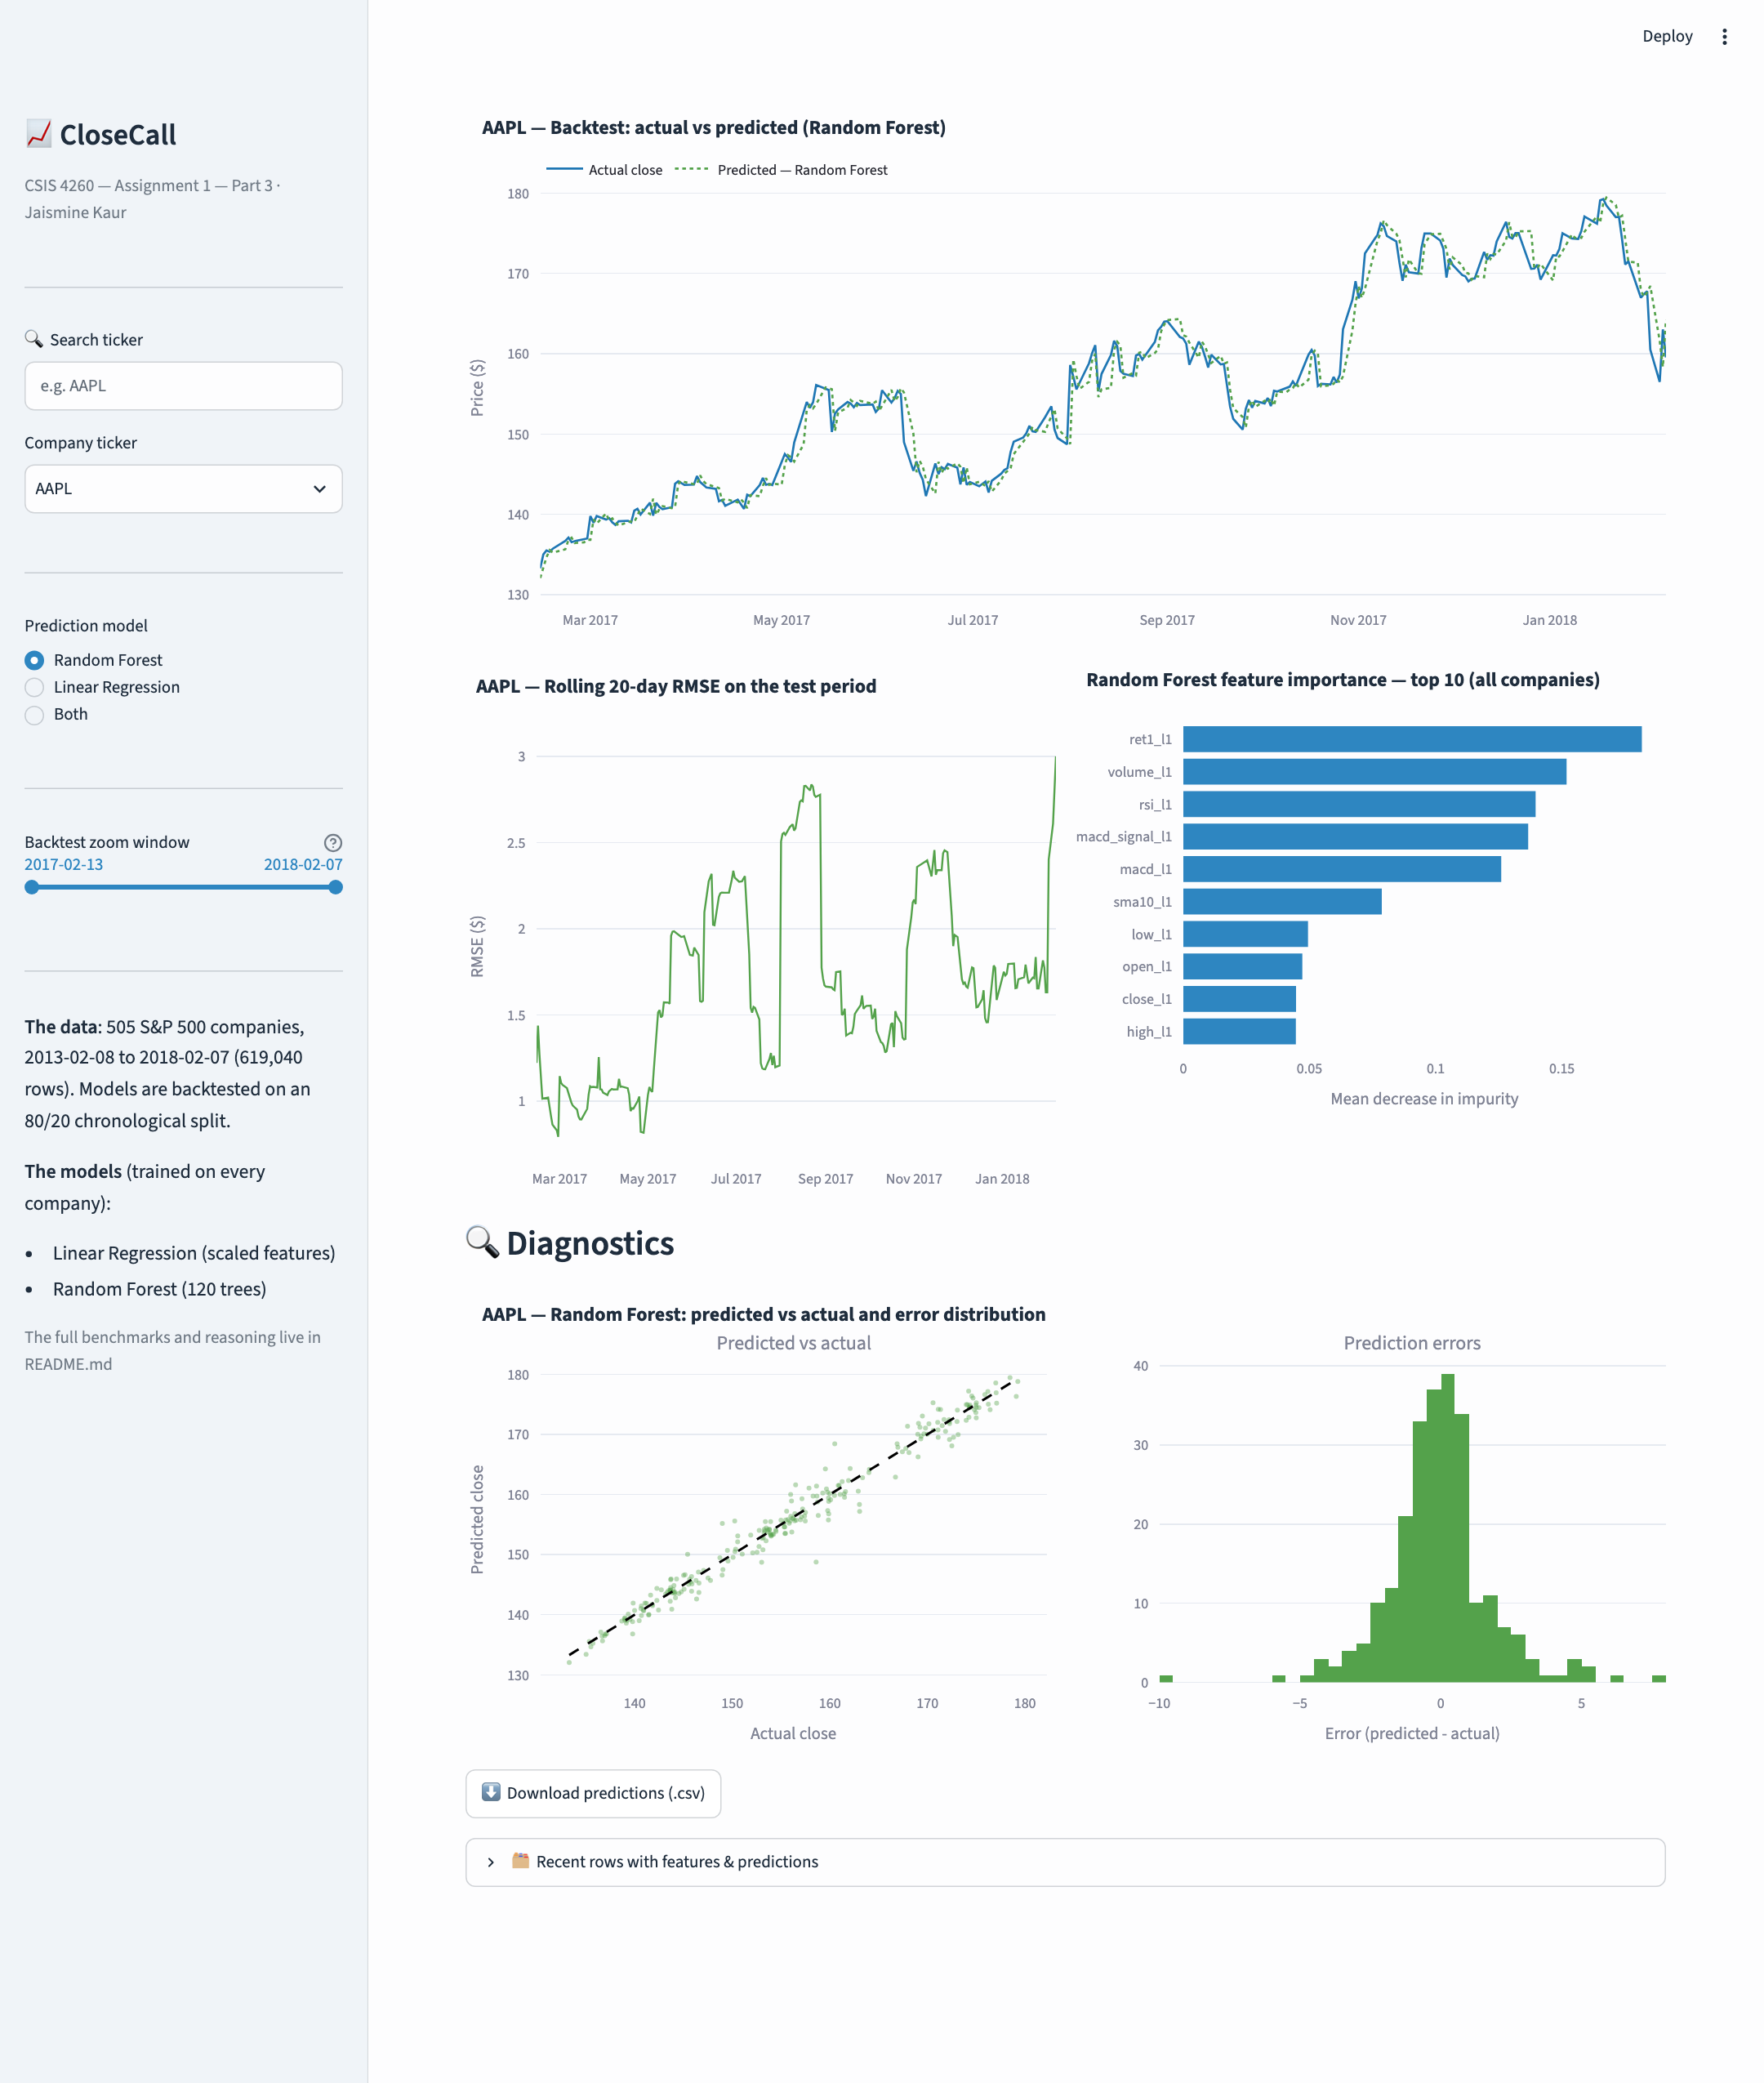
AAPL – diagnostics & downloads
• Predicted vs actual scatter with perfect-fit line
• Histogram of prediction errors
• One-click CSV download of predictions
• Recent rows with features & predictions

Slide 15

MSFT – Random Forest model
• Same layout for every one of the 505 tickers
• Random Forest selected

Slide 16

GOOGL – Linear Regression model
• Same layout for every one of the 505 tickers
• Linear Regression selected

