Slide 1
SKYTRAX AIRLINE REVIEW ANALYSIS
BA TECHNOLOGY, DATA, & INSIGHT
December 2023

Slide 2
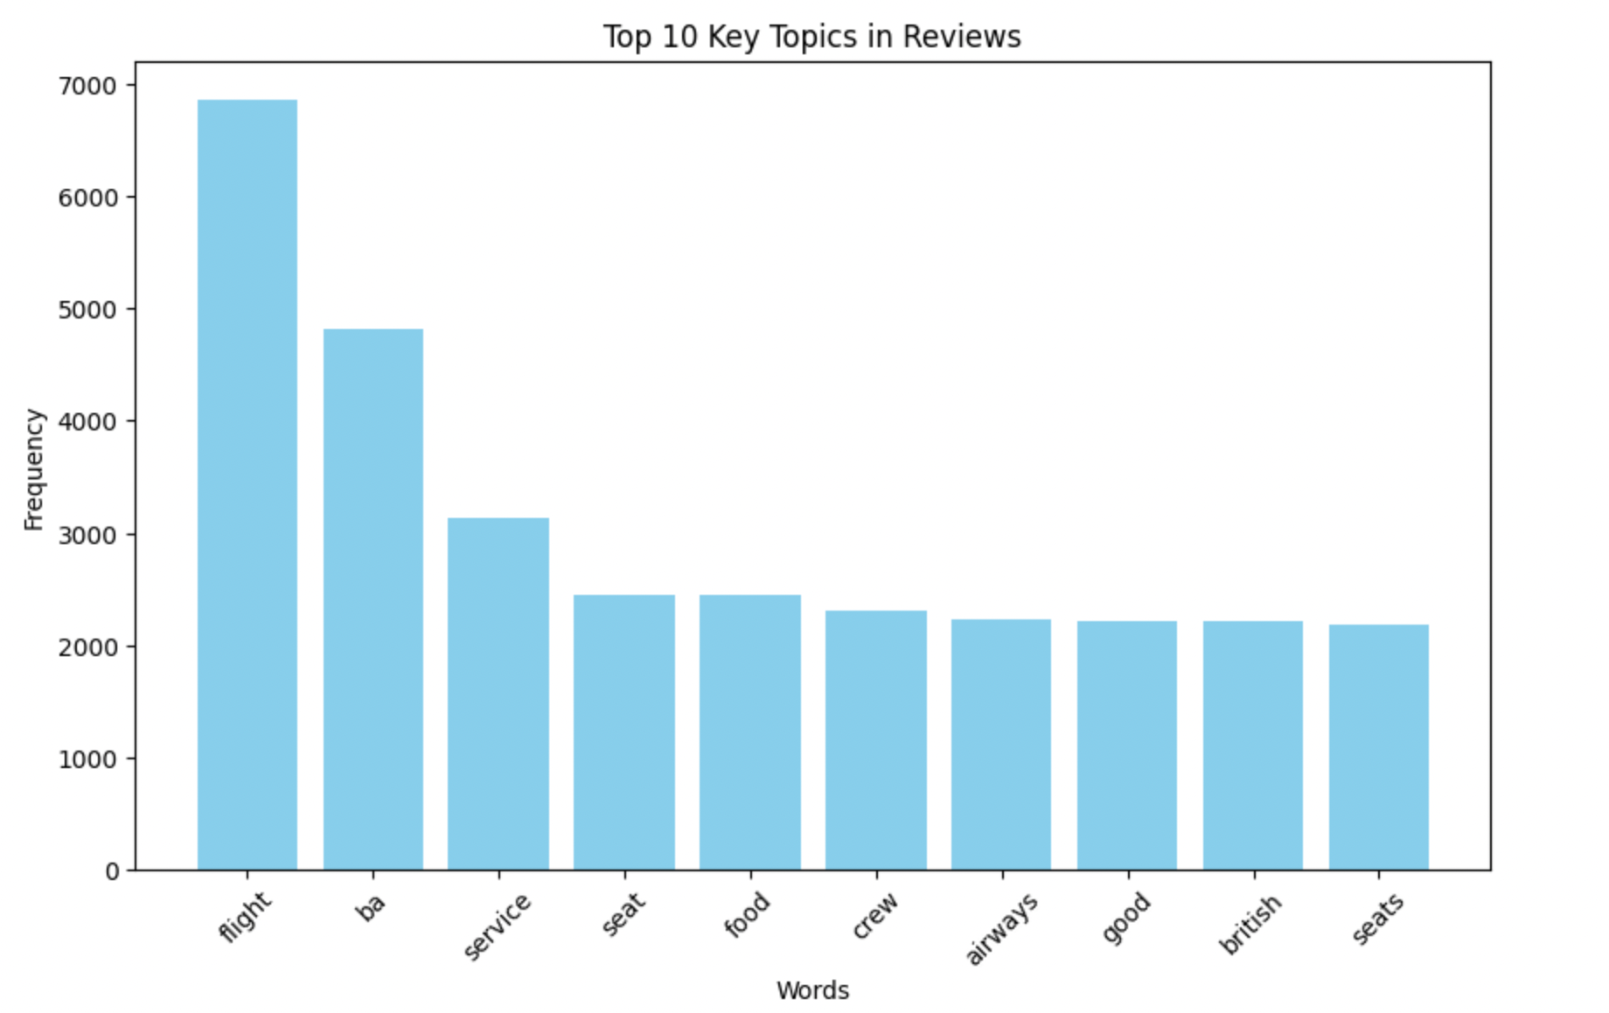
RESULTS
Key topics
Sentiment
The frequency chart below shows that the key topics within the reviews include “service”, “flight”, “crew” and “airline”, showing that people are actively talking about their experience and staff.
Out of 3724 reviews, 2179 were positive, 1560 were negative and 14 were neutral. This means the majority of reviews were polarised as positive.
58.06%
positive
41.57%
negative
0.37%
neutral
INFORMATION FOR BRITISH AIRWAYS INTERNAL USE ONLY
2

