Slide 1

GYPSY, Education Attendance through facial recognition system
Sxca Coders
Jaison John

Slide 2
Problem Statement
Education :
* Attendance through facial recognition system

Slide 3
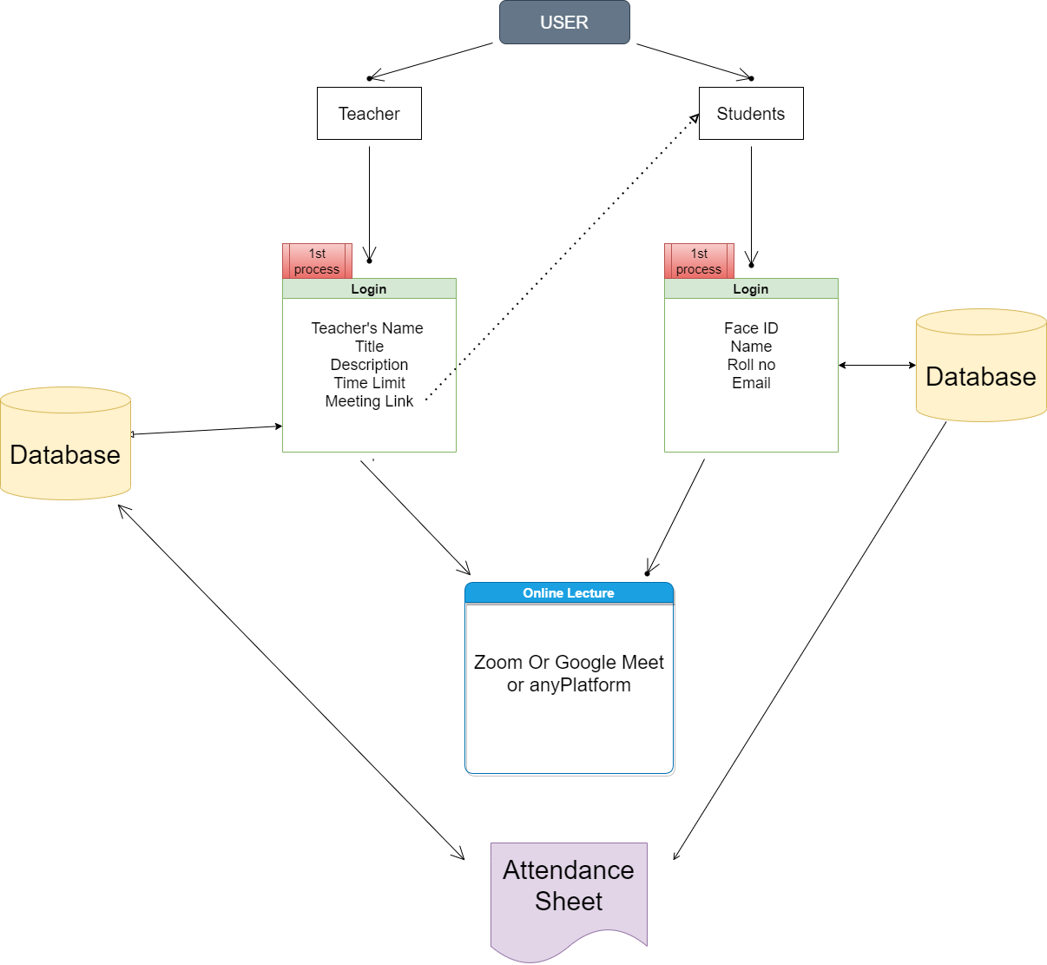
Our Solution
(Data Flow
Diagram)
DFD OF
The Project

Slide 4
Impact
This process of making available of each Students faces recognize and the store it into the database and make available to teachers for Future referrals will not only help teachers but also deals with inconsequential and inappropriate behavior by random participants.

Slide 5
Technology Stack
HTML
Bootstrap 5
Popper.js
Fontawesome
Jquery
PHP
SQL
SweetAleart
Lottie Files
Google Fonts
Picojs
Camva.js

Slide 6
Future Prospects
There was insufficient time or this project had and awesome ideas of making perfect environment for teachers and students
We can also Store Students Database so that when next time if the Student comes back he/she will automatically recognized by AI

Slide 7
Innovation
Face Recognition using PHP/MYSQL and JavaScript and Storing it in Database was a big task for me , I wish I could get some more time to finish this project and Submit it with a better UI and after few Bug fixes.

Slide 8
Feasibility
It Is very Straight Forward and Simple to use Attendance Application Where Many can be benefited

