Slide 1
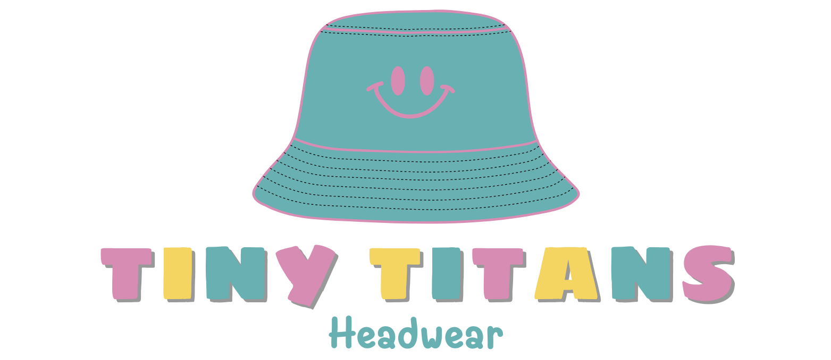
Notes:
Short Story about Cali:
One sunny afternoon, my almost four-year-old niece, Cali, brimming with joy, was exploring a jungle gym at the park. Suddenly, the laughter paused as she lost her footing and fell, striking her head. Everyone’s hearts stopped.
While Cali was fortunate enough to escape with a minor bruise, the implications were clear. Children aged 0-5 are quite active however their motor skills are still not fully developed, and their curiosity can lead to them encountering some unexpected, yet dangerous situations.

Slide 2



The Problem Tiny Titans Solves
Risk of Injury
Fragile skulls and developing motor skills
Constant Fear
Helicopter parenting
Discomfort
Refusal to wear head covering
Notes:
Cali isn't the only one. Falls are a leading cause of emergency department visits in children under 5.
This is because Children have underdeveloped skills and fragile skulls, which makes them more vulnerable to brain injuries
While its the children who are experiencing the problem, it's the parents and caregivers, like myself who are responsible for protecting them.
Meanwhile, 87% of parents have admitted to engaging in helicopter parenting to protect their child, and 73% of them feel judged for this behaviour.
Although, children frequently resist wearing bulky protective gear like helmets due to discomfort and irritation, making it challenging to protect them effectively.

Slide 3
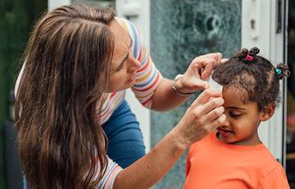
Head Injury Prevalence in Children
Head injuries and concussions in Ontario:
4.1% among children reported concussions¹¹
58% of children 1-5 years reported head injuries from play activities¹¹
Notes:
From the earliest stages of life, we are taught the importance of protecting our heads. This wisdom stems from a well-grounded concern.
However, head injuries and concussions in Ontario alone have a prevalence rate of 4.1% among children under 5.
And a staggering 58% of children reported head injuries stemming from play activities¹¹.
So why aren’t we doing more to safeguard our children in these highly active, developmental years?
We asked ourselves this question.

Slide 4
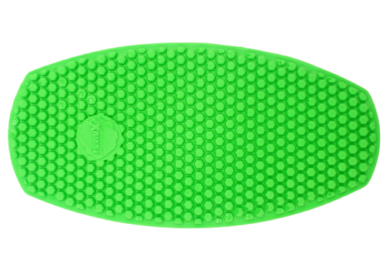
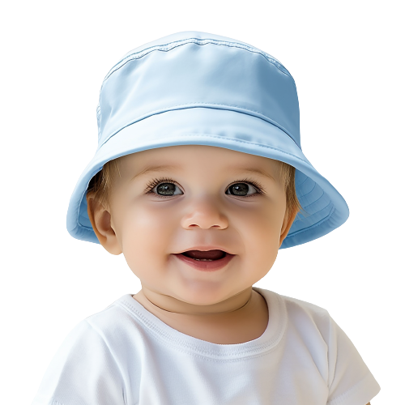
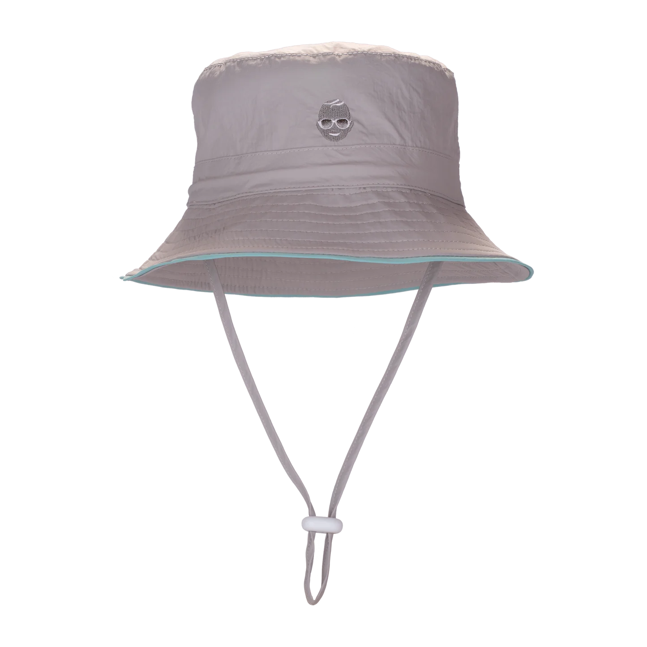
The Solution
Thin & Protective Foam Layer
Premium
Ultra-Comfort
Safe
Lightweight
Breathable
Adjustable
The
“Tiny Titans”
Bucket Hat
Chin Strap
Notes:
And that’s why we created Tiny Titans!
Tiny Titans is our unique, foam-lined hats crafted for infants. These lightweight, bucket-shaped hats offer a snug fit with the adjustable chin straps, ensuring uninterrupted protection.
These hats come in a variety of sizes, colours, and designs, suitable for newborns to preschoolers. What sets us apart is the special lightweight foam layer inside the hat, designed to absorb impact shock, offering reliable safety for your infant.
Alongside protection, our hats offer style, comfort, and versatility, easy to maintain and perfect for little explorers. Tiny Titans provides a trendy, safe solution for your child's adventures
Now, Arvin will demonstrate the protective layer of our hat

Slide 5
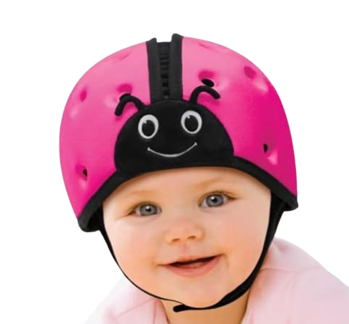
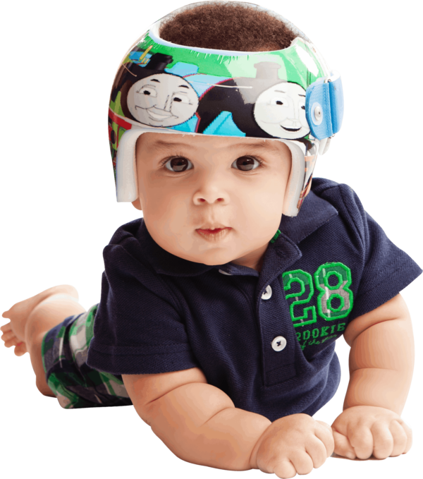
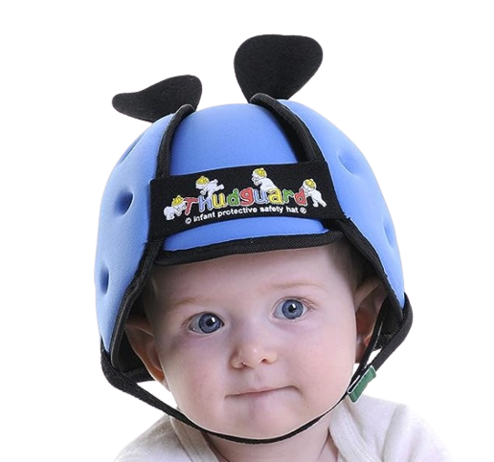
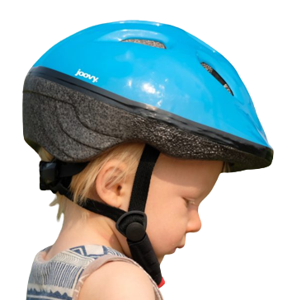
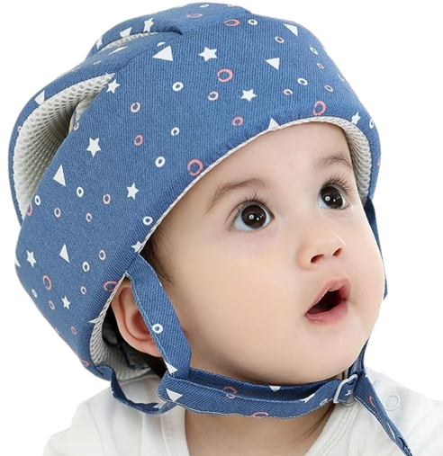
Key Players in the Market
Direct Competitors | Indirect Competitors
Safehead Helmet Thudguard Helmet Ocanoiy soft-cushion helmet | Cranial Remoulding Orthosis (CRO) Helmet Bike Helmet
Notes:
Let’s talk about how Tiny Titans squares up against our competitors. Each product listed has the goal of protecting the infant’s head when they are exploring in their environment. For the direct competitors, these are products that have the same goal as Tiny Titans, being a protective aid. Whereas the indirect competitor serves a more clinical purpose. Yet, for our direct competitors, based on reviews gathered from marketplaces such as Amazon, individuals have complained that products are too bulky, don’t have adequate ventilation, and the fit is just awkward. And not to mention, while these babies all look super cute wearing these products, they aren’t too fashionable.This is where Tiny Titans comes into play….
References:
7. Safehead. (2023). Baby headgear: Soft Helmets for babies: Safeheadbaby. Safehead Inc. https://www.safehead.com/
8. Thudguard. (2019, March 18). Thudguard infant protective hat - baby to senior. Baby To Senior - Baby To Senior. https://babytosenior.ca/product/thudguard-infant-protective-hat/
9. Amazon. (2023). Ocanoiy infant helmet baby helmet for crawling walking toddler... ’ customer reviews. Amazon.ca:Customer reviews: Ocanoiy Infant Helmet Baby Helmet for Crawling Walking Toddler Children Soft Cushion Harnesses Cap Adjustable Kid Hat (Starry Blue). https://www.amazon.ca/product-reviews/B08T22RM27/ref=cm_cr_unknown?ie=UTF8&filterByStar=two_star&reviewerType=all_reviews&pageNumber=1#reviews-filter-bar

Slide 6
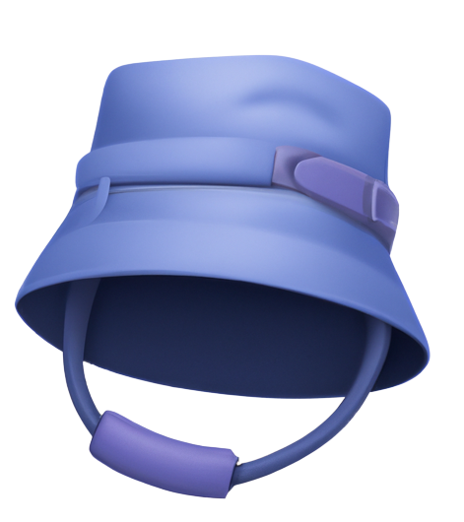
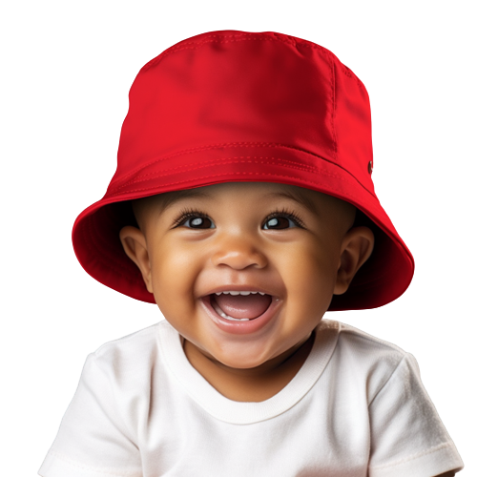
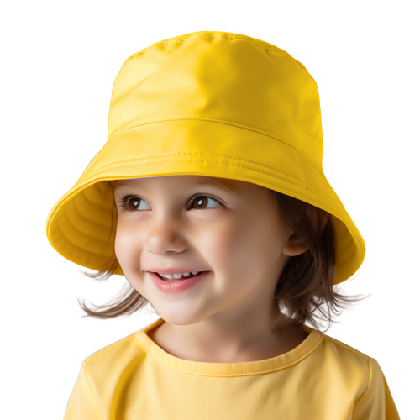
How Tiny Titans is Different
Direct Competitors
Indirect Competitors
TinyTitans
✅
❌
✅
✅
❌
❌
❌
Protective
Fashionable
Comfortable
Adjustable
Lightweight
Travel-Friendly
Weather-proof
✅
❌
✅
✅
✅
❌
✅
Notes:
So how is Tiny Titans different from our competitors…. Well our direct competitors offer protective helmets, they aren’t fashionable and as mentioned they are quite large and not portable. On the other hand, our indirect competitor servers the purpose of shaping the baby’s skull. As you can see Tiny Titans aligns will 7 qualities.
10. Fluidx. (2023). Fluidx Shin Pads. Fluid X Protection. https://fluidxprotects.com/product/fluidx-shin-pads

Slide 7
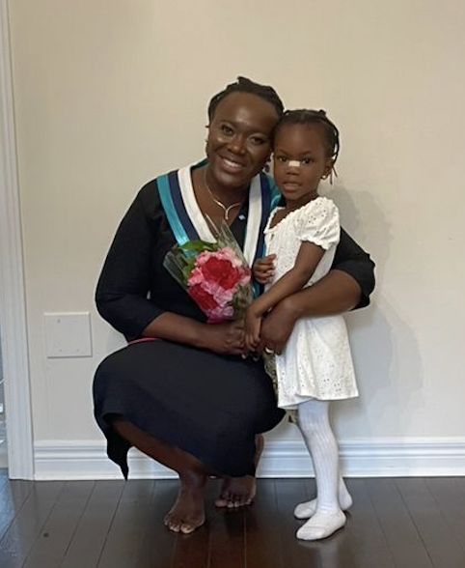
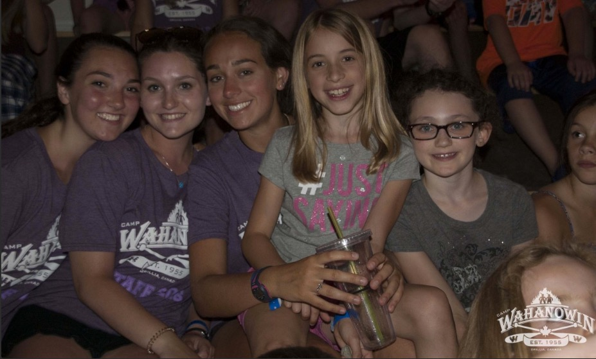
Reactions From Talking With People
Fatimah, 38, with her daughter, Asma.
Three Wahanowin Counsellors (1,2,3 from left): Lauren, 22, is second from left).
“My daughter always falls, this hat is perfect for her!”
“This product would alleviate my stress when my campers are busy with their daily activities”
Notes:
In our quest to understand whether Tiny Titans would appeal to our intended audience, we embarked on a journey of inquiry, directly engaging with potential customers and users. We have a few main takeaways:
We also learned that comfort, breathability, and ease of use are top concerns for children’s headwear. Headwear must be lightweight, easy to wash, and avoid head irritation, such as rashes. Our research validates product-market fit since Tiny Titans checks off all the boxes consumers look for.
Here are some reactions from potential consumers for Tiny Titans. We have your average mom, Fatima, who can see her daughter wearing this everyday and we have your average camp counsellor, Lauren, who takes care of children on the daily who thinks this would make her life a lot easier when watching young children.

Slide 8
Determining The Market Size
Bottom-Up Approach
Number of children under 5 years old in US and Canada^{12,13} | 24.3 million
Frequency of purchase^{Primary Research} | 2x year
Average “safety headgear” selling price^{Primary Research} | $45
Potential Market | $2.2 billion
**Primary research: surveyed 75 Parents/ Grandparents/ Guardians/ Caregivers** (Exhibit 1)
24.3 million * 2 * $45 = $2.2 billion
Notes:
In order to determine the potential market for Tiny Titans, we conducted a bottom up approach. We analyzed the number of children under 5 years old in the US and CAD (these are the infants wearing the product). We then conducted a survey to determine how often individuals purchase a hat within a year and found that is was approx. 2 times. Based on this survey we asked individuals the price point they would be willing to pay for this product (ranging from 0-100) and the most frequent answer was $45. Multiplying these numbers gave us the potential market size of 2.2 billion dollars.
Survey based on 75 responses from parents in the GTA.
12. Statista. (2023, June 2). Number of children in the U.S. by age 2021. Statista. https://www.statista.com/statistics/457786/number-of-children-in-the-us-by-age/
13. Statistics Canada. (2023, July 12). Census families with children by age of children and children by age groups. https://www150.statcan.gc.ca/t1/tbl1/en/tv.action?pid=3910004101

Slide 9
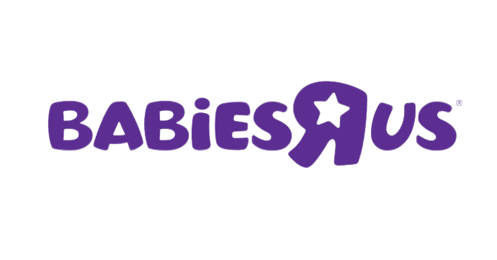
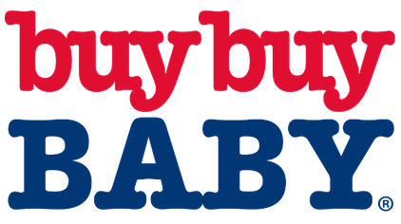





Go-To Market Strategy
Phase 1
Phase 2
Phase 3
Months 0-6
Months 6-12
Years 2-3
Market Testing
Trade Shows & Fairs
Local Partnerships
Goal: Get real-world data
Digital Presence
Social Media
Goal: Reach 2M parents
Retail Expansion
Goal: Sign 5+ contracts with baby retailers in Canada and US
Notes:
The Go-To Market strategy is three phased approach:
In the first phase taking place over the first 6 months, we will focus on market testing to get real-world data and feedback from customers. We will attend trade shows and fairs, such as the baby show and the CNE with booths to showcase our product. We will also work with local groups, such as camps and nurseries, to get more feedback and build on word of mouth.
Phase 2 will be the following 6 months, focused on building our digital presence using social media, such as Tik tok and instagram. We will focus on “mom and baby” categories to create a viral sensation. Our research shows that 2 in 3 moms will purchase something from Tik Tok, which is why it is important to reach parents on the apps they’re using daily.
With a viral product and product sales, we will expand to Canadian baby retailers such as Babies R Us and West Coast Kids. With the momentum in Canada, we will continue our expansion in US baby retailers, including Buy Buy Baby. We estimate this will take 2 to 3 years.

Slide 10
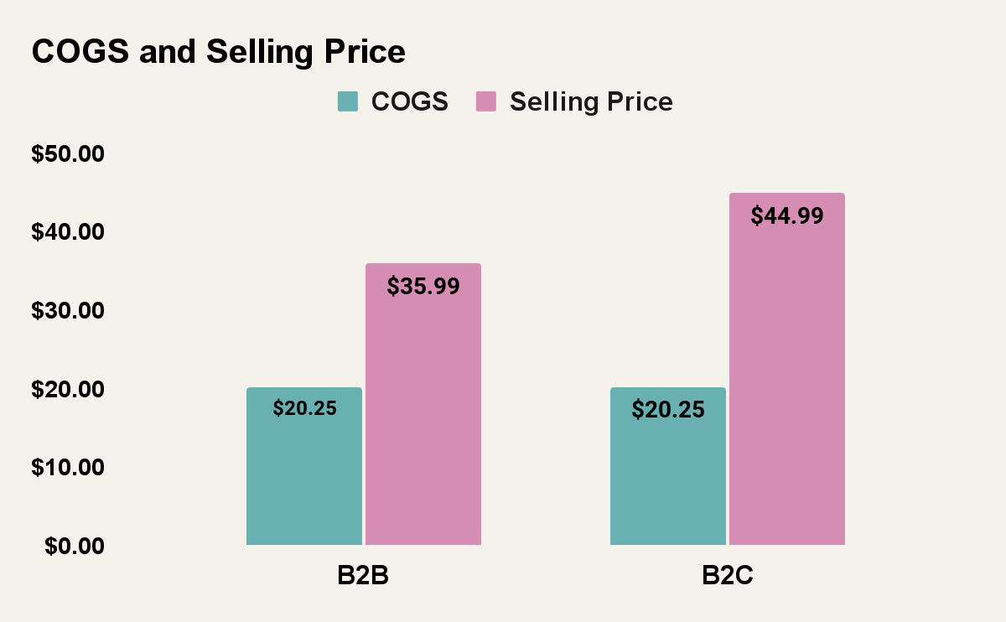
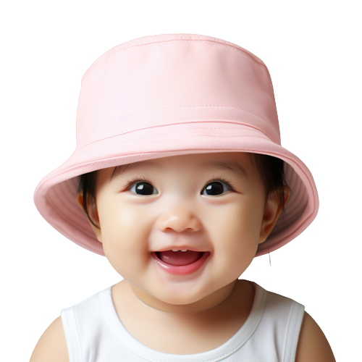
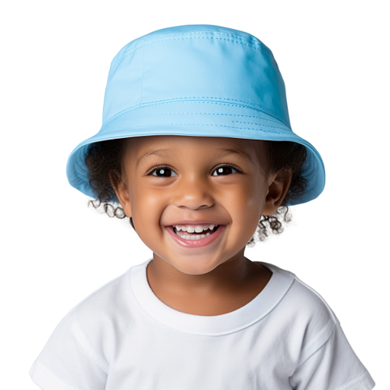
Business Model
Notes:
From our research and talking to suppliers, we calculated our COGS to be roughly $20, with almost 50% coming from the foam layer.
We will sell to both businesses and consumers.
Our B2B operation sells to groups like nurseries, kindergartens, camps, and distributors for $35.99, giving us a gross margin of 44%.
Our B2C operation sells to customers like parents and caregivers, with retail price of $44.99, giving us a gross margin of 55%. We will sell our product on our site, Amazon, and social media.

Slide 11
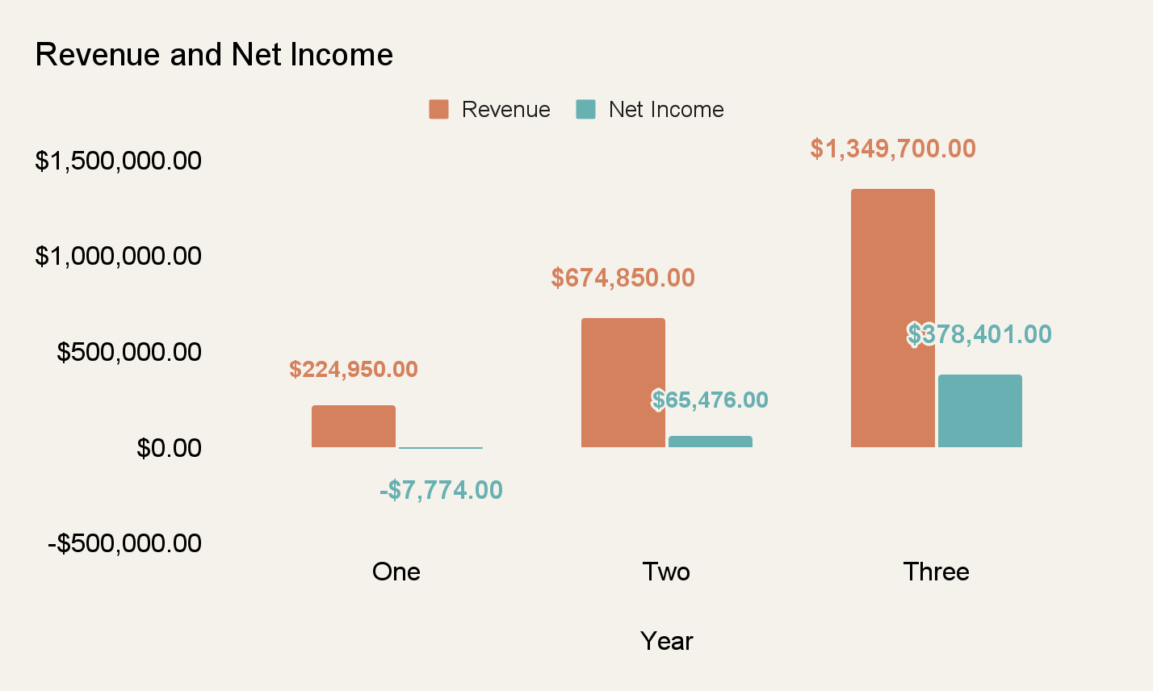

Three Year Projections
*Portion of proceeds will go to
Notes:
Here is a look at our revenue and net income projections over the next three years.
As we execute our Go-to market strategy and build momentum through online and retail channels, we anticipate to grow very quickly. From the first to second year, we expect to triple our revenue, and double it in the third year.
We are also passionate about giving back to our community, which is why we are choosing to donate 1% of proceeds to Holland Bloorview, a children’s rehabilitation center that specializes in concussions.

Slide 12


Scalability in the Infant Head Safety Market
Founded in 2013
Revenue as of 2023: ~5M¹⁵
Revenue projection: By year 3: >1M per year
Tiny Titans has the potential to scale faster than Safehead based on financial projections and a better product market fit.
Notes:
Tiny Titans has the potential to scale like Safehead, which generates $5M in revenue annually.
Given that Tiny Titans has a better product-market fit than safehead, since it checks more of the boxes customers are looking for, our company can scale faster

Slide 13
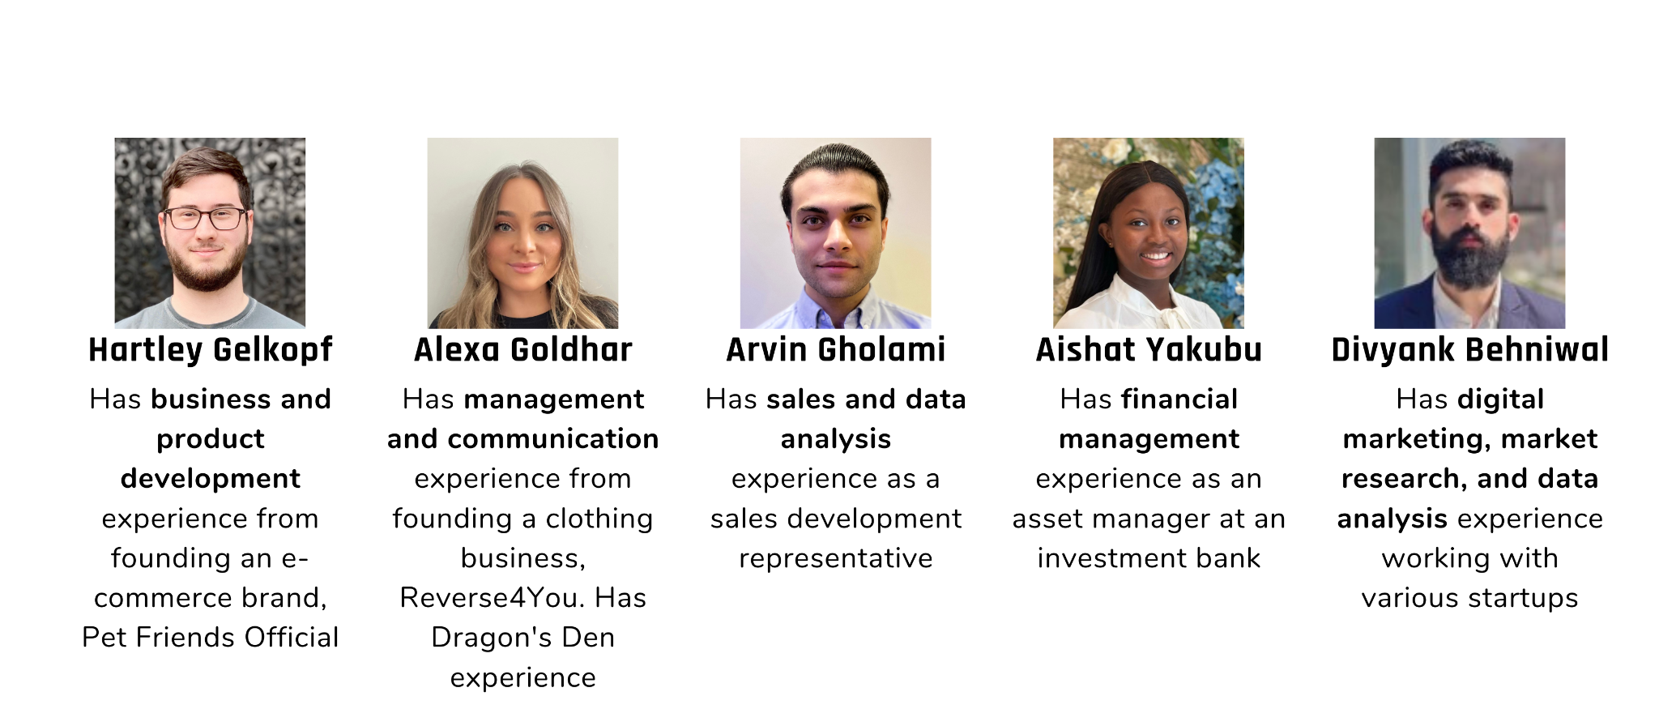
Meet The Team
*Each member of the team is a responsible caregiver for at least one child under 5 years old
Notes:
Our team is connected to the problem, and has the skills and knowledge to build Tiny Titans into the go-to brand for protecting kids.
Hartley: Professional background in business and product development. Founded a successful online pet store during the pandemic, six figures in revenue in one year. Work at IMPACT Initiative collaborating with multidisciplinary groups to create assistive products (experience with product creation)
Alexa: entrepreneurial background (starting a small business during the pandemic, working specifically with apparel, learned the logistics and determined effective ways to assess market readiness, my sister and co-founder of their business went on dragons den → one of our teams advisors is the co-founder of this business and similarly where their business model helps those in needs, profits from tiny titans will go to Holland Bloorview (concussion hospital- https://hollandbloorview.ca/services/programs-services/concussion-centre?gclid=Cj0KCQjwwISlBhD6ARIsAESAmp5OWwfXwMzXVG4It7KV3O31HW_poytpsEEKCYzQK-_uAP1vyfwTKYIaAhXjEALw_wcB)
Arvin: Extensive background working in sales for a real estate marketing agency. Proficient relationship building skills and educational experience in strategic thinking and operations.
Divyank: More than 2-year experience in marketing with various startups. Strong background in market research, digital marketing, and data analysis.
Aishat: Worked as a nanny before and have experienced different kids encounter severe brain injuries. Background in Economics and have worked as an asset manager at an investment bank, so I can deal with the management and allocation of resources, most especially funds.

Slide 14

THANK YOU! Questions?

Slide 15
REFERENCES
Gerritsen, H., Samim, M., Peters, H., Schers, H., & van de Laar, F. A. (2018, May 31). Incidence, course and risk factors of head injury: A retrospective cohort study. BMJ open. https://www.ncbi.nlm.nih.gov/pmc/articles/PMC5988084/#:~:text=Incidence%20of%20all%20head%20injury,-During%201%2Dyear&text=The%20incidence%20rate%20was%20123.0,34%25%20were%20under%2015%20years
Araki, T., Yokota, H., & Morita, A. (2017, February 15). Pediatric traumatic brain injury: Characteristic features, diagnosis, and Management. Neurologia medico-chirurgica. https://www.ncbi.nlm.nih.gov/pmc/articles/PMC5341344/#:~:text=An%20estimated%20475%2C000%20people%20in,die%20because%20of%20their%20injuries.
Haarbauer-Krupa, J., Haileyesus, T., Gilchrist, J., Mack, K. A., Law, C. S., & Joseph, A. (2019, September). Fall-related traumatic brain injury in children ages 0-4 years. Journal of safety research. https://www.ncbi.nlm.nih.gov/pmc/articles/PMC6927527/
Gitnux. (2023, July 12). The most surprising helicopter parenting statistics and trends in 2023. GITNUX. https://blog.gitnux.com/helicopter-parenting-statistics/
Marino, A., & Norkin, L. (2017, October). You’re doomed to be a helicopter parent - but it’s not your fault. Society Made Us All Helicopter Controlling Parents. https://www.refinery29.com/en-us/2017/10/171243/helicopter-parent-millennial-effects
Burke, M. (2023, January 17). Why does my toddler hate their hat?. RollerCoaster. https://rollercoaster.ie/kids/toddlers/why-does-my-toddler-hate-their-hat/#:~:text=If%20they%27re%20not%20used,them%20feel%20restricted%20or%20confined.
Safehead. (2023). Baby headgear: Soft Helmets for babies: Safeheadbaby. Safehead Inc. https://www.safehead.com/
Thudguard. (2019, March 18). Thudguard infant protective hat - baby to senior. Baby To Senior - Baby To Senior. https://babytosenior.ca/product/thudguard-infant-protective-hat/
Amazon. (2023). Ocanoiy infant helmet baby helmet for crawling walking toddler... ’ customer reviews. Amazon.ca:Customer reviews: Ocanoiy Infant Helmet Baby Helmet for Crawling Walking Toddler Children Soft Cushion Harnesses Cap Adjustable Kid Hat (Starry Blue). https://www.amazon.ca/product-reviews/B08T22RM27/ref=cm_cr_unknown?ie=UTF8&filterByStar=two_star&reviewerType=all_reviews&pageNumber=1#reviews-filter-bar
Fluidx. (2023). Fluidx Shin Pads. Fluid X Protection. https://fluidxprotects.com/product/fluidx-shin-pads

Slide 16
REFERENCES
11. Public Health Ontario. (2023, May). Injuries among children using the Canadian Health Survey of children ...Injuries among Children using the Canadian Health
Survey of Children and Youth.
https://www.publichealthontario.ca/-/media/Documents/I/2023/injuries-among-children-using-chscy.pdf?rev=0e44fe7fa026491cb0be099cf1fef1cc&sc_lang=en
12. Statista. (2023, June 2). Number of children in the U.S. by age 2021. Statista.
https://www.statista.com/statistics/457786/number-of-children-in-the-us-by-age/
13. Statistics Canada. (2023, July 12). Census families with children by age of children and children by age groups.
https://www150.statcan.gc.ca/t1/tbl1/en/tv.action?pid=3910004101
14. Media Group Online. (2021, January 5). Moms Turn to TikTok to learn about new products. Media Group Online.
https://mediagrouponlineinc.com/2021/01/05/moms-turn-to-tiktok-to-learn-about-new-products/
15. Zoom Info. (2023). Safehead - Overview, News & competitors | Zoominfo.com. https://www.zoominfo.com/c/safehead-inc/402791236
16. CRO. (2023, July 9). Cranial remolding orthoses (CRO) aka Baby Helmets. Custom Orthotic. https://www.customorthotic.ca/helmets/

Slide 17
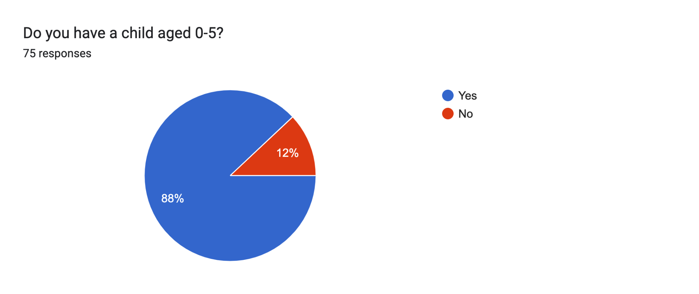
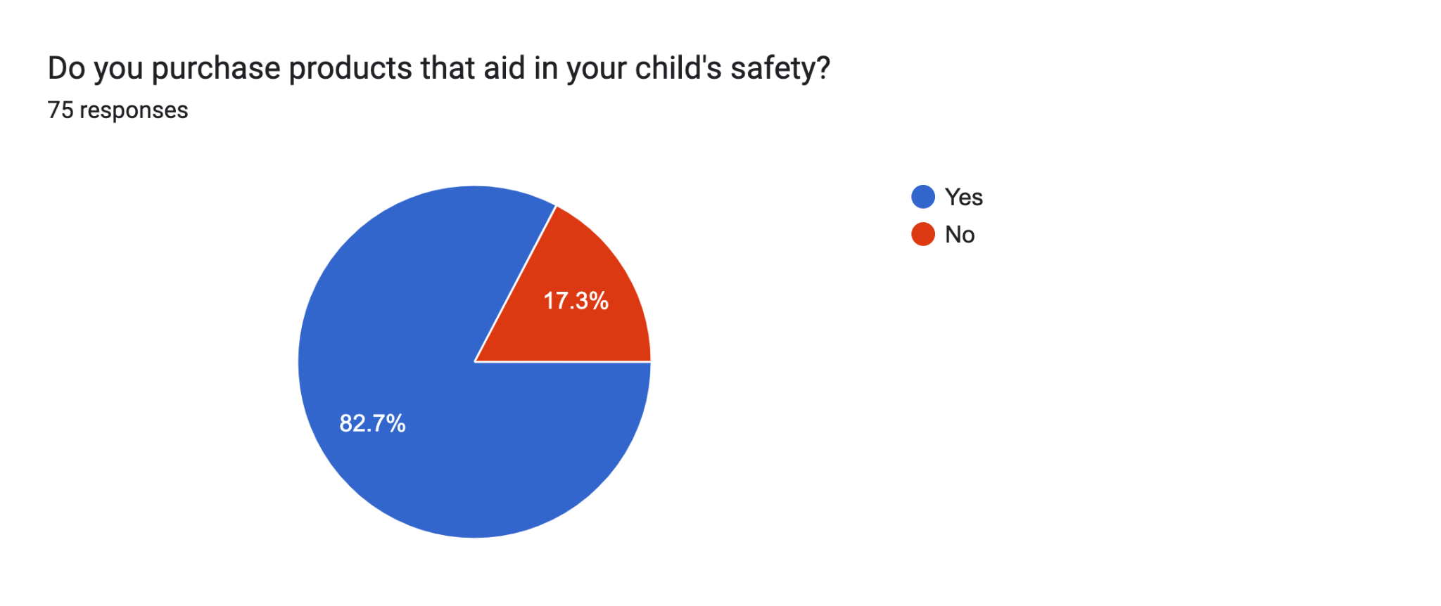
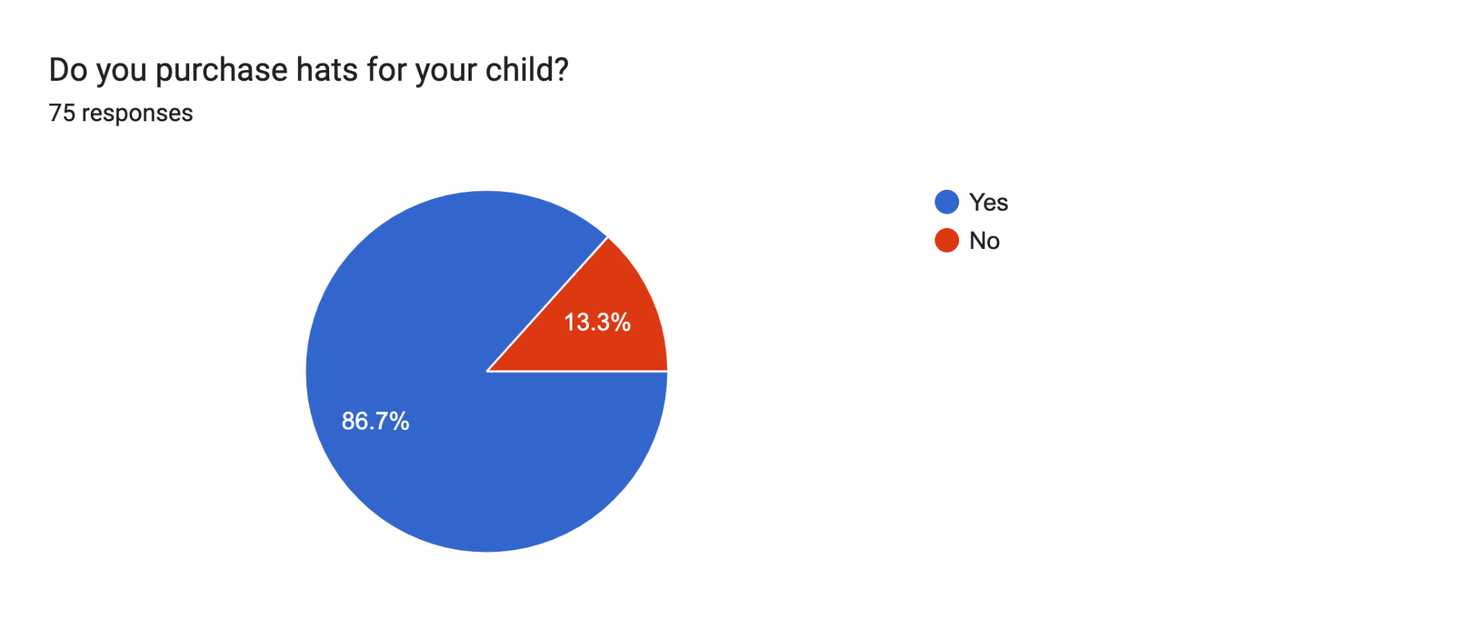
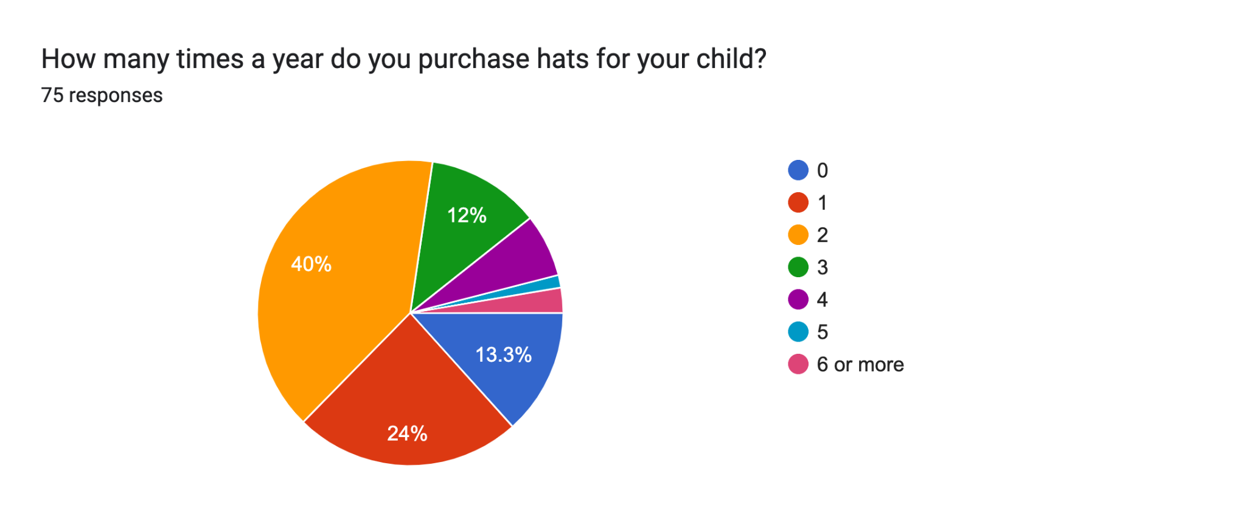
Appendix
Exhibit 1: Primary Research Survey Results
Notes:
Name: Samantha Thompson
Age: 32
Occupation: Marketing Manager
Family Status: Married with a 9-month-old baby girl
Location: Suburban area
Background:
Samantha is a first-time mother who is highly conscious of her baby's safety and well-being. She has always been diligent in researching and implementing safety measures to protect her child. Samantha recently read about the increased risk of head injuries in infants as they gain mobility skills, which has made her even more concerned about her baby's safety.
Goals and Motivations:
Ensure her baby's safety: Samantha's primary goal is to protect her baby girl from any potential head injuries that could occur as she learns to crawl and walk.
Provide freedom for exploration: Samantha wants her daughter to have the freedom to explore her surroundings and develop her motor skills without constant worry about injuries. She believes it is important for her baby's development to have the space to move and learn.
Comfort and convenience: Samantha seeks products that are comfortable for her baby to wear and easy for her to use and maintain. She wants a solution that doesn't compromise her baby's comfort and allows her to go about her daily routine without hassle.
Concerns and Challenges:
Balancing safety and style: Samantha wants her baby to be protected, but she also wants her to look cute and stylish. She is concerned that traditional helmets might be too bulky or unattractive for everyday use.
Finding the right fit: Samantha wants to ensure that the protective gear fits her baby's head properly and can be adjusted as her baby grows. She worries about comfort and the potential for discomfort or resistance from her baby.
Making an informed choice: Samantha wants to make an educated decision when purchasing protective gear for her baby. She looks for reliable information, safety certifications, and positive reviews to ensure she is choosing a trustworthy product.

Slide 18
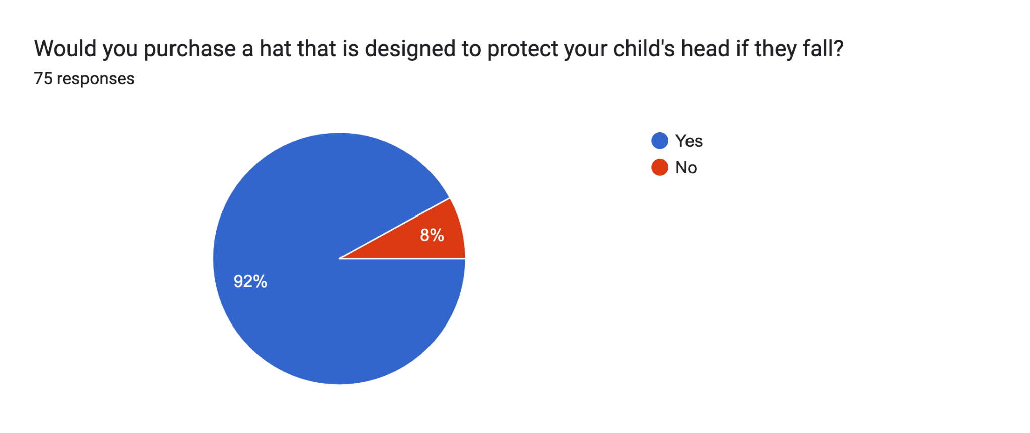
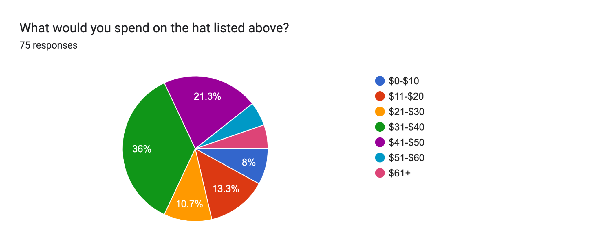
Exhibit 1: Primary Research- Survey Results

Slide 19
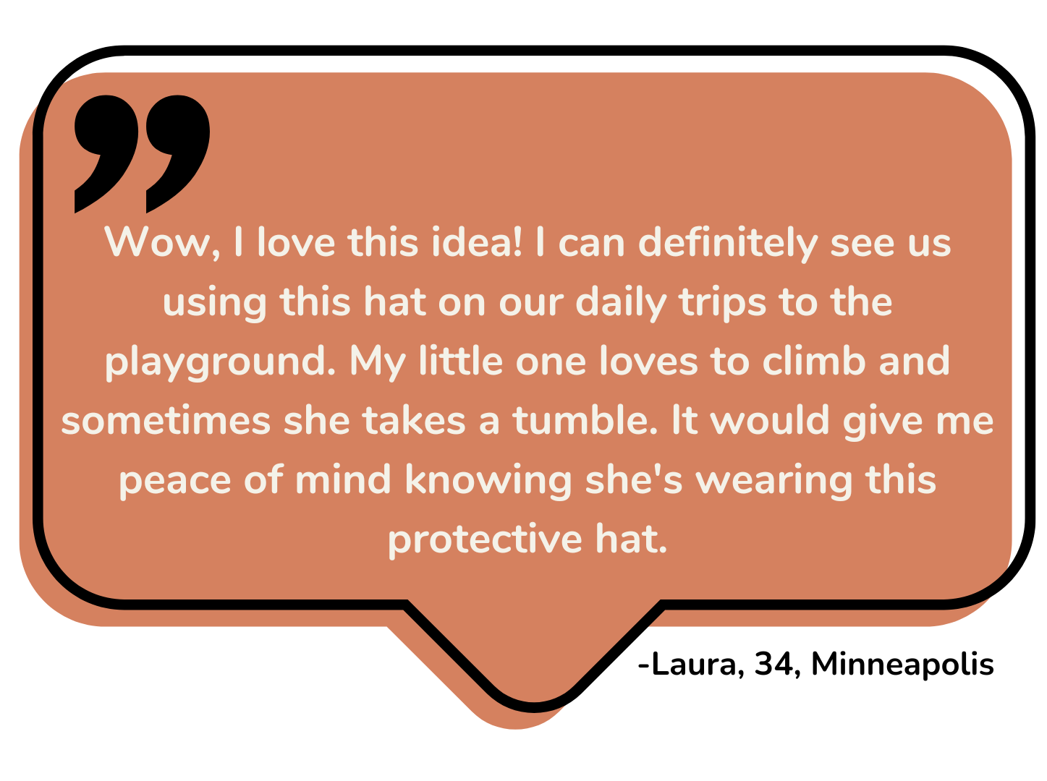
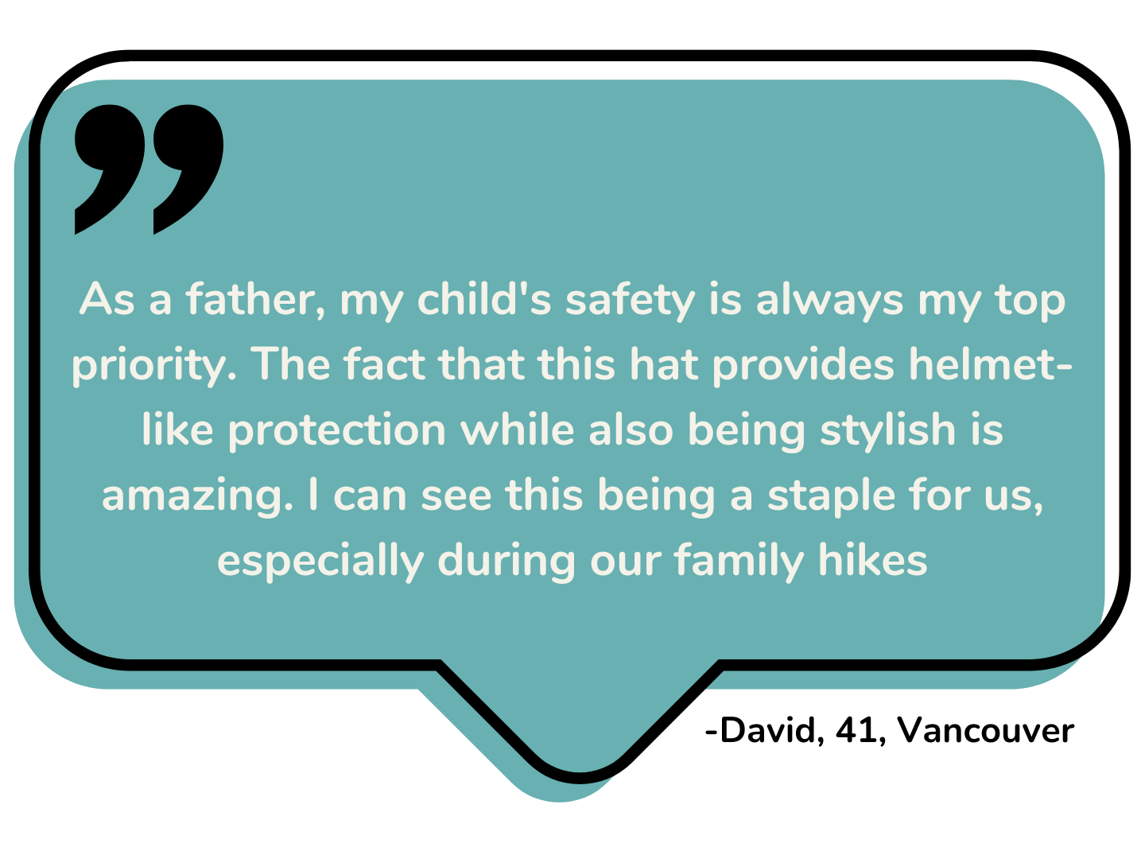
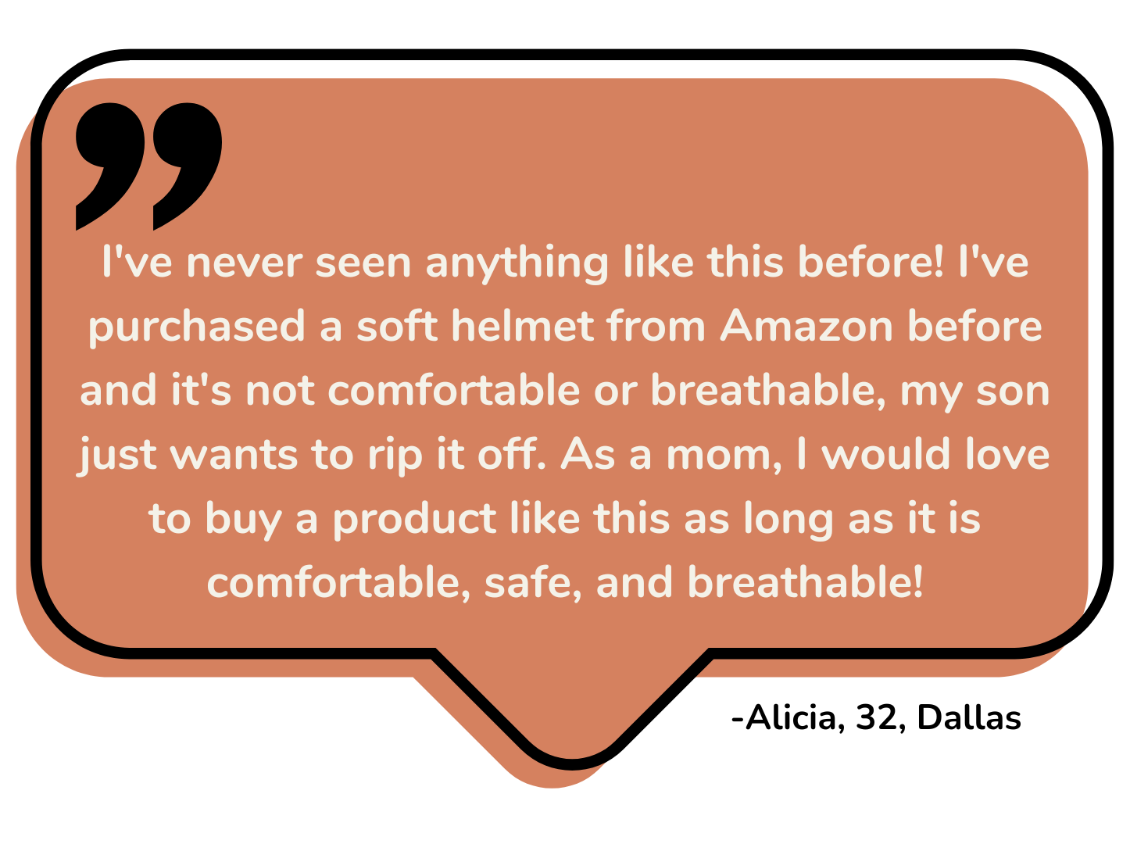
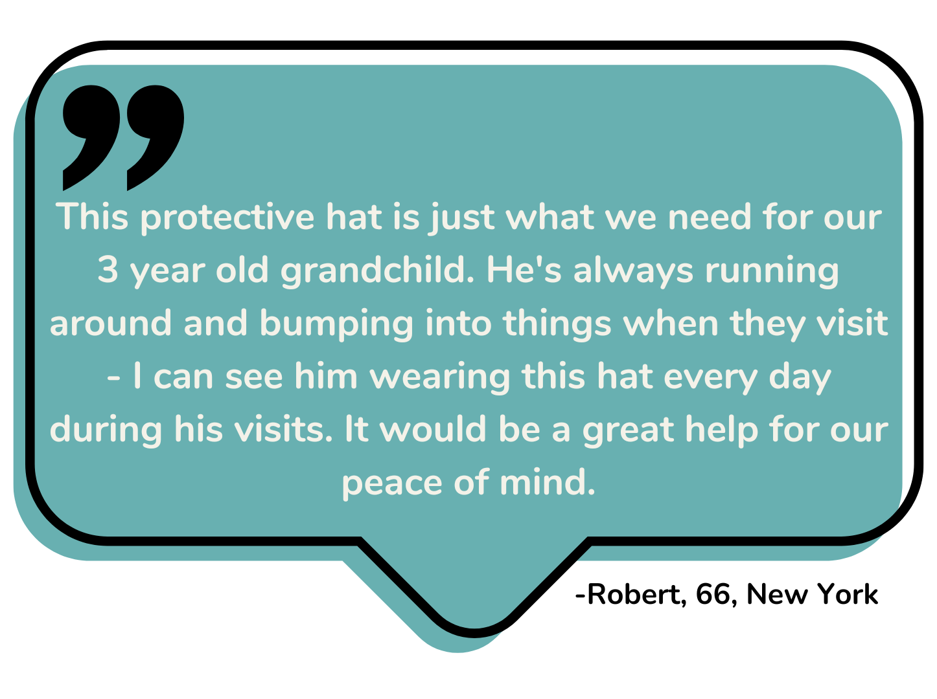
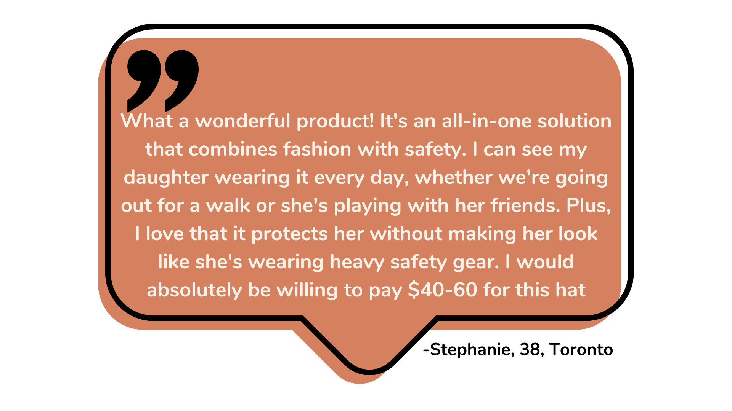
Exhibit 2: Primary Research- Interviews

Slide 20
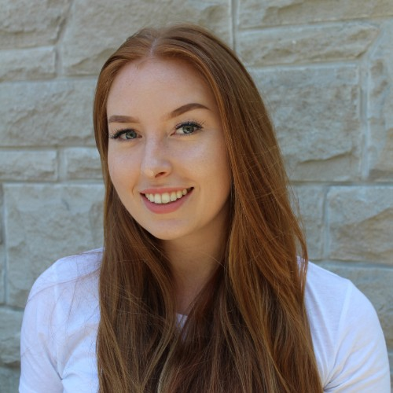
Exhibit 3: Meet Our Customer- Persona
Name: Samantha Thompson
Age: 32
Occupation: Marketing Manager
Family Status: Married with a 9-month-old baby girl
Goals and Motivations:
Ensure her baby’s safety
Provide freedom for exploration
Comfort and convenience
Concerns and Challenges:
Balancing safety and style
Finding the right fit
Making an informed choice
Notes:
Name: Samantha Thompson
Age: 32
Occupation: Marketing Manager
Family Status: Married with a 9-month-old baby girl
Location: Suburban area
Background:
Samantha is a first-time mother who is highly conscious of her baby's safety and well-being. She has always been diligent in researching and implementing safety measures to protect her child. Samantha recently read about the increased risk of head injuries in infants as they gain mobility skills, which has made her even more concerned about her baby's safety.
Goals and Motivations:
Ensure her baby's safety: Samantha's primary goal is to protect her baby girl from any potential head injuries that could occur as she learns to crawl and walk.
Provide freedom for exploration: Samantha wants her daughter to have the freedom to explore her surroundings and develop her motor skills without constant worry about injuries. She believes it is important for her baby's development to have the space to move and learn.
Comfort and convenience: Samantha seeks products that are comfortable for her baby to wear and easy for her to use and maintain. She wants a solution that doesn't compromise her baby's comfort and allows her to go about her daily routine without hassle.
Concerns and Challenges:
Balancing safety and style: Samantha wants her baby to be protected, but she also wants her to look cute and stylish. She is concerned that traditional helmets might be too bulky or unattractive for everyday use.
Finding the right fit: Samantha wants to ensure that the protective gear fits her baby's head properly and can be adjusted as her baby grows. She worries about comfort and the potential for discomfort or resistance from her baby.
Making an informed choice: Samantha wants to make an educated decision when purchasing protective gear for her baby. She looks for reliable information, safety certifications, and positive reviews to ensure she is choosing a trustworthy product.

Slide 21
Exhibit 4: Direct Competition
Direct Competitor | Why are they a competitor?
Safehead Helmet | Lightweight, adjustable, and padded, for infants aged: 7-24 months, criticisms include: non-inclusive sizing, bulky design, & poor fit, quite expensive ($60+)⁷
Thudguard Helmet | Protect infants’ head during development Impact absorbing foam Criticisms include: inadequate ventilation, quality does not reflect high price point ($50)⁸
Ocanoiy soft-cushion helmet | Lightweight & soft cushioned For infants: 6-60 months Criticisms include: require adaptation period, difficult to clean & “awkward fit” Price starts at CAD $27.99⁹
Notes:
Let’s talk about how Tiny Titans squares up against our competitors. Each product listed has the goal of protecting the infant’s head when they are exploring in their environment. Yet, based on reviews gathered from marketplaces such as Amazon, individuals have complained that products are too bulky, don’t have adequate ventilation, and the fit is just awkward. And not to mention, while these babies all look super cute wearing these products, they aren’t too fashionable.This is where Tiny Titans comes into play….
References:
7. Safehead. (2023). Baby headgear: Soft Helmets for babies: Safeheadbaby. Safehead Inc. https://www.safehead.com/
8. Thudguard. (2019, March 18). Thudguard infant protective hat - baby to senior. Baby To Senior - Baby To Senior. https://babytosenior.ca/product/thudguard-infant-protective-hat/
9. Amazon. (2023). Ocanoiy infant helmet baby helmet for crawling walking toddler... ’ customer reviews. Amazon.ca:Customer reviews: Ocanoiy Infant Helmet Baby Helmet for Crawling Walking Toddler Children Soft Cushion Harnesses Cap Adjustable Kid Hat (Starry Blue). https://www.amazon.ca/product-reviews/B08T22RM27/ref=cm_cr_unknown?ie=UTF8&filterByStar=two_star&reviewerType=all_reviews&pageNumber=1#reviews-filter-bar
shorten

Slide 22
Exhibit 4: Indirect Competition
Indirect Competitor | Why are they a competitor?
Cranial Remoulding Orthosis (CRO) Helmet | Helmets for conditions like plagiocephaly, designed to correct skull shape, are indirect competitors. While their primary purpose isn't injury protection, they offer some head safety, which might lead parents to use them for general safety, foregoing a separate safety helmet. However, they may not provide the same level of protection against impacts from every day falls or bumps, representing an alternative, but not directly comparable, solution in the infant safety market. This product should not be worn on infants that do not have an accurate diagnosis¹⁶.
Notes:
Reference:
16. CRO. (2023, July 9). Cranial remolding orthoses (CRO) aka Baby Helmets. Custom Orthotic. https://www.customorthotic.ca/helmets/

Slide 23
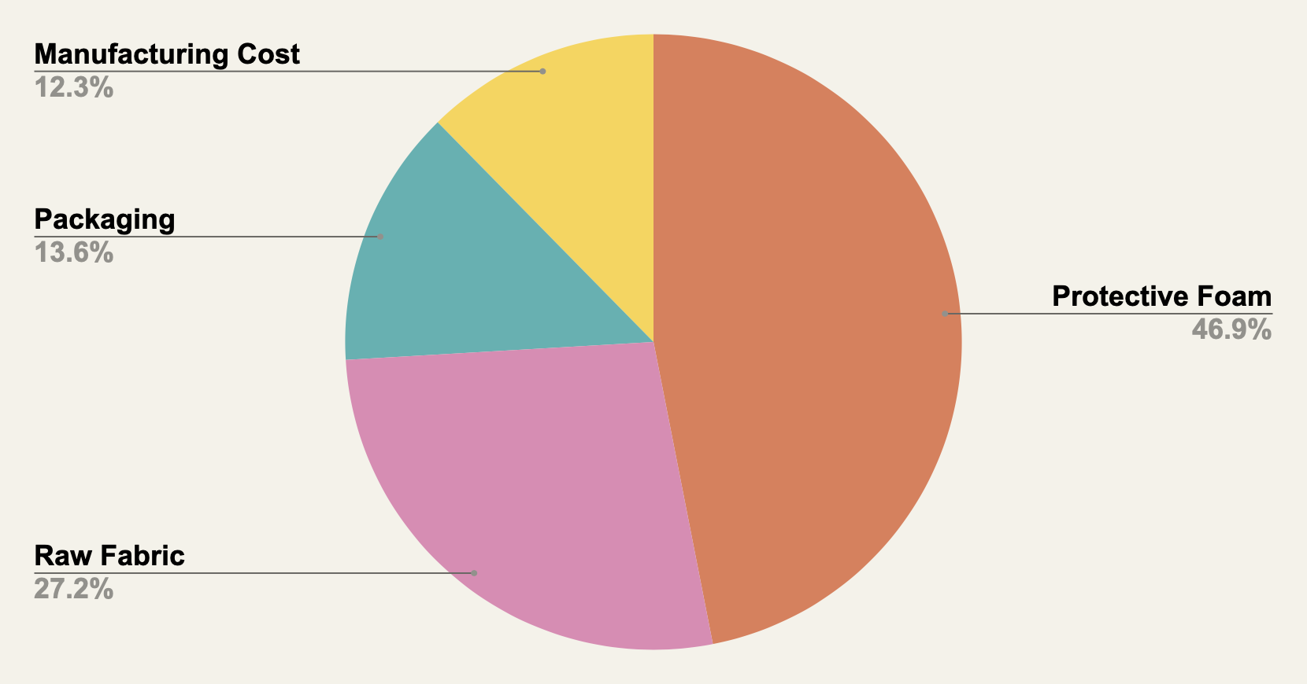
Exhibit 5: Cost of Production in CAD
Total cost of production: $20.25
$9.50
$5.50
$2.75
$2.50

Slide 24
Exhibit 6: Detailed Three Year Financial Projections
 | Year 1 | Year 2 | Year 3
Sales | $224,950.00 | $674,850.00 | $1,349,700.00
Fixed Costs
Storage* | $0.00 | $40,200.00 | $50,250.00
Product Testing | $2,300.00 | $1,500.00 | $4,000.00
Insurance | $2,025.00 | $6,075.00 | $12,150.00
Incorporation Fees and Management | $599.00 | $599.00 | $599.00
Website Development | $17,800.00 | $6,000.00 | $4,300.00
Variable Costs
Production Cost | $101,250.00 | $303,750.00 | $506,250.00
Marketing | $75,000.00 | $150,000.00 | $225,000.00
Shipping and Transportation | $33,750.00 | $101,250.00 | $168,750.00
Total Cost | $232,724.00 | $609,374.00 | $971,299.00
Net Income | -$7,774.00 | $65,476.00 | $378,401.00
* In year one, storage be at team member’s homes

Slide 25
Exhibit 7: Size Chart for Tiny Titans
SIZE | AGE | HEAD SIZE (circumference) | BRIM DEPTH
XXS | 0-3 months | 37 CM | 5.5 CM
XS | 3-6 months | 42 CM | 6 CM
S | 6-12 months | 47 CM | 6.5 CM
M | 1-2 years | 50 CM | 6.8 CM
L | 2-3 years | 52 CM | 7 CM
XL | 3-5 years | 54 CM | 7.2 CM

Slide 26
Exhibit 8: What We Learned From Talking to People
Who’s interested
B2C | B2B
Parents Caregivers Guardians Grandparents Friends | Camp Wahanowin (summer camp)

Slide 27

Exhibit 9: Mission and Vision
Mission:
Tiny Titans is dedicated to fostering the fearless exploration of our infants by providing premium foam-lined hats, blending protection and comfort to provide peace of mind for caregivers and safe discoveries for the young one
Vision:
We aim to set a new benchmark in infant safety and parental peace of mind. We are not just a hat. We are a guardian in your child's exploration. Tiny Titans aspires to be synonymous with reliable, fashionable, and innovative protective gear that empowers every infant's adventurous journey while reassuring their caregivers.

