Slide 1



BLOCK-LEVEL DOUBLE JPEG COMPRESSION DETECTION FOR IMAGE
FORGERY LOCALIZATION
AUTHORS: 1. VINAY VERMA 2. DEEPAK SINGH 3. NITIN KHANNA
Digital image processing (EEL605)
By Team 13
PROJECT INSTRUCTOR
DR. NITIN KHANNA
TEAM MEMBERS
  ANURAG JAISWAL 12340300
  SHIVAM SINGH 12342020
  DIVIT SHARMA 12340680
  SRILATHA 12341720
TA
DHEERAJ BISWAS.

Slide 2
PROJECT GOALS
GIVEN A JPEG IMAGE THAT MAY HAVE BEEN LOCALLY MANIPULATED, THE GOAL IS TO:
1. CLASSIFY EACH BLOCK/PATCH OF THE IMAGE AS SINGLE COMPRESSED OR DOUBLE COMPRESSED.
2. PRODUCE A FORGERY LOCALISATION MAP HIGHLIGHTING THE TAMPERED REGIONS.
3. PRODUCE COMPARASION TABLE BY CHANGING DIFFERENT PARAMETERS

Slide 3
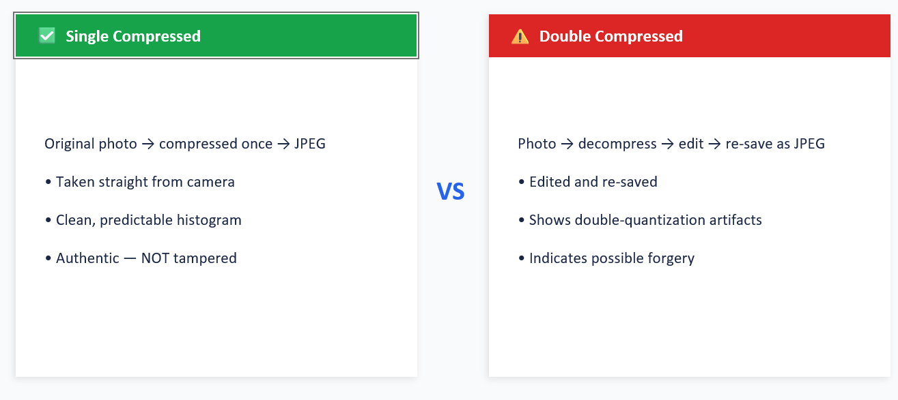
THE CORE IDEA: SINGLE VS. DOUBLE COMPRESSION

Slide 4
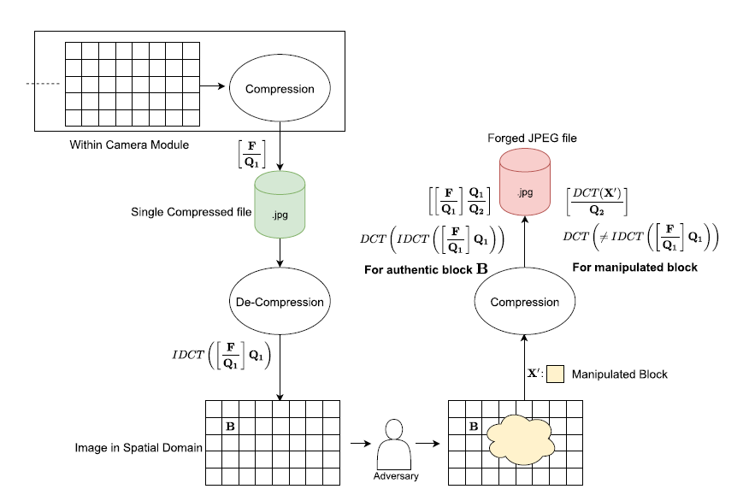
ILLUSTRATION OF FORGERY LOCALIZATION MODEL IN JPEG IMAGES

Slide 5
RELATED WORK
METHOD
INPUT
KEY PROBLEM
VERMA ET AL. 2018
RAW QUANTIZED (FROM BITSTREAM)
NO Q-MATRIX INFO USED AT ALL
PARK ET AL. 2018
DE-QUANTIZED HISTOGRAM + Q APPENDED AT FC LAYERS
FAILS ON UNSEEN Q-MATRICES (TPR ≈ 3%)

Slide 6
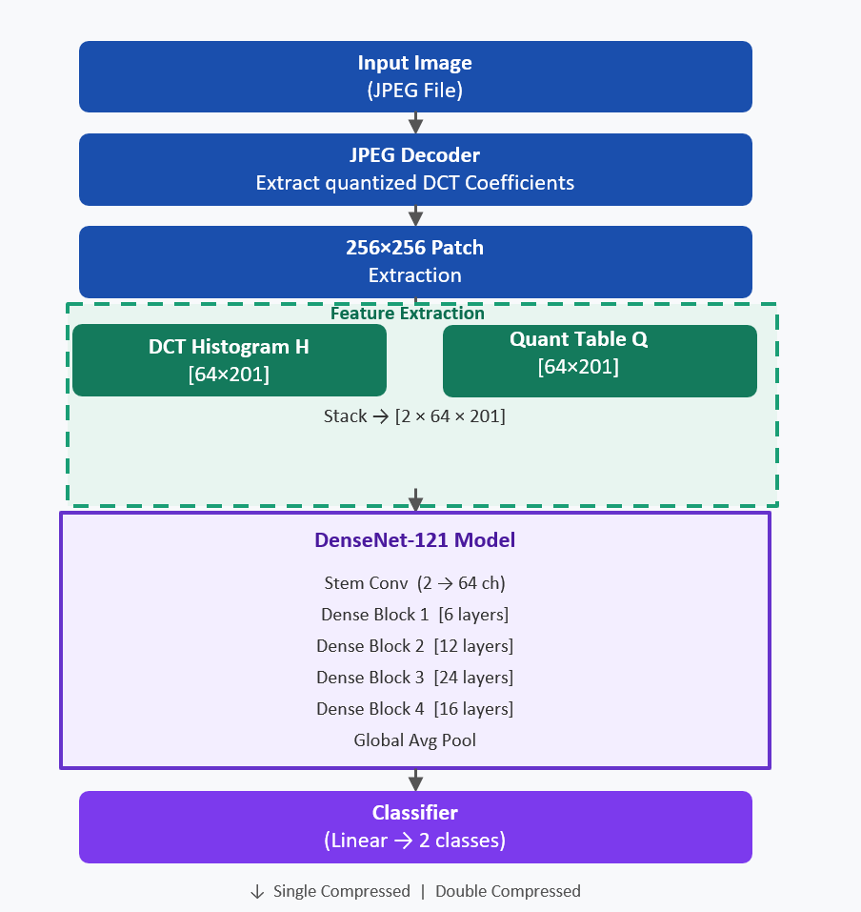
PROPOSED METHOD — BLOCK DIAGRAM

Slide 7
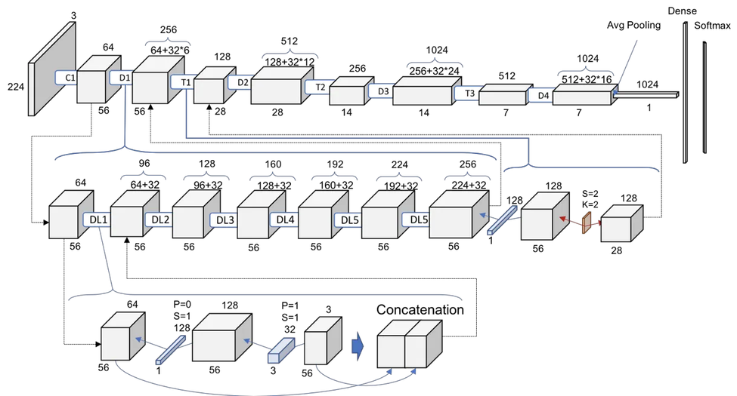
WHY DENSENET 121
  DENSE CONNECTIONS PRESERVE DCT FEATURES — EVERY LAYER ACCESSES ALL PREVIOUS FEATURE MAPS, ENSURING NO SUBTLE DCT STATISTICAL PATTERN IS LOST.
  PARAMETER EFFICIENT — FEATURE REUSE REDUCES REDUNDANCY, PREVENTING OVERFITTING ON LARGE
342K IMAGE DATASET.
  STRONG GRADIENT FLOW — DIRECT BACKPROPAGATION
TO EARLY LAYERS SOLVES VANISHING GRADIENT, ENABLING STABLE
TRAINING ON NON-STANDARD 2-CHANNEL DCT INPUT.

Slide 8
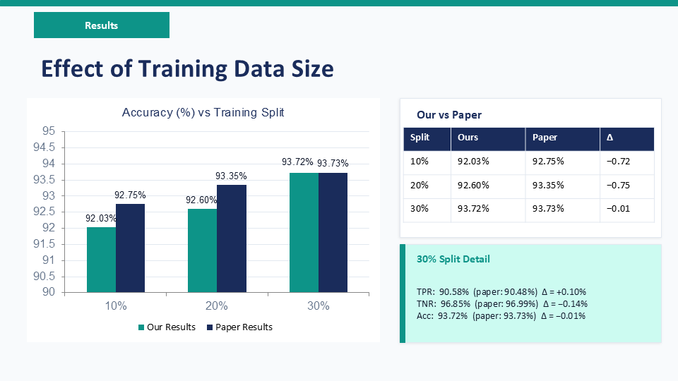

Slide 9
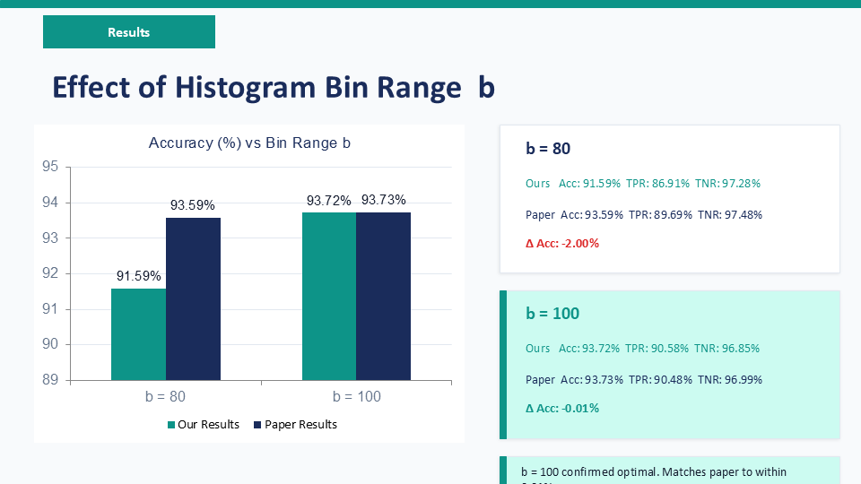

Slide 10
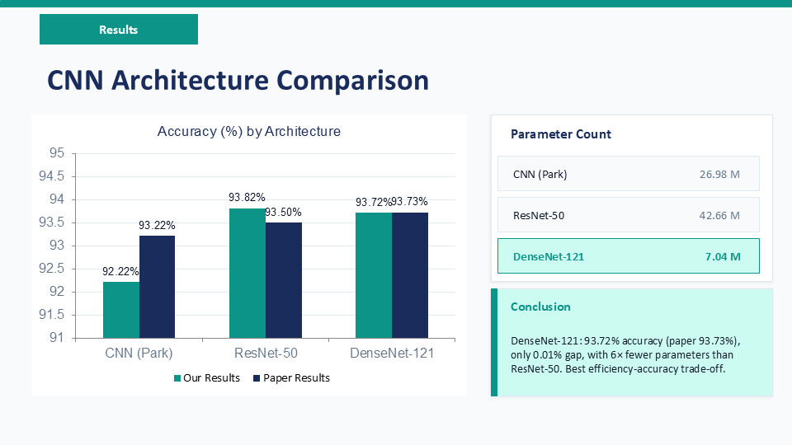

Slide 11
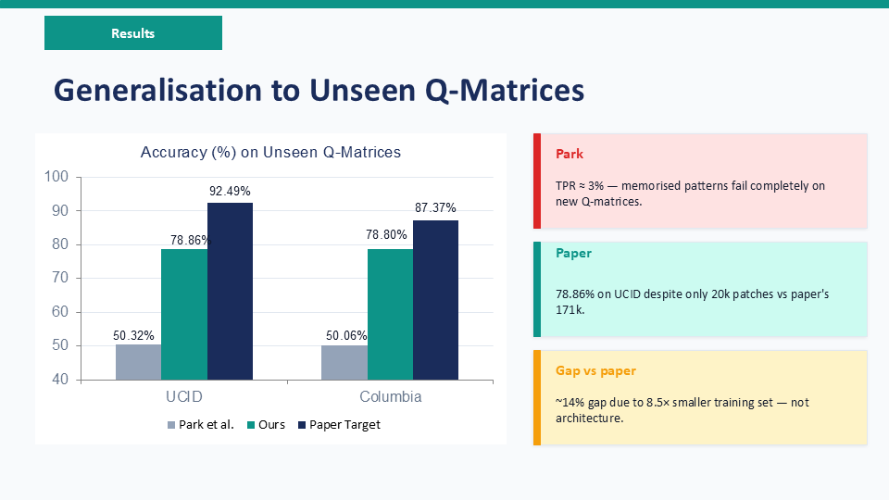

Slide 12
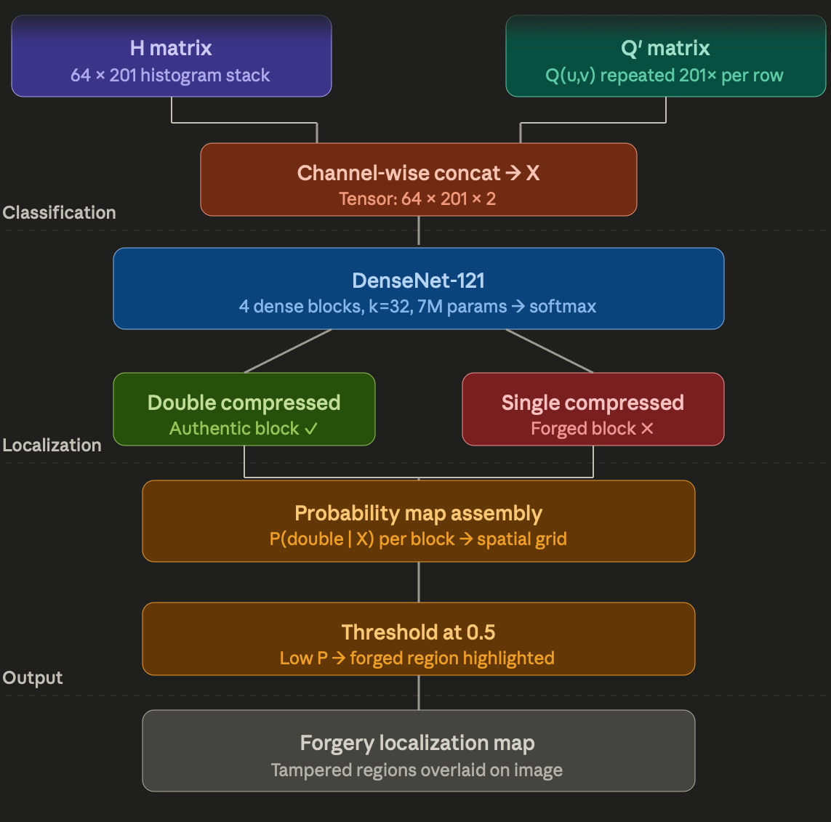
FORGERY LOCALIZATION

Slide 13
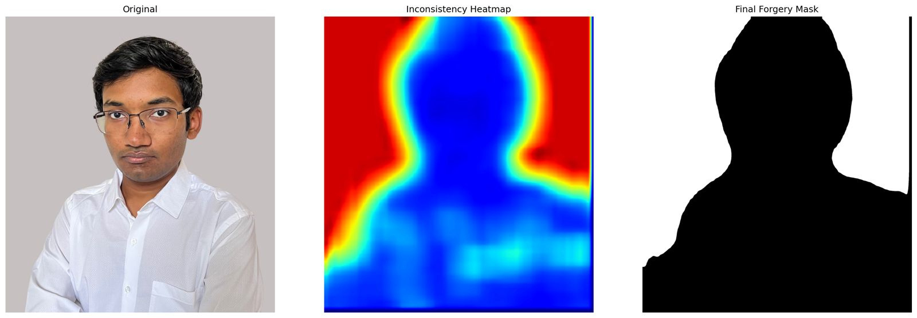
Forgery localization results

Slide 14
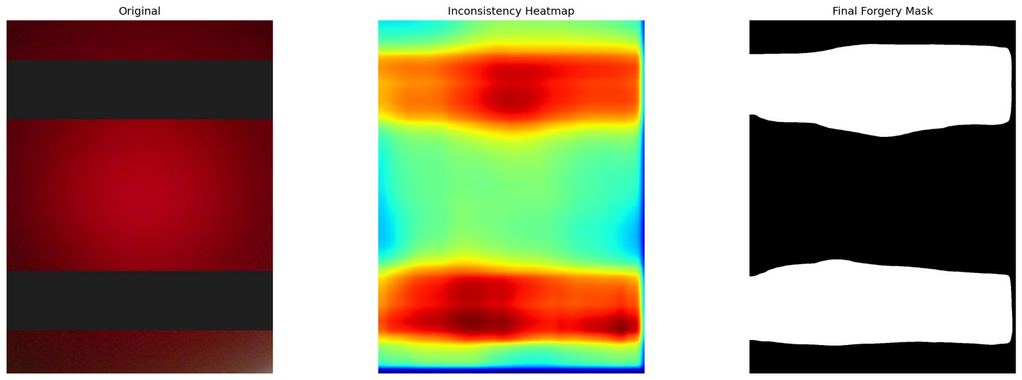
Forgery localization results

Slide 15
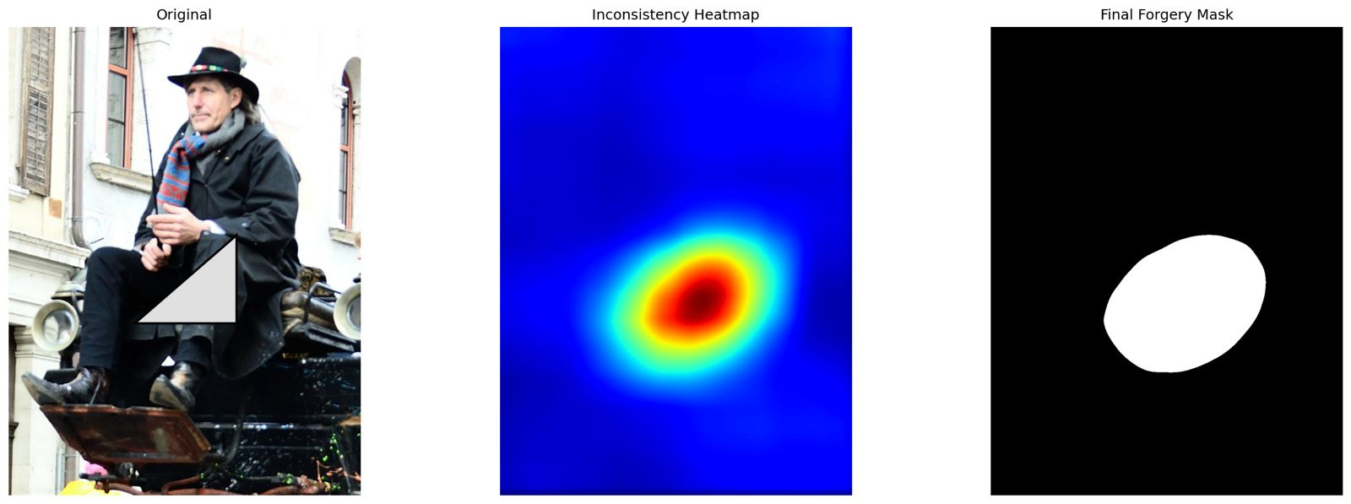
Forgery localization results

Slide 16
CONCLUSION
  DENSENET-121 ACHIEVES COMPETITIVE ACCURACY WITH THE MINIMUM PARAMETER COUNT among the architectures evaluated.
2. THE METHOD IS PARTICULARLY ROBUST TO UNSEEN QUANTISATION MATRICES,
WHERE COMPETING METHODS DEGRADE SEVERELY.
3. THE FAILURE CASES (Q1 = Q2 AND INTERMEDIATE PROCESSING) ARE WELL
UNDERSTOOD THEORETICALLY AND ARE CONSISTENT WITH THE BROADER
LITERATURE.

Slide 17
REFERENCES
[1] V. VERMA, D. SINGH, AND N. KHANNA,
"BLOCK-LEVEL DOUBLE JPEG COMPRESSION DETECTION FOR IMAGE FORGERY LOCALIZATION,"
ARXIV PREPRINT ARXIV:2003.09393, 2020.
[2]PARK, J., CHO, D., AHN, W., LEE, H.K.: DOUBLE JPEG DETECTION IN MIXED JPEG QUALITY FACTORS USING DEEP
CONVOLUTIONAL NEURAL NETWORK. IN: PROCEEDINGS OF THE EUROPEAN CONFERENCE ON COMPUTER VISION (ECCV),
636–652 (2018)

Slide 18
THANK YOU

