Slide 1

Using the IMDB database to evaluate movies
By Fatih, Kaushik, Mary, Prasanna

Slide 2
IMDB raw data are available on https://www.imdb.com/interfaces/
The data are divided into many text files and format of each file differ which make the data collection and cleaning challenging.
To create one data file containing all the desired information we use python script to extract the relevant information and store in database.

Slide 3
Finally we export data to TSV(TAB separated value) to make it easier to import into data analysis package.Following text files were downloaded
Budget. list . Total budget
Generes.list . Geners that movie belongs to
Movies.,list. Master list of all movie title
Running times.list. Movie length in minutesMovies were selected for inclusion if they had a known length and had been rated by at least one IMDB user.
The final output contains the following fields:
• title. Title of the movie.
• year. Year of release.
• budget. Total budget (if known) in US dollars
• length. Length in minutes.

Slide 4
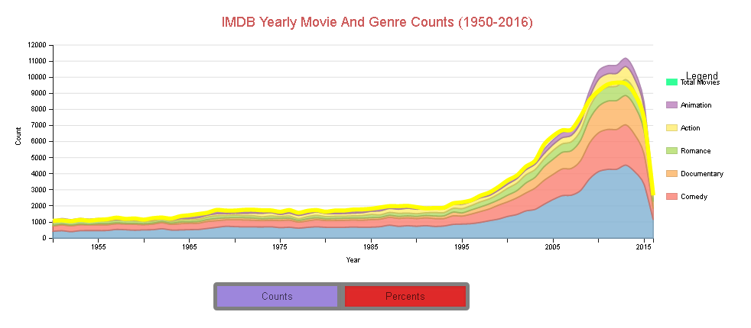
This chart shows us the number of movie genre between 1950 - 2016, and absolute counts and percentage of releases, and also total number of movies in 1950-2016 years.

Slide 5
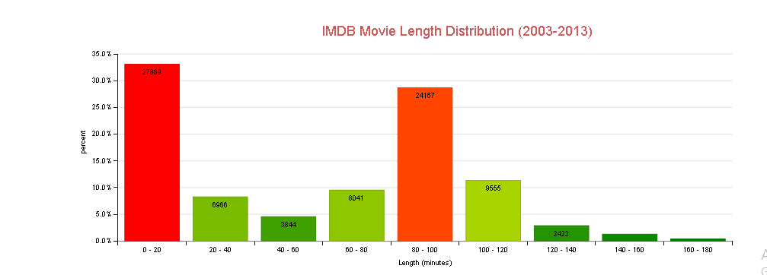
This chart highlights short and middle length movies are watched with high percentage. This is because of the high number of movies produced in these two lengths. One of the reason is it is easier to reach and share short movies on social media and other electronic platforms. The other reason is people have the chance to watch it at their break times.

Slide 6
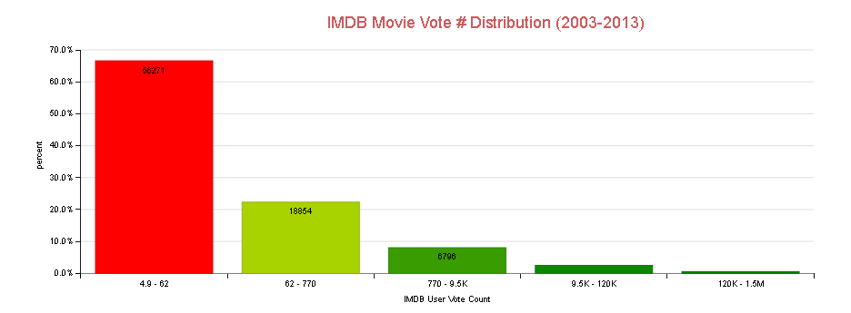
This chart examines while the rating is an increasing percentage of voting decrease.

Slide 7
As seen in this chart, the production percentage of the movies is approximately constant up to 10K budge. Its peak around 10 K budges and then decrease as the budget increase.

