Slide 1

SAMSUNG PRISM
Generative AI
Hackathon
3rd Edition 2026 – 27
Theme ID - Theme 5
Team Name - Accemberg
College Name - SRMIST Chennai
Kanishk Jaiswal - jaiswal.Kanishk.07@gmail.com
Sudhanshu Kumar - sudhanshukumar112003@gmail.com
Chakshu Sharma - chakshusharma21s@gmail.com
Anurag Anand - anuragsujit2005@gmail.com
Submission Github link - https://github.com/jaiswalkanishk07/VaakSetu

Slide 2
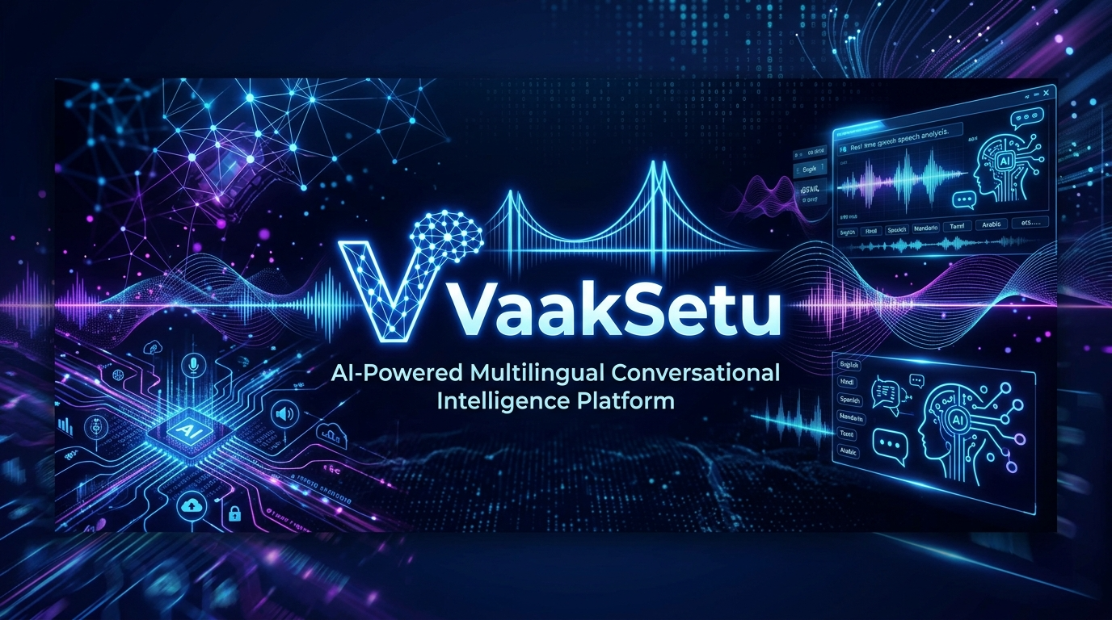
Theme
VaakSetu – The Voice Bridge for Bharat: Interruptible Real-Time Conversational AI Platform
Standard AI operates in half-duplex (listen, think, speak)
Users frequently interrupt, correct themselves, and re-plan mid-sentence
Sequential processing causes unacceptable latency and stale conversational states
The core challenge is concurrency: running perception, reasoning, and speech on a unified timeline
"Real conversations are not turn-based. They are concurrent."

Slide 3
Existing Solutions & Gaps
Cloud STT / TTS Platforms: High latency in streaming mode, no built-in state rollback upon interruption
Standard LLM Pipelines: High Time To First Token blocks concurrent tool execution
Traditional Dialog Trees: Rigid turn-taking, completely fails on mid-flow self-repairs
Generic Voice Bots: Single execution thread, cannot drop stale routing paths

Slide 4
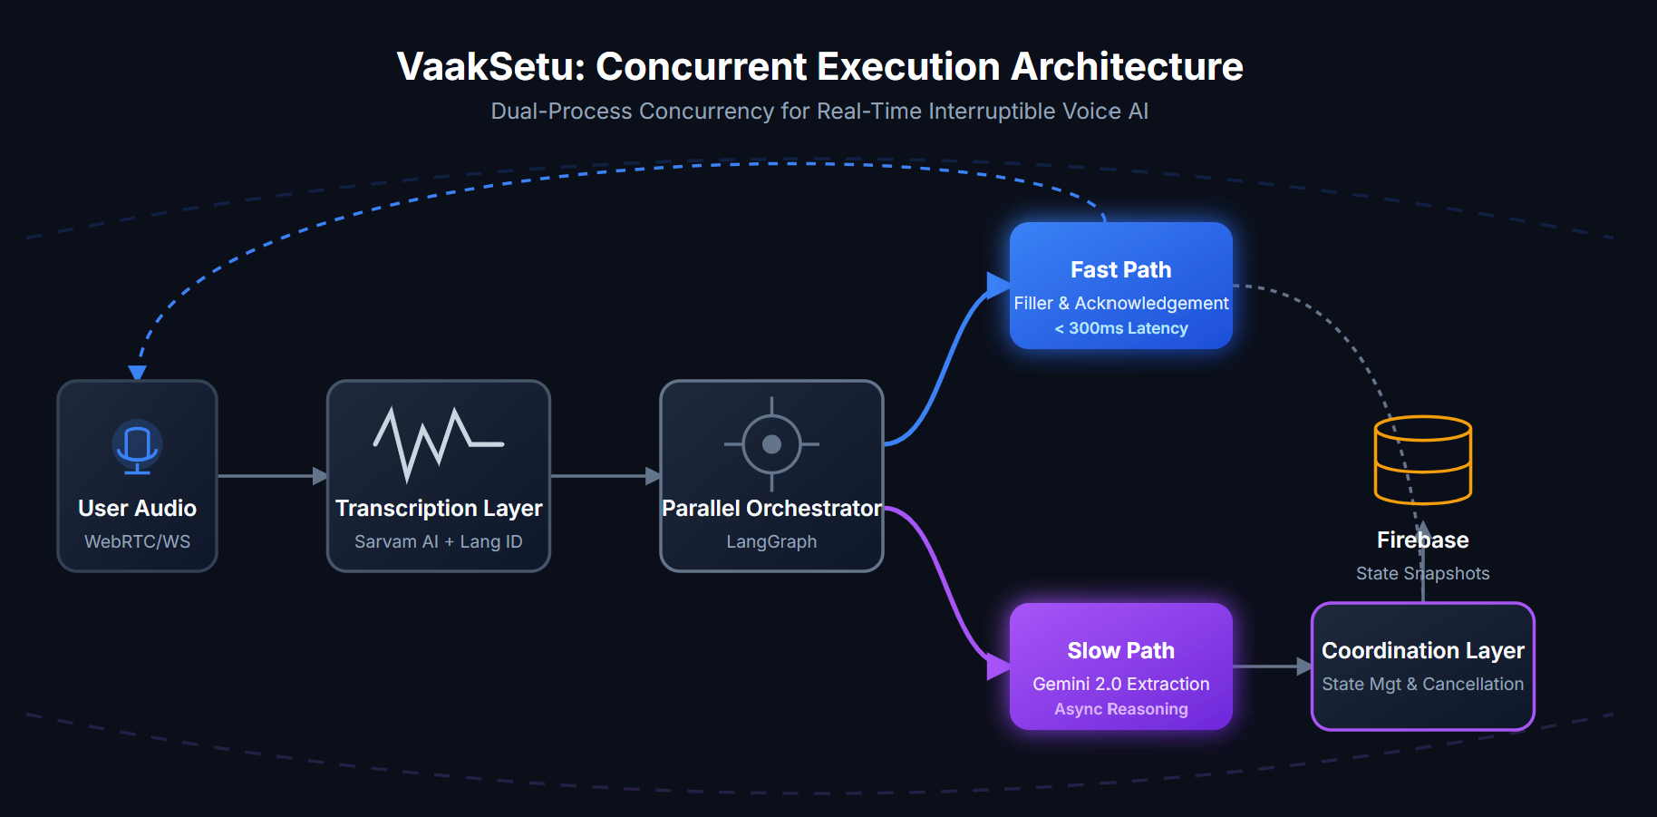
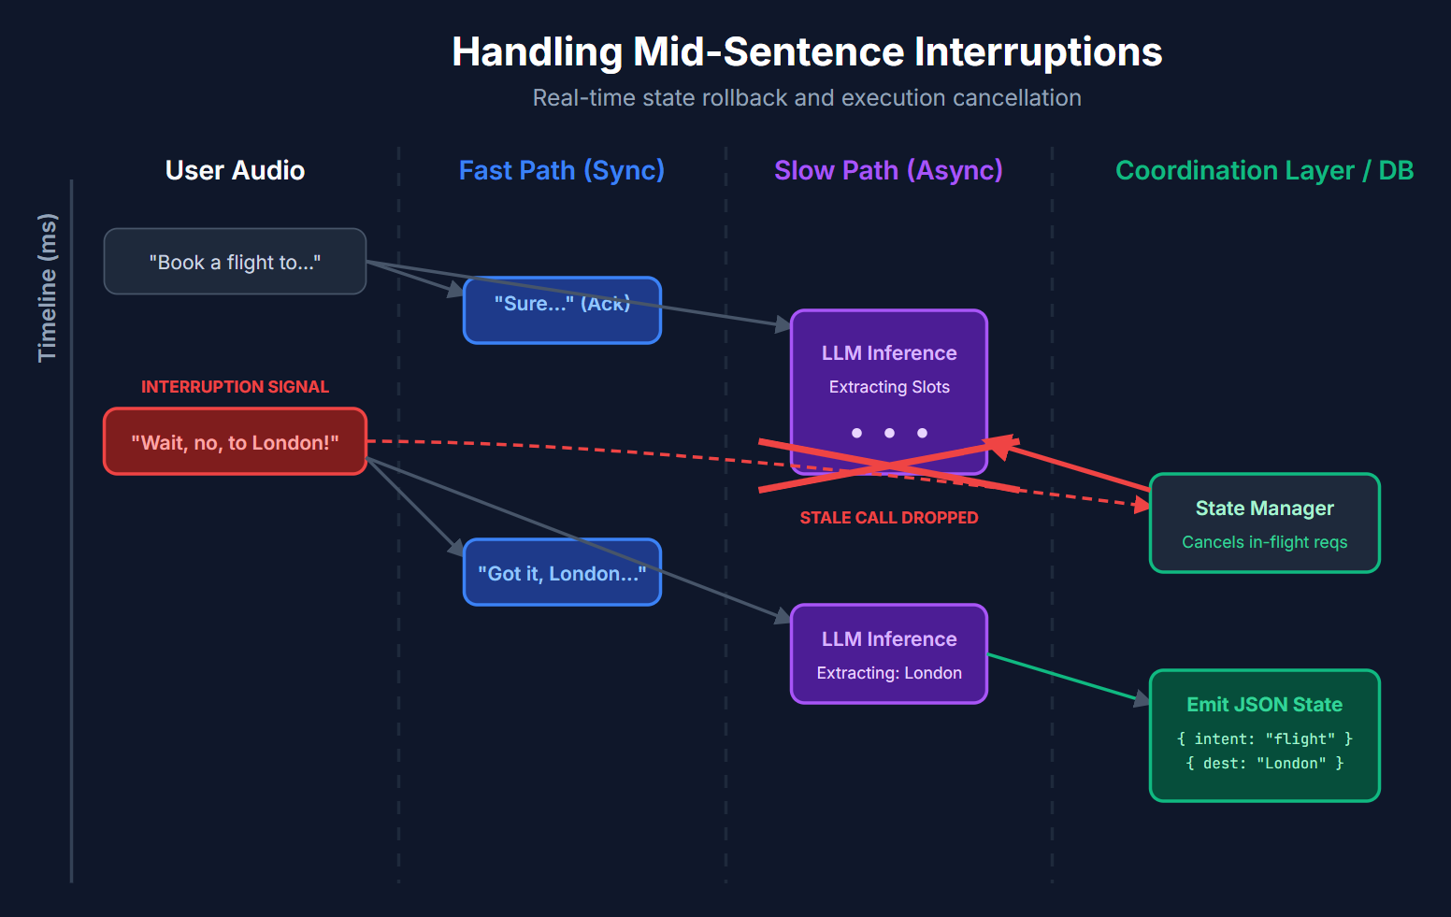
Our Solutions & Architecture Diagram
Dual-Process Concurrency for Voice
Fast Path – Responsiveness: Low-latency acknowledgments and conversational fillers
Slow Path – Asynchronous Reasoning: Complex reasoning, tool execution, and data extraction
Coordination Layer – State Management: Handles non-blocking execution and call cancellation
Parallel Execution Architecture: Fast Path and Slow Path run concurrently
Dynamic State Snapshots: Emits structured JSON state dynamically
Real-Time Interruption Handling: Cancels stale in-flight reasoning
RLAIF Self-Improvement: Automated evaluation of agent performance
End-to-End System Architecture
WebRTC / WebSocket ingress for continuous streaming
Transcription and Language ID layer
Parallel Orchestration via LangGraph
State Snapshot persistence to Database

Slide 5
Demo & Product Walkthrough
Execution & Interruption Handling Demo
Open dashboard, select domain
Start streaming audio via WebSocket
User speaks, pauses, and interrupts themselves
Agent executes Fast Path acknowledgment
Agent updates State Snapshot via Slow Path extraction
Interruption triggers cancellation of stale API calls
Final JSON payload emitted with correct intent and slots
View RLAIF evaluation score post-session
Monitoring Concurrent Execution
Agent Builder: Define schemas and parameters for Slow Path extraction. Configures the state payload structure.
Session Interface: View Fast Path responses alongside live State Snapshots updating in real-time.
Trace Logging & Analytics: Monitor latency to first substantive action, transcription chunks, and tool execution status.
[Insert Image: Dashboard UI showing live transcription, latency metrics, and state extraction]

Slide 6
Tools and tech stack used
Backend: Python 3.10, FastAPI
Frontend: Next.js 15, React 19
Database: Firebase
AI & Orchestration: Sarvam AI, Gemini 2.0 Flash, LangGraph
Streaming: WebRTC / WebSocket

Slide 7
Impact & Use case
Production-Ready Interruptible Voice AI
Drastically reduces Time-To-First-Action for complex voice queries
Zero duplicate state-changing calls during rapid user interruptions
Seamlessly handles code-mixed Indian languages
Healthcare
Extracting symptoms, diagnosis, and treatment plan mid-consultation
Resolving speech hesitations and conversational self-repairs
Gracefully handling interruptions without dropping prior context
Financial Services
Adjusting parameters mid-interaction (e.g., changing payment promises)
Strictly avoiding duplicate state-modifying calls (double-booking)
Emitting updated State Snapshots instantly

Slide 8
Innovation highlights, results and limitations
Concurrency in Action
Fast Path: Floor Management: Issues meaningful responses quickly without making false completion claims. Manages audio playback and conversational fillers.
Slow Path: Structured Extraction: Parses dynamic tool definitions. Extracts data using LLMs without blocking the fast path.
Coordination: Interruption Recovery: Cancels superseded in-flight tool calls. Updates state snapshots and re-plans cleanly upon user interruption.
Evaluating Interruptible Agents
40% Programmatic (Instant): Response Latency, Interruption Recovery Speed, Cancellation of Invalidated Calls, Absence of Stale Re-runs
60% LLM Judge (Gemini): Task Completion Accuracy, State Snapshot Accuracy, Protocol Compliance, Final Response Grounding
Output: Score above 0.70: DPO label chosen. Score below 0.70: DPO label rejected
Parallel execution reduces perceived latency drastically while maintaining state consistency.
[Insert Image: Working Pipeline showing Concurrent Execution and Interruption Signals]

Slide 9
Brownie points slide( differentiation)
Structured State Tracking in Real-Time
Session-Scoped Memory: Maintains intent and slot values across multi-turn interactions
Incremental Extraction: Maps user speech to specific schemas (e.g., Healthcare, Finance) concurrently
Protocol Compliance: Emits well-formed JSON payloads (State Snapshots) upon turn completion
Idempotent Updates: Strictly avoids duplicate state-changing calls during rapid interruptions
Schema-Driven Tools
Switch domains with one config change. No retraining required.
Built on Open Research
RLAIF (Google Brain), DPO (Stanford)

Slide 10
Thank you
Organised by the Language AI Team and the PRISM Team, Samsung R&D Institute India
Notes:
Closing slide. Add the Google Form URL and a contact email before sharing. Edition 2 organising team for reference: Language AI - Sourabh Tiwari, Gaurav, Sanjeeth Pothireddy, Gorang Maniar; PRISM - Binny Lakra, Prakhar Chandrakar, Vishu Kumar; Kick-off and mentors - Giridhar Jakki, Deepraj Prabhakar Patkar (Language AI), Srimanu Prasad Nagaraju, Ashish Kumar (Tech Strategy).

