Slide 1


SMART INDIA HACKATHON 2026
TITLE PAGE
• Problem Statement ID – SIH26044
• Problem Statement Title - Academia–Industry Collaboration Portal for Skill Mapping, Internships and Placement
• Ministry / Organization - Ministry of Ayush, Government of India
• Theme - Smart Automation / EdTech / HealthTech
• PS Category- Software
• Team ID- SIH26-AYUSH-55396
• Team Name - SkillBridge

Slide 2
Objective: Bridge Ayush Curricula & Industry Demands via Closed-Loop Skill Mapping
Goal: Enable diagnostic competency assessment, deficit remediation & cryptographic internship matching
PROPOSED SOLUTION :
INSTANCE OF APPROACH :
Phase-I: Diagnostic Assessment & Ingestion:
Phase 1: Diagnostic Assessment & Ingestion
📊 Standardized testing across 10 Ayush competencies (Schedule T, Pharmacovigilance, Nadi Pariksha).
10 Ayush MCQs
Auto-Graded
Schedule T & GCP
Competencies
Student JSON
Profile Schema
💻 Timed auto-grading engine converting student responses to empirical JSON skill profiles.
Phase 2: Mathematical Gap Mapping:
🎯 5-Tier Deficit Vector formula computes exact skill shortfall against target industry roles.
Phase 2: 5-Tier Deficit Vector & Gap Remediator
🤖 Auto-remediation pipeline assigns tailored micro-courses for Critical (≥30%) and High deficits.
Deficit(k) = Target(k) - Score(k)
Phase 3: Matching & Cryptographic Portfolio:
⚡ 5-Factor weighted recommendation engine computes verified role-compatibility scores (0-100%).
Gap ≥ 20%?
🔒 Deterministic SHA-256 micro-credentials provide instant, tamper-proof W3C verification.
YES → Auto-Remedial Course
NO → Matchmaking Ready
INNOVATION:
UNIQUENESS:
Empirical Skill
Testing
5-Factor Weighted
Match Engine
Ayush Specialized - Industry Mapping
Phase 3: 5-Factor Matching & Cryptographic Credentialing
5-Factor Match Engine
(Score: 0-100%)
SHA-256 Micro-Credential
(W3C Verifiable Ledger)
Closed-Loop Skill - Remediation
Deterministic
SHA-256 Digest
Faculty R&D
Collaboration Hub
Verified Internship / Job Offer Issued
W3C Verifiable - Credential Model

Slide 3
TECHNICAL APPROACH
DATA FLOW AND PROCESSING
👨‍🎓 🏭 🔬
Student / Recruiter /
Faculty App
🛡️ SECURITY LAYER
Helmet.js • HSTS • CSP
X-Request-ID Tracing
Express Rate Limiting
🗄️ Unified Data Store
🍃 MongoDB 7.0
18 Collections
Compound
Indices (<50ms)
📜 Audit Ledger
SHA-256 Hashes
Student Records
W3C Proofs
📤 Outputs & Stakeholder Action
👨‍🎓 Candidate Portfolio
• Radar Skill Breakdown
• Remedial Study Path
• Verified 1-Click Apply
⚙️ Processing Layer (REST Microservices)
📊 Monitoring & Telemetry
🔍 10 Ayush Competency Diagnostic Engine
Timed MCQs • Auto-Grading Scoring
🏭 Ayush Industry HR
• Pre-Screened Pipeline
• Compatibility Breakdown
• Weekly Milestone Tracker
📝 Append-Only Audit Logs
(W3C Compliant Event Trail)
🔄 5-Tier Deficit Vector & Gap Remediation
Deficit(k) = Target(k) - Score(k)
Remedial Micro-Course Assignment
📈 Placement Absorption Funnel
& Regional Skill Demand Heatmaps
🏛 Ministry & Institutes
• Regional Skill Heatmap
• Curriculum Gap Analysis
• NAAC/NIRF Audit Exports
🤖 5-Factor Weighted Engine
(Score = 0.50S + 0.20E +
0.15C + 0.10P + 0.05L)
✔ Validate SHA-256 Micro-Credentials
W3C Verifiable Credentials Ledger
TECH STACK
React 18
Vite 5
Tailwind CSS
Node.js 20
Express.js
MongoDB 7
JWT Auth
Docker
Nginx
Helmet.js
FastAPI / ML
Recharts SVG

Slide 4
KEY FEATURES
USE CASE
ARCHITECTURE
CLOSED-LOOP LIFECYCLE PLATFORM
SkillBridge Unified Ecosystem
🌐 CLIENT APP / EDGE CDN
React 18 SPA • HTTPS • Cloudflare WAF • SSL Termination
Security & RBAC
Take 10 Ayush Diagnostic Tests
JWT • Bcrypt • Helmet
View Skill Deficit Vector vs Role
⚖️ INGRESS & LOAD BALANCER
Diagnostic Engine
Nginx Reverse Proxy • Rate Limiting • UUID Header Tracing
10 Ayush Competencies
Enroll in Auto-Remedial Course
⚙️ DOCKER SERVICE LAYER
Deficit Vector Formula
Node.js 20 REST Services • JWT RBAC • Bcrypt • Helmet
5-Tier Gap Analyzer
Search Matched Jobs (5-Factor Fit)
SHA-256 Credentials
Review Pre-Screened Candidates
⚡ IN-MEMORY CACHE
W3C Verifiable Ledger
Redis 7 • Session Token Store • Assessment Rate Cache
Sign-off Weekly Internship Milestones
6-Stage Internship
Weekly Milestone Logs
Submit Joint Faculty R&D Proposals
🗄️ PERSISTENCE DATA LAYER
MongoDB 7.0+ Replica Set • 18 Schemas • Indexed Collections
Faculty R&D Hub
Joint Grants & Sabbaticals
Access NAAC/NIRF Compliance Audits
📈 MONITORING & TELEMETRY
National Telemetry
Inspect Pan-India Skill Demand Heatmap
Prometheus Metrics • Grafana Heatmaps • Immutable Audit Trail
Macro Workforce Heatmap

Slide 5
IMPACT & FEASIBILITY
MULTI-STAKEHOLDER VALUE & REGULATORY COMPLIANCE
👨‍🎓 STUDENTS & ASPIRANTS — Objective Clarity & Verified Hiring
🏭 AYUSH INDUSTRY & RECRUITERS — 70% Screening Overhead Reduction
✔ Diagnostic assessment across 10 Ayush competencies eliminates resume bias.
✔ Pre-screened talent certified in Schedule T GMP & Clinical Documentation.
✔ Automated remedial learning path bridges deficits before graduation.
✔ 5-Factor compatibility score eliminates unvetted resume screening.
✔ Cryptographically signed SHA-256 portfolio unlocks direct corporate interviews.
✔ Weekly milestone sign-offs ensure structured internship deliverables.
🔬 FACULTY & ACADEMIA — Funded Research & Industry Sabbaticals
🏛 INSTITUTES & MINISTRY OF AYUSH — NAAC / NIRF Audits & National Telemetry
✔ Publish research capabilities and bid directly on corporate consulting RFPs.
✔ Real-time institutional placement velocity and candidate absorption rates.
✔ Apply for industry-sponsored sabbaticals in certified manufacturing plants.
✔ W3C-compliant audit logs provide instant export for NAAC & NCISM accreditation.
✔ Curriculum feedback loops highlight missing market topics for syllabus updates.
✔ National workforce heatmap empowers data-driven skill policy interventions.
🎯 TARGET IMPACT: 70% Faster Hiring | 85%+ Match Fit | 100% Cryptographic Verification | Aligned with NEP 2020 & Ayush Vision 2030

Slide 6
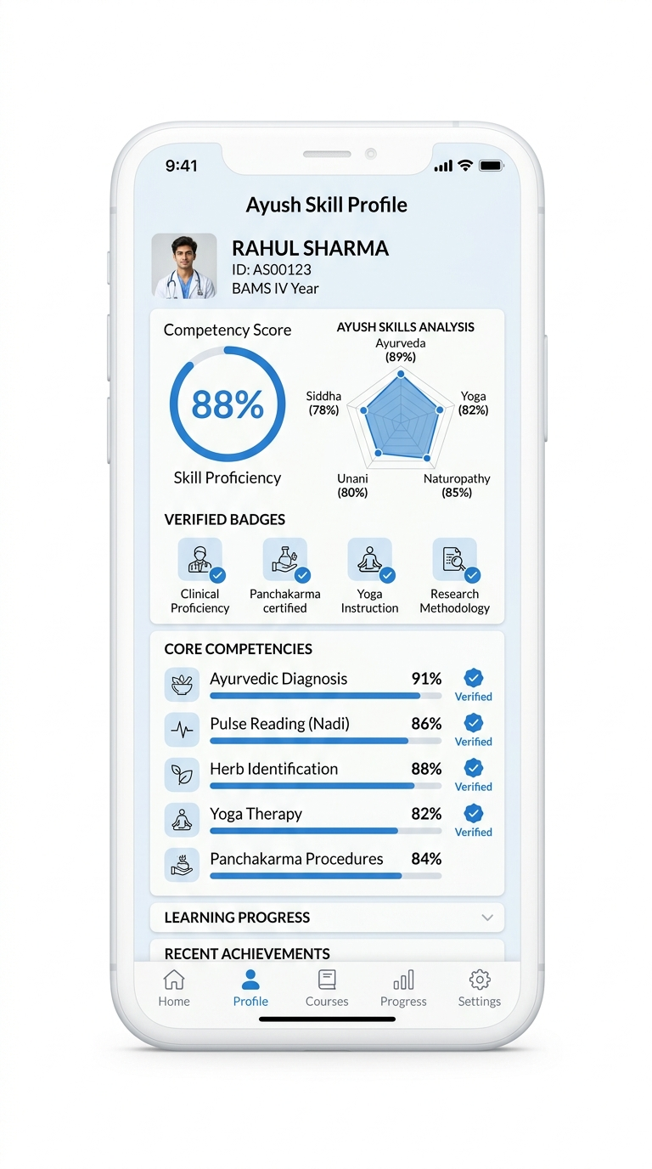
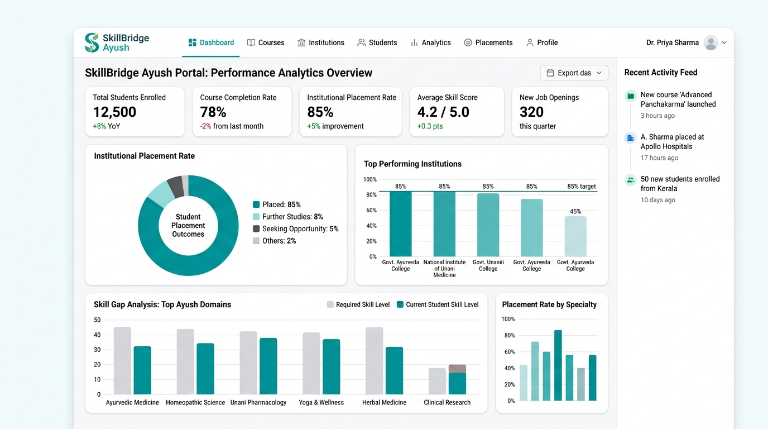
RESEARCH AND REFERENCE
KEY RESEARCH & OFFICIAL DOCUMENTS:
Drugs & Cosmetics Act, 1940 — Schedule T (Good Manufacturing Practices for Ayurvedic Siddha & Unani Medicines).
https://ayush.gov.in/docs/schedule-t-gmp.pdf
National Education Policy (NEP 2020) — Experiential Learning, Credit-Based Internships & Industry Syllabi Sync.
https://www.education.gov.in/sites/upload_files/mhrd/files/NEP_Final_English_0.pdf
W3C Verifiable Credentials Data Model v1.1 — Cryptographic Micro-Credential Transparency Architecture.
https://www.w3.org/TR/vc-data-model/
LINKS FROM WHERE WE TOOK REFERENCES:
• https://ayush.gov.in • https://ncismindia.org • https://abdm.gov.in • https://aicte-india.org • https://github.com/jaiswalvaibhav789/Skill.Bridge
PROTOTYPE
Prototype walkthrough : CLICK HERE (Live Video) | Full Demonstration: CLICK HERE (GitHub Repo)
MOBILE APP
MICROSERVICES & ALGORITHMIC ENGINE
WEB DASHBOARD
$ node tests/run_all_tests.js
✔ [AUTH SUITE] JWT token rotation & 5-role guards (12/12 passed)
✔ [ASSESSMENT] 10 Ayush competency MCQ auto-grader (10/10 passed)
✔ [GAP ENGINE] 5-Tier Deficit Vector formulation (8/8 passed)
✔ [MATCHING] 5-Factor Weighted Compatibility Scoring (15/15 passed)
✔ [LEDGER] SHA-256 deterministic W3C credentials (14/14 passed)
✔ [MILESTONES] 6-Stage internship state transitions (16/16 passed)
===========================================================
MASTER STATUS: 10 SUITES / 97 TESTS PASSING (100% GREEN)

