Slide 1
Introduction to
Apache camel
Notes:
2013-09-26

Slide 2
Problem Statement
Creating a single, big application to run a complete business is next to impossible.
Enterprises are typically comprised of discrete applications.
Custom built
Acquired from 3rd party
Legacy systems
External systems
Integrating different applications to work together is a big challenge.
Notes:
2013-09-26

Slide 3
Solution
Enterprise Application Integration - EAI
Enterprise Application Integration is the use of software and computer systems architectural principles to integrate a set of enterprise software applications using Enterprise Integration Patterns.
Notes:
2013-09-26

Slide 4
Available solutions
Custom solution
Enterprise Service Bus
  Mule ESB
  Service Mix ESB
  JBoss ESB
Enterprise Integration Frameworks
  Spring Integration
  Apache Camel
Notes:
2013-09-26

Slide 5
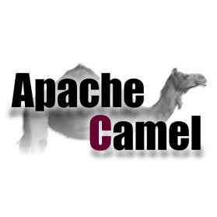
What is Camel
Apache Camel is a Java based open-source integration framework based on Enterprise Integration Patterns.
Notes:
2013-09-26

Slide 6
What is Camel cont.
Apache Camel allows your applications to accomplish
Message routing between endpoints
Message transformation
Protocol mediation
Camel use the established Enterprise Integration Patterns and out-of-the-box adapters with a highly expressive Domain Specific Language (Java, Spring XML, Scala and Groovy).
Notes:
2013-09-26

Slide 7
Why Apache Camel
Routing and mediation engine
Domain-specific language (DSL)
Extensive component library
Modular and pluggable architecture
Easy configuration
  Conventions over configuration paradigm is followed.
Automatic type converters
  Many built in type converters
    Data Format Converters
    Data Type Converters
  Create your own converters
Notes:
2013-09-26

Slide 8
Routing and Mediation Engine
A routing engine moves the message around based on the routing configuration.
Routes are configured using DSL.
from(“step 1").to(“step 2");
Camel route starts with “from” that act as a consumer.
Once data is received by consumer
  A message will be created
  Message is transported to Camel route
Notes:
2013-09-26

Slide 9
Steps involves in message routing
Message received by Consumer
Message transformation
Message format validation
Enriching message contents
Message splitting and aggregating
Activity logging
Notes:
2013-09-26

Slide 10
Domain Specific Language (DSL)
Camel routes are created using a Domain Specific Language (DSL), specifically tailored for application integration.
Camel DSLs are:
High-level languages
Allow us to easily create routes
Combining various processing steps
No need for any low-level implementations
Notes:
2013-09-26

Slide 11
DSL Examples
Java DSL
from("file:data/input").to("file:data/output");
Spring DSL
  <camel:route>
  <camel:from uri="file:data/input?noop=true" />
  <camel:to uri="file:data/output" />
  </camel:route>
Scala DSL
from "file:data/input" -> " file:data/output"
Notes:
2013-09-26

Slide 12
Extensive component library
Camel offers library of components that are modeled after Enterprise Integration Patterns.
Bean Component
File Component
JMS and ActiveMQ Component
CXF Component
Log component
And many more…
Compete list of components can be found here.
http://camel.apache.org/components.html
Notes:
2013-09-26

Slide 13
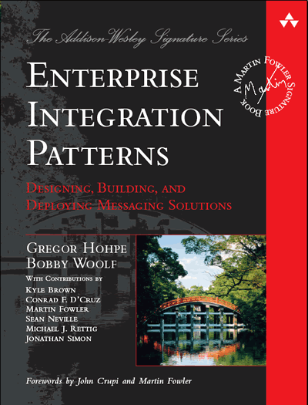
Enterprise Integration Patterns
To help deal with the complexity of integration problems, the Enterprise Integration Patterns
are the standard way to describe, document and implement complex integration problems.
All integration patterns can be found in the book Enterprise Integration Patterns by Gregor Hohpe and Bobby Woolf published in January 2004.
Notes:
2013-09-26

Slide 14
Essential Integration Patterns
Pipes and Filters
  How to perform complex processing on a message while maintaining independence and flexibility?
Message Router
  How to decouple individual processing steps so that messages can be passed to different filters depending on a set of conditions?
Message Translator
  How can systems using different data formats communicate with each other using messaging?
Message Filter
How can a component avoid receiving unwanted messages?
Notes:
2013-09-26

Slide 15
Essential Integration Patterns cont.
Splitter
  How to split the message into pieces and process them individually.
Aggregator
  How to combine the results of individual, but related messages so that they can be processed as a whole?
Resequencer
  How to get a stream of related but out-of-sequence messages back into the correct order?
Dead Letter Channel
  What will the messaging system do with a message it cannot deliver?
Notes:
2013-09-26

Slide 16
How it works
Camel Core
  Contains all the functionality needed to run a Camel application—DSL for various languages, the routing engine, implementations of EIPs, a number of data converters, and core components.
Camel Routes
  A route represents a chain of processing steps applied to a message based on some rules. The route has a beginning defined by the from endpoint, and one or more processing steps commonly called "Processors“.
Camel Context
  A dynamic multithread route container, responsible for managing all aspects of the routing: route lifecycle, message conversions, configurations, error handling, monitoring, and so on.
Notes:
2013-09-26

Slide 17
Message
A Message in Apache Camel is an implementation of org.apache.camel Message interface.
Message has four main parts:
UID
Header
Body
Attachments
Message
Header
Attachment
body
Notes:
2013-09-26

Slide 18
Endpoint
Any producer or consumer in Camel route is an Endpoint. Consider Camel route as a graph and Endpoint as a Node.
Exchange
A message container and link between producer and consumer endpoints and hold information about:
Producer and consumer endpoints
Message route
Protocol used
Any error or exception thrown
Notes:
2013-09-26

Slide 19
Camel Message Routing
Camel route starts with “from” that act as a consumer. Consumer can of the following types:
  Polling consumer (fetches messages periodically)
  Event-Driven consumer (listens for events)
Consumer receives a message from external system.
Consumer wraps the message in a Camel specific format called Exchange and starts routing between endpoints.
Producers are identified by the keyword “to”. Once message received Producer will:
  Converting exchanges
  Delivering them to other channels
Notes:
2013-09-26

Slide 20
Camel Message Routing
endpoint
exchange
endpoint
event
FROM
TO
Camel route
pooling
Notes:
2013-09-26

Slide 21
Camel routes using Java
In Java DSL, we create a route by extending RouteBuilder and overriding the configure method.
public class SampleFileRoute extends RouteBuilder {
@Override
public void configure() throws Exception {
from("file:data/input?noop=true")
.to("file:data/output");
}
}
Notes:
2013-09-26

Slide 22
Camel Context for Java DSL
  final CamelContext camelContext = new DefaultCamelContext();
  camelContext.addRoutes(new SampleFileRoute());
  camelContext.start();
  camelContext.stop();
Notes:
2013-09-26

Slide 23
Camel routes using Spring
In the Spring DSL, we create a route by using Spring configuration.
<camel:camelContext xmlns="http://camel.apache.org/schema/spring">
<camel:route>
<camel:from uri="file:data/input?noop=true" />
<camel:to uri="file:data/output" />
</camel:route>
</camel:camelContext>
Notes:
2013-09-26

Slide 24
Camel Context for Spring DSL
  final AbstractApplicationContext springContext = new ClassPathXmlApplicationContext(“camel-spring-context.xml");
  springContext.start();
  springContext.stop();
  springContext.close();
Notes:
2013-09-26

