Slide 1
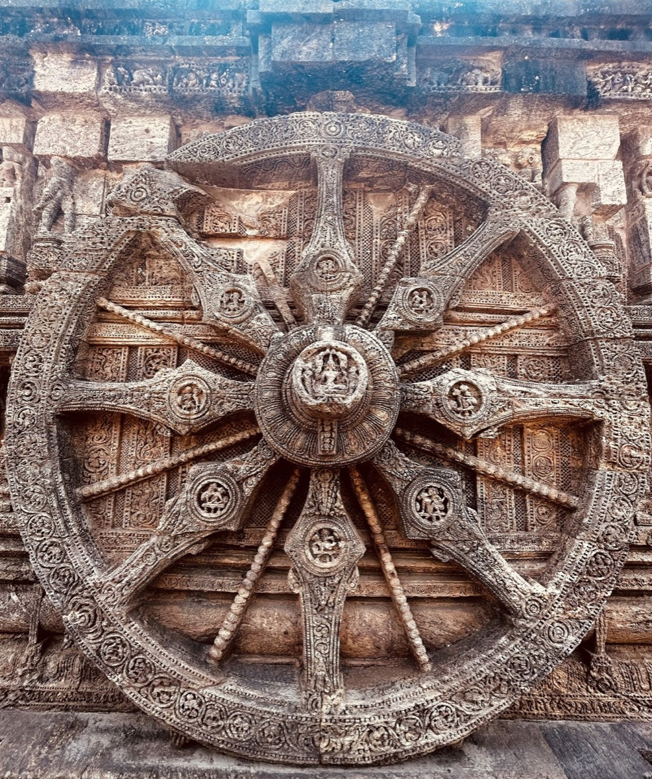
HACKCULT '26 / PS2
HeritageLens
AI-powered cultural archive for India's architectural memory
A working system for digitization, OCR, search, maps and source-grounded research
WORKING PROTOTYPE
TEAM HERITAGELENS // IIT GANDHINAGAR
Notes:
HackCult '26, Problem Statement 2. The working prototype claim is supported by the deployed frontend and automated test suite. Image source is recorded in frontend/public/images/sites/ATTRIBUTION.md.

Slide 2
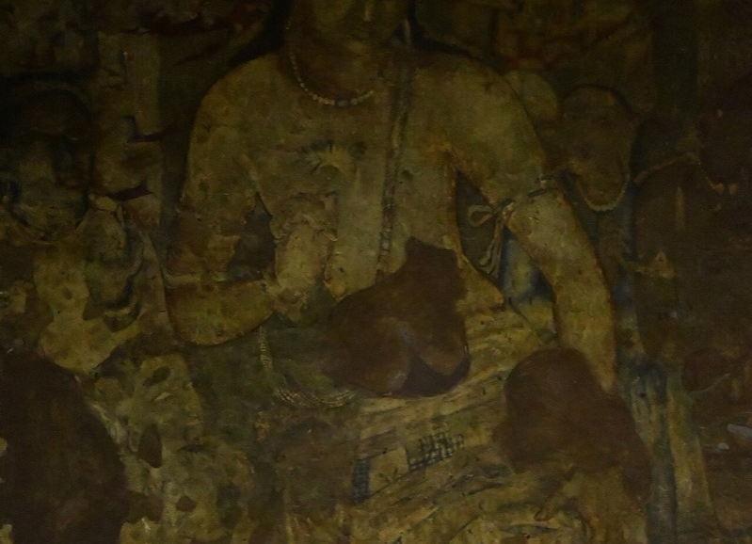
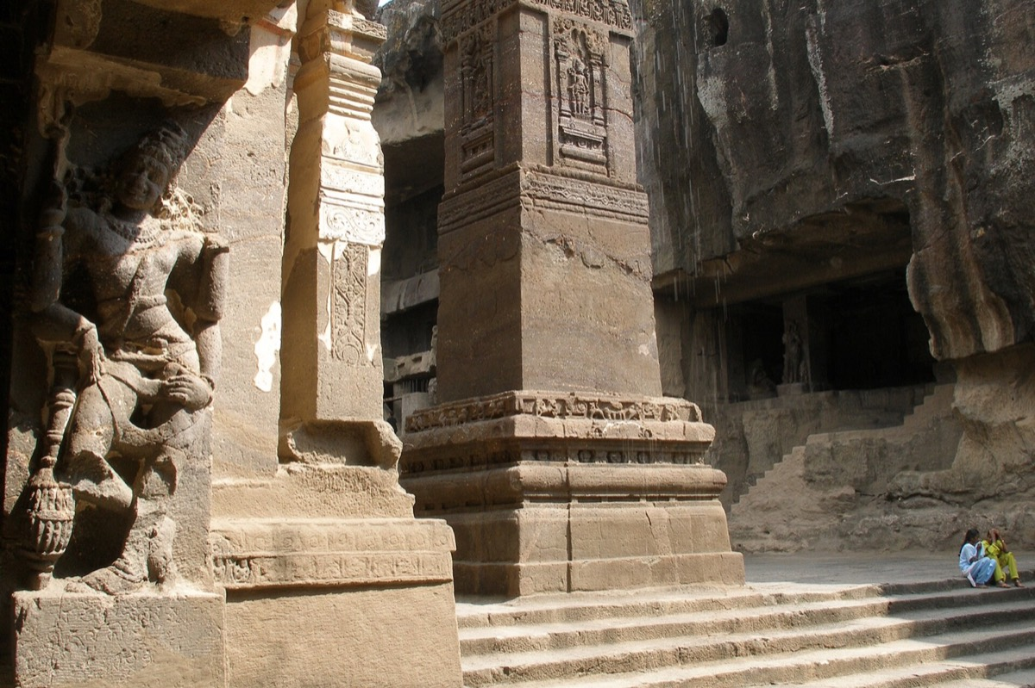
02
The problem and what the system must achieve
Heritage evidence exists, but its formats and archives cannot work together.
CORE REQUIREMENTS
01
Preserve originals
Durable private storage and authorized downloads
02
Make text searchable
PDF extraction and OCR for scanned sources
03
Keep human oversight
Knowledge stays fragmented
Curator review before approval
Photographs lack metadata. Scanned documents hide their text. Field notes and regional records remain disconnected from the monuments they describe.
04
Connect context
Sites, documents, images and map coordinates
05
Support public discovery
Open browsing, filtering and grounded answers
HERITAGELENS // HACKCULT '26
02
Notes:
Problem and requirements come from the hackathon brief and the implemented HeritageLens workflow. No size, accuracy or adoption claims are made.

Slide 3

03
HeritageLens turns scattered sources into a usable archive
The judges can inspect the deployed product, not a mock-up.
01
Searchable archive
LIVE PRODUCT
Site metadata plus extracted and corrected document text
02
Document digitization
PDF extraction, Tesseract OCR and curator correction
03
Interactive map
Coordinates connect monuments to archival records
04
Grounded assistant
Answers reference retrieved archive sources
HERITAGELENS // HACKCULT '26
03
Notes:
Screenshot captured from https://heritage-pearl.vercel.app/. Features are verified in frontend routes, backend services and automated tests.

Slide 4
04
From an uploaded source to verified discovery
Automation handles repetitive processing. Curators retain editorial control.
01
02
03
04
05
06
UPLOAD
VALIDATE
PRESERVE
EXTRACT
REVIEW
DISCOVER
PDF or image
File type and size
Private object storage
PyMuPDF or OCR
Correct text and metadata
Search, map and citations
PERSISTED PROCESSING STATES
UPLOADED
PROCESSING
EXTRACTED
NEEDS REVIEW
APPROVED
FAILED
Failure remains visible and recoverable
The backend records errors, preserves the original source and can resubmit interrupted background work after restart.
HERITAGELENS // HACKCULT '26
04
Notes:
Workflow verified in backend document router, storage service and background processing service. Upload polling and curator review are implemented in the frontend UploadPage.

Slide 5
05
Technical architecture and verified stack
The repository uses one modular backend with clear boundaries for storage, processing and public discovery.
FRONTEND
BACKEND
DATA
DOCUMENT PIPELINE
React 19 + Vite 8
React Router 7
React Leaflet 5
Framer Motion + Axios
Hosted on Vercel
FastAPI + Uvicorn
SQLAlchemy 2 + Pydantic 2
Curator session auth
REST API on Render
Supabase PostgreSQL
psycopg2 driver
Alembic migrations
SQLite for local work
Private Supabase Storage
PyMuPDF text extraction
Tesseract OCR + Pillow
ThreadPool background jobs
SEARCH AND ASSISTANT
SECURITY
PostgreSQL full-text search, archive retrieval, optional Omnirouter completion and a local grounded fallback
Service-role credentials stay on the backend. Public browsing remains read-only.
HERITAGELENS // HACKCULT '26
05
Notes:
Stack verified from package manifests, Docker configuration, backend database and storage code, Alembic migrations, deployment configuration and frontend source.

Slide 6
06
Feasibility for a pilot archive
The current system can support a controlled institutional pilot. Each feasibility claim has evidence and a defined next step.
AREA
EVIDENCE IN THE CURRENT BUILD
NEXT STEP FOR PRODUCTION
01
Technical
Deployed React and FastAPI application with PostgreSQL, private storage, OCR and automated migrations
Run live storage and migration checks after every production deployment
02
Operational
Curator authentication, review states, audit events and recoverable processing failures
Replace the shared prototype login with individual curator accounts
03
Cost
Managed Vercel, Render and Supabase services keep the pilot infrastructure small
Measure storage, OCR time and database usage with real institutional collections
04
Growth
The modular monolith separates API, storage, processing, search and presentation concerns
Move OCR jobs to a managed queue when upload volume exceeds one worker
Pilot conclusion
Ready for a controlled pilot. A broader rollout still needs individual curator roles, production monitoring and a managed job queue.
HERITAGELENS // HACKCULT '26
06
Notes:
Feasibility is framed for a controlled pilot rather than a full institutional rollout. The architecture and repository support each current-build claim. Live Supabase storage and production migrations still require deployment verification. Cost claims are qualitative because production usage data is not available.

Slide 7
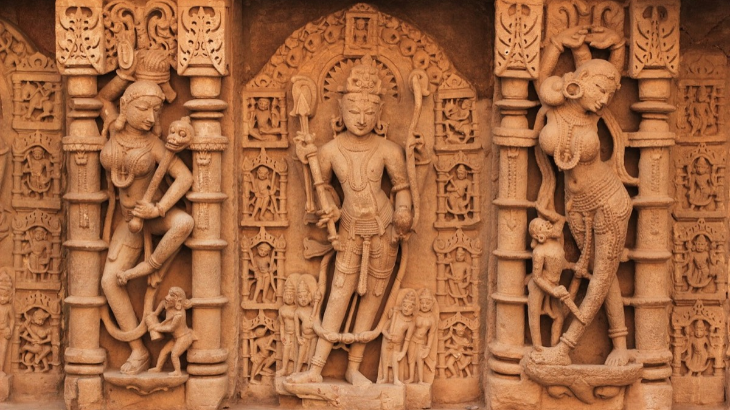
07
Impact now, stronger retrieval next
The current product solves preservation and discovery first. Phase 2 can improve multilingual retrieval after production verification.
Researchers
Archivists
Institutions
Visitors
Find evidence across sites and digitized records
Preserve originals and approve corrected text
Publish structured collections with traceable sources
Explore monuments through maps and accessible narratives
NEXT
01
02
03
Production verification
Multilingual retrieval
Evaluation
Apply migrations, configure private storage and test live upload
Add embeddings and hybrid ranking for regional-language archives
Measure retrieval quality and citation faithfulness
HeritageLens makes cultural evidence searchable without losing the path back to its source.
HERITAGELENS // HACKCULT '26
07
Notes:
The roadmap clearly separates implemented functionality from future work. Phase 2 multilingual semantic retrieval has not been implemented.

