Slide 1
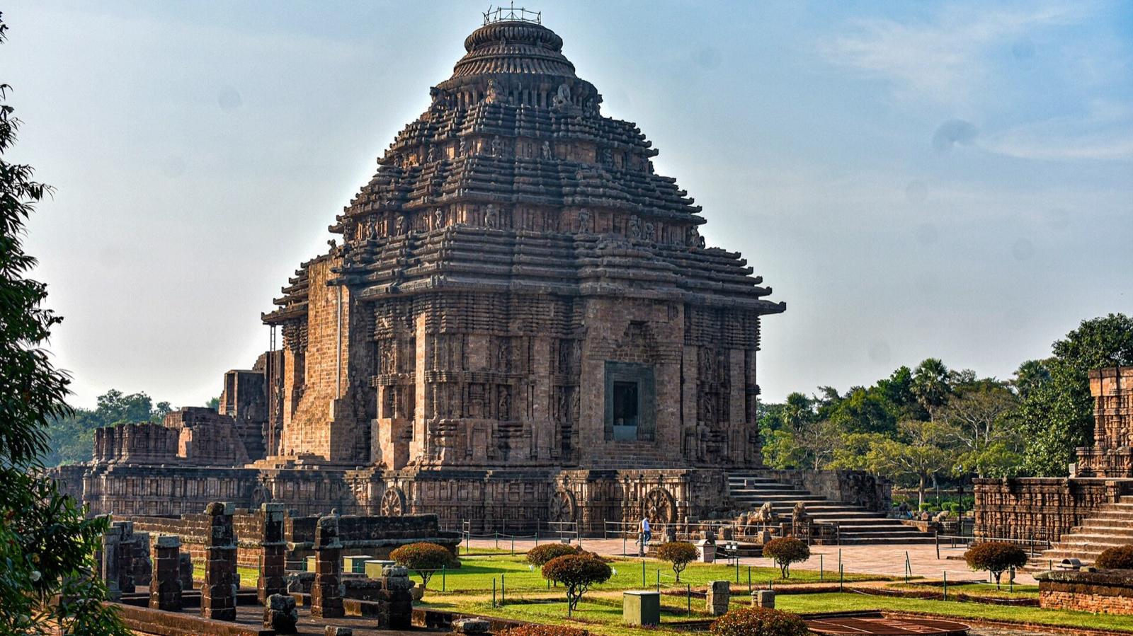
HACKCULT '26 · PS2
HeritageLens
Rediscovering India's architectural memory through AI
Digital revitalisation of unstructured cultural and architectural heritage archives
TEAM HERITAGELENS · IIT GANDHINAGAR
Notes:
Project brief: HackCult '26 Problem Statement 2. Cover image: Konark Sun Temple asset from the HeritageLens licensed image library. Photography attribution is recorded in frontend/public/images/sites/ATTRIBUTION.md.

Slide 2
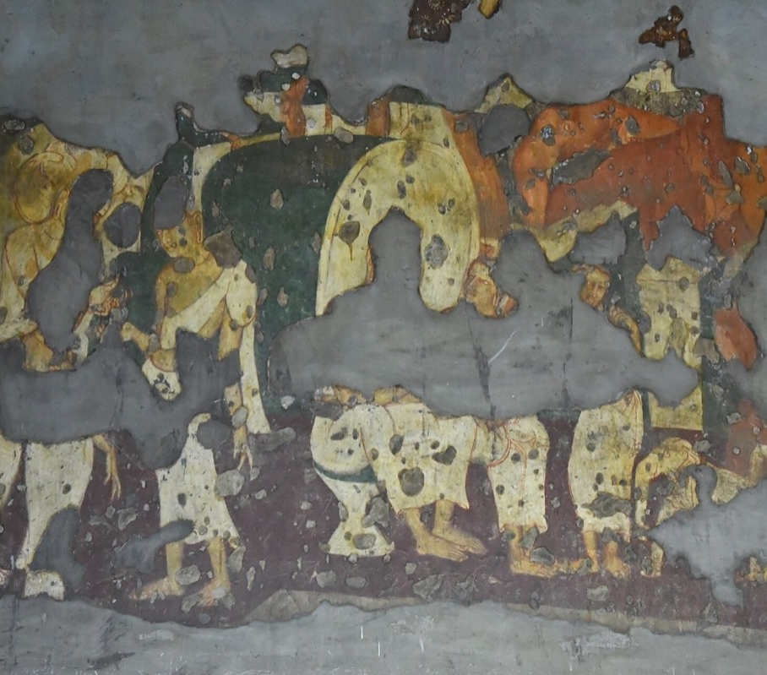
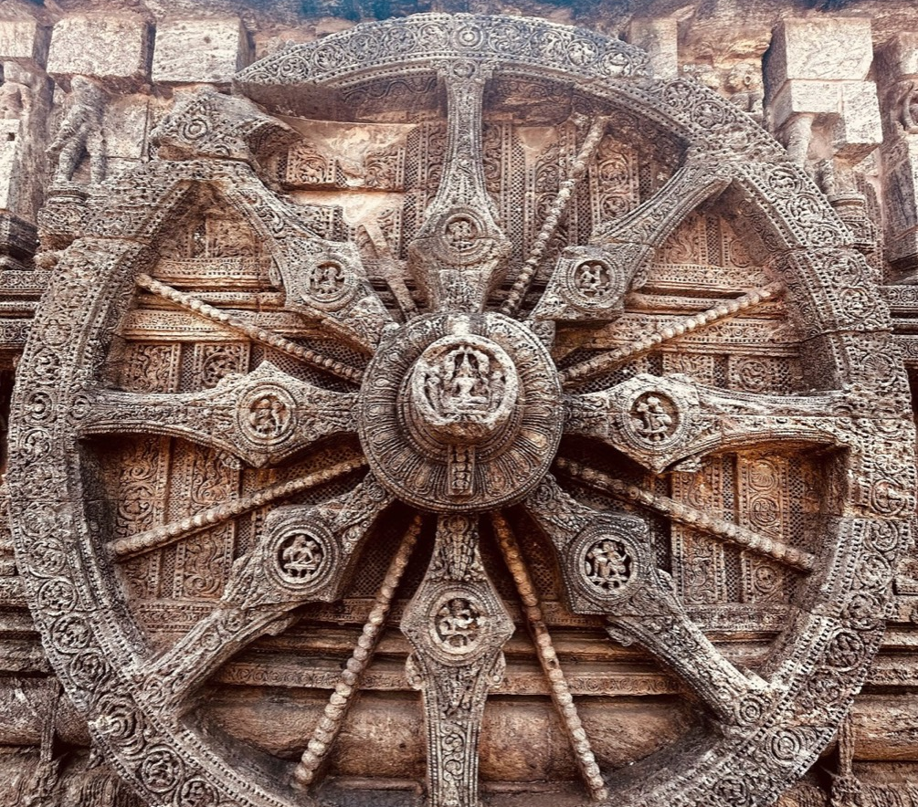
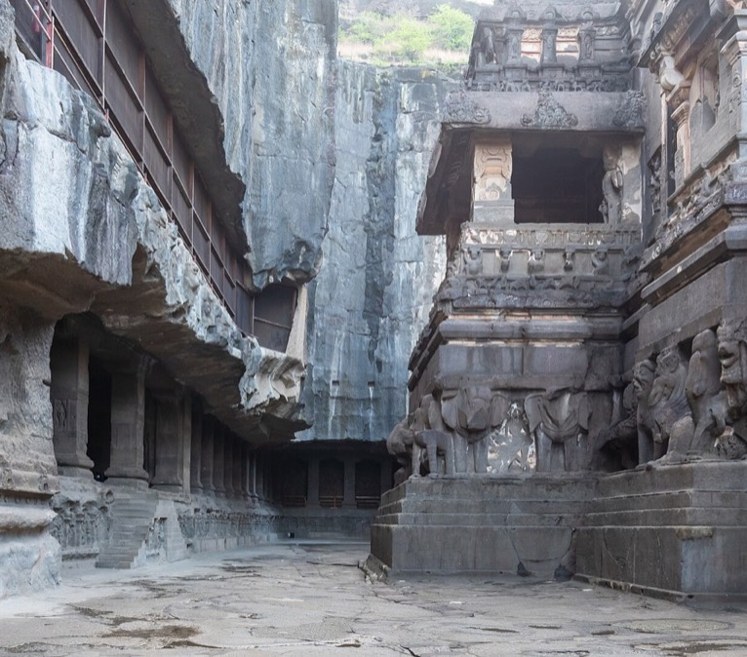
02
Heritage knowledge lives in disconnected formats
Photographs, PDFs, field journals and regional-language scans cannot be searched as one archive.
THE CONSEQUENCE
Discovery slows down.
Context breaks.
Fragile sources stay hidden.
PHOTOGRAPHS
FIELD NOTES
SCANNED DOCUMENTS
Visual evidence without structured context
Observations trapped in isolated records
Text remains invisible to search
Researchers cannot trace evidence across collections without manually reopening every source.
HERITAGELENS / HACKCULT '26
02
Notes:
Problem framing supplied by the user and reflected in the HeritageLens project README. Images come from the project image library and its recorded attributions.

Slide 3
03
One archive connects source files to cultural context
HeritageLens turns unstructured evidence into records people can browse, search and verify.
01
02
03
INGEST
STRUCTURE
DISCOVER
Upload a PDF, photograph or manuscript scan
Extract text, capture metadata and preserve the original
Explore sites, documents, maps and grounded answers
Public archive
Curator workspace
Browsing, filters, map and document search remain open to everyone.
Authenticated upload, review, correction and archive maintenance.
HERITAGELENS / HACKCULT '26
03
Notes:
Verified in frontend routes, backend routers and browser acceptance tests. Public reads remain open; modifying APIs require curator authentication.

Slide 4
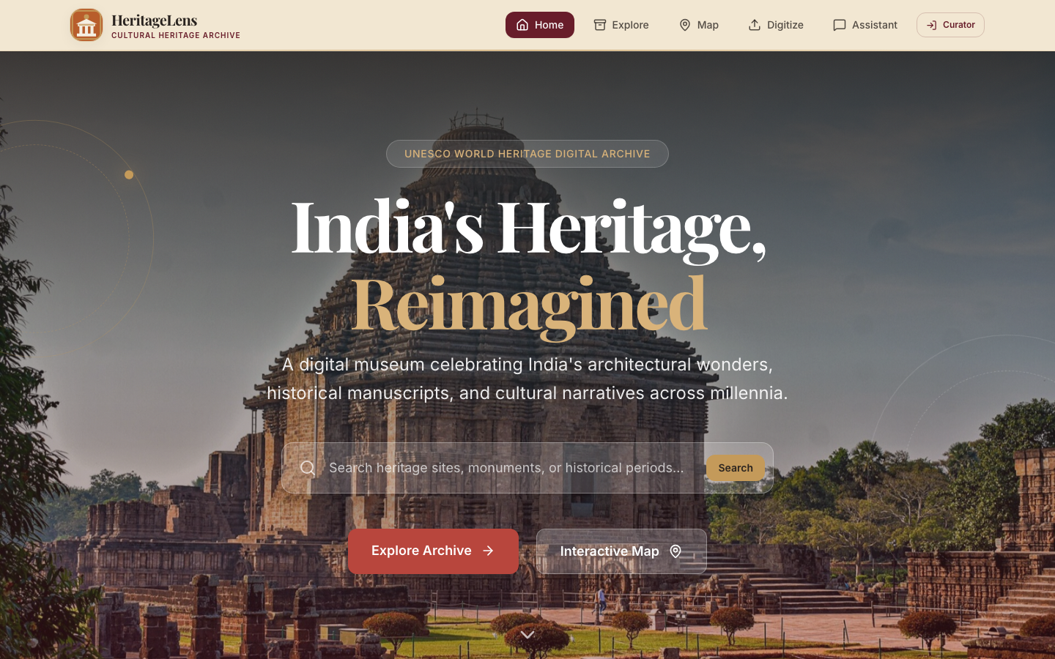
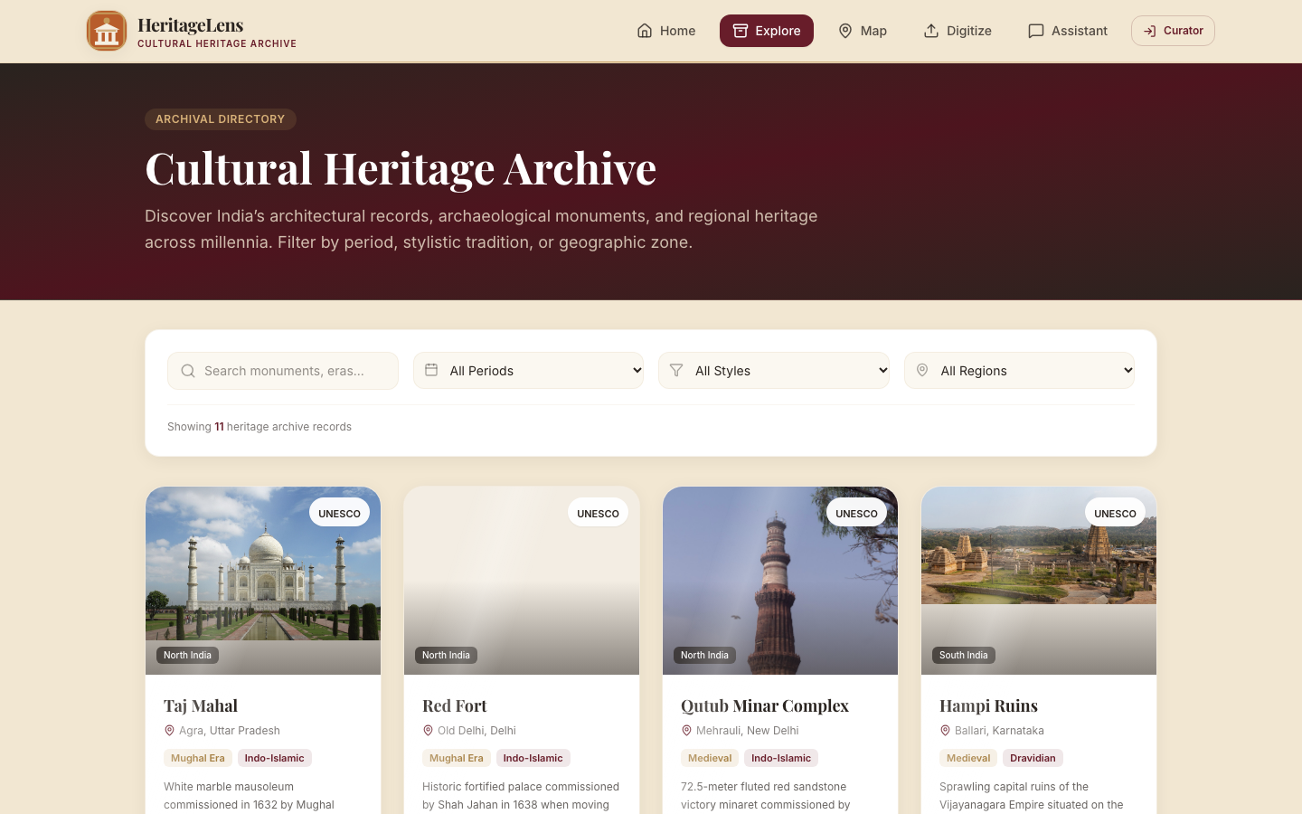
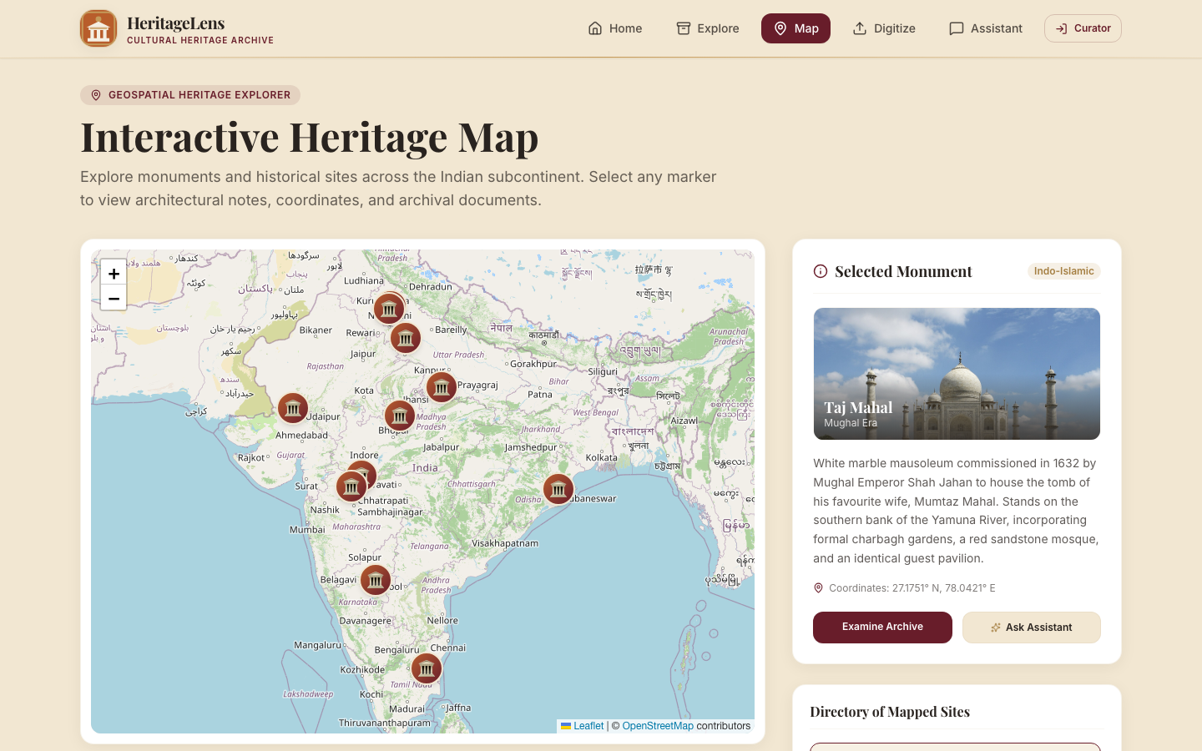
04
The working product
Live screens from heritage-pearl.vercel.app. No mock interface is presented as real.
SEARCHABLE ARCHIVE
GEOSPATIAL EXPLORER
11 seeded heritage records with filters and document search
Interactive markers connect monuments to archival detail
Also implemented
IMMERSIVE ENTRY
Curator login · OCR upload · review workflow · grounded archive assistant
Search and visual discovery
HERITAGELENS / HACKCULT '26
04
Notes:
Screenshots captured from https://heritage-pearl.vercel.app/, /archive and /map on 2 November 2026. OCR and curator workflows are verified through automated tests but are not represented with a fabricated production screenshot.

Slide 5
05
System architecture
A modular monolith keeps the hackathon build coherent while preserving clean service boundaries.
SQLAlchemy + Alembic
Supabase PostgreSQL
Processing executor
FastAPI application
Sites, documents, images, workflow state and audit events
PyMuPDF for PDFs
Tesseract for scanned images
React + Vite SPA
Render
REST routers and service layer
HTTPS / JSON
Vercel
Public archive and curator UI
Private Supabase Storage
Search and retrieval
Original documents and short-lived signed downloads
PostgreSQL full-text search
SQLite fallback locally
Server-side service role only
AI answer layer
Omnirouter provider
Grounded archive fallback
HERITAGELENS / HACKCULT '26
05
Notes:
Architecture verified from docker-compose.yml, frontend API service, backend FastAPI routers, SQLAlchemy models, Alembic migrations, Supabase storage service, document processing service and assistant service. Deployment targets: Vercel frontend and Render backend.

Slide 6
06
Data and archival architecture
The schema preserves cultural context, original evidence and the complete processing lifecycle.
ARCHIVAL DOCUMENT
HERITAGE SITE
id · site_id · title · type
storage provider · object key
extracted and corrected text
processing and review state
OCR method · pages · timestamps
id · name · description
period · style · region
location · coordinates
significance · sources
AUDIT EVENT
1
many
actor · action · outcome
resource · timestamp · details
Deletion safety
1
Site relationships cascade intentionally. Storage cleanup occurs through the application service.
many
SITE IMAGE
id · site_id
image URL · caption
HERITAGELENS / HACKCULT '26
06
Notes:
Entity fields and relationships verified in backend/app/models/heritage_site.py, archival_document.py, site_image.py and audit_event.py. PostgreSQL search indexes are managed by Alembic migration 0004.

Slide 7
07
Document digitization workflow
Automation handles extraction. A curator controls what enters the searchable archive.
AUTOMATED
HUMAN REVIEW
01
02
03
04
Upload
Validate
Store
Extract
Review and correct
PDF or image
Type and size
Private object key
PyMuPDF or OCR
Curator verifies text and metadata
PERSISTED STATES
Searchable archive
UPLOADED
PROCESSING
EXTRACTED
Approved text becomes discoverable
NEEDS REVIEW
APPROVED
FAILED
HERITAGELENS / HACKCULT '26
07
Notes:
Workflow verified in backend/app/routers/documents.py, services/storage.py, services/document_processing.py and the UploadPage review interface. Background processing persists state before extraction and recovers pending work at startup.

Slide 8
08
Search and source-grounded answers
Search reaches both site metadata and curator-corrected document text.
IMPLEMENTED
PHASE 2 ROADMAP
User question
Indexed archive
Evidence first
Multilingual semantic retrieval
Natural language or archive query
Site fields plus extracted and corrected text
Matching records, citations and grounded synthesis
Embeddings and hybrid ranking across regional-language archives.
PostgreSQL full-text search in production
Portable substring fallback for SQLite development
Omnirouter when configured
Grounded archive fallback when unavailable
RAG evaluation
Measure retrieval quality and citation faithfulness before expanding the corpus.
HERITAGELENS / HACKCULT '26
08
Notes:
Current search implementation verified in backend/app/routers/search.py and Alembic migration 0004. Assistant provider and grounded fallback verified in backend/app/services/assistant.py. Embeddings, hybrid semantic retrieval and formal RAG evaluation are planned, not implemented.

Slide 9
09
Engineering choices that support growth
The current architecture favors tested boundaries and reversible deployment decisions.
40%
TECHNICAL EXECUTION
Protected write APIs, explicit processing states, audit trail, migration-managed schema
30%
ARCHITECTURE
Modular monolith, durable object storage, PostgreSQL indexes, configurable providers
20%
UI / UX
Public discovery, curator review flow, direct-route support, meaningful failure states
10%
PROBLEM FIT
OCR, correction and source-grounded retrieval for unstructured heritage archives
VERIFIED: 39 backend tests · 3 browser acceptance workflows · frontend lint and production build
HERITAGELENS / HACKCULT '26
09
Notes:
Evaluation weights supplied by the user. Verified repository capabilities include Alembic migrations 0001–0005, Supabase/local storage provider, curator HMAC sessions, rate limiting, audit events, PostgreSQL search indexes, background document processing and GitHub Actions CI. Local results: 39 backend tests and 3 Playwright workflows passed.

Slide 10
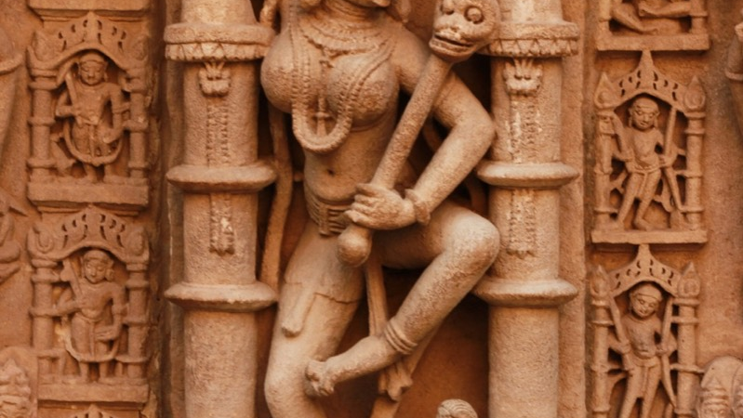
10
A living digital record of India's architectural memory
HeritageLens gives every source a durable place, searchable context and a path back to evidence.
Researchers
Archivists
Institutions
Heritage tourism
Find connected evidence across sites and documents
Preserve originals while correcting machine-extracted text
Publish structured collections through a maintainable system
Explore monuments through maps and accessible narratives
Technology should help cultural memory remain discoverable, verifiable and alive.
TEAM HERITAGELENS · HACKCULT '26 · IIT GANDHINAGAR
HERITAGELENS / HACKCULT '26
10
Notes:
Impact groups and vision are based on the project brief. No adoption, accuracy or performance numbers are claimed. Image comes from the HeritageLens licensed image library; attribution is recorded in frontend/public/images/sites/ATTRIBUTION.md.

