Slide 1
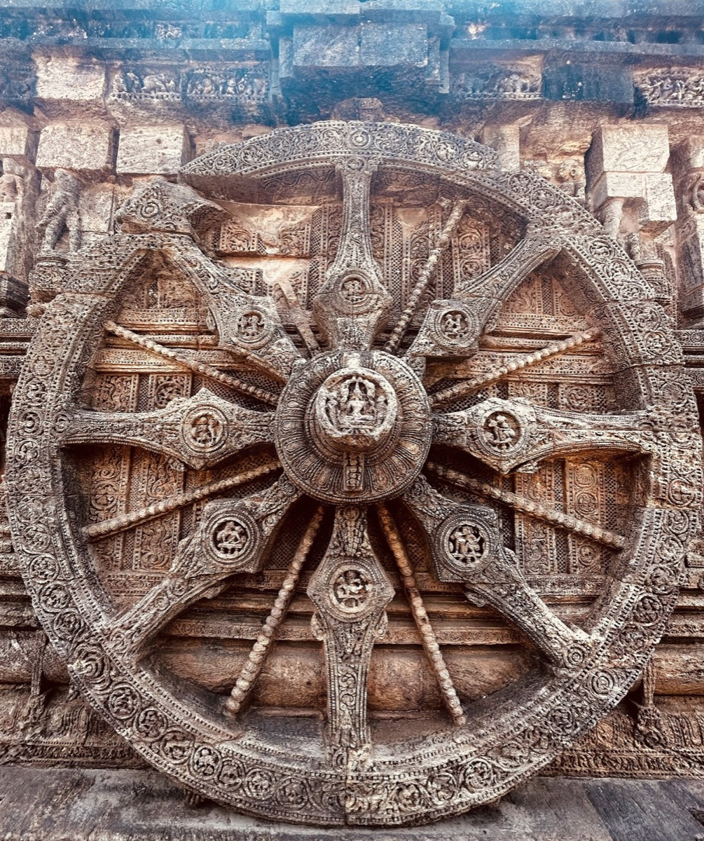
HACKCULT '26 / PS2
HeritageLens
AI-powered cultural archive for India's architectural memory
A working system for digitization, OCR, search, maps and source-grounded research
WORKING PROTOTYPE
TEAM HERITAGELENS // IIT GANDHINAGAR
Notes:
HackCult '26, Problem Statement 2. The working prototype claim is supported by the deployed frontend and automated test suite. Image source is recorded in frontend/public/images/sites/ATTRIBUTION.md.

Slide 2
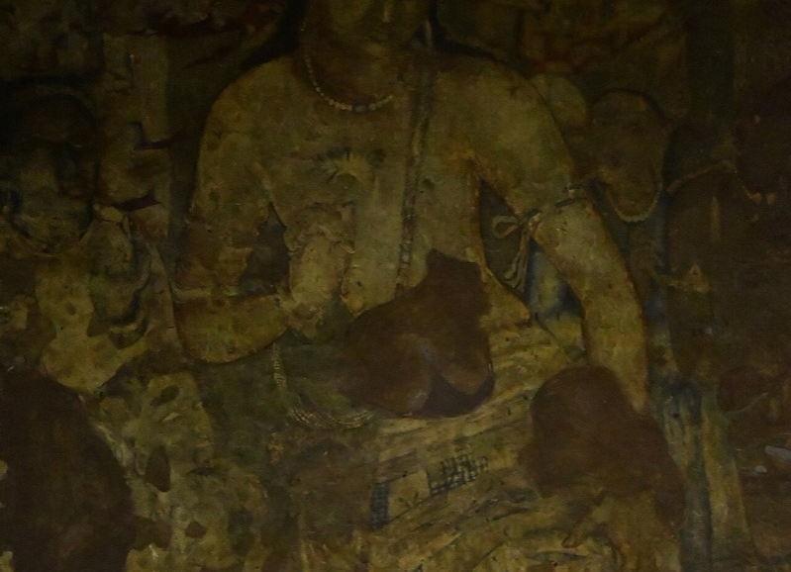
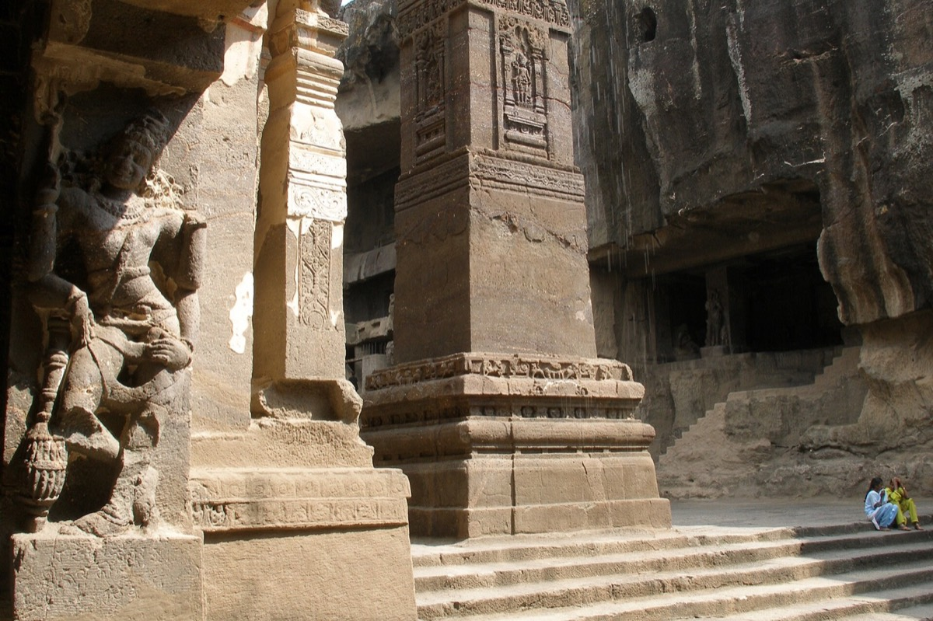
02
The problem and what the system must achieve
Heritage evidence exists, but its formats and archives cannot work together.
CORE REQUIREMENTS
01
Preserve originals
Durable private storage and authorized downloads
02
Make text searchable
PDF extraction and OCR for scanned sources
03
Keep human oversight
Knowledge stays fragmented
Curator review before approval
Photographs lack metadata. Scanned documents hide their text. Field notes and regional records remain disconnected from the monuments they describe.
04
Connect context
Sites, documents, images and map coordinates
05
Support public discovery
Open browsing, filtering and grounded answers
HERITAGELENS // HACKCULT '26
02
Notes:
Problem and requirements come from the hackathon brief and the implemented HeritageLens workflow. No size, accuracy or adoption claims are made.

Slide 3
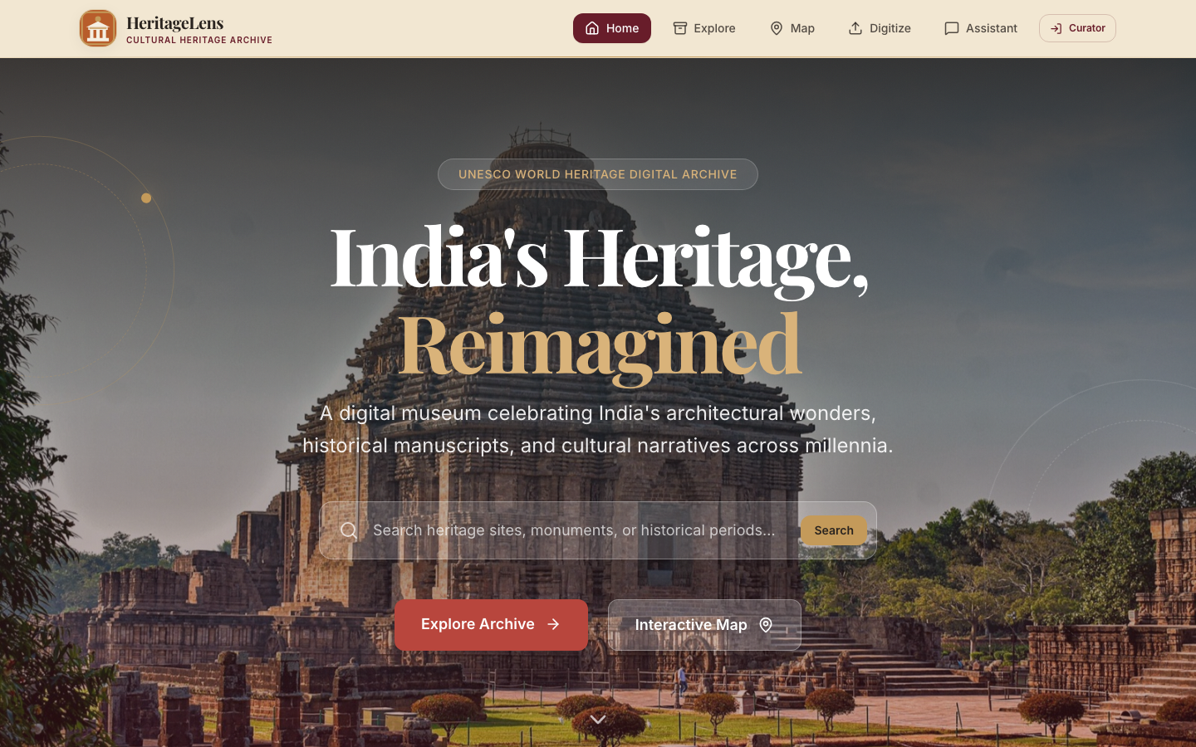
03
HeritageLens turns scattered sources into a usable archive
The judges can inspect the deployed product, not a mock-up.
01
Searchable archive
LIVE PRODUCT
Site metadata plus extracted and corrected document text
02
Document digitization
PDF extraction, Tesseract OCR and curator correction
03
Interactive map
Coordinates connect monuments to archival records
04
Grounded assistant
Answers reference retrieved archive sources
HERITAGELENS // HACKCULT '26
03
Notes:
Screenshot captured from https://heritage-pearl.vercel.app/. Features are verified in frontend routes, backend services and automated tests.

Slide 4
04
From an uploaded source to verified discovery
Automation handles repetitive processing. Curators retain editorial control.
01
02
03
04
05
06
UPLOAD
VALIDATE
PRESERVE
EXTRACT
REVIEW
DISCOVER
PDF or image
File type and size
Private object storage
PyMuPDF or OCR
Correct text and metadata
Search, map and citations
PERSISTED PROCESSING STATES
UPLOADED
PROCESSING
EXTRACTED
NEEDS REVIEW
APPROVED
FAILED
Failure remains visible and recoverable
The backend records errors, preserves the original source and can resubmit interrupted background work after restart.
HERITAGELENS // HACKCULT '26
04
Notes:
Workflow verified in backend document router, storage service and background processing service. Upload polling and curator review are implemented in the frontend UploadPage.

Slide 5
05
Technical architecture and stack
A modular monolith keeps development fast without mixing responsibilities.
APPLICATION
DATA
PROCESSING
EXPERIENCE
FastAPI
SQLAlchemy
Curator auth
REST API on Render
Supabase PostgreSQL
Alembic migrations
Full-text indexes
SQLite locally
Private Supabase Storage
PyMuPDF
Tesseract OCR
Background executor
React + Vite
React Router
Leaflet map
Vercel
SEARCH + AI
SECURITY BOUNDARY
PostgreSQL full-text search / archive retrieval / Omnirouter when configured / grounded fallback
Service-role credentials stay on the backend. Public browsing remains read-only.
HERITAGELENS // HACKCULT '26
05
Notes:
Stack verified from package manifests, Docker configuration, backend database and storage code, Alembic migrations, deployment configuration and frontend source.

Slide 6
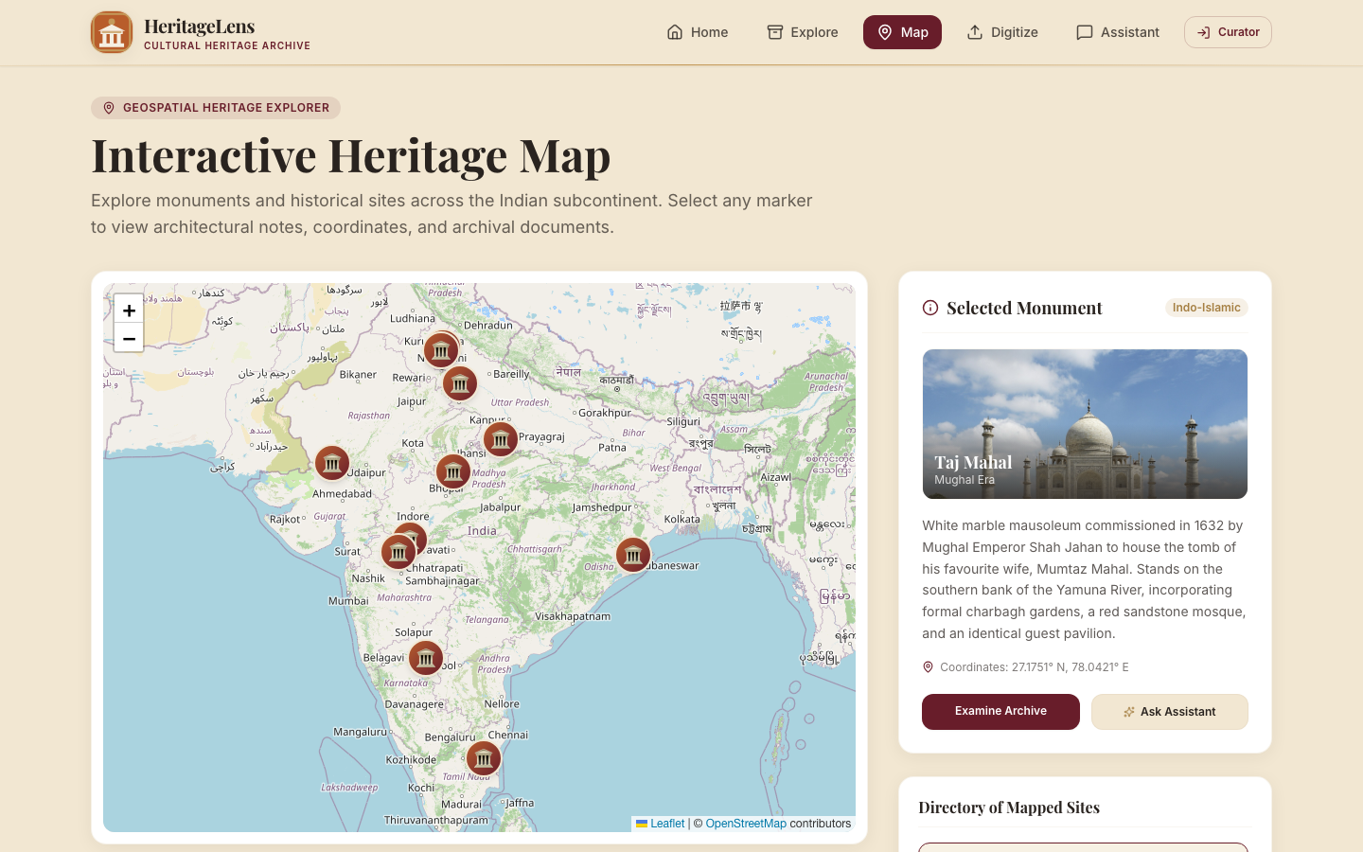
06
Feasibility is demonstrated by the working build
The architecture uses services already configured for the deployment target.
11
39
3
seeded heritage records
backend tests passed
browser workflows passed
WHY IT CAN SHIP
1
Vercel frontend and Render backend already deployed
2
Supabase Session Pooler and private object storage supported
Known limits
3
Alembic controls schema changes without startup mutations
Shared curator credential for the prototype. In-process OCR uses one Render worker. Distributed queues and individual roles remain future work.
4
CI checks migrations, backend tests, lint, build and browser flows
HERITAGELENS // HACKCULT '26
06
Notes:
Results verified locally: 39 backend tests, 3 Playwright acceptance workflows, frontend lint and production build. Live Supabase storage and the new CI workflow still require post-deployment verification. The limitations are stated explicitly.

Slide 7
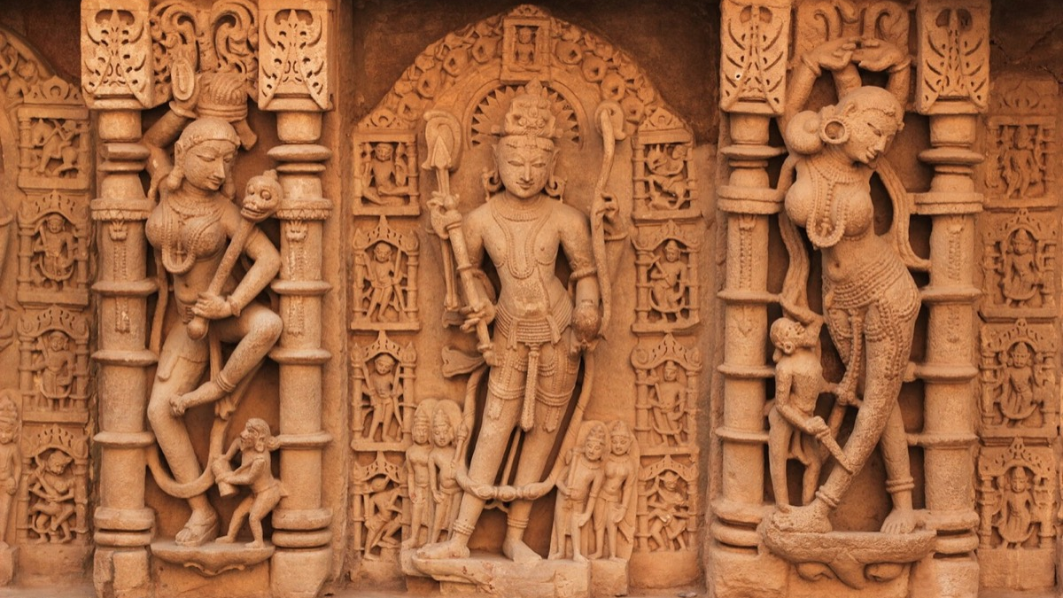
07
Impact now, stronger retrieval next
The current product solves preservation and discovery first. Phase 2 can improve multilingual retrieval after production verification.
Researchers
Archivists
Institutions
Visitors
Find evidence across sites and digitized records
Preserve originals and approve corrected text
Publish structured collections with traceable sources
Explore monuments through maps and accessible narratives
NEXT
01
02
03
Production verification
Multilingual retrieval
Evaluation
Apply migrations, configure private storage and test live upload
Add embeddings and hybrid ranking for regional-language archives
Measure retrieval quality and citation faithfulness
HeritageLens makes cultural evidence searchable without losing the path back to its source.
HERITAGELENS // HACKCULT '26
07
Notes:
The roadmap clearly separates implemented functionality from future work. Phase 2 multilingual semantic retrieval has not been implemented.

