Slide 1
Final Project
JAIVANT B R
PSG Institute of Technology and Applied Research
B.E. Computer Science and Engineering
NM id: au715521104019
Email: rajajai2003@gmail.com
3/21/2024 Annual Review

Slide 2
Rice Image Classification
The project aims to develop a deep learning model for rice image classification, utilizing Convolutional Neural Networks (CNNs) in TensorFlow/Keras. By leveraging a dataset of categorized rice images, the model seeks to accurately identify different rice varieties, aiding in agricultural management. Through automation of rice variety identification, the project endeavors to streamline crop monitoring, disease detection, and quality assessment processes. Ultimately, it strives to empower farmers with efficient tools for optimizing crop yield, enhancing agricultural productivity, and ensuring food security.
3/21/2024 Annual Review

Slide 3


AGENDA
1. Problem Statement
2. Problem Overview
3. Who are the end users?
4. Your solution and its value proposition
5. The wow in your solution
6. Modelling
7. Results
3/21/2024 Annual Review

Slide 4

PROBLEM STATEMENT
Rice cultivation plays a crucial role in global food security, yet manual identification of rice varieties and monitoring for diseases is time-consuming and prone to errors. The objective is to develop an automated system using deep learning techniques to accurately classify rice images into different varieties and detect disease symptoms. This system aims to streamline agricultural management processes, enabling timely intervention and optimization of crop yield, ultimately contributing to sustainable food production.
3/21/2024 Annual Review

Slide 5

PROJECT OVERVIEW
The project focuses on automating the classification of rice images using deep learning techniques, particularly Convolutional Neural Networks (CNNs). It begins with acquiring a dataset containing images of various rice varieties and their corresponding labels. The dataset is preprocessed and organized into training and testing sets. Multiple CNN architectures are explored and trained on the dataset to identify the most effective model. Through iterative training and evaluation, the model's performance is optimized, achieving high accuracy in classifying rice images. The final model is deployed to provide a scalable solution for rice variety identification, supporting agricultural management practices and enhancing food security efforts.
3/21/2024 Annual Review

Slide 6

WHO ARE THE END USERS?
Farmers: Quickly identify rice varieties and diseases in their fields to make informed crop management decisions.
Agricultural Researchers: Analyze trends in rice varieties and disease prevalence for improving crop yields and sustainability.
Agricultural Extension Workers: Provide advisory services to farmers by assisting in rice variety identification and disease diagnosis.
Food Industry Professionals: Ensure quality and authenticity of rice products through accurate rice variety classification.
Government Agencies: Utilize data and insights for informed policy decisions and strategies to promote rice cultivation and food security.
3/21/2024 Annual Review

Slide 7

YOUR SOLUTION AND ITS VALUE PROPOSITION
The solution employs state-of-the-art deep learning techniques, specifically Convolutional Neural Networks (CNNs), to automate the classification of rice images. By leveraging a comprehensive dataset of rice varieties and diseases, our system accurately identifies different rice varieties and detects disease symptoms with high precision. This enables farmers, agricultural researchers, extension workers, food industry professionals, and government agencies to make informed decisions, optimize crop management practices, ensure food quality, and promote agricultural sustainability. With scalability and efficiency in mind, our solution aims to revolutionize rice cultivation practices and contribute to global food security initiatives.
3/21/2024 Annual Review

Slide 8

THE WOW IN YOUR SOLUTION
The wow factor in our solution lies in its ability to seamlessly integrate cutting-edge deep learning technology with practical agricultural needs. By harnessing the power of Convolutional Neural Networks (CNNs), our system offers accurate and efficient classification of rice varieties and disease symptoms from images. This transformative capability empowers stakeholders across the agricultural ecosystem, from farmers to government agencies, with actionable insights for improving crop management, sustainability, and food security. Additionally, the scalability and accessibility of our solution make it a valuable tool for addressing real-world challenges in rice cultivation on a global scale, marking a significant leap forward in agricultural innovation.
3/21/2024 Annual Review

Slide 9
MODELLING
Model cnn: This model consists of a convolutional layer followed by max-pooling, flattening, and a dense layer with 40 units and ReLU activation. A dropout layer with a dropout rate of 0.1 is included to prevent overfitting. The final output layer has 5 units with sigmoid activation for multi-class classification.
Model cnn2: This model has a convolutional layer, max-pooling, and flattening layers. It includes two dense layers with 45 and 15 units, respectively, both activated by ReLU. A dropout layer with a dropout rate of 0.1 is added. The output layer remains the same with 5 units for multi-class classification using sigmoid activation.
3/21/2024 Annual Review

Slide 10
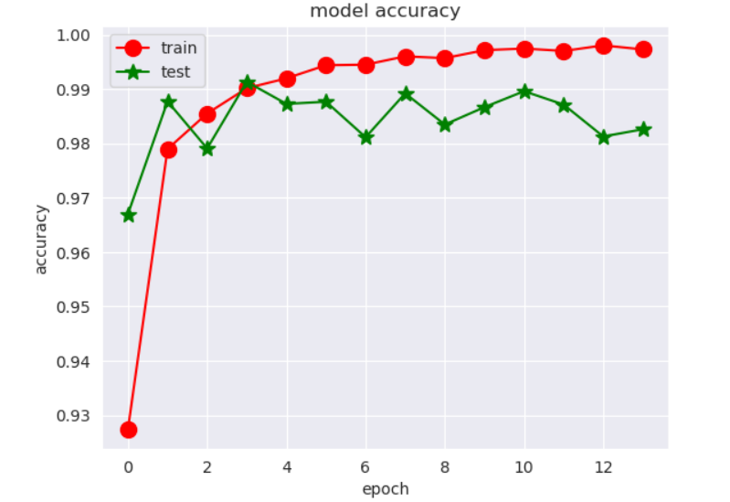
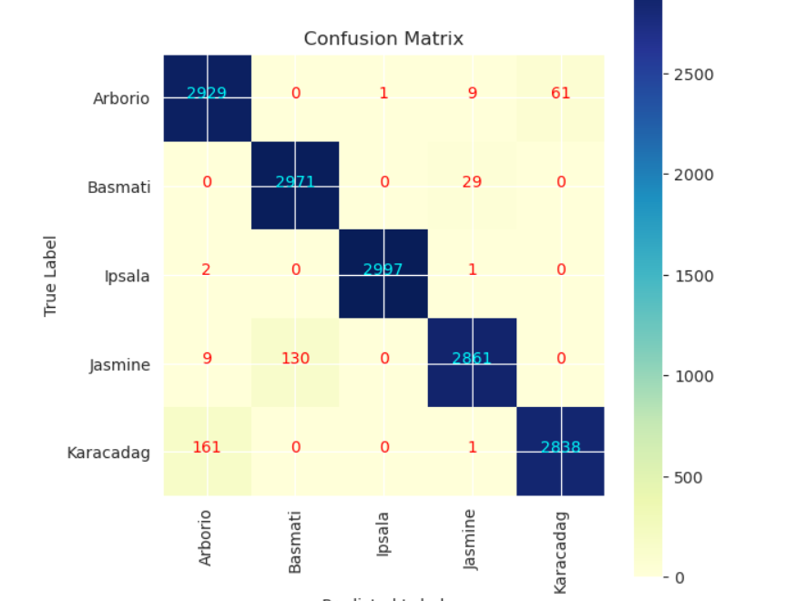
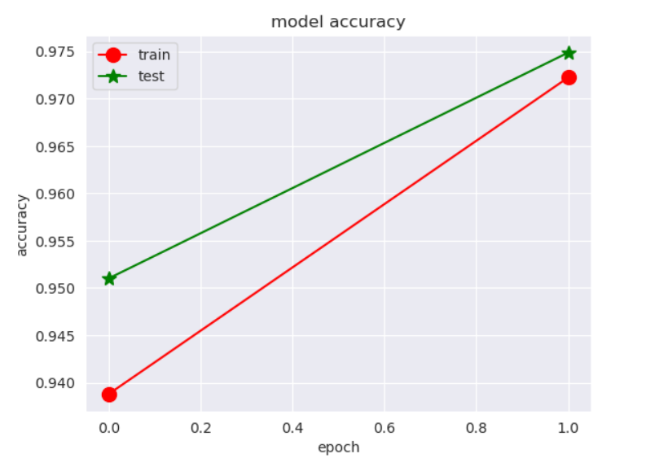
RESULTS
Demo Link
3/21/2024 Annual Review

