Slide 1
Advertising Technology
Industry Report for IMT 500 B
Jaivardhan Singh Chauhan

Slide 2






About the industry
Advertisers
Advertising-technology involves the technologies and softwares advertisers use to reach audiences, and deliver quantifiable digital marketing campaigns (Stewart, 2012). The ad-tech ecosystem consists of (Shkuropat, 2023):
Advertisers, who are trying to reach their potential customers and current clients on devices such as computers and smartphones. These advertisers can range from a big Fortune 500 company like Target to your nearby local retail store.
Publishers help advertisers deliver messages and ads using sophisticated algorithms and technologies. They are the ‘supply-side’ in the industry.
Publishers

Slide 3
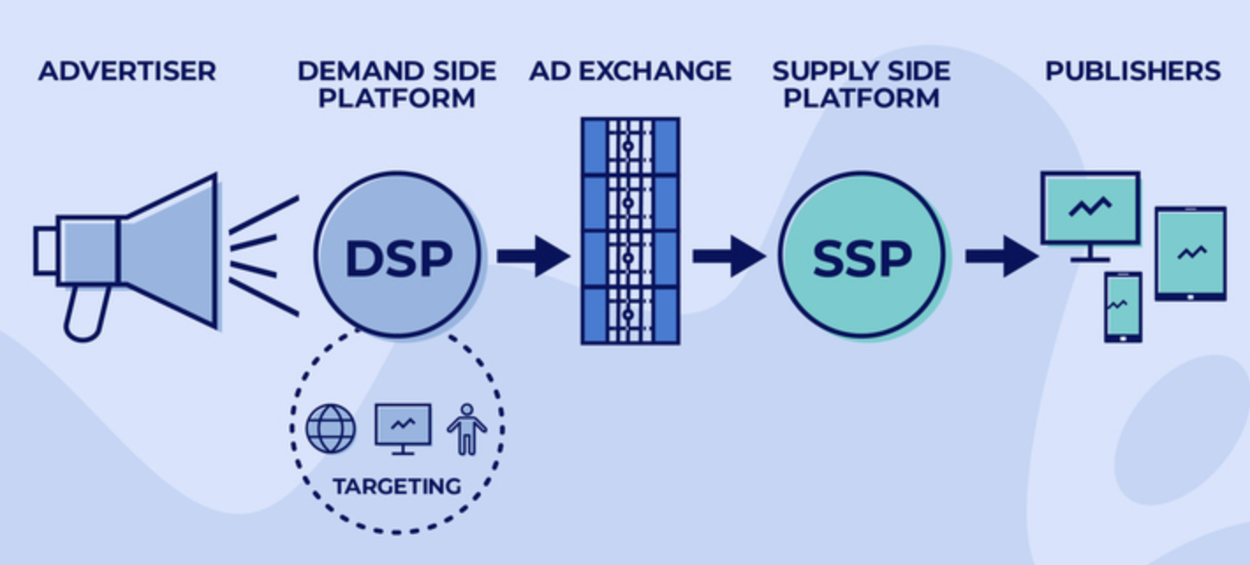
About the industry
Agencies or ad networks are the intermediaries between advertisers and publishers. They help brands in managing and running digital marketing campaigns. Agencies also help with planning omnichannel spending, complementing the brand’s overall vision and strategy.
Other products such as Supply-side platforms (SSPs), Demand-side platforms (DSPs), Data Management Platforms (DMP), ad exchanges, etc. help advertisers reach the correct audiences, optimize spending, and measure campaign performance.

Slide 4
Introduction
In 2021, five large technology companies - Google, Meta, Alibaba, Bytedance, and Amazon owned about half (53%) of all global ad revenue (Fischer, 2022). The global advertising-technology industry is valued at $886B in 2022 and is expected to grow at a compound growth rate of 13.7% annually from 2023 to 2030 (Grand View Research).

Slide 5
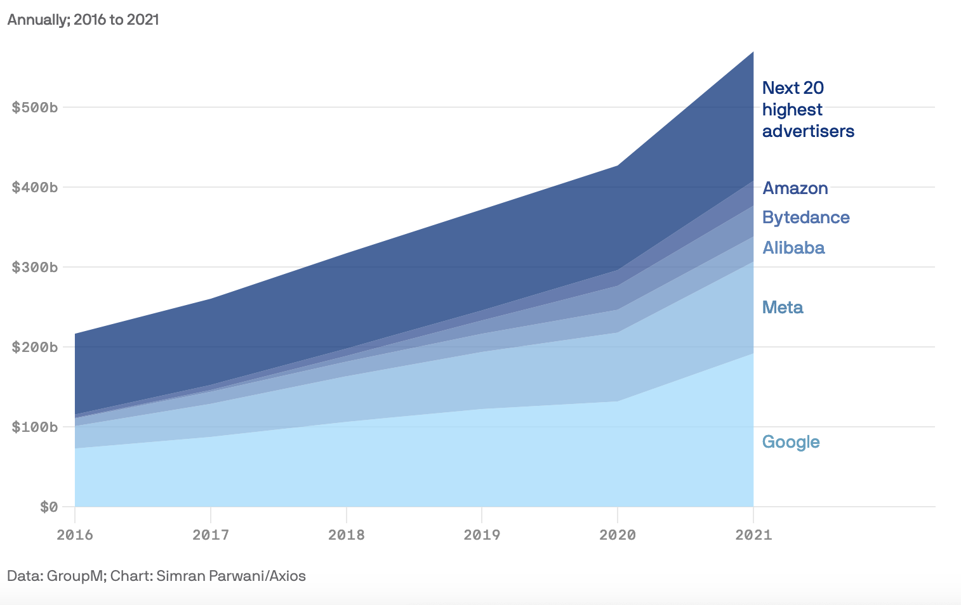



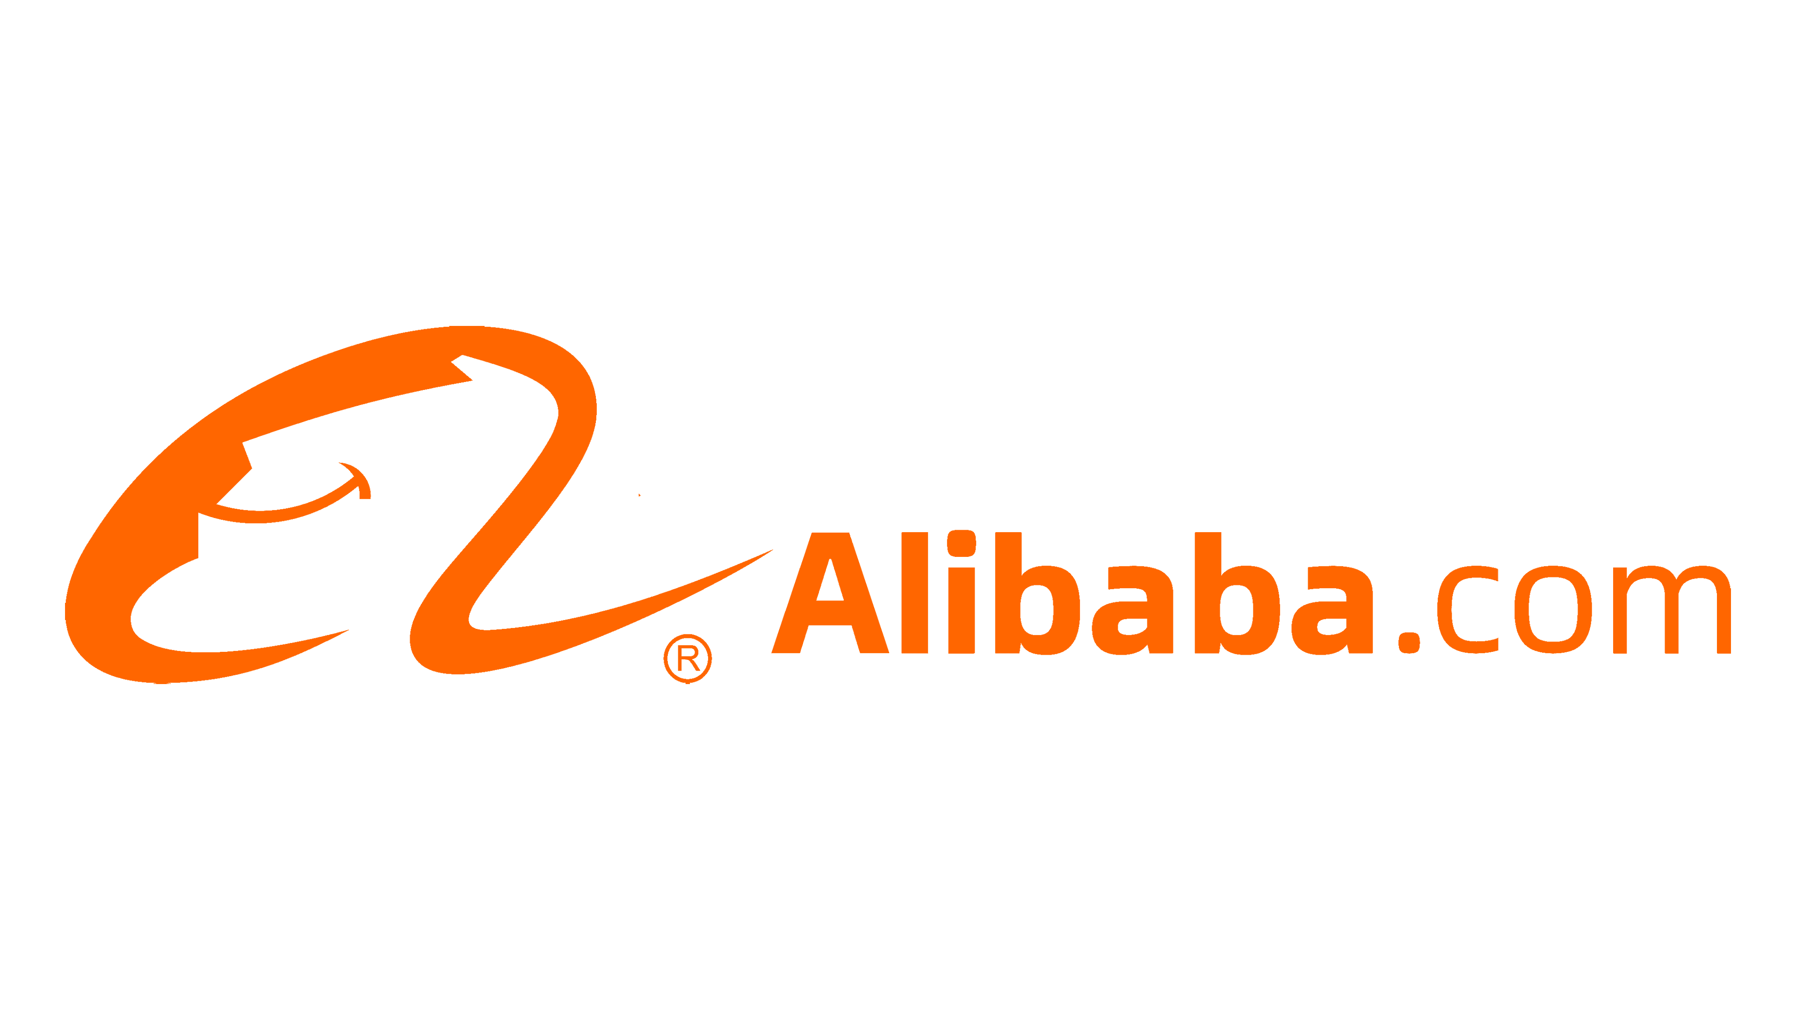
Top 25 Global Advertisers by Revenue
Key players:

Slide 6



Key issues
Governmental regulations and the end of third-party cookies: Cookies track user activity online and their demise will result in a loss of users’ demographic and behavioral data, which is critical for targeting. The change comes because of evolving regulatory frameworks to protect user privacy (Brodherson, 2021).
Mobile Ad Fraud: Click spamming, click injections, Ad stacking, Device farms, Geo-masking are some of the common ways advertisers are duped of their money. The impact of such ad fraud is often far-reaching and leads to a loss of confidence in mobile advertising (Singh, 2023).
Apple’s IDFA (Identifiers for Advertisers) policy: Apple’s App Tracking Transparency feature requires users’ explicit permission to track activity, which has resulted in a catastrophic impact on ad revenue for advertising-technology companies. In 2022, Meta anticipated losing $10B in sales revenue, as per David Wehner, CFO (Newman, 2022).

Slide 7


Key issues
Rise of Generative Artificial Intelligence: In a fast-moving ad-tech industry, generative Artificial Intelligence seems to pose a serious, potential threat to Google search, which is one of the backbones of Google’s advertising revenue channels. Internally, Google has labeled the issue as ‘Code Red’ (Homonoff, 2023).
Role in Climate Change: The rise of programmatic advertising, which increases the touchpoints for every ad impression, is resulting in additional power demands. There is a growing focus on the advertising industry to address the issue (Homonoff, 2023).

Slide 8
Information Management in Advertising-tech

Slide 9

Information Management Systems
Customer Relationship Management softwares help plan digital marketing campaigns from signing an agreement with the advertiser to successfully executing a campaign.
IM Systems help in cross-team alignment and automate routine tasks.
Similarly, Supply Chain Management solutions, known as SSPs, facilitate sales of publishers’ ad inventory (Stewart, 2012).
Supply-side platforms simplify the complex advertising landscape, providing a unified platform for real-time bidding and ad auctions.

Slide 10


Business Intelligence
Emerging trends
BI plays a vital role in the advertising industry, providing data-driven insights for campaign optimization and reporting analytics.
Data visualizations help marketers understand user behavior and make better business decisions.
Predictive analytics is used for targeted advertising and audience segmentation while prescriptive analytics helps derive strategy for innovative marketing campaigns (Paliska, 2023).
Artificial Intelligence is continually disrupting the advertising-technology ecosystem.
Generative AI can be used to hyper-personalize content and offering for users and its advanced algorithms can be used to increase audience targeting precision (Deveau, 2023).

Slide 11


Cybersecurity
Cloud Technologies
It is a widespread practice for ad networks to deploy cloud solutions for storage and computing services. Cloud enables improved analytics and better collaboration among an agency’s cross-functional teams. Besides, it acts as a secure storage solution for the ever-increasing user and campaign data (Alibaba, 2022).
Cloud allows quick access to data in the fast-paced advertising-technology world, and the resultant speed enables marketers to accommodate the needs of advertisers and publishers rapidly.
Anti-fraud platforms are deployed to protect against risks such as third-party data breaches and click injections.
If an online campaign suffers a cyberattack, revenue as well as the reputation of the advertiser and the agency are at stake (Murphey, 2023).
In 2020, about 10% of the global ad spending (about $35B) (Shkuropat, 2022) was lost to ad fraud, so developing secure solutions is increasingly becoming necessary and in fact, a big business.

Slide 12
Importance of advertising technology industry

Slide 13
Understanding the impact of advertising technology
INNOVATION – Platform for creativity
SOCIAL – Creates awareness for non-profits & social causes
EMPLOYMENT – Provides jobs to millions of people around the world
ECONOMIC - Digital is ~47% of $2 trillion/yr. advertising spend

Slide 14



Why is Ad-tech vital to the world?
The industry generates immense benefits to the overall economy and society in multiple ways:
Economic: Advertising technology is a multi-billion-dollar industry, and it generates revenue not just for advertisers or publishers but for employees, who in turn pay taxes to the government. Overall, its contribution to the economy is massive - in 2021, digital ad spending was ~47% of $2 trillion (Joseph, 2022).
Employment: The industry provides jobs to millions of people around the world. These include indirect jobs in the wider economy created because of advertising activity. E.g., Hospitality, content producers, etc. (EACA, 2017).
Social: Nonprofits and social causes use digital advertising to create awareness and drive change. It also helps in fundraising for political campaigns, helping candidates reach audiences and capture voters.

Slide 15


Why is Ad-tech vital to the world?
Innovation: Advertising builds national creativity as it provides a platform for artists, writers, photographers, designers, etc. to showcase their talent in exchange for high compensation and the customers get to witness amusing, witty, and even beautiful displays of messages (Fletcher, 2010).
Voice of SMEs: Small and Medium Enterprises can now access a global user base. Traditional advertising would have made such a reach an incredibly arduous and expensive task. Approximately 75% of Google’s advertising-technology users are Australian small and medium-sized enterprises (PwC, 2021).

Slide 16
Future of the advertising-technology industry

Slide 17

Cloud Solutions
Cloud technologies will become indispensable assets to manage workflows and marketing relationships.
It will be a norm to integrate the cloud for CRMs, mobile, social, personalization, content handling, and analytics.

Slide 18

Artificial Intelligence footprint
Artificial intelligence is expected to rapidly increase its footprint in the industry from business decision-making to consumer behavior analysis.
AI will benefit from the massive amounts of user activity data.

Slide 19

Context is King!
Contextual advertising will be the need of the hour and advanced analytics will be used to improve audience targeting and messaging.
The trend will only accelerate with higher adoption of digital as the primary advertising channel.

Slide 20
References
Stewart, S., & Small, D. (2012). The library. Amazon. https://advertising.amazon.com/library/guides/what-is-adtech
Stewart, S., & Small, D. (2012a). The library. Amazon. https://advertising.amazon.com/library/guides/supply-side-platform
Shkuropat, L. (2023, April 4). AD Tech Industry Overview & Opportunities. Web and Mobile App Development Company - MindK.com. https://www.mindk.com/blog/ad-tech-industry-overview/
Shkuropat, L. (2022, November 7). Ad fraud detection: Methods to prevent and fight ad fraud. Web and Mobile App Development Company - MindK.com. https://www.mindk.com/blog/ad-fraud-detection/
Murphey, D. (2023, October 5). The importance of cybersecurity in digital marketing. Mention. https://mention.com/en/blog/cybersecurity-digital-marketing/
Fischer, S. (2022). 5 tech giants own over half the global ad market - axios. https://www.axios.com/2022/06/14/tech-ad-market-global
Grand View Research. (n.d.). Adtech market size, Share & Trends Analysis Report, 2030. AdTech Market Size, Share & Trends Analysis Report, 2030. https://www.grandviewresearch.com/industry-analysis/adtech-market-report
Brodherson, M., Broitman, A., Macdonald, C., & Royaux, S. (2021, April 12). The demise of third-party cookies and identifiers. McKinsey & Company. https://www.mckinsey.com/capabilities/growth-marketing-and-sales/our-insights/the-demise-of-third-party-cookies-and-identifiers
Singh, J. (2023). The Dark Side of mobile advertising: How to fight mobile ad fraud. Business of Apps. https://www.businessofapps.com/insights/the-dark-side-of-mobile-advertising-how-to-fight-mobile-ad-fraud/
Newman, D. (2022, October 12). Apple, Meta and the $10 billion impact of privacy changes. Forbes. https://www.forbes.com/sites/danielnewman/2022/02/10/apple-meta-and-the-ten-billion-dollar-impact-of-privacy-changes/?sh=4c530a8972ae
Homonoff, H. (2023, January 27). Digital Advertising Biz faces new, old challenges in 2023. Forbes. https://www.forbes.com/sites/howardhomonoff/2023/01/25/digital-advertising-biz-faces-new-old-challenges-in-2023/?sh=5a6e78522d28

Slide 21
References
Alibaba Cloud. (2022). 7 ways digital marketing is more successful with cloud computing. Alibaba Cloud Community. https://www.alibabacloud.com/blog/7-ways-digital-marketing-is-more-successful-with-cloud-computing_599611
Paliska, W. (2023, May 1). 6 predictive analytics use cases in advertising. dotData. https://dotdata.com/blog/six-predictive-analytics-use-cases-in-advertising/
Deveau, R., Griffin, S. J., & Reis, S. (2023, May 11). AI-powered marketing and sales reach new heights with Generative AI. McKinsey & Company. https://www.mckinsey.com/capabilities/growth-marketing-and-sales/our-insights/ai-powered-marketing-and-sales-reach-new-heights-with-generative-ai
Joseph, S. (2022, February 7). The rundown: Google, Meta and Amazon are on track to absorb more than 50% of all AD money in 2022. Digiday. https://digiday.com/marketing/the-rundown-google-meta-and-amazon-are-on-track-to-absorb-more-than-50-of-all-ad-money-in-2022/
Owens, R. (2022, October 26). Advertising: Vital to our economy – essential to business. Capitol Communicator. https://capitolcommunicator.com/advertising-vital-to-our-economy-essential-to-business/
EACA. (2017, January 16). Advertising delivers powerful economic benefits across the EU. https://eaca.eu/news/advertising-delivers-powerful-economic-benefits-across-eu/
Fletcher, W. (2010, June 24). The role of advertising in society. OUP Academic. https://academic.oup.com/book/707/chapter/135380346?searchresult=1#228908733
PwC Australia. (2021). Examination of the value created by the advertising technology. https://storage.googleapis.com/gweb-uniblog-publish-prod/documents/Report_2_-_Economic_benefits_of_advertising_technology_industry_in_Australia_B3ReCW5.pdf
Deloitte. (2022a, April 22). The future of advertising: Four scenarios. Deloitte Deutschland. https://www2.deloitte.com/de/de/pages/technology-media-and-telecommunications/articles/future-of-advertising.html

Slide 22
End Layout
By Jaivardhan Singh Chauhan

